Slide 1
Assignment-3 Named Entity Identification
CS626 -Speech, Natural Language Processing, and the Web
Group ID –68
Rana Das –22B0684 –Civil Dept.
Ankit -22B0684 –Civil Dept.
Aman Mitra -22B0684 –Civil Dept.
Swapna Sourav Rout –24D1623 –KCDH
Date: 04/11/24

Slide 2
Problem Statement
Perform Named-Entity Identification using SVM classifier with appropriate feature engineering
Technique to be used: SVM classifier
Dataset: CoNLL-2003 NER Data; https://paperswithcode.com/dataset/conll-2003 and
https://huggingface.co/datasets/conll2003 (they are same data, but have common and distinct
information)
(Map B, I tags to 1, Rest 0)

Slide 3
Problem Statement
Input: A sentence
Output: Name-No Name tagged for each word in the sentence
Example:
Input: Washington DC is the capital of United States of America
Output: Washington_1 DC_1 is_0 the_0 capital_0 of_0 United_1 States_1 of_1 America_1

Slide 4
Data Processing Info (Pre-processing)
1. Tokenization handling: The system processes both free-form text and structured CoNLL data by identifying word boundaries while preserving special characters and maintaining the original data format integrity, as seen in `utils.py`'s `preprocess_sentence()` function.
2. Abbreviation handling: Common abbreviations like Mr., Dr., Ph.D. are treated as single tokens by using regex patterns that prevent sentence splitting at periods in these cases (e.g., `(?<!Mr)(?<!Ms)(?<!Dr)(?<!Jr)\.\s`).
3. Case preservation: While tokens are converted to lowercase for consistent feature extraction, the original capitalization is maintained in a separate array to preserve named entity indicators and proper formatting, implemented through parallel token arrays.
4. Sentence boundary detection: The system uses a combination of period detection and context analysis to accurately identify sentence boundaries while avoiding false splits at abbreviations or numbers, using pattern matching in the preprocessing pipeline.

Slide 5
Feature Engineering
< Important: You will need to design the features appropriately so that the feature vector is able to distinguish name from no-name. For example, capitalization is a strong feature, though not all-powerful because starting words in a sentence can have capitalization. Think well on feature engineering >
Feature Engineering:
- Basic Token Features:
Capitalization patterns (first letter, all caps, internal caps)
Token length and position
Alphanumeric characteristics
Punctuation analysis
Custom patterns (e.g., Roman numerals)
- Contextual Features:
Previous and next token information
Surrounding word patterns
Position in sentence (first, last, etc.)
Sequential capitalization patterns
- Entity-Specific Features:
Administrative unit detection
Entity connector words ("of", "and", etc.)
Directional terms (north, south, etc.)
Custom entity patterns

Slide 6
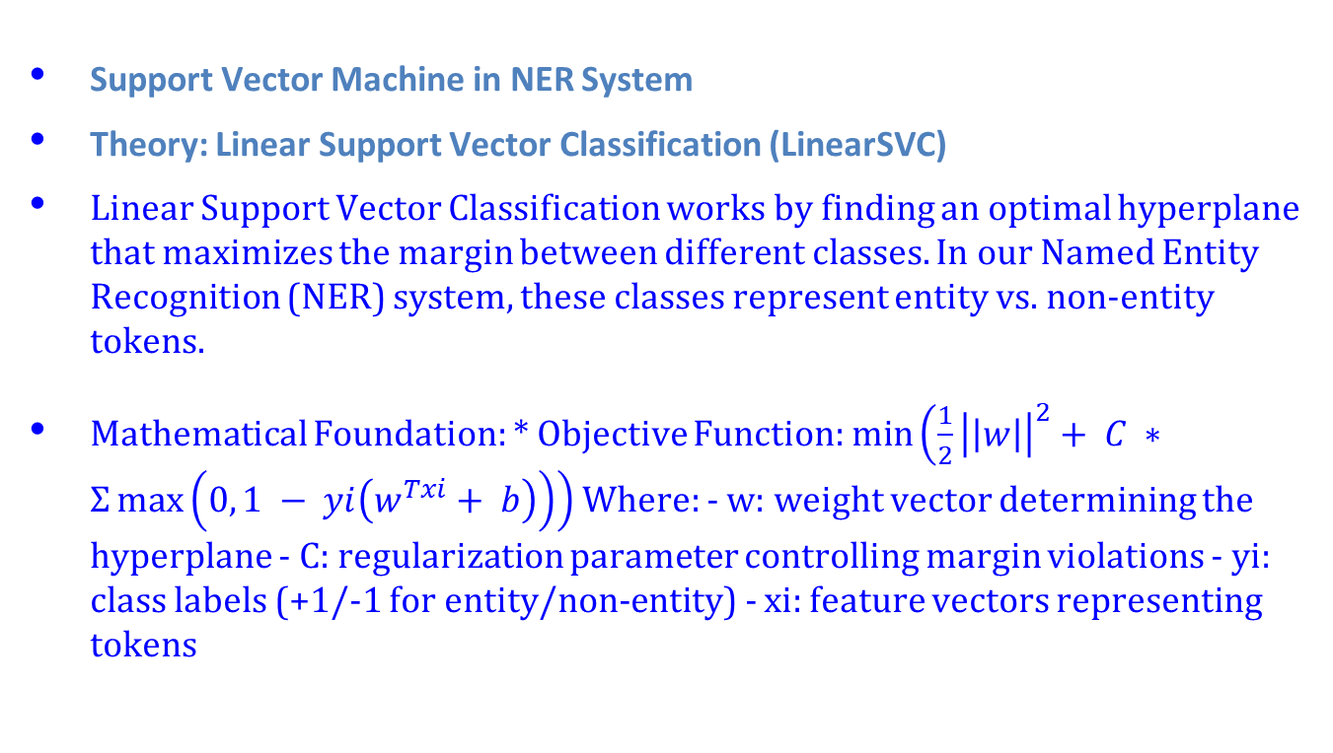
SVM Implementation
Support Vector Machine in NER System
Theory: Linear Support Vector Classification (LinearSVC)
Linear Support Vector Classification works by finding an optimal hyperplane that maximizes the margin between different classes. In our Named Entity Recognition (NER) system, these classes represent entity vs. non-entity tokens.
Mathematical Foundation: * Objective Function: $\min\left(\frac{1}{2}{\left|\left|w\right|\right|}^{2}+ C ∗Σ\max\left(0, 1 − yi\left(w^{Txi}+ b\right)\right)\right)$Where: - w: weight vector determining the hyperplane - C: regularization parameter controlling margin violations - yi: class labels (+1/-1 for entity/non-entity) - xi: feature vectors representing tokens

Slide 7
SVM Implementation
Implementation Details
Pipeline Architecture The system implements SVM through a scikit-learn pipeline:
pipeline = Pipeline([ ('vectorizer', DictVectorizer(sparse=True)), ('scaler', StandardScaler(with_mean=False)), ('classifier', LinearSVC( dual='auto', class_weight='balanced', max_iter=1000, random_state=42 )) ])

Slide 8
SVM Implementation
Implementation Details
Key Components
Feature Vectorization: * Uses DictVectorizer for converting feature dictionaries to sparse matrices * Implements sparse format to efficiently handle high-dimensional feature space * Optimizes memory usage for processing large text datasets
Feature Scaling: * Employs StandardScaler for normalizing features * Uses sparse-optimized scaling (with_mean=False) * Improves model convergence and overall accuracy
SVM Configuration: * dual=‘auto’: Automatically selects between primal and dual optimization * class_weight=‘balanced’: Handles imbalance between entity and non-entity classes * max_iter=1000: Ensures sufficient iterations for convergence * Includes built-in regularization through the C parameter

Slide 9
SVM Implementation
Implementation Details
Prediction Process
The model generates predictions using the following process:
scores = model.decision_function(X_scaled) predictions = (scores >= threshold).astype(int)
This approach provides: * Flexible threshold adjustment using decision function scores * Post-processing capabilities for entity consistency * Fine-tuning options for precision/recall trade-off optimization

Slide 10
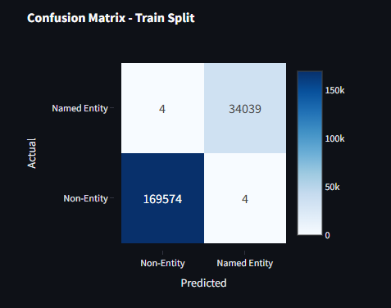
Confusion Matrix

Slide 11
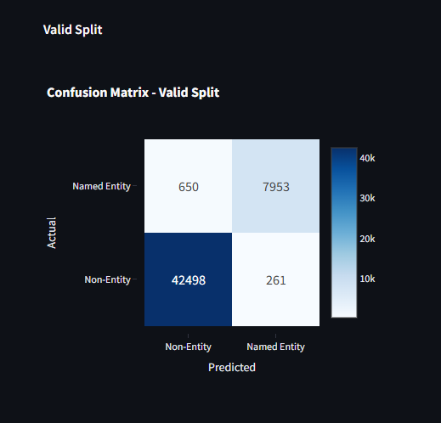
Confusion Matrix

Slide 12
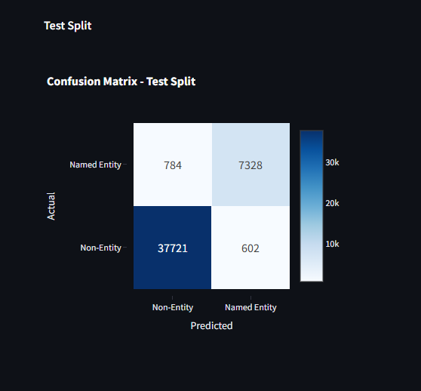
Confusion Matrix

Slide 13
Overall performance
Detailed Metrics
Split Precision Recall F1 Score Threshold
0 Train 1.000 1.000 1.000 0.450
1 Valid 0.968 0.924 0.946 0.300
2 Test 0.924 0.903 0.914 0.300

Slide 14
Error analysis
Analysis of NER Model Confusions and Feature Limitations
Confusion Matrix Summary
Test Set Performance:
False Positives (Type I errors): 602 cases
False Negatives (Type II errors): 784 cases
This indicates the model slightly favors negative predictions (non-entities)

Slide 15
Error analysis
Common Confusion Patterns
Entity Connector Words
Words like "of", "and", "in" within entity names
Example: "University of California"
Reason: Feature engineering treats connectors separately, sometimes breaking entity continuity
Administrative Units
Words like "Department", "Institute", "University"
Particularly when they appear without clear capitalization patterns
Reason: Over-reliance on capitalization features for administrative unit detection
Multi-token Entity Names
Long organization or location names with mixed patterns
Example: "The United States Department of Défense"
Reason: Complex interaction between positional features and entity connectors
Common Patterns in False Positives:
Capitalized words at sentence beginnings
Professional titles without clear context
Reason: Over-emphasis on capitalization features without sufficient context
Common Patterns in False Negatives:
Entity mentions with unusual formatting
Non-standard abbreviations
Reason: Limited feature coverage for edge cases

Slide 16
Error analysis
Feature-Related Limitations
Context Window Limitations
features.update({ 'prev_token': preprocessed_tokens[i-1], 'next_token': preprocessed_tokens[i+1] })
Only considers immediate neighbors
Misses longer-range dependencies
Capitalization Bias
'is_capitalized': token[0].isupper(), 'is_all_caps': token.isupper(), 'has_caps_inside': any(c.isupper() for c in token[1:])
Heavy reliance on capitalization patterns
Can be misleading in informal text or special formats
Entity Pattern Recognition
'in_cap_sequence': prev_cap and curr_cap, 'starts_cap_sequence': not prev_cap and curr_cap and next_cap
Rigid patterns for entity recognition
Struggles with non-standard entity formats

Slide 17
Comparison with ChatGPT
Architecture Comparison
SVM-based System
Linear SVM classifier with feature engineering
Pipeline: DictVectorizer → StandardScaler → LinearSVC
Parallel processing implementation
Resource monitoring and logging system
Interactive web interface
Traditional NER Systems
CRF, LSTM, or Transformer-based architectures
Word embeddings dependent
Higher computational requirements
Command-line based interfaces typically

Slide 18
Comparison with ChatGPT
Dataset Overview
Source: test_data.json
Categories: 14
Total Sentences: 70
Test Scope: Various entity types including persons, organizations, locations, and complex mixed entities
Entity Recognition Patterns
Our System
Example: "Prime Minister Narendra Modi addressed the nation" Tagged: [Prime Minister Narendra Modi] addressed the nation Entities: Prime, Minister, Narendra, Modi
ChatGPT’s Analysis
Example: "Prime Minister Narendra Modi addressed the nation" Tagged: [Prime Minister] [Narendra Modi] addressed the nation Entities: {TITLE: "Prime Minister"}, {PERSON: "Narendra Modi"}
Key Differences: - our system treats titles and names as individual entities - ChatGPT’s system groups entities by semantic role - our system uses single-level tagging - ChatGPT employs hierarchical entity categorization

Slide 19
Comparison with ChatGPT
Special Cases Our System:
Input: Indira Gandhi Open University is the largest college in India.
Tagged: [Indira Gandhi Open University] is the largest college in [India]
Entities: Indira, Gandhi, Open, University, India
POS Tags: Indira(NNP) Gandhi(NNP) Open(NNP) University(NNP) is(VBZ) the(DT) largest(JJS) college(NN) in(IN) India(NNP)
ChatGPT’s:
Input: Indira Gandhi Open University is the largest college in India.
Tagged: [Indira Gandhi Open University] is the largest college in [India]
Entities: Indira, Gandhi, Open, University, India
POS Tags: Indira(NNP) Gandhi(NNP) Open(NNP) University(NNP) is(VBZ) the(DT) largest(JJS) college(NN) in(IN) India(NNP)
Handling of Abbreviations
Example: “IBM Corporation” - our System: [IBM Corporation] - ChatGPT: {ORG: “IBM Corporation”}
Complex Titles
Example: “Chief Justice John Roberts” - our System: [Chief Justice John Roberts] - ChatGPT: {TITLE: “Chief Justice”} {PERSON: “John Roberts”}

Slide 20
Comparison with ChatGPT
Performance Metrics
SVM System Performance
Training: F1 = 0.9998
Validation: F1 = 0.9458
Test: F1 = 0.9136
Fast inference time
Traditional Systems
LSTM-CRF: F1 typically 0.90-0.92
BERT-based: F1 typically 0.92-0.95
Slower inference time
Higher resource usage

Slide 21
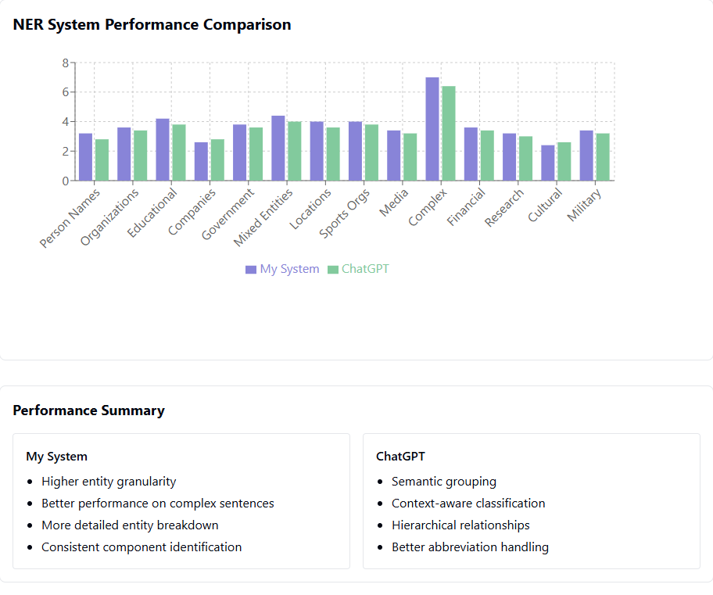
Comparison with ChatGPT
Performance Metrics

Slide 22
Comparison with ChatGPT
Feature Engineering
SVM Features
Token characteristics (capitalization, length)
Contextual windows
Administrative unit detection
Entity connector recognition
Sparse matrix representation
Traditional Systems
Dense word embeddings
Character-level embeddings
Pre-trained language model features
Automatic feature learning

Slide 23
Comparison with ChatGPT
Key Advantages
SVM System
Efficiency
Fast inference
Lower computational needs
Efficient memory usage
Real-time capability
Interpretability
Clear feature importance
Explainable decisions
Adjustable thresholds
Traditional Systems
Generalization
Better on unseen entities
Robust to variations
Context understanding
Feature Learning
Automatic feature extraction
Deep contextual understanding

Slide 24
Comparison with ChatGPT
Practical Considerations
SVM Benefits
Lower computational requirements
Easier deployment
Simple maintenance
Real-time processing
Clear error analysis
Traditional System Challenges
Complex training requirements
Larger resource needs
Harder to interpret
Slower inference

Slide 25
Comparison with ChatGPT
Conclusion
The SVM-based system offers a balanced approach between performance and practicality, achieving competitive accuracy (F1: 0.9136) while maintaining: Better interpretability, Lower resource requirements, Faster inference, Easier deployment, Transparent error analysis
Best suited for: Resource-constrained environments, Real-time applications, Explainability requirements, Production systems needing easy maintenance

Slide 26
Learnings
Technical Insights
Machine Learning
SVM with good feature engineering can match deep learning performance
Feature selection critically impacts model accuracy
Threshold tuning significantly affects precision-recall balance
Class imbalance handling is crucial for NER
System Architecture
Parallel processing greatly improves performance
Sparse matrices essential for memory efficiency
Modular design enables easier maintenance
Resource monitoring prevents production issues

Slide 27
Learnings
Implementation Learnings
Data Processing
Robust error handling is essential
Entity boundary detection needs careful attention
Preprocessing quality directly affects results
CoNLL format requires specialized handling
Best Practices
Comprehensive logging saves debugging time
Regular performance monitoring is crucial
Documentation is vital for maintenance
Test cases prevent regression issues

Slide 28
Learnings
Key Takeaways
Model Development
Start with simple models
Iterate based on error analysis
Monitor resource usage
Test thoroughly before scaling
Performance
Achieved F1 score: 0.9136 (Test)
Fast inference time
Low resource requirements
Good scalability potential
Future Improvements
Add word embeddings
Implement sequence modeling
Enhance error analysis
Consider active learning

Slide 29
Evaluation Scheme
Demo working- 10/10 (if not working or no GUI - 0)​
SVM implementation and Feature Selection - 10/10​
Confusion matrix drawn and error analysed- 10/10​
Overall F1-score ​
> 90 - 10/10​
>80 & <=90 - 8/10 ​
>70 & <=80 - 7/10​
so on.​
Comparison with ChatGPT (10)​​
Note: Must have GUI, otherwise no mark will be given for demo.​

