Slide 1

QR
Home
DURIAN HACKS
Fawwaz Sehaimi – Imran Ariffin – Afiq Asri

Slide 2
PROBLEMS
750,000 Canadians have Alzheimer’s disease and other dementias.
Six in 10 people with Alzheimer’s and other forms of dementia become lost at least once.
$1,500 estimated per hour cost of a missing person search for a dementia wanderer.
SOURCE: Alzheimer’s Association, Alzheimer Society Of Canada, Project Lifesaver

Slide 3
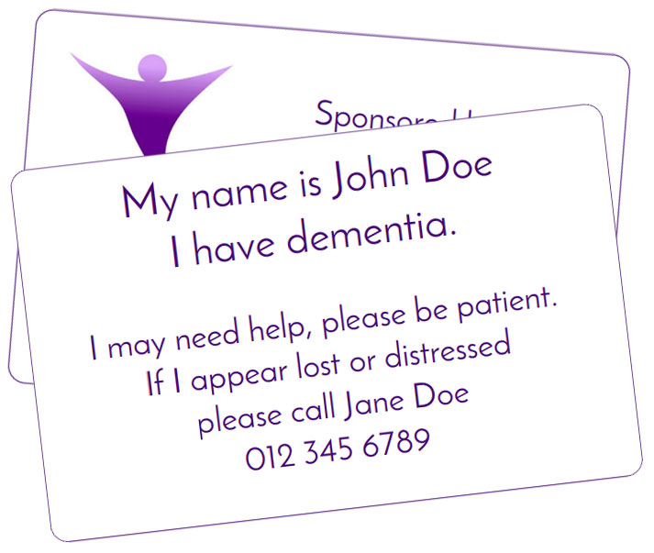

Slide 4
BE
MIGHT
LOST
I
.
.
THIS
PLEASE
SCAN

Slide 5
SOFTWARE STACKS
Python
MongoDB

Slide 6
