Slide 1


Machine Learning based Diabetes Prediction
By: Imran Chowdhury Dipto
Department of Electronics and Telecommunications (DET)
Add the date

Slide 2
Outline
Background
Data Processing
ML Methods Used
Evaluation Methods
Results
Findings
Limitations & Future Work

Slide 3
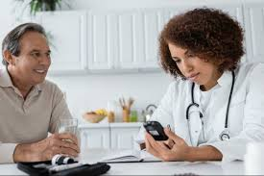
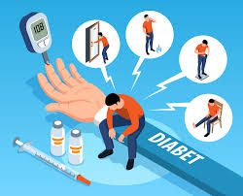
Context
Diabetes is a rising global disease
It can lead to many other diseases
Early detection is key to prevention and treatment
ML has the potential to aid clinicians to classify diabetes patients other than traditional methods
This project aims to predict diabetes using a broader set of features indluding lifestyle habits

Slide 4
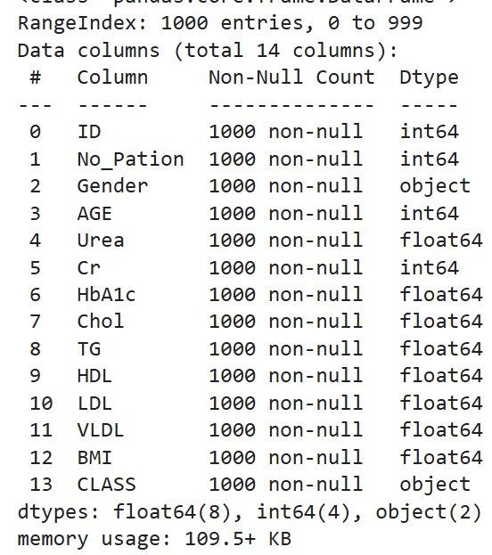
Dataset Preparation
Missing value analysis
Duplicate checking
Dropping Unnecessary Columns
Fixing column values
Label Encoding
Dataset Link: https://www.kaggle.com/code/devraai/diabetes-analysis-modeling

Slide 5
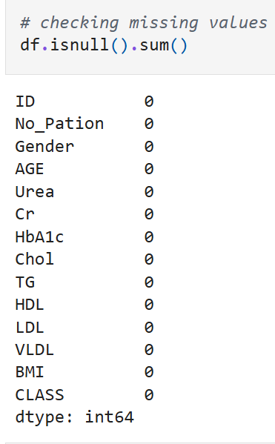
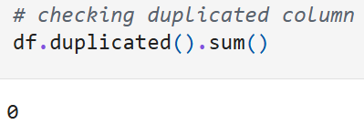
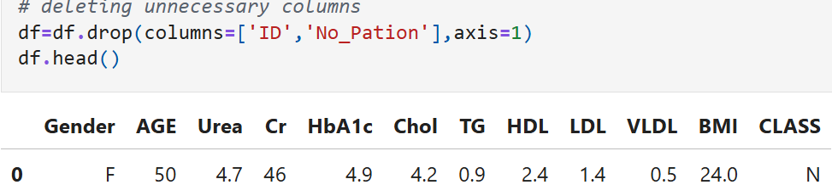
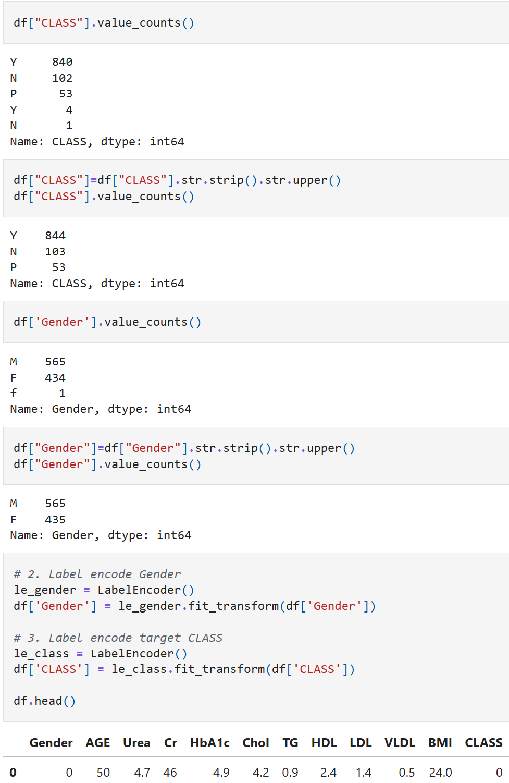
Dataset Preparation

Slide 6
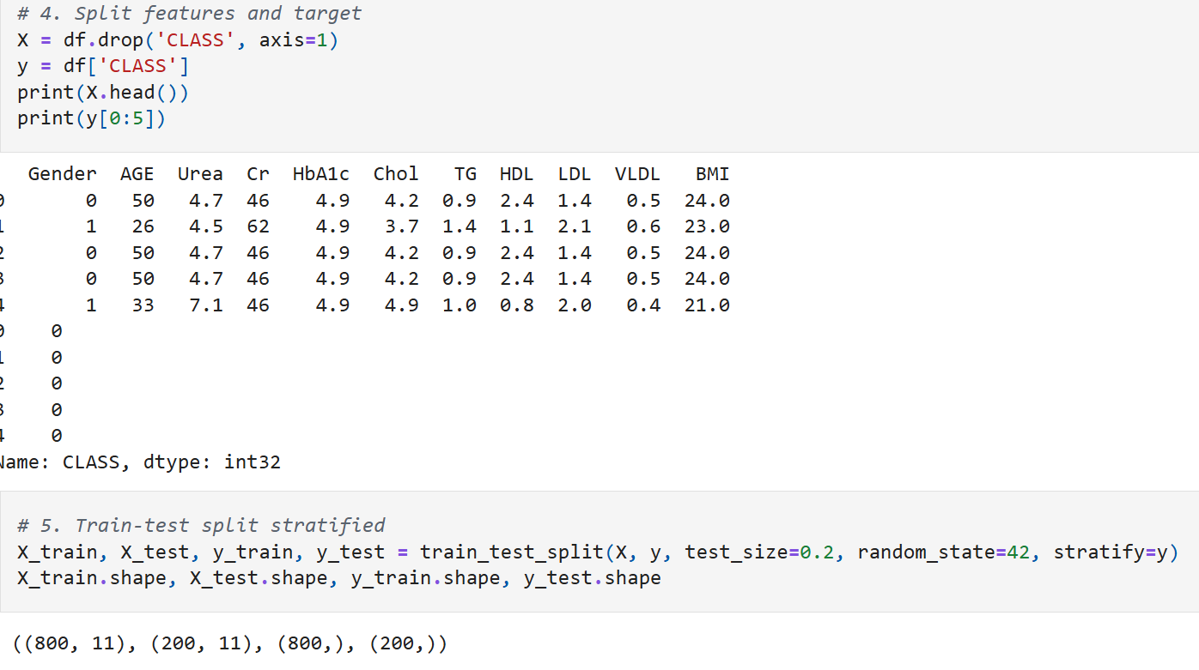
Dataset Preparation
Taken the input features into X and target feature to y variables
Split the data into 80% training and 20% testing sets
Checked for Class distribution
Applied SMOTE for class sampling
Scaled the Data for Machine Learning

Slide 7
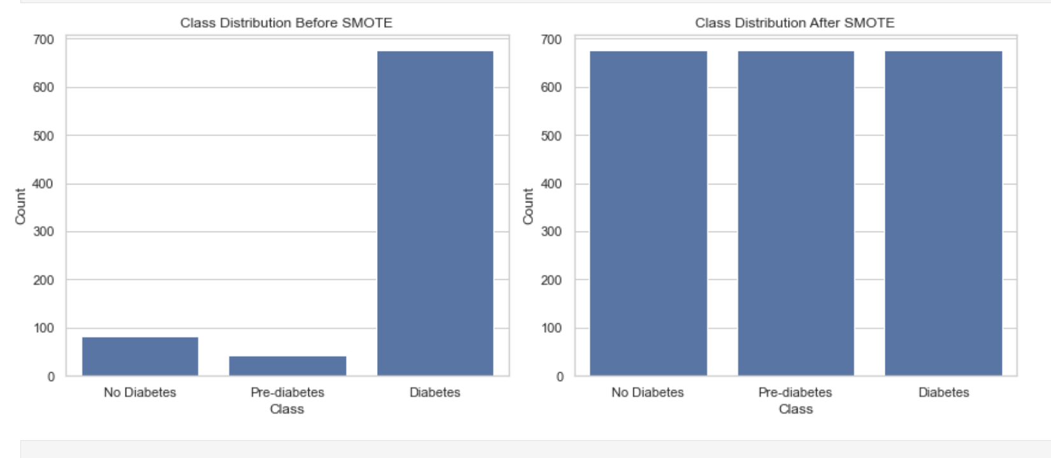
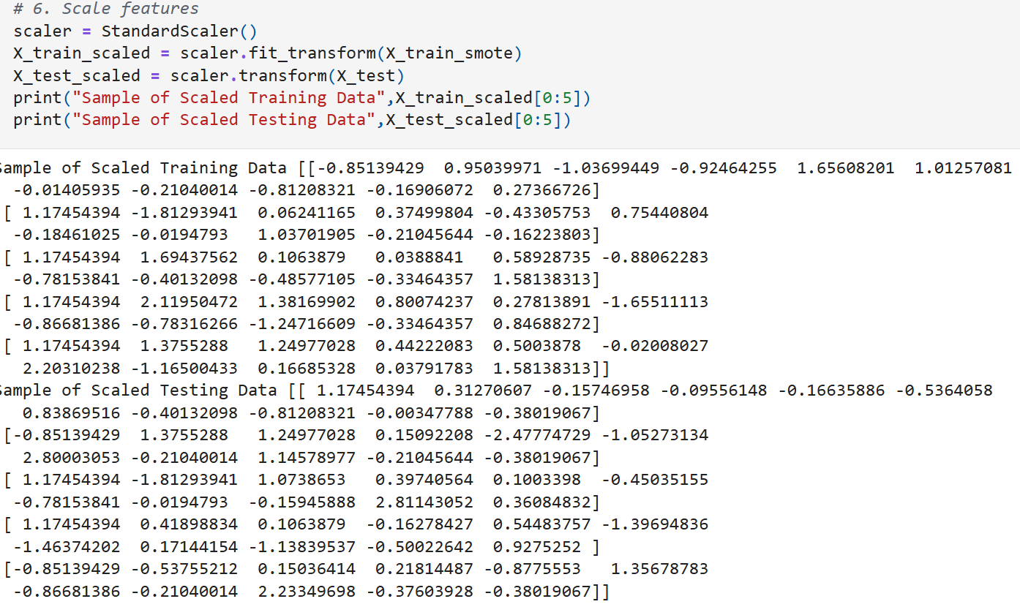
Dataset Preparation

Slide 8
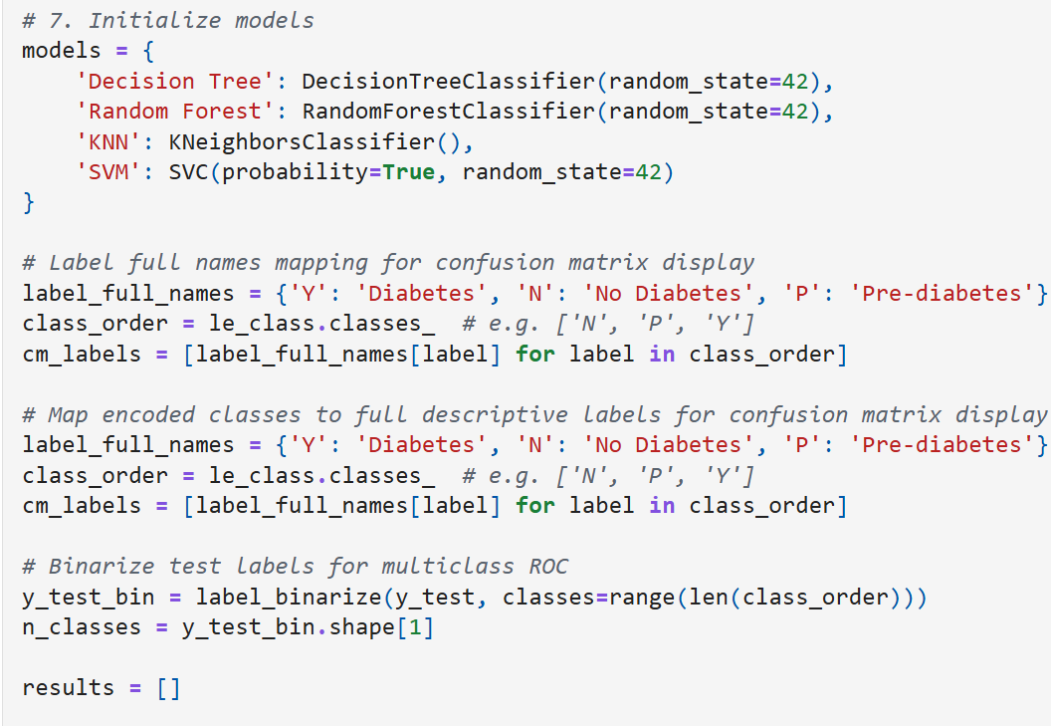
Machine Learning Models used
Decision Tree
Random Forest
K-Nearest Neighbors
Support Vector Machine

Slide 9
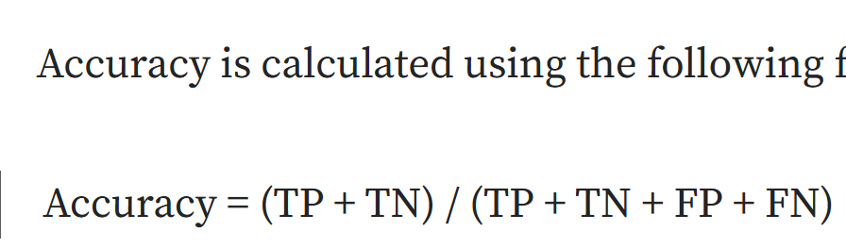
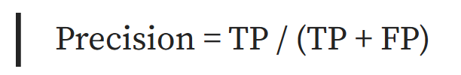

Evaluation Metrics
Evaluation Metrics:
Confusion Metrix
Accuracy
Precision
Recall
F1-Score
AUC-ROC Score

Slide 10
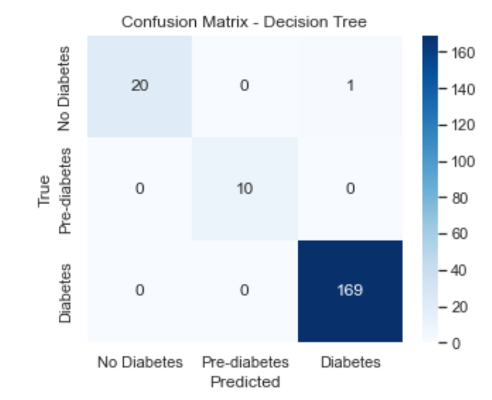
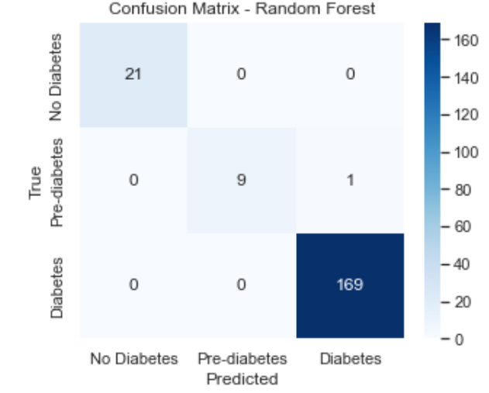
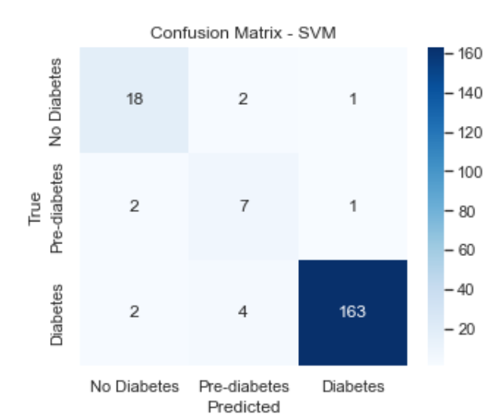

Results

Slide 11
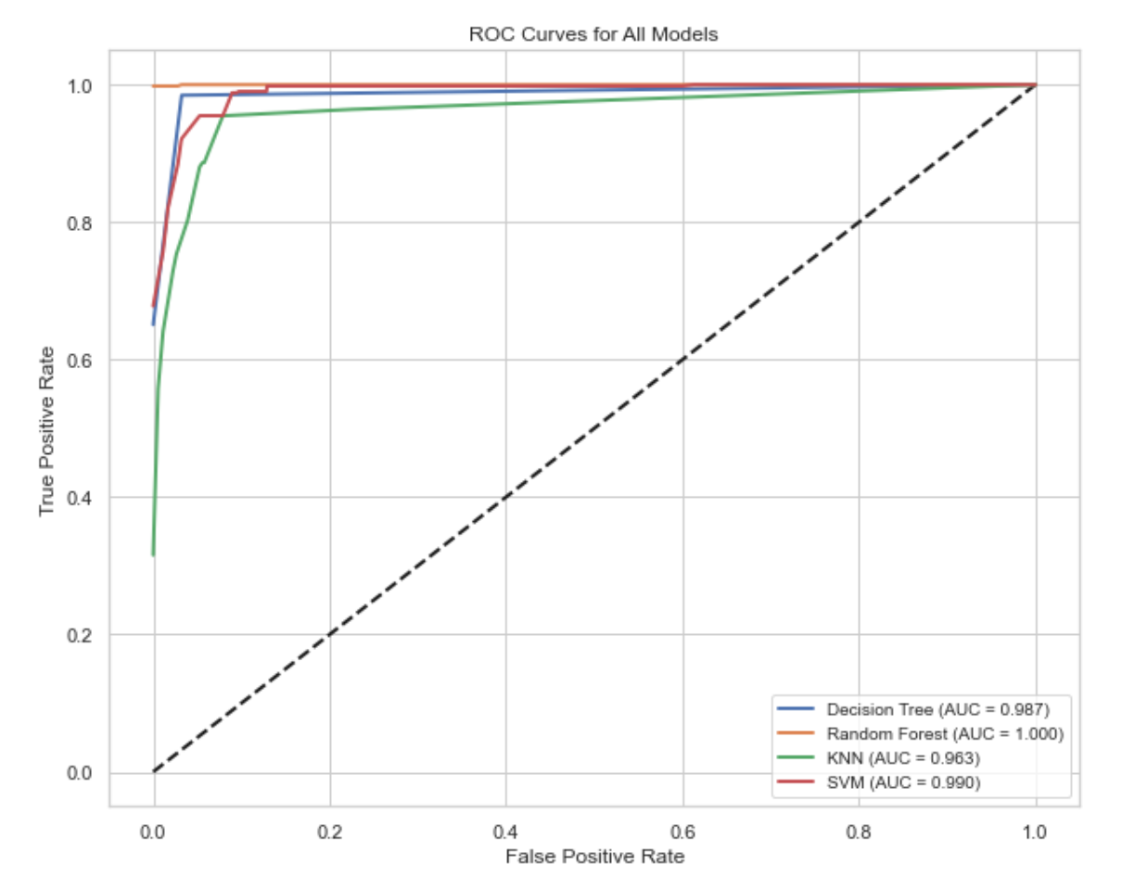
Results

Slide 12
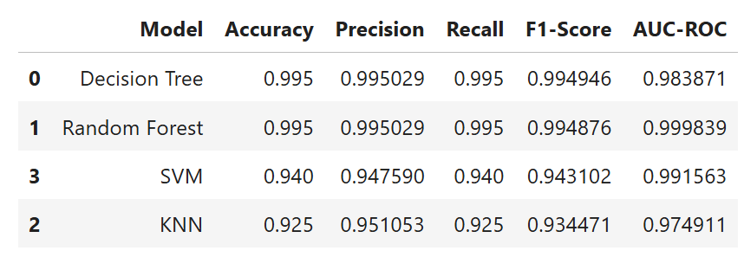
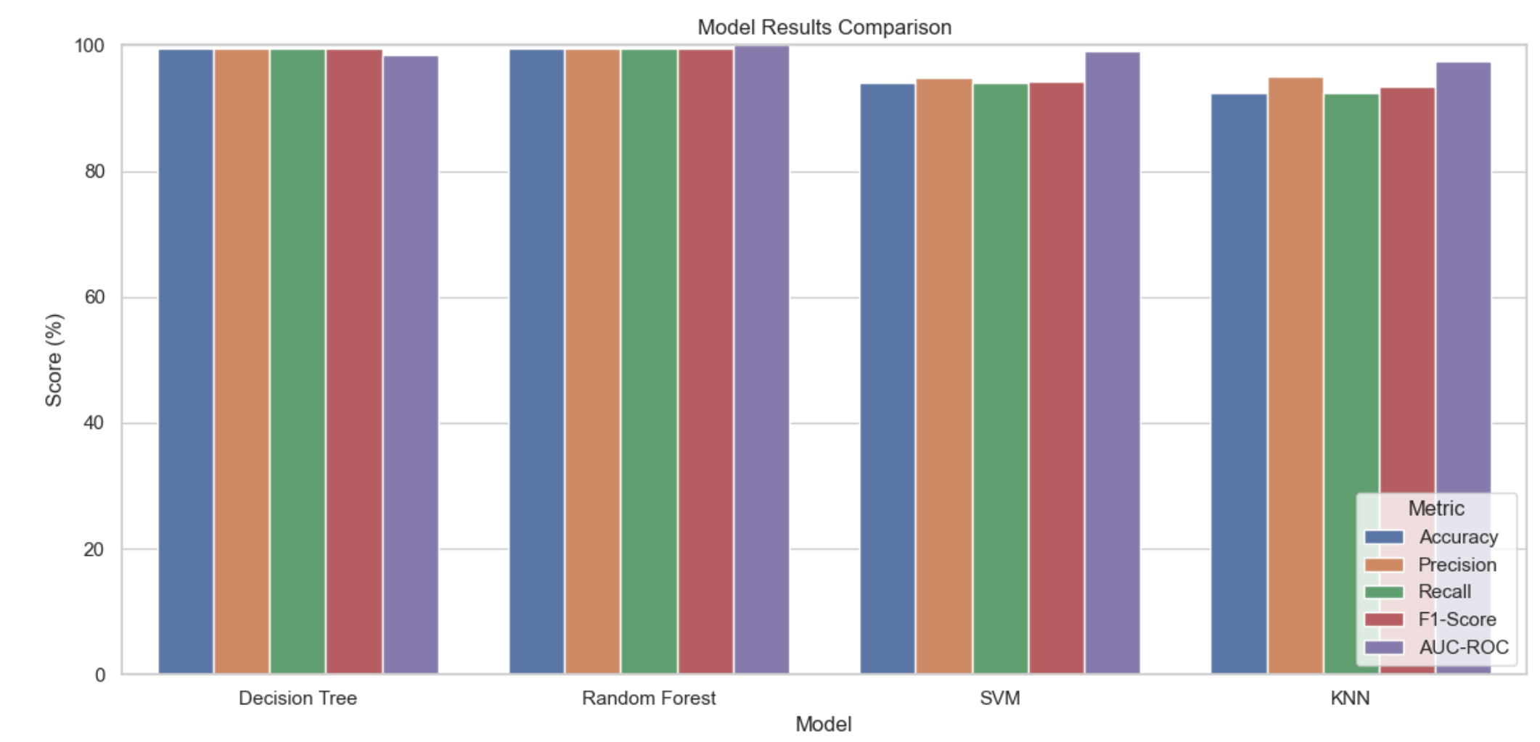
Results
GitHub Link of the Project: https://github.com/imranchy/ml_based_diabetics_prediction/blob/main/ML%20Based%20Diabetics%20Prediction.ipynb

Slide 13
Findings
All models achieved over 90% accuracy score
Decision Tree and Random Forest had the same accuracy score (99%)
Random Forrest was the ideal model for this task
It could predict 21 cases of Non-Diabetic cases correctly
This was demonstrated by its high value in the AUC-ROC Curve

Slide 14
Limitations & Future Work
Access to high volume data in medical domain
Training the models on a more complex dataset
Use extensive hyperparameter tuning
Use K-fold cross validation
Test additional models like ANN, Deep Learning
Test the models on unseen dataset and integrate that model into a software application

Slide 15
Thank You!

