Slide 1


Resilient Anomaly Detection in Fiber-Optic Networks: A Machine Learning Framework for Multi-Threat Identification Using State-of-Polarization Monitoring
By: Imran Chowdhury Dipto
Department of Electronics and Telecommunications (DET)

Slide 2
Outline
Background
Methodology
Dataset & Preparation
ML Models
Training and Evaluation
Results
Findings
Limitations and Future Work

Slide 3

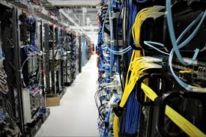
Background
Optical Networks are crucial for High-Speed data transmissions in Telecom Industry
Maintaining the security of such network systems are important as these data can contain sensitive information
Fiber Optic cables are used worldwide
These cables are susceptible to environmental factors like temperatures, earthquakes are so on resulting in fiber breaks, unauthorized evesdroppting etc.

Slide 4
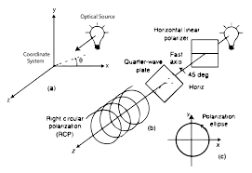
Background
Although traditional methods can be used to monitor such systems (DAS systems, OTDR etc)
Monitoring the State-of-Polarization (SOP) offer greater benefits of identifying the fibers physical properties
It can directly capture alterations in the polarization state of light going through the fiber
Resulting in the identification of the type of Network Anomaly based on the Stokes parameters
Recent studies in Machine Learning research shows that there is great promise in using them for Network Fiber anomaly detection

Slide 5
Objective
Goal: To build a resilient ML framework for identifying multiple anomaly types in SOP signals under varying noise conditions.
Based on:
Stokes parameter (SOP values)
Engineered features
Latency, Signal-to-Noise Ratio (SNR, GSNR ROP, Distance, Path & Boundary)
Classification Label Rule: Labelling done by observing the different times

Slide 6

Methodology
The SOP serves as a real time sensing mechanism for detecting mechanical disturbances in optical fiber networks
Monitoring the polarization state trajectory on the device allows us to detect shifts caused by phenomenon like drilling, vibrations etc
The time variation of the stokes parameters speed on the device is at a specific angle was calculated as:

Slide 7
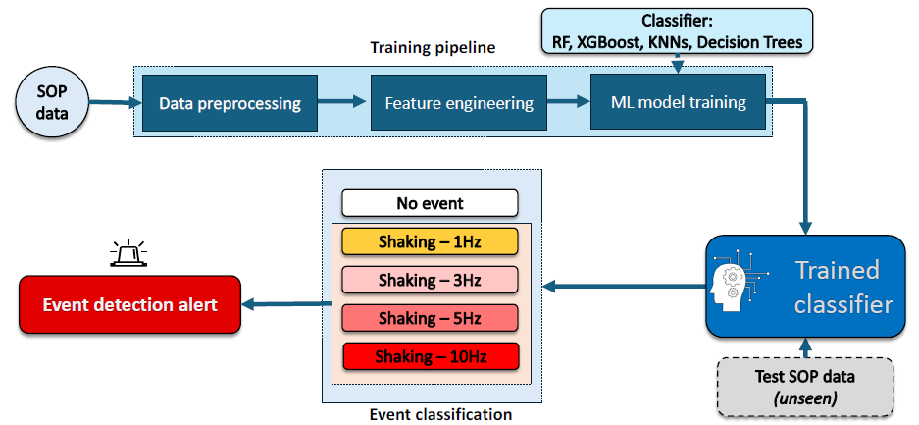
Methodology

Slide 8
Methodology
First the ML models were trained on a labelled clean dataset with features (S1, S2, S3, w(k) and the target was Label column
The experiment was done a number of times to identify a number of useful features to add in the dataset
Then the ideal ML classifier was identified and tuned
The ideal model was saved and used to classify events on 3 noisy datasets

Slide 9









Software
GitHub Link of the Project: https://github.com/imranchy/ml_based_network_anamoly_detection/tree/main

Slide 10
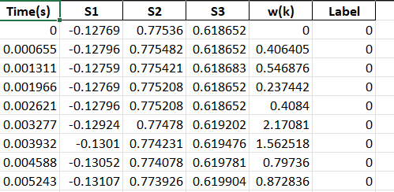
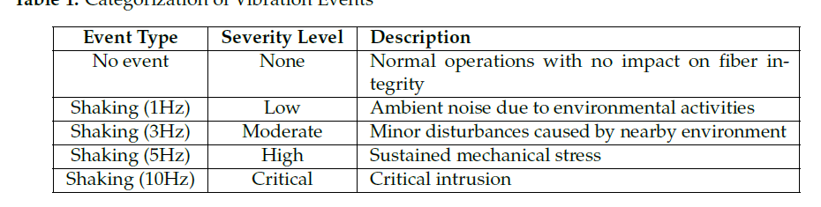
Dataset

Slide 11
Data Preparation
We have added several features to the training data
Split the data into input features (x) and the Label as (y)
Applied Standard Scaling to the data
Separated the training set into 80% and kept 20% for testing on the clean dataset
Incorporated the same feature engineering setup on the unseen data
Tested and evaluated the ideal model on those datasets

Slide 12
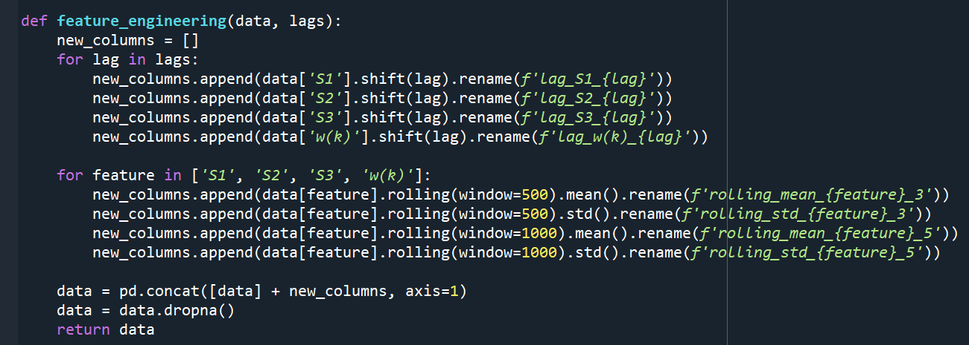
Feature Engineering

Slide 13
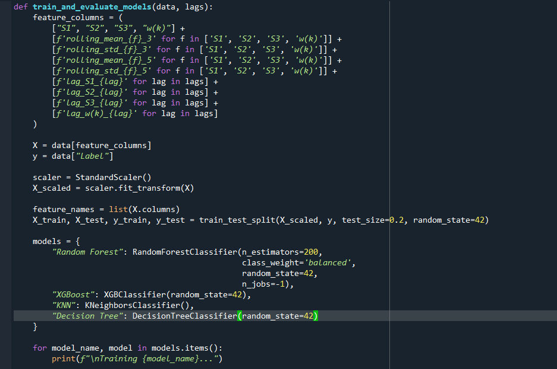
Model Setup
Trained 3 different models on the clean dataset (Random Forest, XGBoost, Decision Tree)
Ran the experiment multiple tiles to identify the ideal parameters of the
Tested the ideal model on some unseen datasets

Slide 14
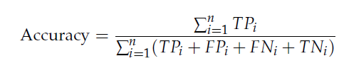



Training & Evaluation
Evaluation Metrics:
Confusion Matrix
Accuracy
Precision
Recall
F1 Score
AUC-ROC Curve

Slide 15
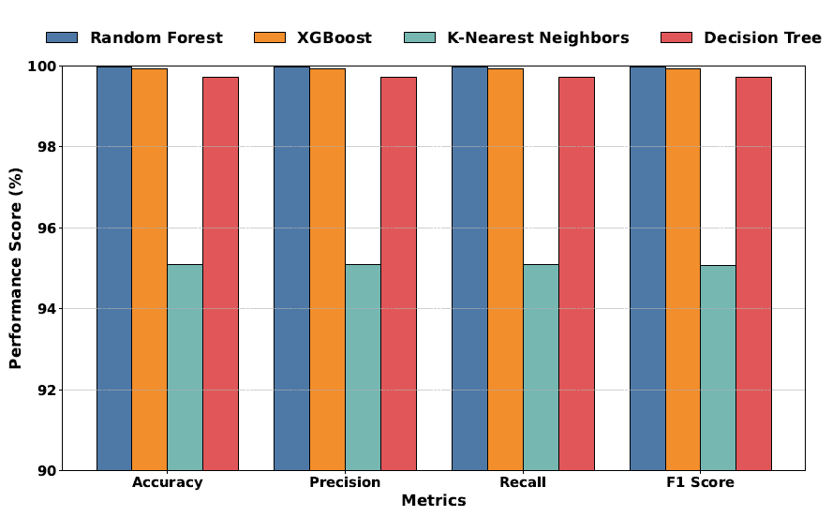
Results on Clean Data

Slide 16
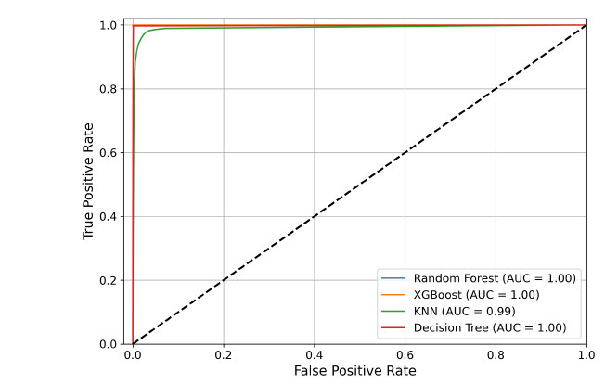
Results on Clean Data

Slide 17
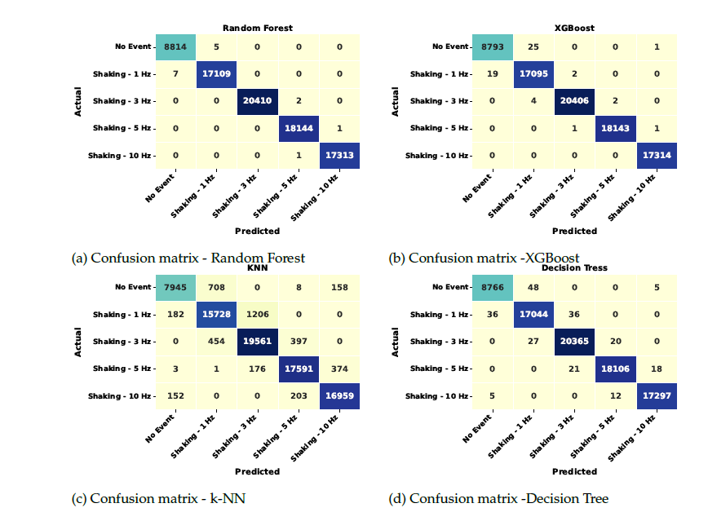
Results on Clean Data

Slide 18
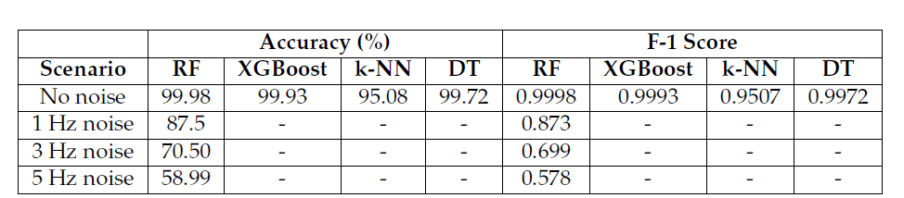
Results on Unseen Data

Slide 19
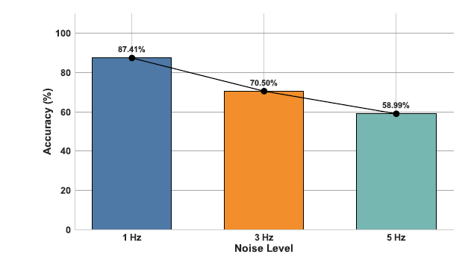
Results on Unseen Data

Slide 20
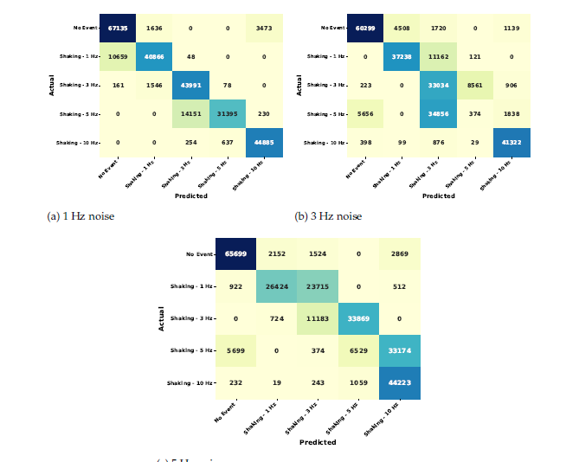
Results on Unseen Data

Slide 21
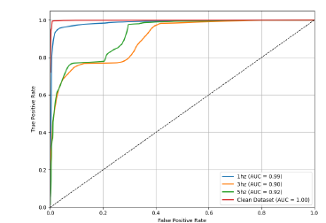
Results on Unseen Data

Slide 22
Findings
Random Forest Model achieved the better accuracy scores
This model had also performed well on the unseen data with various levels of noise
The Random Forest model has the potential to be deployed in the real-world as it was the most robust model

Slide 23
Limitations & Future Work
Having access to data from different lab setups
Train different models
Apply automatic grid search methods (GridSearch, Optuna, etc)
Apply automated feature selection methods (Random Forest based etc)
Future Work:
We will demonstrate the predictive capability of the model in a live demo in ICTON July 2025

Slide 24
Acknowledgement
Professor Vittorio Curri: https://www.polito.it/personale?p=002900
Gulmina Malik: https://www.polito.it/personale?p=gulmina.malik
Links Foundation
NOKIA Portugal

Slide 25
Thank You!

