Slide 1



Multi-Agent Digital Twin for SLA Management inCoherent P2MP Metro-Access Networks
7th September 2026

Slide 2
Points to improve on
Maintain shared states
Collaborate Dynamically
Validation
Explain an error
Select different workflows for the query types
The system did not follow the specific guidelines written on the spreadsheet

Slide 3
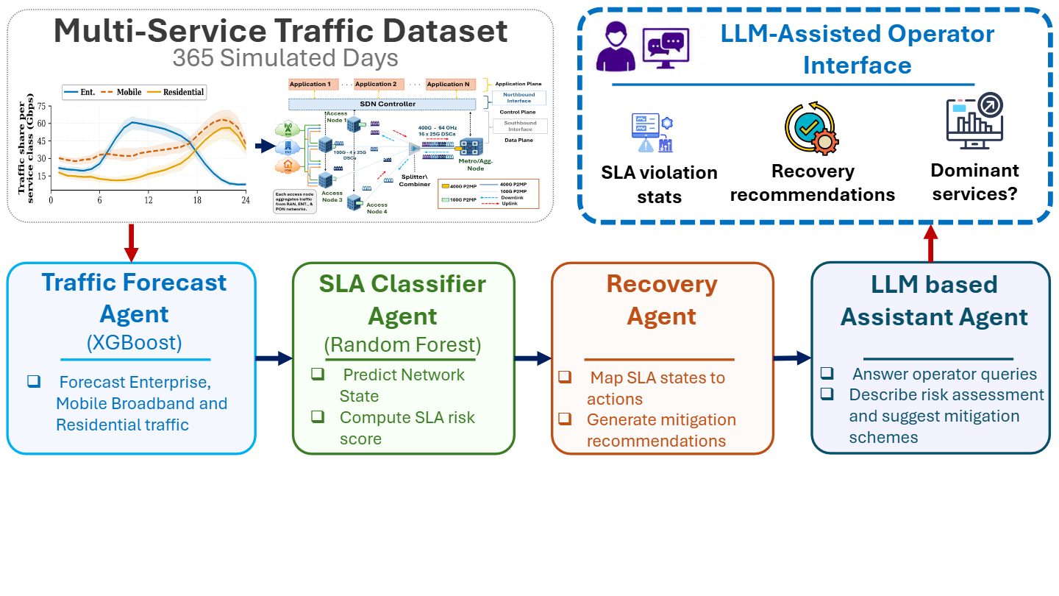
Agentic setup

Slide 4
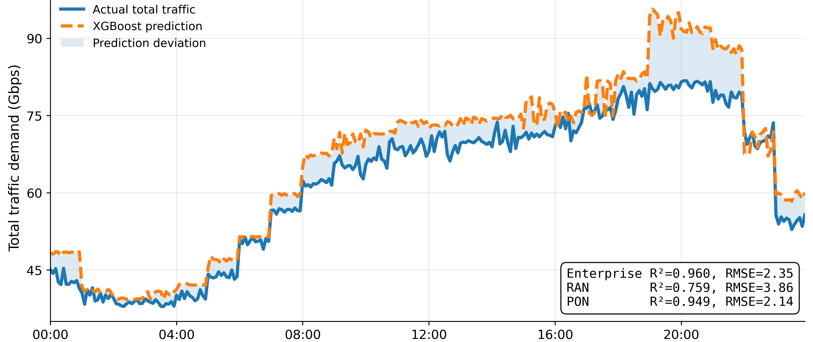
Traffic forecasting result

Slide 5
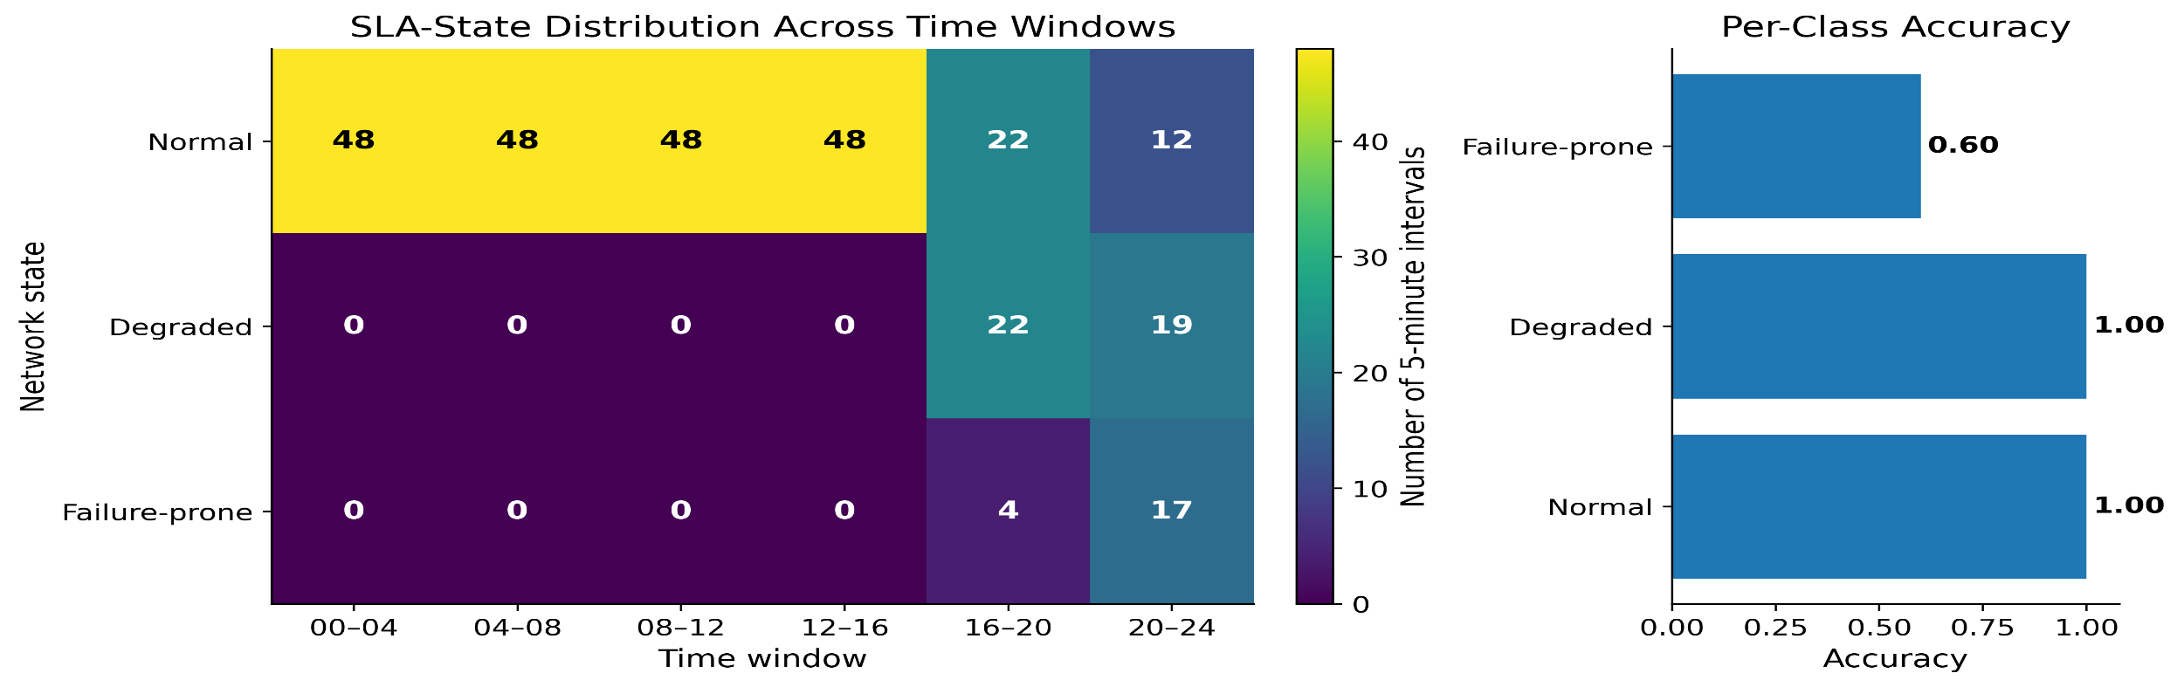
Network state classification
SLA states are derived from blocking-ratio thresholds
Normal operations are common during low-demand periods
Degraded and failure-prone states start after 16:00
Highest SLA risk occurs during the evening hour window (20:00-24:00)
Random forest achieved 97.2% classification accuracy over the classes
These results show proactive prediction can be achieved before service disruption

Slide 6
Agent architecture
Traffic Forecaster Agent
SLA Classifier Agent
Reads the predicted Enterprise, RAN, and PON traffic values from XGBoost regressor
Computes total predicted traffic
Recreates time-of-day features which are used by the Random Forest model
Converts each 5-minute interval into a readable time and slot index
Loads XGBoost regressor metrics for reporting
Loads pre-trained classifier model
Processes forecasted traffic features
Predicts network states
Computes SLA risk scores
Forwards risk information to recovery agent
Assistant Agent
Recovery Agent
Receives Outputs from the Recovery agent
Generates natural language explanations
Answers Network Operator questions
Supports Network decision making
Receives predicted SLA States
Maps states to recovery actions
Generates proactive mitigation recommendations
Passes operations to the operator assistant

Slide 7
changes
  Reconstruction of the system
  Grounded recovery recommendations in observed subcarrier allocations in mappings with the document
  Creation of an easy to use web application for Demo purpose

Slide 8
Todays demo
1. Forecast overview
T: “Generate an operational summary for tomorrow”
Demonstrates:
Assistant Agent: recognizes a day-ahead summary request.
Forecast Agent: supplies 288 five-minute traffic intervals.
SLA Agent: provides state classifications and risk scores.
Guardrail Agent: attaches the low-confidence warning.
Operator Response Agent: produces the concise summary.
Purpose:
Establishes the complete day-ahead operational situation.

Slide 9
Todays demo
2. SLA-risk detection
T: “Tell me the next predicted SLA-risk interval”
Demonstrates:
Assistant Agent: selects the next_risk workflow.
SLA Agent: identifies the earliest non-normal classification.
Guardrail Agent: detects low classifier confidence.
Operator Response Agent: explains the interval and warning.
Purpose:
Shows proactive identification of the first potential service problem.

Slide 10
Todays demo
3. Diagnosis
T: “Which service contributes most during the highest-risk interval?”
Demonstrates:
Assistant Agent: distinguishes diagnosis from basic forecasting
SLA Agent: locates the highest-risk interval
Diagnosis Agent: compares Enterprise, RAN and PON contributions
Operator Response Agent: identifies RAN as the dominant service.
Purpose:
Moves from detecting risk to explaining the likely contributing service

Slide 11
Todays demo
4. Recovery and allocation
T: “What subcarrier allocation is recommended at the highest-risk interval?”
Demonstrates:
Assistant Agent: selects the recovery workflow
Recovery Agent: evaluates the three observed allocations
Recovery Agent: calculates per-service capacities and residual overflow
Guardrail Agent: ensures the recommendation remains advisory
Operator Response Agent: translates allocation codes into readable language
Purpose:
Shows actionable decision support while retaining human approval

Slide 12
Todays demo
5. Service traffic analysis
T: “When is RAN traffic expected to peak?”
Demonstrates:
Assistant Agent: extracts service=ran, selects service_peak and which result to display (top_k)
Forecast Agent: searches all 288 RAN forecast intervals
Operator Response Agent: returns the peak time and load
Purpose:
Demonstrates service specific analytical tool selection

Slide 13
Todays demo
6. Contextual follow-up
T: “Do the same for PON”
Demonstrates:
Assistant Agent: interprets a contextual follow-up
Shared conversational state: reuses the previous service_peak intent
Coordinator: changes the target service from RAN to PON
Forecast Agent: calculates the corresponding PON peak
Operator Response Agent: returns the PON result
Purpose:
Demonstrates that the assistant maintains context instead of treating every question as an isolated command

Slide 14
Findings and future work
Future Work:
  Stronger documentation with all relevant policies
  Integration of data storage
  Device a stronger set of Operator Queries
  Agent Analysis, system resource usage tracking
  Model fine tuning
  Cloud deployment

