Slide 1



Multi-Agent Digital Twin for SLA Management inCoherent P2MP Metro-Access Networks
7th September 2026

Slide 2
Points to improve on
Maintain shared states
Collaborate Dynamically
Validation
Explain an error
Select different workflows for the query types
The system did not follow the specific guidelines written on the spreadsheet

Slide 3
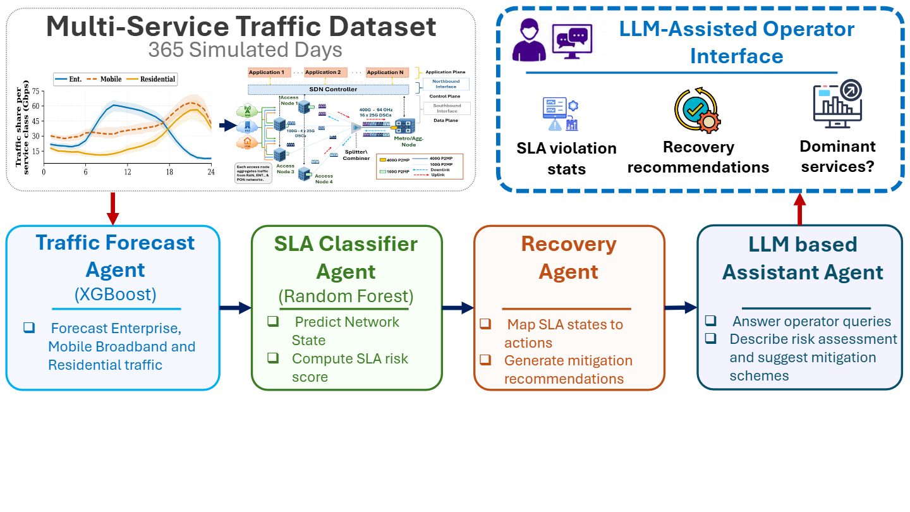
Agentic setup

Slide 4
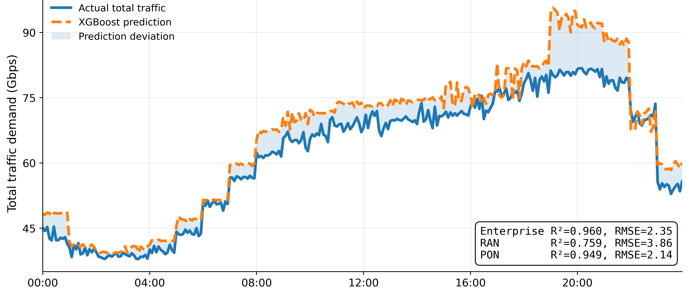
Traffic forecasting result

Slide 5
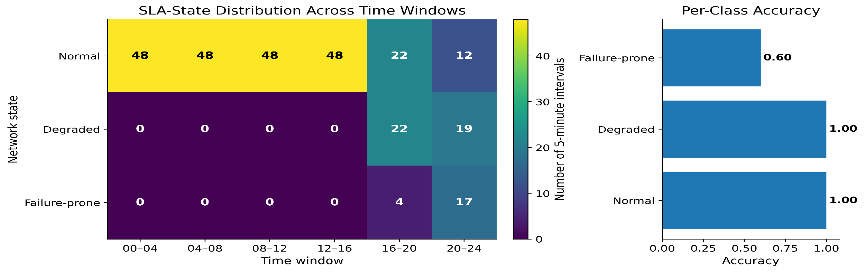
Network state classification
SLA states are derived from blocking-ratio thresholds
Normal operations are common during low-demand periods
Degraded and failure-prone states start after 16:00
Highest SLA risk occurs during the evening hour window (20:00-24:00)
Random forest achieved 97.2% classification accuracy over the classes
These results show proactive prediction can be achieved before service disruption

Slide 6
Agent architecture
Traffic Forecaster Agent
SLA Classifier Agent
Reads the predicted Enterprise, RAN, and PON traffic values from XGBoost regressor
Computes total predicted traffic
Recreates time-of-day features which are used by the Random Forest model
Converts each 5-minute interval into a readable time and slot index
Loads XGBoost regressor metrics for reporting
Loads pre-trained classifier model
Processes forecasted traffic features
Predicts network states
Computes SLA risk scores
Forwards risk information to recovery agent
Assistant Agent
Recovery Agent
Receives Outputs from the Recovery agent
Generates natural language explanations
Answers Network Operator questions
Supports Network decision making
Receives predicted SLA States
Maps states to recovery actions
Generates proactive mitigation recommendations
Passes operations to the operator assistant

Slide 7
changes
  Reconstruction of the system
  Grounded recovery recommendations in observed subcarrier allocations in mappings with the document
  Creation of an easy to use web application for Demo purpose

Slide 8
Todays demo
1. Forecast overview
T: “Generate an operational summary for tomorrow”
Demonstrates:
Assistant Agent: recognizes a day-ahead summary request.
Forecast Agent: supplies 288 five-minute traffic intervals.
SLA Agent: provides state classifications and risk scores.
Guardrail Agent: attaches the low-confidence warning.
Operator Response Agent: produces the concise summary.
Purpose:
Establishes the complete day-ahead operational situation.

Slide 9
Todays demo
2. SLA-risk detection
T: “Tell me the next predicted SLA-risk interval”
Demonstrates:
Assistant Agent: selects the next_risk workflow.
SLA Agent: identifies the earliest non-normal classification.
Guardrail Agent: detects low classifier confidence.
Operator Response Agent: explains the interval and warning.
Purpose:
Shows proactive identification of the first potential service problem.

Slide 10
Todays demo
3. Diagnosis
T: “Which service contributes most during the highest-risk interval?”
Demonstrates:
Assistant Agent: distinguishes diagnosis from basic forecasting
SLA Agent: locates the highest-risk interval
Diagnosis Agent: compares Enterprise, RAN and PON contributions
Operator Response Agent: identifies RAN as the dominant service.
Purpose:
Moves from detecting risk to explaining the likely contributing service

Slide 11
Todays demo
4. Recovery and allocation
T: “What subcarrier allocation is recommended at the highest-risk interval?”
Demonstrates:
Assistant Agent: selects the recovery workflow
Recovery Agent: evaluates the three observed allocations
Recovery Agent: calculates per-service capacities and residual overflow
Guardrail Agent: ensures the recommendation remains advisory
Operator Response Agent: translates allocation codes into readable language
Purpose:
Shows actionable decision support while retaining human approval

Slide 12
Todays demo
5. Service traffic analysis
T: “When is RAN traffic expected to peak?”
Demonstrates:
Assistant Agent: extracts service=ran, selects service_peak and which result to display (top_k)
Forecast Agent: searches all 288 RAN forecast intervals
Operator Response Agent: returns the peak time and load
Purpose:
Demonstrates service specific analytical tool selection

Slide 13
Todays demo
6. Contextual follow-up
T: “Do the same for PON”
Demonstrates:
Assistant Agent: interprets a contextual follow-up
Shared conversational state: reuses the previous service_peak intent
Coordinator: changes the target service from RAN to PON
Forecast Agent: calculates the corresponding PON peak
Operator Response Agent: returns the PON result
Purpose:
Demonstrates that the assistant maintains context instead of treating every question as an isolated command

Slide 14
Findings and future work
Future Work:
  Stronger documentation with all relevant policies
  Integration of data storage
  Device a stronger set of Operator Queries
  Agent Analysis, system resource usage tracking
  Model fine tuning
  Cloud deployment

Slide 15
Changelog 18th September 2026
Autonomous Tool Selection
Context aware follow up reasoning
Test in 50 curated queries
Enhanced prompting/instruction tuning
Policy-aware mathematical execution (PSC): PCA, MBA, and SAA policies they are executed through deterministic Python policy logic and feed to the Mistral Agent
What-if policy simulation: operators can ask counterfactual questions such as changing SC constraints or replaying a policy at a timestamp.
Constraint-aware allocation analysis: the system can evaluate hard operator constraints, e.g. reserving SCs for PON/RAN, and recompute feasible allocations.
LLM + deterministic split: Mistral decides the intent/tool, while Python performs the traffic, SLA, policy, blocking, and reconfiguration calculations.

Slide 16
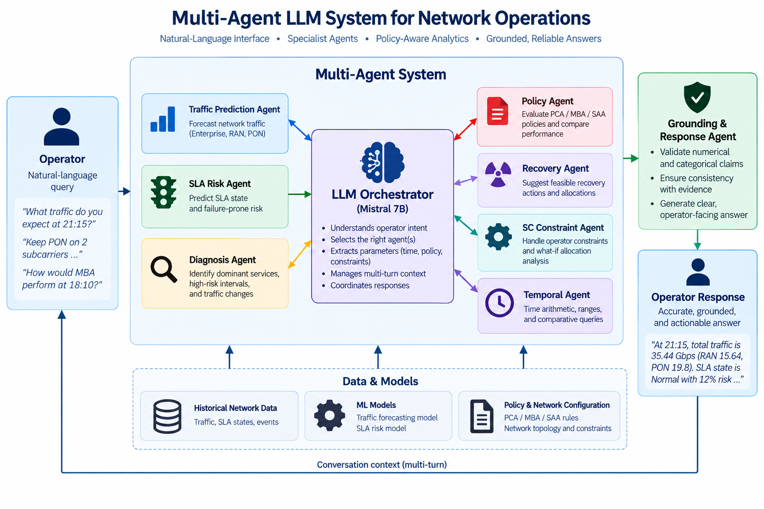
architecture

Slide 17
Explanation of risk scores
  Risk(t)=P(SLAstate​=Failure-prone∣Xt​)
  Where:
  𝑋_𝑡={𝑡ⓜ,𝑟ⓜ,𝑎ⓜ,𝑓ⓜ,𝑓𝑖𝑐_𝑡 " " 𝑝𝑜𝑙𝑖𝑐𝑦" " 𝑠𝑡𝑎𝑡𝑒_𝑡 " " 𝑎𝑙𝑙𝑜𝑐𝑎𝑡𝑖𝑜𝑛" " 𝑓𝑒𝑎𝑡𝑢𝑟𝑒𝑠_𝑡 " " 𝑏𝑙𝑜𝑐𝑘𝑖𝑛𝑔_𝑡 " " 𝑟𝑒𝑐𝑜𝑛𝑓𝑖𝑔𝑢𝑟𝑎𝑡𝑖𝑜𝑛_𝑡 }
  Hence:
  Input: predicted traffic + network/policy features at timestamp 𝑡
  Model output: Failure-prone probability/risk score
  Displayed result: SLA state + risk percentage
  Example: at 21:15, SLA state = Normal, Failure-prone risk = 12%

Slide 18
tools
Traffic Prediction — get_traffic_forecast
SLA Risk/State Prediction — get_sla_prediction
SLA Risk Explanation — explain_sla_risk
Full Network State — get_network_state_at_time
Policy Comparison & Recommendation — compare_policies_at_time
Policy Counterfactual Simulation — simulate_policy_at_time
SC Constraint Analysis — analyze_constrained_allocation
Temporal Network Comparison — compare_network_states
Risk/Peak Interval Discovery — find_risk_intervals
Time-Range Summary — summarize_time_range
Context Clarification — request_clarification
Physical-Layer Scope Guardrail — decline_physical_layer
General Out-of-Scope Guardrail — decline_out_of_scope

Slide 19
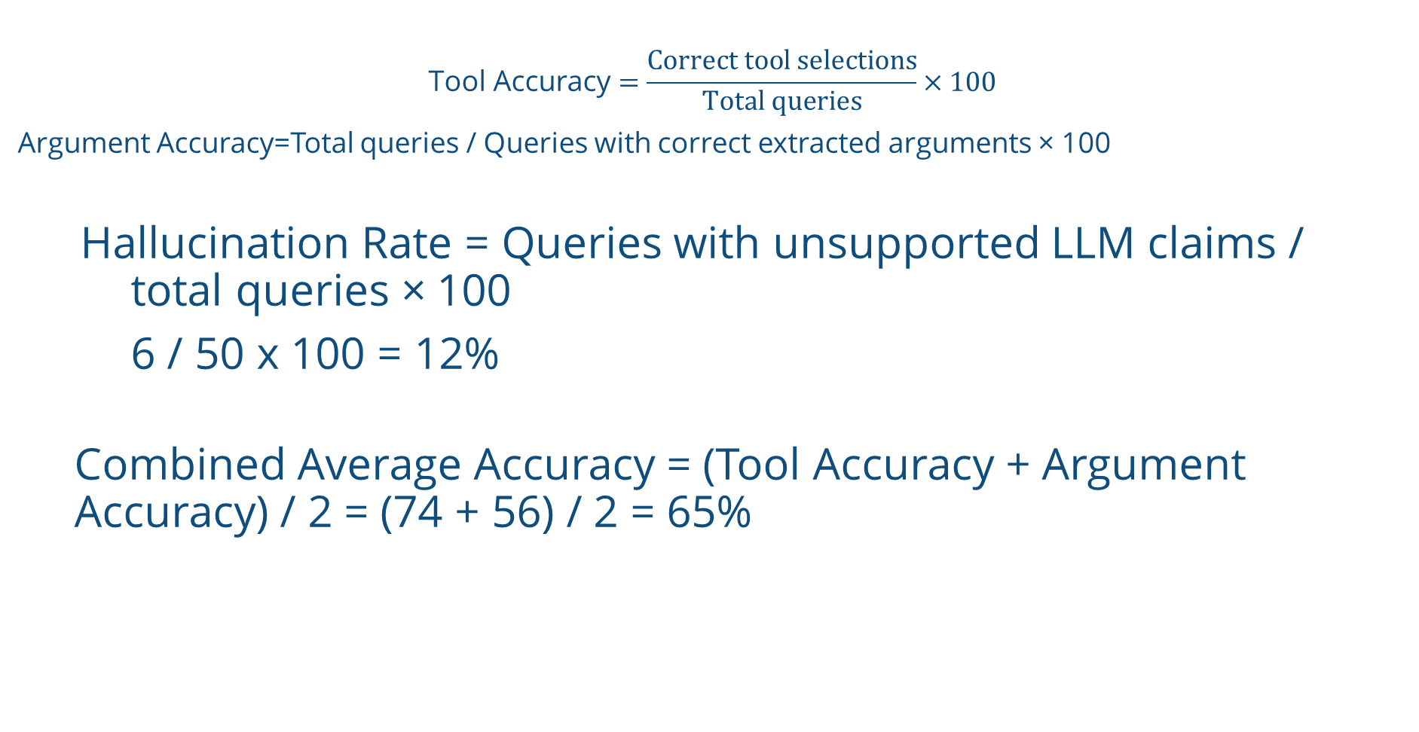
Evaluation steps
$$\text{Tool Accuracy}=\frac{\text{Correct tool selections}}{\text{Total queries}}×100$$
Argument Accuracy=Total queries / Queries with correct extracted arguments ​× 100
Hallucination Rate = Queries with unsupported LLM claims / total queries​ × 100
6 / 50 x 100 = 12%
  Combined Average Accuracy = (Tool Accuracy + Argument Accuracy) / 2 = (74 + 56) / 2 = 65%

Slide 20
Todays demo
1. What traffic do you expect at 21:15?
2. What is the predicted SLA state at 21:15?
3. Show me the complete network state at 16:20.
4. Keep PON on 2 subcarriers at 21:15 and allocate the remaining two.
5. Reserve 1 subcarrier for PON at 21:15 and allocate the remaining three.
6. And one hour later?
System → Which time should I use as the reference?
7. 10:00

Slide 21
Moving forward
Access to Physical parameters
Larger Mesh network topology
Integration of live telemetry
Devising comprehensive set of training queries probably in different language variants as well
Fine tuning the model for latency reduction
Compare the current results with the fine-tune dataset

Slide 22
OFC 2026: OPTS – A Fine tuned slm for transceiver data extration
Converts optical transceiver PDF datasheets into editable Markdown using PyMuPDF4LLM
Extracts parameters such as wavelength, baud rate, modulation, FEC, optical power and reach
Uses a local Qwen model through llama-server, keeping datasheet content on the user’s machine
Separates atomic parameter extraction from operational mode synthesis to improve accuracy
Validates outputs with Pydantic and stores the source text, raw model response and structured JSON for review

Slide 23
Use case
Automate the conversion of vendor optical transceiver datasheets into validated, machine-readable specifications for:
Faster transceiver comparison and selection
Network planning and link feasibility assessment
Automated standards and interoperability checks
Capability-based equipment inventory
Reduced manual effort and parameter-entry errors

Slide 24
proposed idea
Develop a fine-tuned small language model (SLLM) that learns to extract optical transceiver parameters from datasheets accurately and return schema-valid JSON
Fine-tune a compact Qwen 4B model using human verified datasheet and JSON pairs
Train it on separate tasks for parameter extraction, mode discovery and scope resolution
Use constrained JSON generation and Pydantic validation to ensure valid outputs
Compare the original 4B model with the fine-tuned version for accuracy, hallucination rate and latency

Slide 25
Potential use case
  Capability ingestion: Populate the digital twin with supported rates, modulation formats, FEC, power limits and reach
  Device compatibility: Check whether a transceiver supports a requested link or operational configuration
  Configuration support: Identify valid operating modes and prevent unsupported parameter combinations
  Planning input: Supply structured equipment constraints to link-budget, spectrum-allocation and path-planning tools

