Slide 1
BLOCKCHAIN TECHNOLOGY PROJECT
EPHEMERAL SECRET SHARING VAULT
Blockchain-based secure secret storage · threshold recovery · tamper-proof audit trail · dead man's switch
TYCS24 Imran Khan · TYCS29 Danish Lakhani · TYCS38 Shubham Rathod · TYCS44 Mohd Muzzamil Shaikh
B.Sc. Computer Science — Third Year · 2025–26
Guided by Ms. Shamaila Baloch
Notes:
Good morning. I am Imran Khan. Our team built the Ephemeral Secret Sharing Vault - a blockchain-anchored system for safe secret storage with threshold recovery and a dead man's switch.

Slide 2
THE PROBLEM
Where secrets are lost today
Single point of failure
A password manager, USB drive or cloud vault. Lost, destroyed or unreachable → the secret is gone forever.
Naive sharing
Copying the secret to many people multiplies the attack surface — any ONE custodian has full access.
Owner unavailable
Death, illness or lockout. No guarantee the owner will ever renew — nothing auto-releases to the right people.
No audit trail
Who saw it, when, and what happened — all held in a database that anyone with access can quietly rewrite.
Server cannot be trusted
A compromised server must never be able to reconstruct the whole secret on its own. Threshold = trust.
Credential overload
Crypto wallet keys, 2FA backup codes, master passwords, legal docs — the stakes keep rising.
One shared weakness: if any single component holds the full secret, security collapses with it.
Notes:
Traditional backup has two flaws: putting everything in one place, or giving full copies to everyone. Plus no guarantee the owner stays available, and no trustworthy record of events.

Slide 3

OUR APPROACH
Mathematics over trust
Shamir Secret Sharing
01
Split into n shares — any k reconstruct it, fewer than k reveal NOTHING. Over GF(2³¹−1) with BigInt.
y = f(x) · k-of-n threshold
AES-256-GCM envelope
02
Each vault gets its own random data key, wrapped by a master key. Authenticated + tamper-proof.
Dead Man's Switch
03
Owner must renew before the TTL. Miss it → vault auto-enters RECOVERY_MODE with full notification.
Blockchain audit trail
04
Every event mined into a SHA-256 PoW chain with Merkle integrity — immutable, verifiable.
Notes:
The core guarantee: threshold math — Shamir shares — means no one person, not even the server, can ever reconstruct the secret alone.

Slide 4
SYSTEM ARCHITECTURE
Four layers, one process
FRONTEND
HTML · CSS · JS · Fetch API
9+ web pages · wizard UI · recovery console · explorers
APPLICATION
Node.js (ESM) · Express 4.18
Controllers · services · JWT middleware · scoped routing
BLOCKCHAIN
JavaScript · Solidity · Web3.js
Custom SHA-256 PoW chain · Merkle trees · 13 tx types
PERSISTENCE
better-sqlite3 · fs
SQLite WAL · embedded · JSON ledger (blockchain.json)
Notes:
Four layers — presentation, application, blockchain, persistence — everything in a single Node.js process, no external infra.

Slide 5

DEFENSE IN DEPTH
Security stack
AES-256-GCM
Authenticated encryption + envelope key wrapping
scrypt
Memory-hard password hashing (N=16384)
HS256 JWT
Constant-time signature verification
Timing-safe login
Dummy hashes — no username enumeration
Rate limiting
Exponential backoff 5s → 15 min
Session identity only
Client-supplied ownerId / from / actor never trusted
One-time shares
Share consumed on first read, then deleted
Ephemeral seal
All crypto destroyed after recovery
Notes:
Defense in depth: authenticated encryption, memory-hard hashing, timing-safe comparisons, rate limiting, session-only identity, ephemeral material.

Slide 6
THE KILLER FEATURE
Dead Man's Switch → Recovery flow
1
Active
Owner renews before TTL — vault stays private
2
2-of-3 threshold
One share alone reveals nothing — only the ceremony of cooperating guardians opens the vault.
The secret is shown exactly once.
Then it can never be reconstructed again.
⚠ Expiry
Monitor fires every 30s ; owner absent
3
Recovery mode
VAULT_EXPIRED + RECOVERY_STARTED mined on-chain
4
Shares in
Guardians submit one-time shares (SHA-256 verified)
5
Reveal once
Threshold met → secret reconstructed & shown once
6
Destroyed
Ephemeral seal wipes all crypto material forever
Notes:
Demo highlight: create a vault, stop renewing, watch it expire into recovery, guardians submit shares, recipient sees the secret once — then prove it can't be recovered twice.

Slide 7
IMMUTABLE AUDIT TRAIL
Custom Proof-of-Work blockchain
GENESIS
BLOCK 1
BLOCK 2
BLOCK 3
BLOCK N
0
VAULT_CREATED
RENEWED · EXPIRED
SHARES · COMPLETED
… 13 tx types
Genesis→Block N
Merkle tree
PoW mining
13 transaction types
Chained by previousHash — altering history is detectable immediately.
One transaction changed → root changed → chain flagged INVALID.
Difficulty 4, adjustable 1–8. ~65k hashes per block.
VAULT_CREATED · RENEWED · EXPIRED · RECOVERY_* · SHARE_* · DOC/SUPPLY/VOTE
The blockchain is the project's memory — every vault lifecycle event is permanently, verifiably recorded.
/api/blockchain/validate → every hash and Merkle root rebuilt from scratch
Notes:
The audit backbone: SHA-256 proof of work, Merkle trees per block, per-block difficulty so old blocks stay valid, and a validate endpoint.

Slide 8
PERSISTENCE
Database design — SQLite (WAL)
backend/database/sqlite.js
Isolated crypto table
vault_crypto is separate from vaults — metadata queries never touch key material.
CREATE TABLE vault_crypto (
vaultId INTEGER PRIMARY KEY,
prime, chunkLengths, encryptedSecret,
FOREIGN KEY (vaultId) REFERENCES vaults(id)
ON DELETE CASCADE);
-- 9 tables: users vaults vault_crypto
-- guardians recoveries notifications
-- documents supply_chain voting
-- metadata never stored beside crypto
DELETE v.id → crypto destroyed atomically
CASCADE destroys data
Deleting a vault atomically deletes its ciphertext, shares and recovery records.
WAL journal mode
Concurrent reads during writes; microsecond synchronous queries via better-sqlite3.
Share commitments only
Guardians table stores the SHA-256 digest, never the plaintext share.
Foreign-key integrity enforced — no orphaned secrets, ever.
Notes:
Nine tables. Key choice: semantic separation — cryptographic material lives apart from metadata, and deleting a vault cascades the crypto away.

Slide 9
VERIFICATION
83 automated tests — all passing
Blockchain
Global difficulty wrongly used — old blocks failed validation
Recovery
Shares could hit a live vault; double-complete → 500 crash
Renewal
Renew reset TTL to default 2 min, not the vault's own
Voting
' A'/'A ' passed duplicate check before trimming
Supply chain
Non-custodian could transfer; 'from' forged in body
Frontend
XSS from unescaped input — added esc() sanitizer
52 API validation · 27 regression · 4 chain integrity
Found by testing the boundaries — not the happy path. Every fix has a regression test.
Notes:
79 + 4: 52 API validation, 27 regression, 4 chain-integrity. Biggest catches: blockchain validity, recovery state machine, renewal TTL, voting dedupe, supply-chain authorization, XSS.

Slide 10
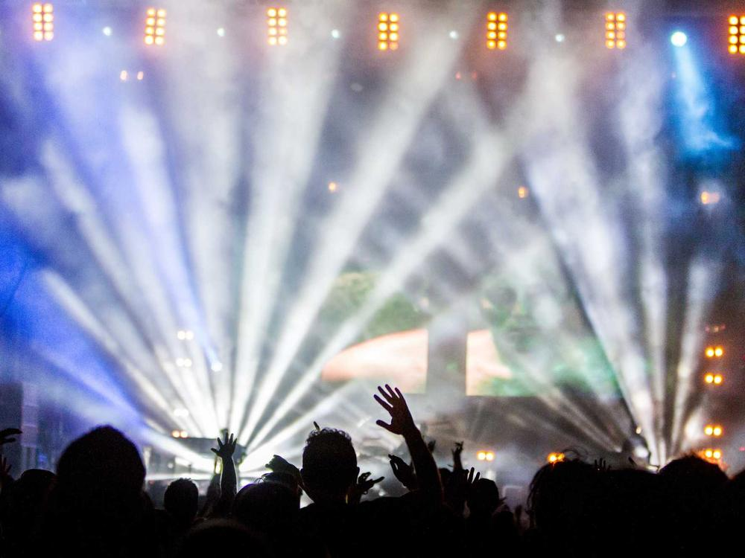
WHERE IT LANDS
Real-world applications
Crypto estates
Wallet recovery phrases released to a trusted threshold when the holder passes away.
Corporate secrets
API keys & root passwords held by executives — no single insider can act alone.
Healthcare access
Emergency read of patient credentials when the patient cannot authorise.
Legal escrow
Wills, NDAs, trade secrets with automatic release conditions.
Credential proof
Tamper-proof timestamps for academic & research records.
Supply integrity
Blockchain custody chains that expose counterfeit goods.
Notes:
The same architecture generalises from personal secrets to corporate, healthcare, legal, academic and logistics domains.

Slide 11
A Secret Vault that
Outlives its owner · Unlocks by consensus · and erases itself after use
THANK YOU
Questions & feedback welcome
TYCS24
TYCS29
TYCS38
TYCS44
Imran Khan
Danish Lakhani
Shubham Rathod
Mohd Muzzamil Shaikh
Team Lead · Backend & Blockchain
Backend & Cryptography
Frontend & Integration
Testing & Documentation
Notes:
Closing: the vault outlives its owner, unlocks by consensus, and erases itself after use. Thank you — we welcome your questions.

