Slide 1
S-Box Substitution
Presented By-
Imran Hosen
14055420
Department of Computer Science and Engineering

Slide 2
S-Box Theory
S-box is a basic component which perform substitution.

Slide 3
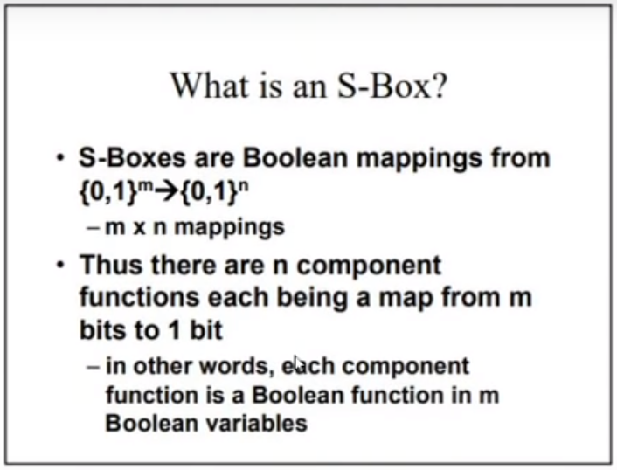

Slide 4
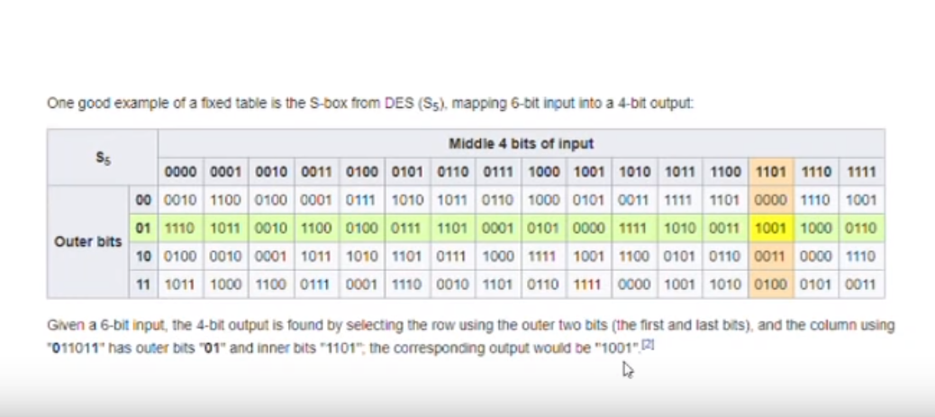
Example

Slide 5


