Slide 1
Data Preprocessing
Data Mining* (CSC521)
Dr M Muzammal
*The instructor thanks Dr Jae-Gil Lee for sharing the lecture slides.

Slide 2


At the Beginning
Transformation
A Werewolf Boy 2012
Descendants of the Sun 2016

Slide 3
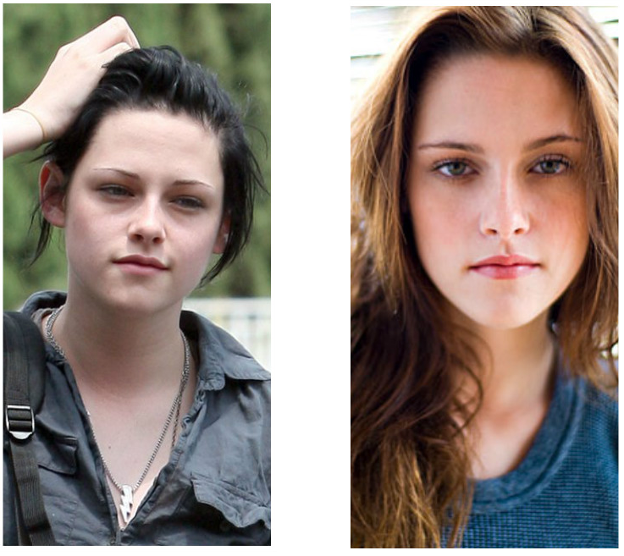
Transformation

Slide 4
Contents
Overview
Data Cleaning
Data Integration
Data Reduction
Data Transformation and Discretization

Slide 5
Data Quality: Why Preprocess the Data?
Measures for data quality: a multidimensional view
Accuracy: correct or wrong, accurate or not
Completeness: not recorded, unavailable, …
Consistency: some modified but some not, dangling, …
Timeliness: timely updated
Believability: trustable
Interpretability: easily understandable

Slide 6

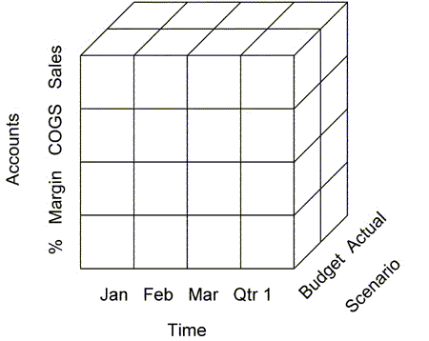
Forms of Data Preprocessing
Data cleaning
Data integration
Attributes
Attributes
A1 A2 A3 A4 A5 A6 … A126
Transactions
A1 A4 A7 … A115
T1
T2
T3
T4
T5
…
T2000
T1
T4
T8
…
T1456
Data reduction
Transactions
Data transformation
-2, 32, 100, 59, 48 -0.02, 0.32, 1.00, 0.59, 0.48

Slide 7
Contents
Overview
Data Cleaning
Data Integration
Data Reduction
Data Transformation and Discretization

Slide 8
Data Cleaning
Data in the real world is dirty
Incomplete: lacking attribute values, lacking certain attributes of interest, or containing only aggregate data
e.g., Occupation=“ ” (missing data)
Noisy: containing noise, errors, or outliers
e.g., Salary=“−10” (an error)
Inconsistent: containing discrepancies in codes or names
Age=“42”, Birthday=“03/07/2010”
Was rating “1, 2, 3”, now rating “A, B, C”
Discrepancy between duplicate records
Intentional (e.g., disguised missing data)
Born in Alabama? ← The first state in the list of U.S.
Born on January 1? ← The first value in the pop-up lists of month and day

Slide 9
Missing Data
Data is not always available
i.e., many tuples have no recorded value for several attributes
Missing data can occur because
The equipment (e.g., sensor) malfunctioned
Information is not collected, e.g., girls decline to give their age and weight
Attributes may not be applicable to all cases, e.g., annual income is not applicable to children
…
Missing data may need to be inferred

Slide 10
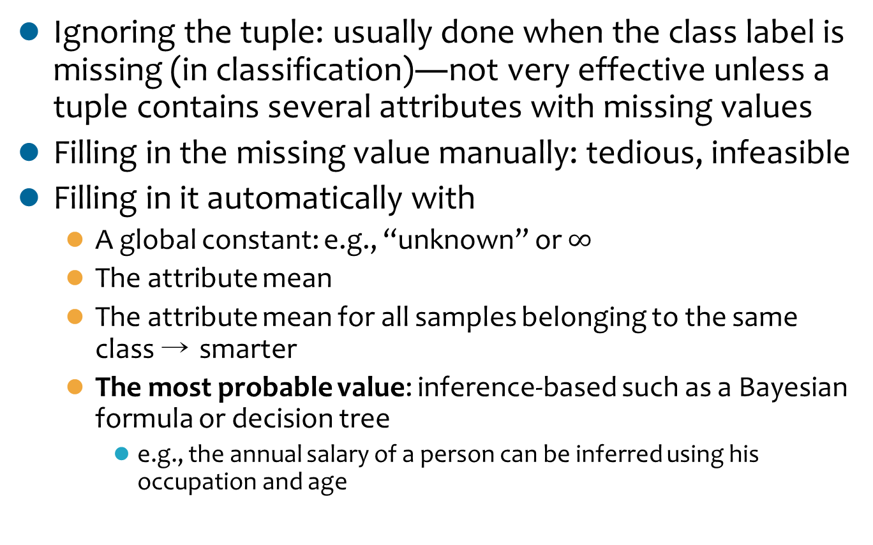
How to Handle Missing Data?
Ignoring the tuple: usually done when the class label is missing (in classification)―not very effective unless a tuple contains several attributes with missing values
Filling in the missing value manually: tedious, infeasible
Filling in it automatically with
A global constant: e.g., “unknown” or $∞$
The attribute mean
The attribute mean for all samples belonging to the same class → smarter
The most probable value: inference-based such as a Bayesian formula or decision tree
e.g., the annual salary of a person can be inferred using his occupation and age
Notes:
The first method is especially poor when the percentage of missing values per attribute varies considerably. By ignoring the tuple, we do not make use of the remaining attributes’ values in the tuple. Such data could have been useful to the task at hand.

Slide 11
Noisy Data
Noise is a random error or variance in a measured variable
Incorrect attribute values may be due to
Faulty data collection instruments
Data transmission problems
Technology limitation
e.g., GPS error: 10 ~ 20 meters
…

Slide 12
How to Handle Noisy Data?
Binning
Partitioning the data into bins after sorting
Smoothing by bin means, by bin median, by bin boundaries, etc.
Regression
Fitting the data into regression functions
Clustering
Detecting and removing outliers
Combined computer and human inspection
Detecting suspicious values and checking by human

Slide 13
An Example of Binning
Smoothing by bin means:
Bin 1: 9, 9, 9
Bin 2: 22, 22, 22
Bin 3: 29, 29, 29
Smoothing by bin boundaries:
Bin 1: 4, 4, 15
Bin 2: 21, 21, 24
Bin 3: 25, 25, 34
Sorted data for price (in dollars):
4, 8, 15, 21, 21, 24, 25, 28, 34
Partition into (equal-frequency) bins:
Bin 1: 4, 8, 15
Bin 2: 21, 21, 24
Bin 3: 25, 28, 34

Slide 14
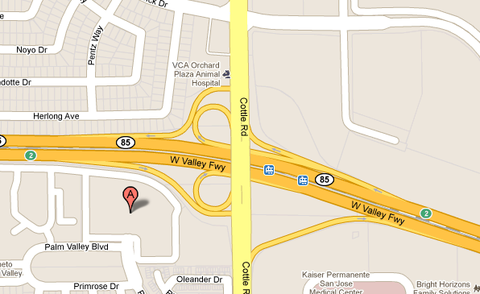
An Example of Handling Noisy Data: Map Matching
Finding a sequence of road segments from noisy GPS data

Slide 15
Contents
Overview
Data Cleaning
Data Integration
Data Reduction
Data Transformation and Discretization

Slide 16
Data Integration (1/2)
Data integration is combining data from multiple sources into a coherent data store, as in data warehouses
There are a number of issues: schema integration, entity resolution, redundancy, inconsistency, …
Data Warehouse
Database 1
Database 2
Database n

Slide 17
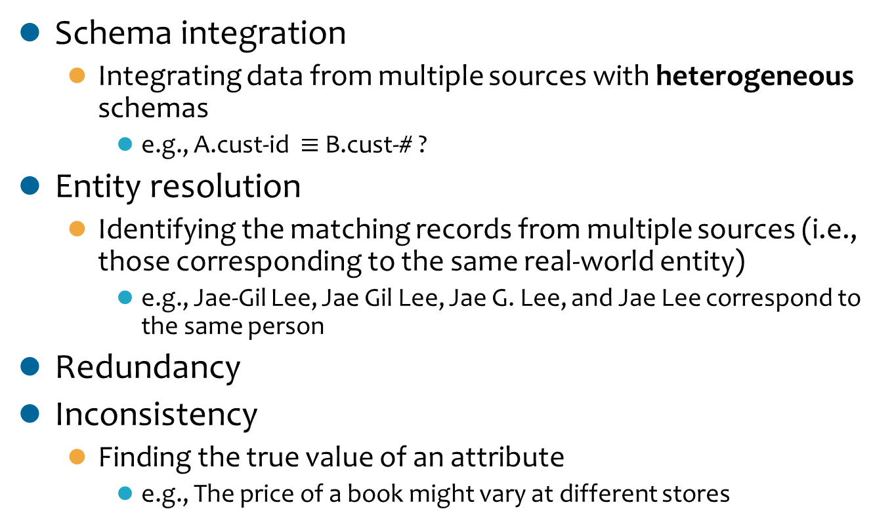
Data Integration (2/2)
Schema integration
Integrating data from multiple sources with heterogeneous schemas
e.g., A.cust-id $≡$B.cust-# ?
Entity resolution
Identifying the matching records from multiple sources (i.e., those corresponding to the same real-world entity)
e.g., Jae-Gil Lee, Jae Gil Lee, Jae G. Lee, and Jae Lee correspond to the same person
Redundancy
Inconsistency
Finding the true value of an attribute
e.g., The price of a book might vary at different stores

Slide 18
Handling Redundancy in Data Integration
Redundant data occur often when integrating multiple databases
Object identification: the same attribute or object may have different names in different databases
Derivable data: one attribute may be a “derived” attribute in another table, e.g., annual revenue
Redundant attributes may be able to be detected by correlation analysis and covariance analysis
χ² (chi-square) test
Pearson’s product moment coefficient
Covariance
…

Slide 19


Pearson Product-Moment Coefficient (1/2)
A measure of the correlation (linear dependence) between two variables X and Y
Giving a value between +1 and −1 inclusive
Being widely used in the sciences as a measure of the strength of linear dependence between two variables
Defined as the covariance of the two variables divided by the product of their standard deviations
Population
Sample

Slide 20
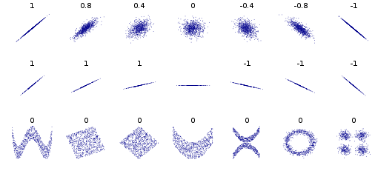
Pearson Product-Moment Coefficient (2/2)
Correlation examples

Slide 21
Contents
Overview
Data Cleaning
Data Integration
Data Reduction
Data Transformation and Discretization

Slide 22
Data Reduction
A database/data warehouse may store petabytes of data, and complex data analysis may take a very long time to run on the complete data set
Data reduction is obtaining a reduced representation of the data set that is much smaller in volume but yet produces the same (or almost the same) analytical results

Slide 23
Strategies
Dimensionality reduction
Wavelet transform
Principal components analysis (PCA)
Feature subset selection, feature creation
Numerosity reduction (some simply call it data reduction)
Regression
Histograms, clustering, sampling
Data cube aggregation
Data compression

Slide 24
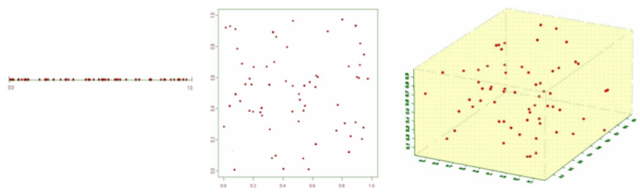
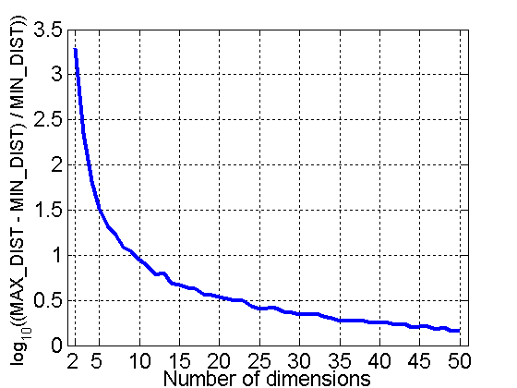
Motivation for Dimensionality Reduction
Curse of dimensionality
When dimensionality increases, data becomes increasingly sparse in the space that it occupies
Definitions of density and distance between points, which is critical for clustering and outlier detection, become less meaningful
1-dimension 2-dimension 3-dimension
Randomly generate 500 points
Compute difference between max and min distance between any pair of points

Slide 25
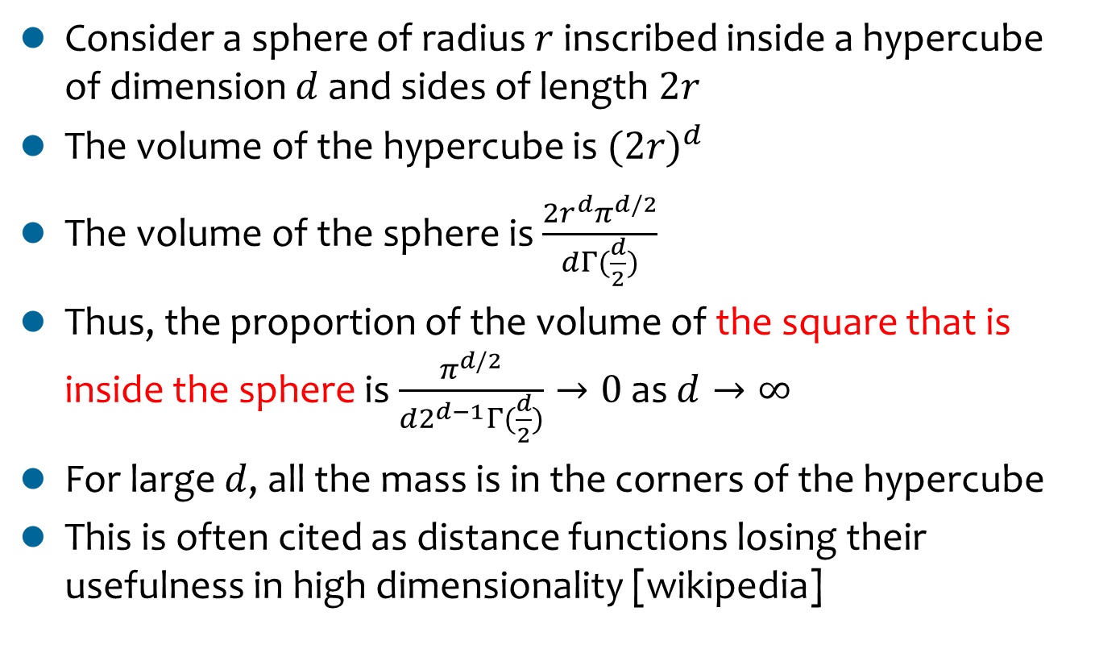
Curse of Dimensionality
r
Consider a sphere of radius $r$inscribed inside a hypercube of dimension $d$and sides of length $2r$
The volume of the hypercube is ${(2r)}^{d}$
The volume of the sphere is $\frac{{2r}^{d}π^{d/2}}{dΓ(\frac{d}{2})}$
Thus, the proportion of the volume of the square that is inside the sphere is $\frac{π^{d/2}}{d2^{d−1}Γ(\frac{d}{2})}→0$as $d→∞$
For large $d$, all the mass is in the corners of the hypercube
This is often cited as distance functions losing their usefulness in high dimensionality [wikipedia]
Notes:
http://en.wikipedia.org/wiki/N-sphere

Slide 26
Data Reduction 1: Dimensionality Reduction
Purposes
To avoid curse of dimensionality
To reduce the amount of time and memory required by data mining algorithms
To allow data to be more easily visualized
Possibly, to help eliminate irrelevant features or reduce noise
Techniques
Wavelet transform
Principal component analysis (PCA)
Feature selection

Slide 27
Principal Component Analysis (PCA) (1/3)
Dimensionality Reduction
A statistical procedure that uses orthogonal transformation to convert a set of observations of possibly correlated variables into a set of values of linearly uncorrelated variables called principal components
The number of principal components is less than or equal to the number of original variables ← Dimensionality reduction
This transformation is defined in such a way that the first principal component has the largest possible variance, and each succeeding component in turn has the highest variance possible under the constraint that it is orthogonal to (i.e., uncorrelated with) the preceding components

Slide 28
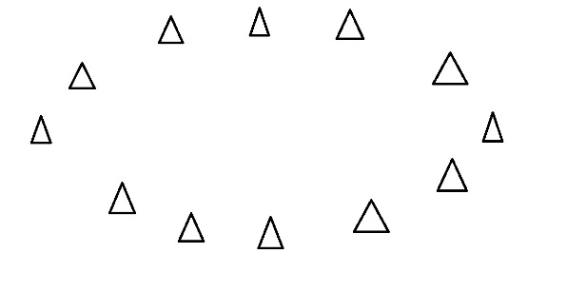
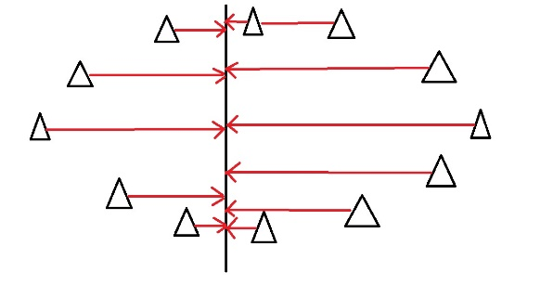
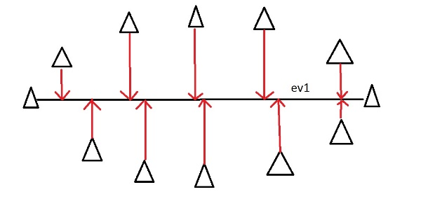
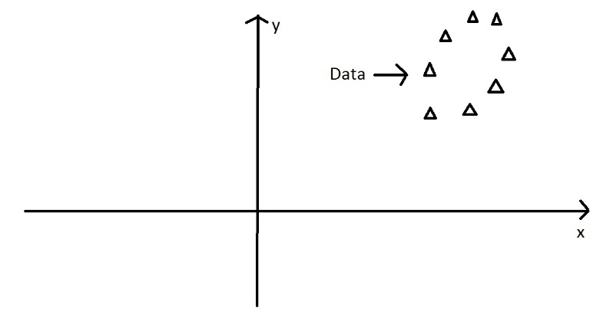
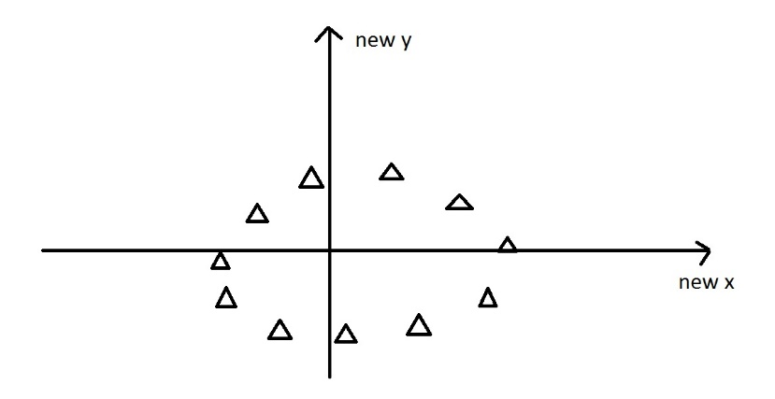
Principal Component Analysis (PCA) (2/3)
Dimensionality Reduction
<
vs.
An example of the direction that has the largest variance
Eigenvectors and eigenvalues
An eigenvector: a direction
An eigenvalue: a number, telling the variance of the data in that direction
e.g.,
Notes:
From http://georgemdallas.wordpress.com/2013/10/30/principal-component-analysis-4-dummies-eigenvectors-eigenvalues-and-dimension-reduction/

Slide 29
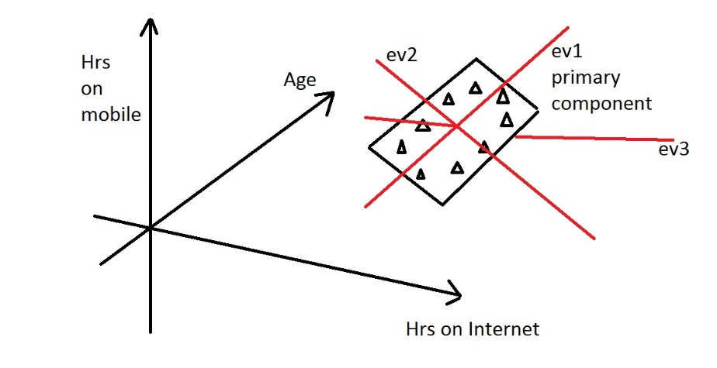
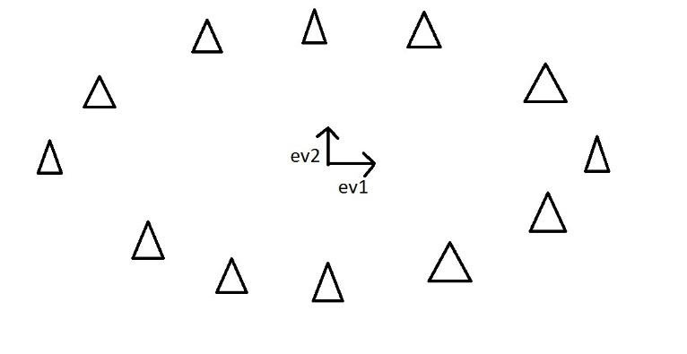
Principal Component Analysis (PCA) (3/3)
Dimensionality Reduction
Dimensionality reduction
e.g.,
ev1 is the first eigenvector, which has the biggest eigenvalue ← the principal component
ev2 is the second eigenvector, which has a non-zero eigenvalue
ev3 is the third eigenvector, which has an eigenvalue of zero
⇒ We can discard the eigenvectors whose eigenvalue is very small, in order to make the data set simpler

Slide 30
Attribute Subset Selection (Feature Selection)
Dimensionality Reduction
Another way to reduce dimensionality of data by removing redundant and irrelevant features
Redundant features
Duplicating much or all of the information contained in one or more other attributes
e.g., the purchase price of a product and the amount of sales tax paid
Irrelevant features
Containing no information that is useful for the data mining task at hand
e.g., students' ID is often irrelevant to the task of predicting students' GPA

Slide 31
Heuristics in Attribute Subset Selection (1/2)
Dimensionality Reduction
Stepwise forward selection
Repeatedly picking the best single-attribute
Stepwise backward elimination
Repeatedly eliminating the worst attribute
Combination of the two heuristics
Decision tree induction
Using the attributes appeared in the decision tree

Slide 32
Heuristics in Attribute Subset Selection (2/2)
Dimensionality Reduction
Forward selection Backward elimination Decision tree induction
Initial attribute set:
{A1, A2, A3, A4, A5, A6}
Initial attribute set:
{A1, A2, A3, A4, A5, A6}
Initial attribute set:
{A1, A2, A3, A4, A5, A6}
Reduced attribute set: {A1, A4, A6}
Initial reduced set:
{}
{A1}
{A1, A4}
Reduced attribute set: {A1, A4, A6}
{A1, A3, A4, A5, A6}
{A1, A4, A5, A6}
Reduced attribute set: {A1, A4, A6}
A4?
Y
N
A1?
A6?
Y N Y N
C1
C2
C3
C4

Slide 33
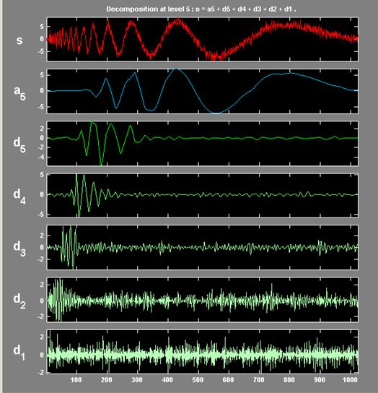
Discrete Wavelet Transform (DWT)
Dimensionality Reduction
A wavelet is a mathematical function used to divide a given function or continuous-time signal into different scale components
The discrete wavelet transform (DWT) is any wavelet transform for which the wavelets are discretely sampled

Slide 34
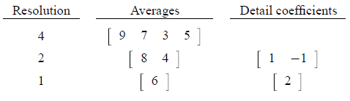
Haar Wavelet (1/2)
Dimensionality Reduction
One-dimensional Haar wavelet transform
The pairwise average
The difference of the second of the averaged values from the computed pairwise average
e.g.,
Original data = [9 7 3 5] ⇒ Wavelet transform = [6 2 1 -1]
Note that we can reconstruct the original data from the wavelet transform

Slide 35
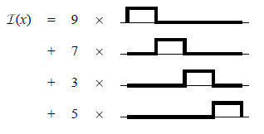
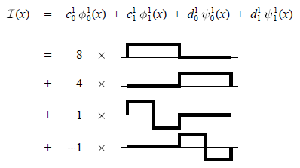
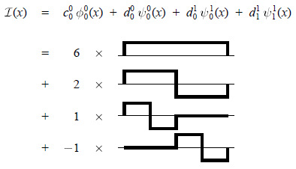
Haar Wavelet (2/2)
Dimensionality Reduction
A graphical representation

Slide 36
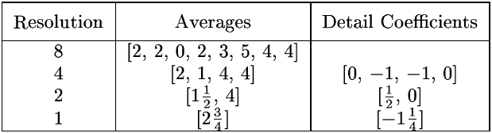
Wavelet Compression
Dimensionality Reduction
[2, 2, 0, 2, 3, 5, 4, 4] ⇒ [2³/₄, -1¹/₄, ¹/₂, 0, 0, -1, -1, 0]
Storing the wavelet transform instead of the original data has a number of advantages. One advantage of the wavelet transform is that often a large number of the detail coefficients turn out to be very small in magnitude. Truncating, or removing, these small coefficients introduces only small errors in the reconstructed data, giving a form of “lossy” compression.

Slide 37
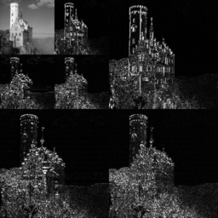
Image Compression Using the DWT
Dimensionality Reduction
An example of the 2D discrete wavelet transform that is used in JPEG2000. The original image is high-pass filtered, yielding the three large images, each describing local changes in brightness (details) in the original image. It is then low-pass filtered and downscaled, yielding an approximation image; this image is high-pass filtered to produce the three smaller detail images, and low-pass filtered to produce the final approximation image in the upper-left. [Wikipedia]

Slide 38
Data Reduction 2: Numerosity Reduction
Reducing the data volume by choosing alternative, smaller forms of data representation
Parametric methods (e.g., regression)
Assume the data fits in some model, estimate the model parameters, store only the parameters, and discard the data (except possible outliers)
e.g., linear regression Y = w X + b
Non-parametric methods
Do not assume models
Major families: histograms, clustering, sampling, …

Slide 39
Regression Analysis
Numerosity Reduction
Regression analysis includes any techniques for the modeling and analysis of numerical data consisting of values of a dependent variable and of one or more independent variables
The parameters are estimated so as to give a “best fit” of the data
Most commonly, the best fit is evaluated by using the least squares method, but other criteria have also been used

Slide 40
Linear Regression
Numerosity Reduction
Y1
Y1’
y = x + 1
Y = w X + b
Two regression coefficients, w and b, specify the line and are to be estimated by using the data at hand (Y1, Y2, …, X1, X2, …)
X1
x

Slide 41
Sampling
Numerosity Reduction
Definition: selection of a subset of individual observations within a population of individuals intended to yield some knowledge about the population
Goal: allowing a mining algorithm to run in complexity that is potentially sub-linear to the size of the data
Key principle: choosing a representative subset of the data
Simple random sampling may have very poor performance in the presence of skew

Slide 42
Types of Sampling
Numerosity Reduction
Simple random sampling
There is an equal probability of selecting any particular item
Sampling without replacement
Once an object is selected, it is removed from the population
Sampling with replacement
A selected object is not removed from the population
In sampling with replacement, the same object can be picked up more than once
Stratified sampling
The population is divided into non-overlapping groups (i.e., strata)

Slide 43
Stratified Sampling
Numerosity Reduction
In general, the size of the sample in each stratum is taken in proportion to the size of the stratum ← called proportional allocation
e.g., suppose that in a company there are staff members as below, and we are asked to sample 40 staffs
Male, full-time | 90
Male, part-time | 18
Female, full-time | 9
Female, part-time | 63
Total | 180
= (90 x 40) / 180 = 20
= (18 x 40) / 180 = 4
= (9 x 40) / 180 = 2
= (63 x 40) / 180 = 14

Slide 44

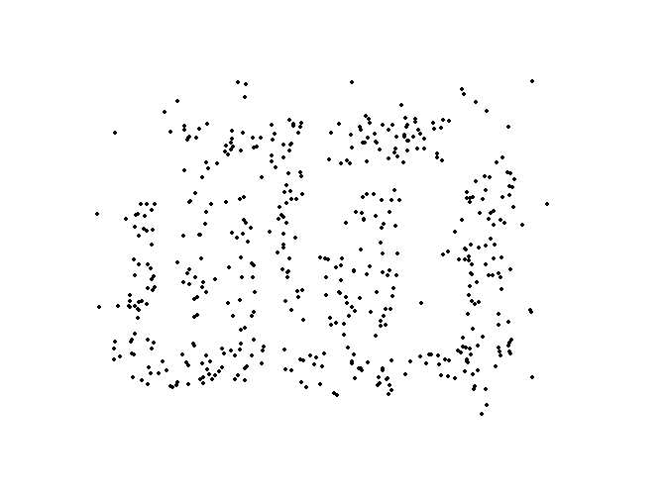
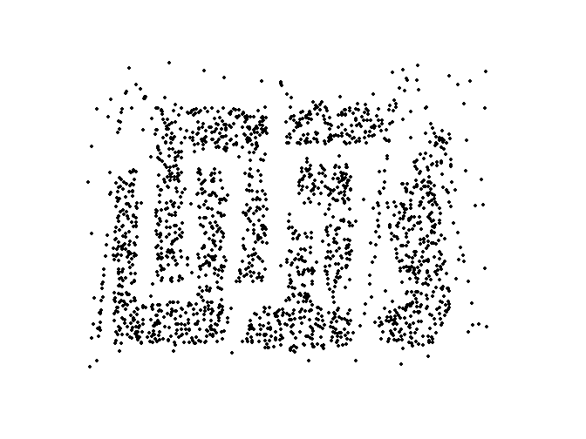
Sampling Size
Numerosity Reduction
8000 points 2000 Points 500 Points

Slide 45
Data Cube Aggregation
Numerosity Reduction
The lowest level of a data cube (base cuboid)
The aggregated data for an individual entity of interest
e.g., the amount of sales per day
Multiple levels of aggregation in data cubes
Further reducing the size of data to deal with
e.g., day → week → month → quarter → year
Referencing appropriate levels
Using the smallest representation which is enough to solve the task

Slide 46
Data Reduction 3: Data Compression
Data compression is the process of encoding information using fewer bits than the original representation would use
It was originally developed for reducing the data size, but it is important also for improving the query performance
Operations can be performed directly on compressed data, and the amount of disk I/O’s is much reduced
Almost all data warehousing systems compress data when loading the data

Slide 47
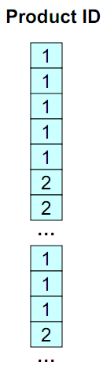
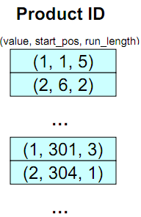
Run-Length Encoding
Data Compression
Runs of data (i.e., sequences in which the same data value occurs in many consecutive data elements) are stored as a single data value and count, rather than as the original run

Slide 48
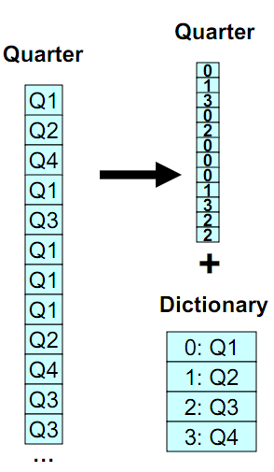
Dictionary Encoding
Data Compression
For each unique value, a separate dictionary entry is created; the index of the dictionary entry is used instead of the value
In the right figure, only two bits are required for each value

Slide 49
Contents
Overview
Data Cleaning
Data Integration
Data Reduction
Data Transformation and Discretization

Slide 50
Data Transformation
Definition
A function that maps the entire set of values of a given attribute to a new set of replacement values such that each old value can be identified with one of the new values
Methods
Normalization
Min-max normalization
z-score normalization
Discretization: concept hierarchy climbing
…

Slide 51
Normalization
Min-max normalization: [new_minA, new_maxA]
e.g., let the income range $12,000 to $98,000 normalized to [0.0, 1.0]. Then, $73,000 is mapped to
Z-score normalization (μ: mean, σ: standard deviation):
e.g., let μ = 54,000, σ = 16,000. Then,

Slide 52
Data Discretization
Definition
Reducing the number of values for a given continuous attribute by dividing the range of the attribute into intervals and replacing actual data values with the interval labels
Purposes
To find informative cut-off points in the data
e.g., finding that the cut-off for blood's acidity is 7.3 may mean something to physicians
To enable the use of some learning algorithms
To reduce the data size

Slide 53
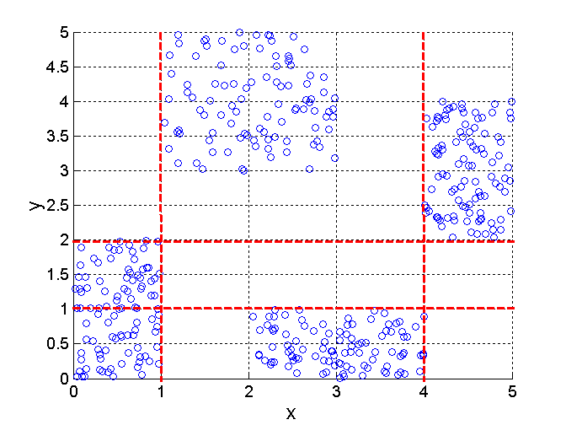
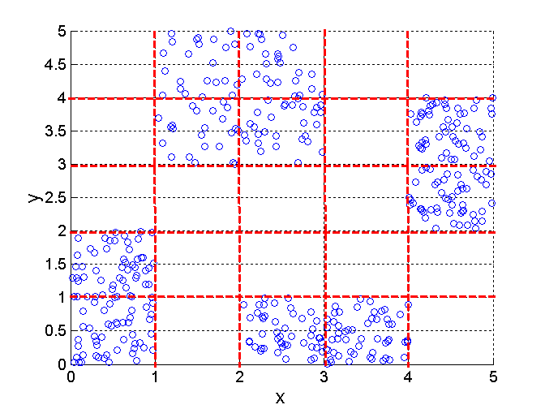
Discretization Using Class Labels
3 categories for both x and y
5 categories for both x and y
Entropy-based discretization can be used

Slide 54
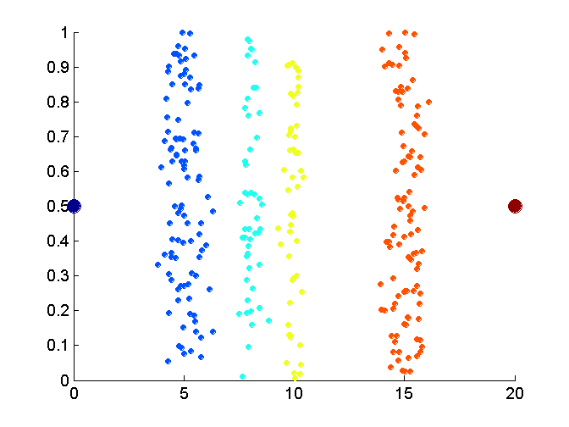
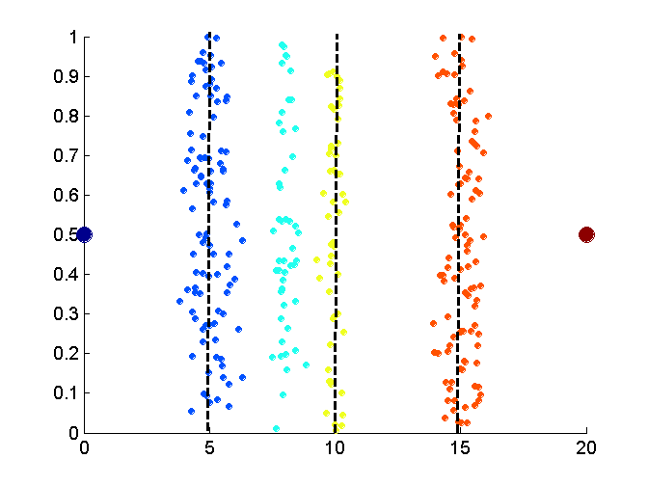
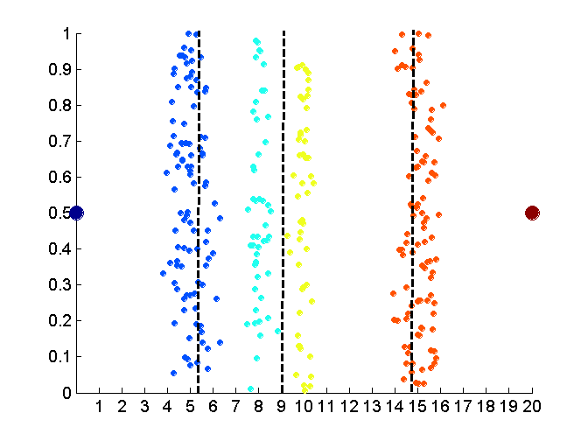
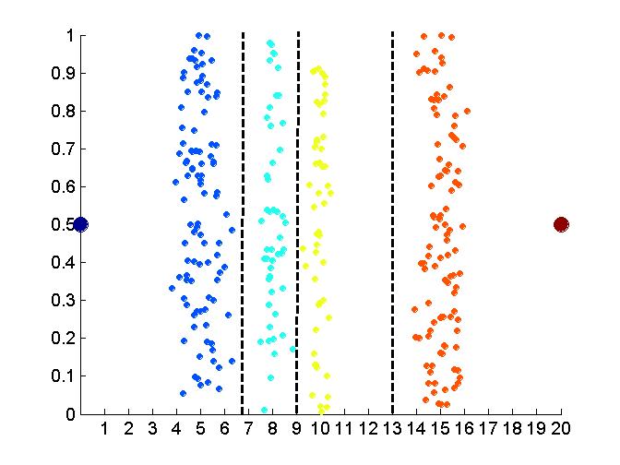
Discretization Without Using Class Labels
Data
Equal interval width
Equal frequency
K-means

Slide 55
Concept Hierarchy Generation
Concept hierarchy organizes concepts (i.e., attribute values) hierarchically and is usually associated with each dimension in a data warehouse
Concept hierarchies facilitate drilling and rolling in data warehouses to view data in multiple granularity
Concept hierarchy formation: Recursively reduce the data by collecting and replacing low level concepts (such as numeric values for age) by higher level concepts (such as youth, adult, or senior)
Concept hierarchies can be explicitly specified by domain experts and/or data warehouse designers
Concept hierarchy can be automatically formed for both numeric and nominal data

Slide 56
Concept Hierarchy Generation for Nominal Data
Specification of a partial/total ordering of attributes explicitly at the schema level by users or experts
street < city < state < country
Specification of a hierarchy for a set of values by explicit data grouping
e.g., {Urbana, Champaign, Chicago} < Illinois
Specification of only a partial set of attributes
e.g., only street < city, not others
Automatic generation of hierarchies (or attribute levels) by the analysis of the number of distinct values
e.g., for a set of attributes: {street, city, state, country}

Slide 57
Thank You!
Any Questions?

