Slide 1
Association Analysis (Basic)
Data Mining* (CSC521)
Dr M Muzammal
*The instructor thanks Dr Jae-Gil Lee for sharing the lecture slides.

Slide 2
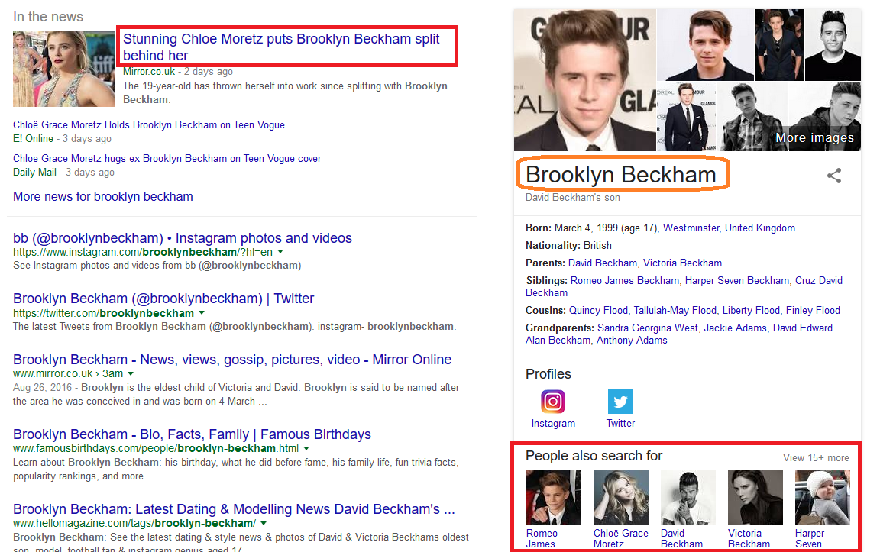
Associations

Slide 3
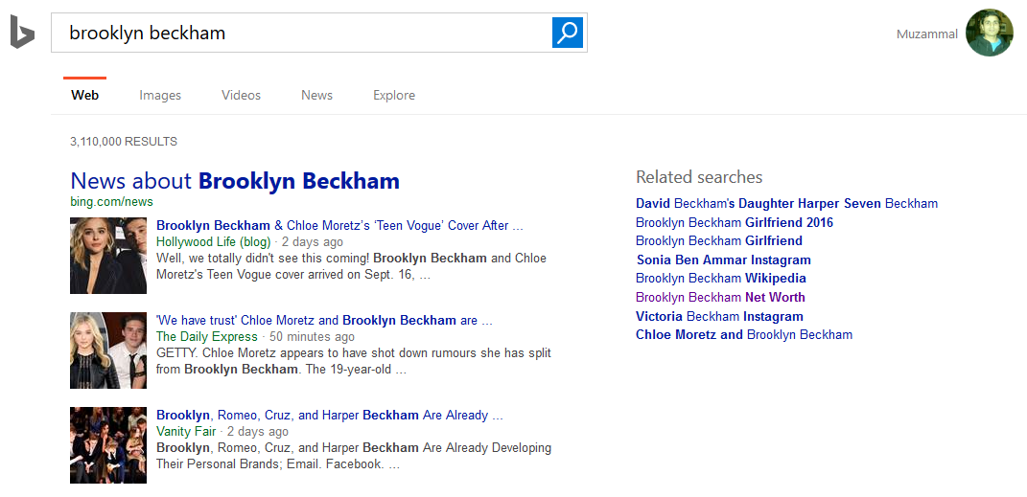
Associations…

Slide 4
Contents
Basic Concepts
Frequent Itemset Mining Methods
Apriori
FP-Growth
Maximal, Closed Frequent Itemsets
Rule Generation
Interestingness Measures

Slide 5
Overview
First proposed by Agrawal, Imielinski, and Swami in 1993
Motivation: finding inherent regularities in data
What products were often purchased together?— Beer and diapers?
What are the subsequent purchases after buying a PC?
What kinds of DNA are sensitive to this new drug?
Can we automatically classify Web documents?
Applications
Basket data analysis, cross-marketing, catalog design, sale campaign analysis, Web log (click stream) analysis, and DNA sequence analysis

Slide 6
Association Rule Mining
Market-Basket transactions
Given a set of transactions, we find rules that will predict the occurrence of an item based on the occurrences of other items in the transaction
{Diaper} → {Beer} {Milk, Bread} → {Eggs, Coke} {Beer, Bread} → {Milk}
Association Rules

Slide 7
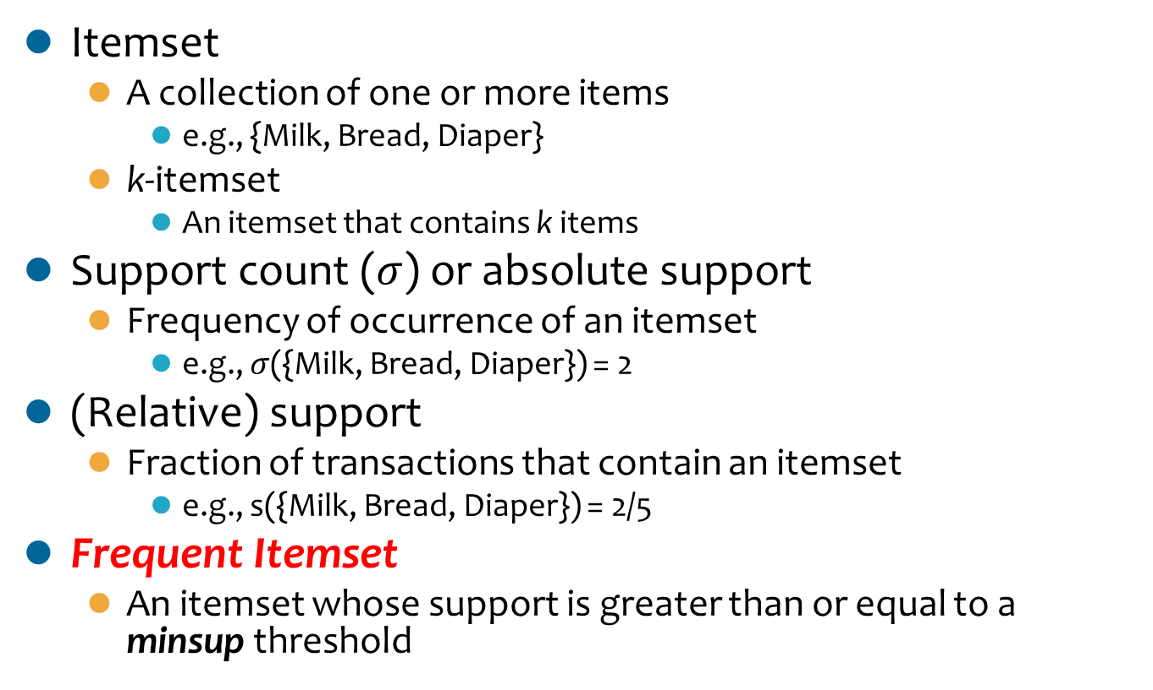
Definition: Frequent Itemset
Itemset
A collection of one or more items
e.g., {Milk, Bread, Diaper}
k-itemset
An itemset that contains k items
Support count ($σ$) or absolute support
Frequency of occurrence of an itemset
e.g., $σ$({Milk, Bread, Diaper}) = 2
(Relative) support
Fraction of transactions that contain an itemset
e.g., s({Milk, Bread, Diaper}) = 2/5
Frequent Itemset
An itemset whose support is greater than or equal to a minsup threshold

Slide 8
Definition: Association Rule
Association Rule
An implication expression of the form X→Y, where X and Y are itemsets
e.g., {Milk, Diaper}→{Beer}
Rule Evaluation Metrics
Support (s)
Fraction of transactions that contain both X and Y
Confidence (c)
Measures how often items in Y appear in transactions that contain X
Example:

Slide 9
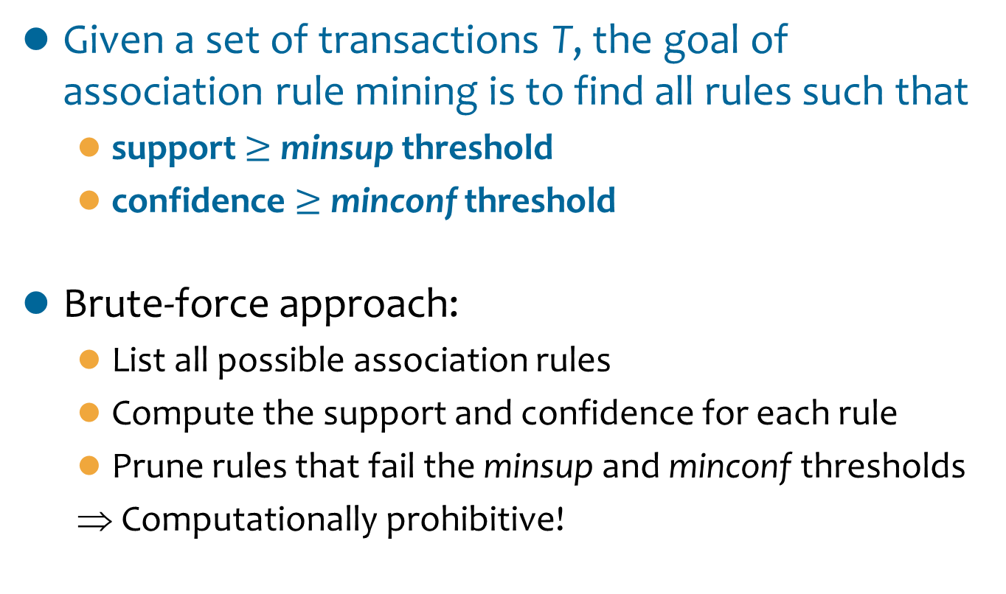
Association Rule Mining Task
Given a set of transactions T, the goal of association rule mining is to find all rules such that
support $≥$minsupthreshold
confidence $≥$minconf threshold
Brute-force approach:
List all possible association rules
Compute the support and confidence for each rule
Prune rules that fail the minsup and minconfthresholds
⇒ Computationally prohibitive!

Slide 10
Mining Association Rules (1/2)
Example of Rules:
{Milk,Diaper} → {Beer} (s=0.4, c=0.67) {Milk,Beer} → {Diaper} (s=0.4, c=1.0)
{Diaper,Beer} → {Milk} (s=0.4, c=0.67)
{Beer} → {Milk,Diaper} (s=0.4, c=0.67) {Diaper} → {Milk,Beer} (s=0.4, c=0.5)
{Milk} → {Diaper,Beer} (s=0.4, c=0.5)
Observations:
All the above rules are binary partitions of the same itemset: {Milk, Diaper, Beer}
Rules originating from the same itemset have identical support but can have different confidence
Thus, we may decouple the support and confidence requirements

Slide 11
Mining Association Rules (2/2)
Frequent Pattern Mining
Generating all patterns whose support at least minsup
Association Rule Generation
Generating high confidence rules from each frequent itemset, where each rule is a binary partitioning of a frequent itemset
Frequent itemset generation is still computationally expensive

Slide 12
Discussion
Clickstream
A clickstream is the recording of what a computer user clicks on while Web browsing or using another software application
A clickstream is a series of page requests, every page requested generates a signal; the main point of clickstream tracking is to give webmasters insight into what visitors on their site are doing
How is association analysis helpful for clickstream analysis?

Slide 13
Contents
Basic Concepts
Frequent Itemset Mining Methods
Apriori
FP-Growth
Maximal, Closed Frequent Itemsets
Rule Generation
Interestingness Measures

Slide 14
Candidate Itemsets
Given d items, there are 2^{d} possible candidate itemsets

Slide 15
Frequent Itemset Generation
Brute-force approach:
Each itemset in the lattice is a candidate frequent itemset
We count the support of each candidate by scanning the database
We match each transaction against every candidate
Complexity ~ O(NMw) ⇒ Expensive since M = 2^{d} !!!

Slide 16
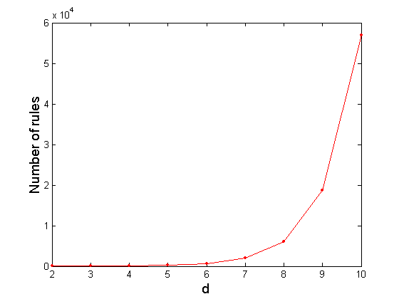
Computational Complexity
Given d unique items:
Total number of itemsets = 2^{d}
Total number of possible association rules:
If d = 6, R = 602 rules

Slide 17
Possible Improvements
Reducing the number of candidates (M)
Complete search: M=2^{d}
Using pruning techniques to reduce M
Reducing the number of transactions (N)
Reducing size of N as the size of itemset increases
Being used by vertical-based mining algorithms
Reducing the number of comparisons (NM)
Using efficient data structures (e.g., hash tables) to store the candidates or transactions
No need to match every candidate against every transaction

Slide 18
Contents
Basic Concepts
Frequent Itemset Mining Methods
Apriori
FP-Growth
Maximal, Closed Frequent Itemsets
Rule Generation
Interestingness Measures

Slide 19
Reducing Number of Candidates
Apriori principle or downward closure property
If an itemset is frequent, then all of its subsets must also be frequent
Apriori principle holds due to the following property of the support measure:
Support of an itemset never exceeds the support of its subsets
This is known as the anti-monotone property of support

Slide 20
Apriori Principle (1/2)
Found to be Infrequent
Pruned supersets

Slide 21
Apriori Principle (2/2)
Items (1-itemsets)
Pairs (2-itemsets)
(No need to generate candidates involving Coke or Eggs)
Minimum Support = 3
If every subset is considered,
⁶C₁ + ⁶C₂ + ⁶C₃ = 41
With support-based pruning,
6 + 6 + 1 = 13
Triplets (3-itemsets)

Slide 22
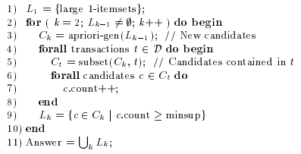
Algorithm Apriori
Pseudo-code
L_{k}: { frequent k-itemsets }
C_{k}: { candidate k-itemsets }

Slide 23


Candidate Generation
1. Self-joining L_{k-1}
2. Pruning
An Example
L₃ = {abc, abd, acd, ace, bcd}
Self-joining: L₃*L₃
abcd from abc and abd
acde from acd and ace
Pruning:
acde is removed because ade is not in L₃
C₄ = {abcd}

Slide 24
Reducing Number of Comparisons
Support counting
Scan the database of transactions to determine the support of each candidate itemset
To reduce the number of comparisons, store the candidates in a hash structure
Instead of matching each transaction against every candidate, match it against candidates contained in the hashed buckets

Slide 25
Generating the Hash Tree (1/4)
Suppose you have 15 candidate itemsets of length 3:
{1 4 5}, {1 2 4}, {4 5 7}, {1 2 5}, {4 5 8}, {1 5 9}, {1 3 6}, {2 3 4}, {5 6 7}, {3 4 5}, {3 5 6}, {3 5 7}, {6 8 9}, {3 6 7}, {3 6 8}
You need:
Hash function
Max leaf size: max number of itemsets stored in a leaf node (if number of candidate itemsets exceeds max leaf size, split the node)
2 3 4
5 6 7
Hash function
3,6,9
1 4 5
3 4 5
3 5 6
3 5 7
6 8 9
3 6 7
3 6 8
1,4,7
1 3 6
2,5,8
1 2 4
4 5 7
1 2 5
4 5 8
1 5 9

Slide 26
Generating the Hash Tree (2/4)
Hash Function
Candidate Hash Tree
Hash on 1, 4 or 7
i-th level checks
i-th item in each itemset
1,4,7
3,6,9
2,5,8
2 3 4
5 6 7
1 4 5
1 3 6
3 4 5
3 5 6
3 6 7
3 5 7
3 6 8
1 2 4
1 5 9
6 8 9
1 2 5
4 5 7
4 5 8

Slide 27
Generating the Hash Tree (3/4)
Hash Function
Candidate Hash Tree
1,4,7
3,6,9
2,5,8
Hash on 2, 5 or 8
2 3 4
5 6 7
1 4 5
1 3 6
3 4 5
3 5 6
3 6 7
3 5 7
3 6 8
1 2 4
1 5 9
6 8 9
1 2 5
4 5 7
4 5 8

Slide 28
Generating the Hash Tree (4/4)
Hash Function
Candidate Hash Tree
Hash on 3, 6 or 9
1,4,7
3,6,9
2,5,8
2 3 4
5 6 7
1 4 5
1 3 6
3 4 5
3 5 6
3 6 7
3 5 7
3 6 8
1 2 4
1 5 9
6 8 9
1 2 5
4 5 7
4 5 8

Slide 29
Subset Operation
Given a transaction t, what are the possible subsets of size 3?

Slide 30
Subset Operation Using the Hash Tree (1/3)
1 2 3 5 6
transaction
Hash Function
1 +
2 3 5 6
2 +
3 5 6
1,4,7
3,6,9
3 +
5 6
2,5,8
2 3 4
5 6 7
1 4 5
1 3 6
3 4 5
3 5 6
3 6 7
3 5 7
3 6 8
1 2 4
1 2 5
1 5 9
6 8 9
4 5 7
4 5 8

Slide 31
Subset Operation Using the Hash Tree (2/3)
1 2 3 5 6
transaction
Hash Function
1 +
2 3 5 6
2 +
3 5 6
1,4,7
3,6,9
1 2 +
3 5 6
3 +
5 6
2,5,8
1 3 +
5 6
2 3 4
1 5 +
6
5 6 7
1 4 5
1 3 6
3 4 5
3 5 6
3 6 7
3 5 7
3 6 8
1 2 4
1 2 5
1 5 9
6 8 9
4 5 7
4 5 8

Slide 32
Subset Operation Using the Hash Tree (3/3)
1 2 3 5 6
transaction
Hash Function
1 +
2 3 5 6
2 +
3 5 6
1,4,7
3,6,9
1 2 +
3 5 6
3 +
5 6
2,5,8
1 3 +
5 6
2 3 4
1 5 +
6
5 6 7
1 4 5
1 3 6
3 4 5
3 5 6
3 6 7
3 5 7
3 6 8
1 2 4
1 2 5
1 5 9
6 8 9
4 5 7
4 5 8
Match transaction against 9 out of 15 candidates

Slide 33
Factors Affecting Complexity
Choice of minimum support threshold
Lowering the support threshold results in more frequent itemsets; this may increase the number of candidates and max length of frequent itemsets
Dimensionality (number of items) of the data set
More space is needed to store the support count of each item
If number of frequent items also increases, both computation and I/O costs may also increase
Size of database
Since Apriori makes multiple passes, run time of the algorithm may increase with the number of transactions
Average transaction width
Transaction width increases with denser data sets; this may increase max length of frequent itemsets and traversals of hash tree (the number of subsets in a transaction increases with its width)

Slide 34
Contents
Basic Concepts
Frequent Itemset Mining Methods
Apriori
FP-Growth
Maximal, Closed Frequent Itemsets
Rule Generation
Interestingness Measures

Slide 35
Motivation
Multiple database scans are costly
Mining long patterns needs many passes of scanning and generates lots of candidates
Bottleneck: candidate-generation-and-test
Can we avoid candidate generation?

Slide 36
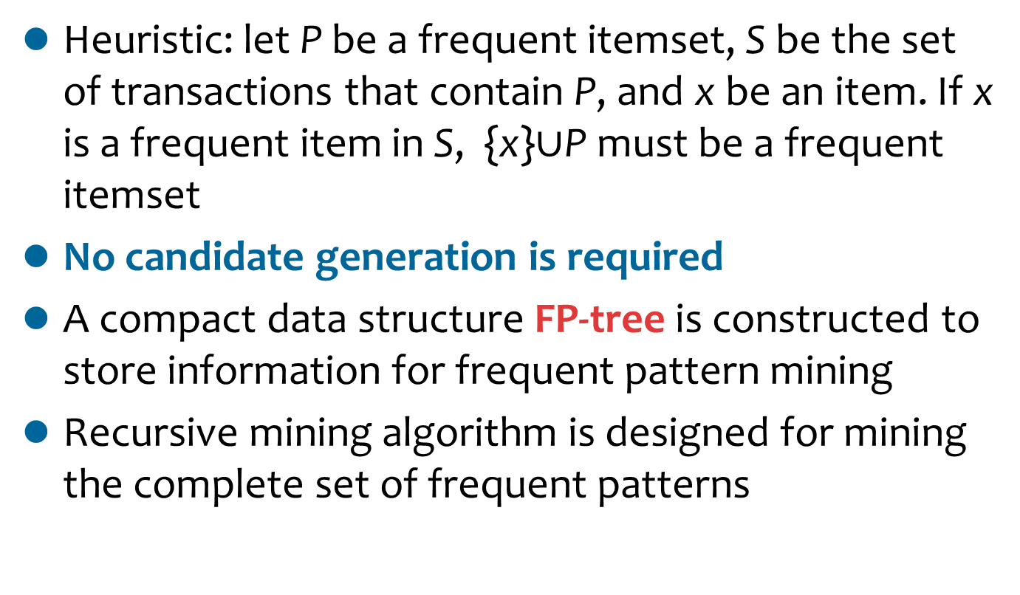
FP-Growth: Frequent-Pattern Mining without Candidate Generation
Heuristic: let P be a frequent itemset, S be the set of transactions that contain P, and x be an item. If x is a frequent item in S, {x}$∪$P must be a frequent itemset
No candidate generation is required
A compact data structure FP-tree is constructed to store information for frequent pattern mining
Recursive mining algorithm is designed for mining the complete set of frequent patterns

Slide 37
Intuition behind FP-Growth
Universe
S
P
x

Slide 38
FP-Tree (1/4)
TID Items bought (ordered) frequent items
100 {f, a, c, d, g, i, m, p} {f, c, a, m, p}
200 {a, b, c, f, l, m, o} {f, c, a, b, m}
300 {b, f, h, j, o, w} {f, b}
400 {b, c, k, s, p} {c, b, p}
500 {a, f, c, e, l, p, m, n} {f, c, a, m, p}
min_support = 3
Scan the database once, find frequent 1-itemsets (single item patterns)
Sort the frequent items in frequency descending order, f-list
Scan the DB again, construct the FP-tree
F-list = f-c-a-b-m-p

Slide 39
FP-Tree (2/4)
root
{}
Transaction
Database
TID Items
100 f,a,c,d,g,i,m,p
Header Table
Node
Item count head
f 1
c 1
a 1
m 1
p 1
f:1
c:1
a:1
m:1
p:1
Scanning the transaction with TID=100

Slide 40
FP-Tree (3/4)
root
{}
Transaction
Database
TID Items
200 f,c,a,b,m
Header Table
Node
Item count head
f 1
c 1
a 1
b 1
m 2
p 1
f:2
c:2
a:2
m:1
b:1
p:1
m:1
Scanning the transaction with TID=200

Slide 41
FP-Tree (4/4)
Frequent 1-items in frequency descending order: f,c,a,b,m,p
Transaction
Database
TID Items
100 f,a,c,d,g,i,m,p
200 a,b,c,f,l,m,o
300 b,f,h,j,o
400 b,c,k,s,p
500 a,f,c,e,l,p,m,n
Min support = 3
{}
Header Table
Node
Item count head
f 1
c 2
a 1
b 3
m 2
p 2
f:4
c:1
c:3
b:1
b:1
a:3
p:1
m:2
b:1
p:2
m:1
The final FP-tree

Slide 42
FP-Tree Construction
Construction needs to scan the database only twice (once for finding frequent 1-itemsets, once for inserting each transaction into the tree)
Subsequent mining is based on the FP-tree which is very compact (not using the database)

Slide 43
How to Mine an FP-Tree?
Step 1: forming conditional pattern bases
Step 2: constructing conditional FP-trees
Step 3: recursively mining conditional FP-trees

Slide 44
Conditional Pattern Base
{}
pattern_base | α
A sub database which consists of the set of prefix paths in the FP-tree with a frequent itemset α as a co-occurring suffix pattern
A partition of frequent patterns
Example:
{m} is a frequent itemset
{m}’s conditional pattern base:
<f,c,a>: support =2
<f,c,a,b>: support = 1
f:4
c:1
c:3
b:1
b:1
a:3
p:1
m:2
b:1
p:2
m:1

Slide 45
Conditional Pattern Tree
FP-tree | α
A small FP-tree on pattern_base | α
Example:
{m} is a frequent itemset
{m}’s conditional pattern base:
<f,c,a>: support =2
<f,c,a,b>: support = 1
{m}’s conditional pattern tree
{}
f:3
c:3
a:3

Slide 46
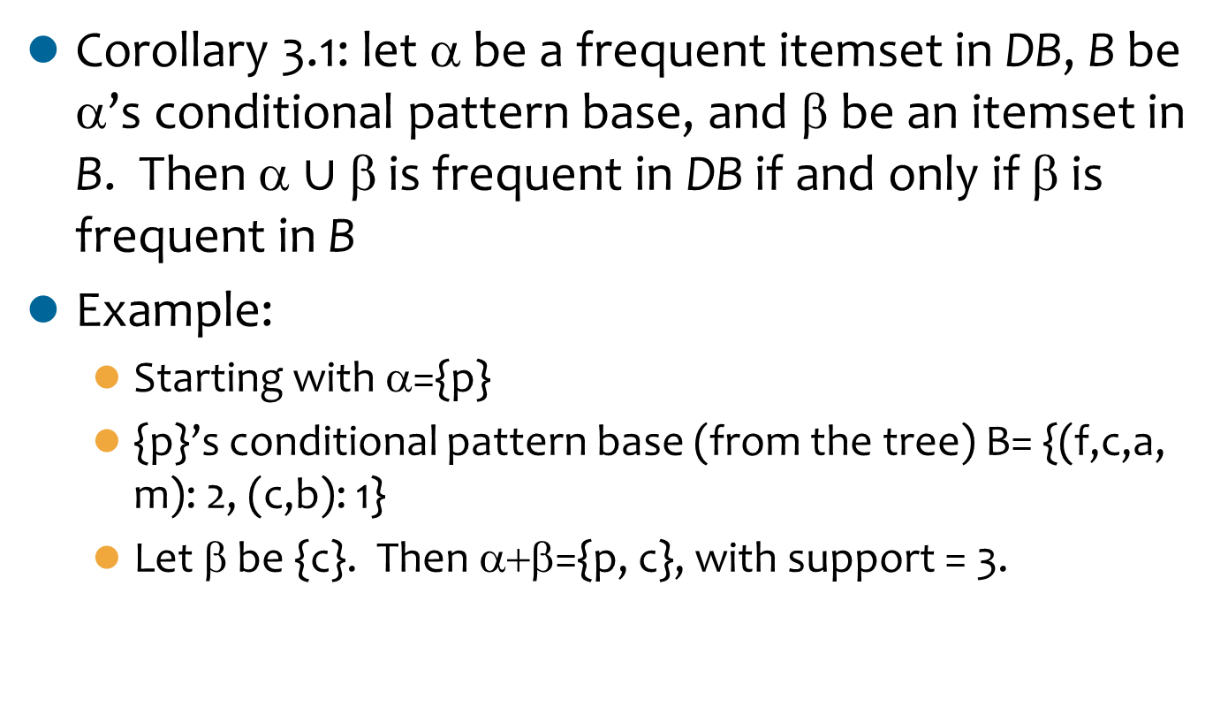
Pattern Growth (1/3)
Corollary 3.1: let α be a frequent itemsetin DB, B be α’s conditional pattern base, and β be an itemset in B. Then α$∪$β is frequent in DB if and only if β is frequent in B
Example:
Starting with α={p}
{p}’s conditional pattern base (from the tree) B= {(f,c,a,m): 2, (c,b): 1}
Let β be {c}. Then α+β={p, c}, with support = 3.

Slide 47
Pattern Growth (2/3)
Implication in Corollary 3.1
Process of mining frequent patterns can be viewed as first mining frequent 1-itemsets and then progressively growing each such itemset by mining its conditional pattern base, which can in turn be done similarly
We successfully transform a frequent k-itemset mining problem into a sequence of k frequent 1-itemset mining problems via a set of conditional pattern bases

Slide 48
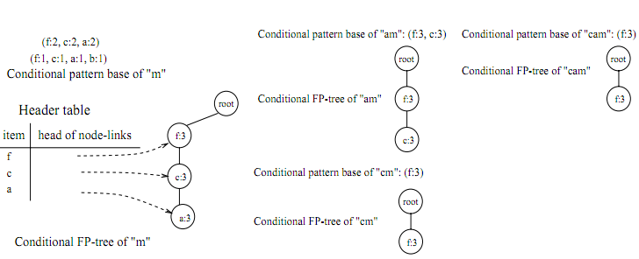
Pattern Growth (3/3)
(fcam:3)
Example:
(cam:3)
(am:3)
(fam:3)
(fcm:3)
(cm:3)
(m:3)
(fm:3)

Slide 49
Single Path Tree
Suppose an FP-tree T has a single path P
The complete set of the frequent patterns of T can be generated by the enumeration of all the combinations of the subpaths of P
The support is the minimum support of the items contained in the subpath

Slide 50
FP_Growth Algorithm
Recursive Algorithm
Input: a transaction database, min_sup
Output: the complete set of frequent patterns
FP-Tree construction
Mining the FP-Tree by calling FP_growth(FP-tree, null)
Key Idea: considering single path FP-trees and multi-path FP-trees separately
Continue to split until we get a single-path FP-tree

Slide 51
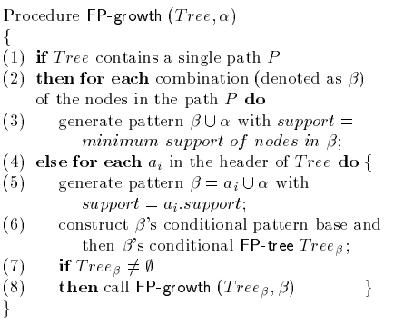
FP_Growth (Tree, α)

Slide 52
Step 1: FP-Tree Construction
FP-Tree is constructed using 2 passes over the data-set:
Pass 1:
Scan data and find support for each item.
Discard infrequent items.
Sort frequent items in decreasing order based on their support.
Use this order when building the FP-Tree, so common prefixes can be shared.

Slide 53
Step 1: FP-Tree Construction
Pass 2:
Nodes correspond to items and have a counter
FP-Growth reads 1 transaction at a time and maps it to a path
Fixed order is used, so paths can overlap when transactions share items (when they have the same prfix ).
In this case, counters are incremented
Pointers are maintained between nodes containing the same item, creating singly linked lists (dotted lines)
The more paths that overlap, the higher the compression. FP-tree may fit in memory.
Frequent itemsets extracted from the FP-Tree.

Slide 54
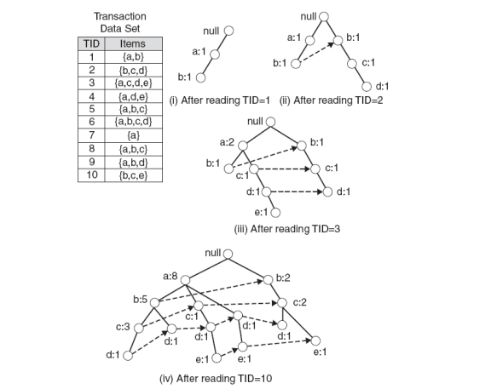
Step 1: FP-Tree Construction (Example)

Slide 55
FP-Tree size
The FP-Tree usually has a smaller size than the uncompressed data - typically many transactions share items (and hence prefixes).
Best case scenario: all transactions contain the same set of items.
1 path in the FP-tree
Worst case scenario: every transaction has a unique set of items (no items in common)
Size of the FP-tree is at least as large as the original data.
Storage requirements for the FP-tree are higher - need to store the pointers between the nodes and the counters.
The size of the FP-tree depends on how the items are ordered
Ordering by decreasing support is typically used but it does not always lead to the smallest tree (it's a heuristic).

Slide 56
Step 2: Frequent Itemset Generation
FP-Growth extracts frequent itemsets from the FP-tree.
Bottom-up algorithm - from the leaves towards the root
Divide and conquer: first look for frequent itemsets ending in e, then de, etc. . . then d, then cd, etc. . .
First, extract prefix path sub-trees ending in an item(set). (hint: use the linked lists)

Slide 57
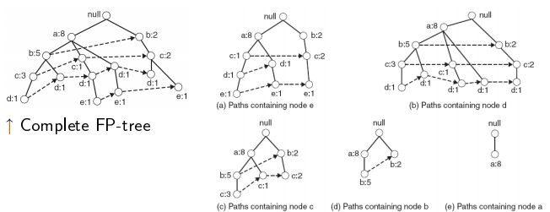
Prefix path sub-trees (Example)

Slide 58
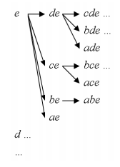
Step 2: Frequent Itemset Generation
Each prefix path sub-tree is processed recursively to extract the frequent itemsets. Solutions are then merged.
E.g. the prefix path sub-tree for e will be used to extract frequent itemsets ending in e, then in de, ce, be and ae, then in cde, bde, cde, etc.
Divide and conquer approach

Slide 59
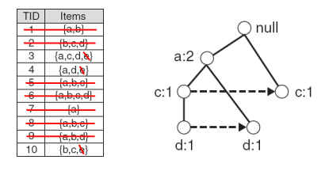
Conditional FP-Tree
The FP-Tree that would be built if we only consider transactions containing a particular itemset (and then removing that itemset from all transactions).
I Example: FP-Tree conditional on e.

Slide 60
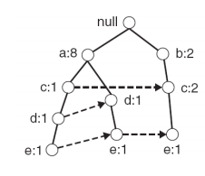
Example
Let minSup = 2 and extract all frequent itemsets containing e.
1. Obtain the prefix path sub-tree for e:

Slide 61
Example
2. Check if e is a frequent item by adding the counts along the linked list (dotted line). If so, extract it.
Yes, count =3 so {e} is extracted as a frequent itemset.
3. As e is frequent, find frequent itemsets ending in e. i.e. de, ce, be and ae.

Slide 62
Example
4. Use the the conditional FP-tree for e to find frequent itemsets ending in de, ce and ae
Note that be is not considered as b is not in the conditional FP-tree for e.
For each of them (e.g. de), find the prefix paths from the conditional tree for e, extract frequent itemsets, generate conditional FP-tree, etc... (recursive)

Slide 63
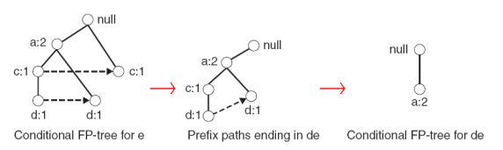
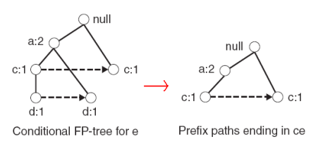
Example
Example: e -> de -> ade ({d,e}, {a,d,e} are found to be frequent)
Example: e -> ce ({c,e} is found to be frequent)

Slide 64
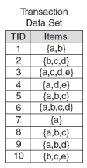
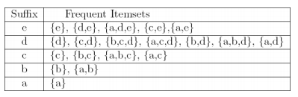
Result
Frequent itemsets found (ordered by sufix and order in which they are found):

Slide 65
FP-Growth vs. Apriori
Data set T25I20D10K

Slide 66
Why Is FP-Growth the Winner?
Divide-and-conquer
Decomposing both the mining task and database according to the frequent patterns obtained so far
Leading to focused search of smaller databases
Other factors
No candidate generation, no candidate test
Compressed database: FP-tree structure
No repeated scan of the entire database
Cheap operations: counting local frequent items and building sub FP-trees, but no pattern search and matching

Slide 67
Contents
Basic Concepts
Frequent Itemset Mining Methods
Apriori
FP-Growth
Maximal, Closed Frequent Itemsets
Rule Generation
Interestingness Measures

Slide 68
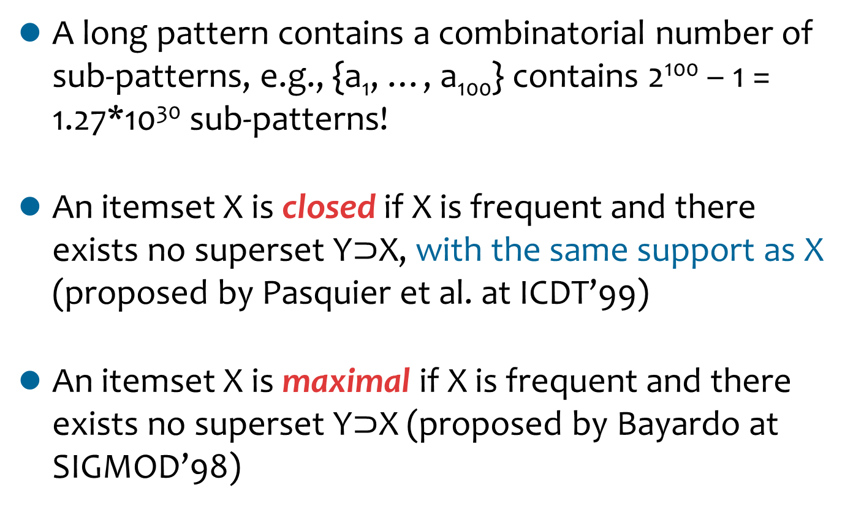
Definitions
A long pattern contains a combinatorial number of sub-patterns, e.g., {a₁, …, a₁₀₀} contains 2¹⁰⁰– 1 = 1.27*10³⁰ sub-patterns!
An itemset X is closedif X is frequent and there exists no superset Y$⊃$X, with the same support as X (proposed by Pasquieret al. at ICDT’99)
An itemset X is maximalif X is frequent and there exists no superset Y$⊃$X (proposed by Bayardoat SIGMOD’98)

Slide 69
Examples
DB = {<a₁, …, a₁₀₀>, < a₁, …, a₅₀>}, minsup = 1
What is the set of closed frequent itemsets?
<a₁, …, a₁₀₀>: 1
< a₁, …, a₅₀>: 2
What is the set of maximal frequent itemsets?
<a₁, …, a₁₀₀>: 1
What is the set of all frequent itemsets?
!!

Slide 70
Maximal vs. Closed

Slide 71
Contents
Basic Concepts
Frequent Itemset Mining Methods
Apriori
FP-Growth
Maximal, Closed Frequent Itemsets
Rule Generation
Interestingness Measures

Slide 72
Rule Generation (1/2)
Given a frequent itemset L, we find all non-empty subsets f ⊂ L such that f → L – f satisfies the minimum confidence requirement
If {A,B,C,D} is a frequent itemset, candidate rules:
ABC→D, ABD→C, ACD→B, BCD→A, A→BCD, B→ACD, C→ABD, D→ABC AB→CD, AC→BD, AD→BC, BC→AD, BD→AC, CD→AB,
If |L| = k, then there are 2^{k} – 2 candidate association rules (ignoring L → ∅ and ∅ → L)

Slide 73
Rule Generation (2/2)
How to efficiently generate rules from frequent itemsets?
In general, confidence does not have an anti-monotone property
e.g., c(ABC →D) can be larger or smaller than c(AB →D)
However, confidence of rules generated from the same itemset has an anti-monotone property
e.g., L = {A,B,C,D}: c(ABC → D) ≥ c(AB → CD) ≥ c(A → BCD)
Confidence is anti-monotone w.r.t. the number of items on the RHS of the rule

Slide 74
Rule Generation for Apriori Algorithm (1/2)
Lattice of rules
Low Confidence Rule
Pruned Rules

Slide 75
Rule Generation for Apriori Algorithm (2/2)
A candidate rule is generated by merging two rules that share the same prefix in the rule consequent
Example:
join(CD→AB, BD→AC) would produce the candidate rule D→ABC
D→ABC is pruned if its subset AD→BC does not have high confidence

Slide 76
Contents
Basic Concepts
Frequent Itemset Mining Methods
Apriori
FP-Growth
Maximal, Closed Frequent Itemsets
Rule Generation
Interestingness Measures

Slide 77
Applications of Interestingness Measures
Interestingness Measures

Slide 78
Overview
Antecedent | Consequent
A | 0
A | 0
A | 1
A | 0
B | 1
B | 0
B | 1
Two Rules:
Rule 1: A→0 [3/7, 3/4]
Rule 2: B→1 [2/7, 2/3]
lift = confidence / probability of consequent
The lift for Rule 1 is (3/4)/(4/7) = 1.31
The lift for Rule 2 is (2/3)/(3/7) = 1.56
If the lift > 1, it lets us know the degree to which those two occurrences are correlated / dependent from one another.
Observe that even though Rule 1 has higher confidence, it has lower lift. Intuitively, it would seem that Rule 1 is more valuable because of its higher confidence.

Slide 79
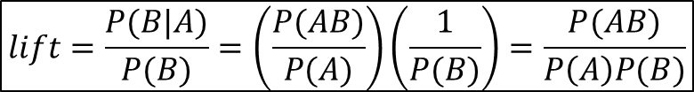
Interestingness Measure: Correlation (Lift)
 | Basketball | Not basketball | Sum (row)
Cereal | 2000 | 1750 | 3750
Not cereal | 1000 | 250 | 1250
Sum(col.) | 3000 | 2000 | 5000
play basketball ⇒ eat cereal [40%, 66.7%] is misleading
The overall % of students eating cereal is 75% > 66.7%
play basketball ⇒ not eat cereal [20%, 33.3%] is more accurate, although with lower support and confidence
$$lift=\frac{P(B|A)}{P(B)}=\left(\frac{P(AB)}{P(A)}\right)\left(\frac{1}{P(B)}\right)=\frac{P(AB)}{P\left(A\right)P(B)}$$

Slide 80
Good Measures for Correlation?
“Buy walnuts ⇒ buy milk [1%, 80%]” is misleading if 85% of customers buy milk
Support and confidence are not good to indicate correlations
Over 20 interestingness measures have been proposed
See the paper “Selecting the Right Interestingness Measures for Association Patterns” by Tan, Kumar, Sritastava at KDD’02
Which are good ones?

Slide 81
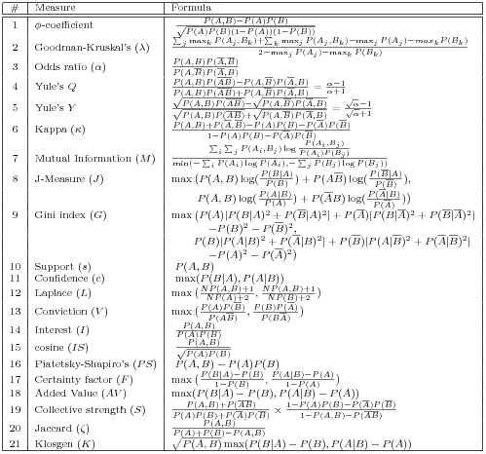
Interestingness Measures
Notes:
Lift = Interest
Confidence = MaxConf

Slide 82
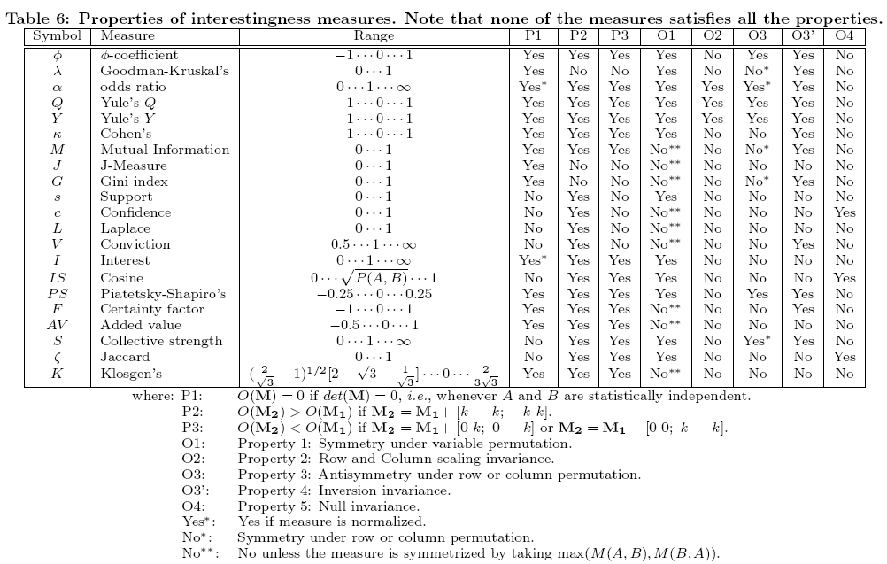
Null-Invariant Measures
Notes:
The null-transaction is a transaction that does not contain any of the itemsets being examined.

Slide 83
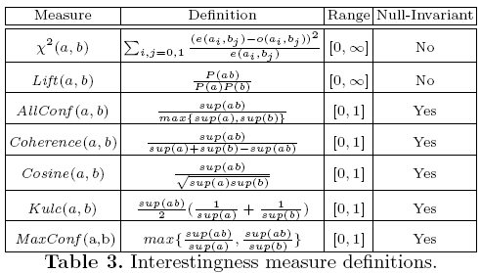
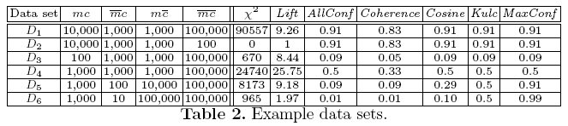
Comparison of Interestingness Measures
 | Milk | No Milk | Sum (row)
Coffee | m, c | ~m, c | c
No Coffee | m, ~c | ~m, ~c | ~c
Sum(col.) | m | ~m | Σ
Null-(transaction) invariance is crucial for correlation analysis
Lift and χ² are not null-invariant
5 null-invariant measures
Kulczynski measure (1927)
Null-invariant
Null-transactions w.r.t. m and c
Notes:
D1, D2: positively correlated
D3: negatively correlated
D4: neutral
Kulc
D4: 500 * (1/2000+1/2000)=500*(2/2000)=0.5
D5: 500 * (1/1100+1/11000)=500*(11/11000)=0.5
D6: 500 * (1/1010+1/101000)=500*(101/101000)=0.5

Slide 84
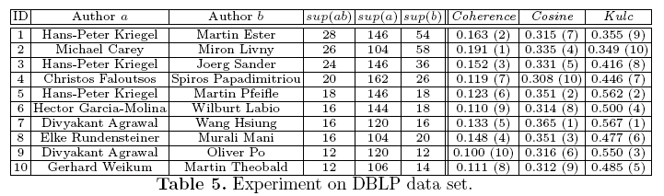
Analysis of DBLP Coauthor Relationships
Recent DB conferences, removing balanced associations, low sup, etc.
Advisor-advisee relation: Kulc: high, coherence: low, cosine: middle
Tianyi Wu, Yuguo Chen and Jiawei Han, “Association Mining in Large Databases: A Re-Examination of Its Measures”, Proc. 2007 Int. Conf. Principles and Practice of Knowledge Discovery in Databases (PKDD'07), Sept. 2007
Notes:
Kulc tends to give more credits to
skewed patterns (e.g., advisor-advisee relationships), Coherence prefers balanced
patterns (e.g., two comparable collaborators), and Cosine lies in-between.

Slide 85
Which Null-Invariant Measure Is Better?
IR (Imbalance Ratio): measure the imbalance of two itemsets A and B in rule implications
Kulczynski and Imbalance Ratio (IR) together present a clear picture for all the three datasets D₄ through D₆
D₄ is balanced & neutral
D₅ is imbalanced & neutral
D₆ is very imbalanced & neutral

Slide 86
Thank You!
Questions?

