Slide 1
Classification (Decision Tree)
Data Mining* (CSC521)
Dr M Muzammal
*The instructor thanks Dr Jae-Gil Lee for sharing the lecture slides.

Slide 2
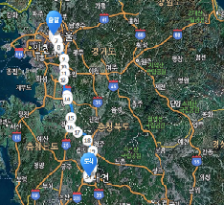
Roadmap
Preliminaries
Association Analysis
Classification
Clustering

Slide 3
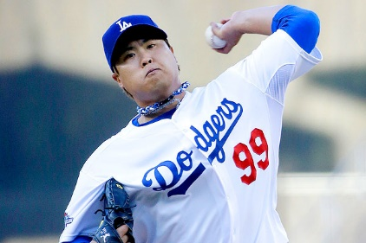
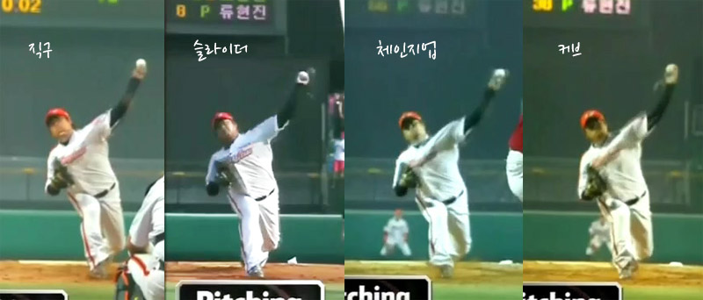
At the Beginning
Hyun-Jin Ryu (Los Angeles Dodgers)
Fast Ball Slider Change-up Curve Ball

Slide 4
Contents
Basic Concepts
Decision Tree Induction
GINI Index (CART)
Information Gain / Gain Ratio (ID3, C4.5)
Overfitting and Other Issues
Model Evaluation

Slide 5
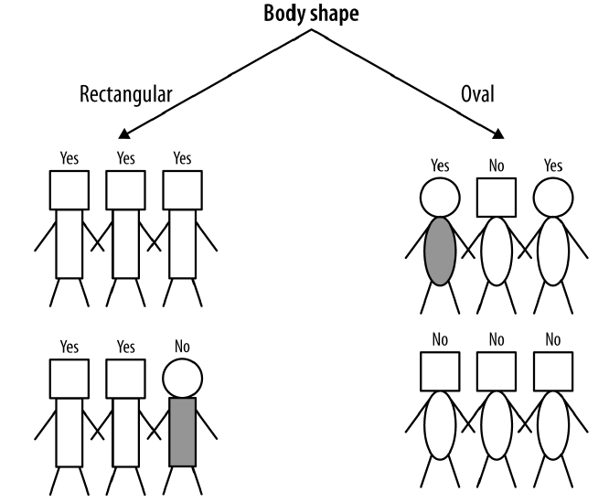
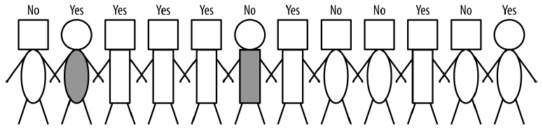
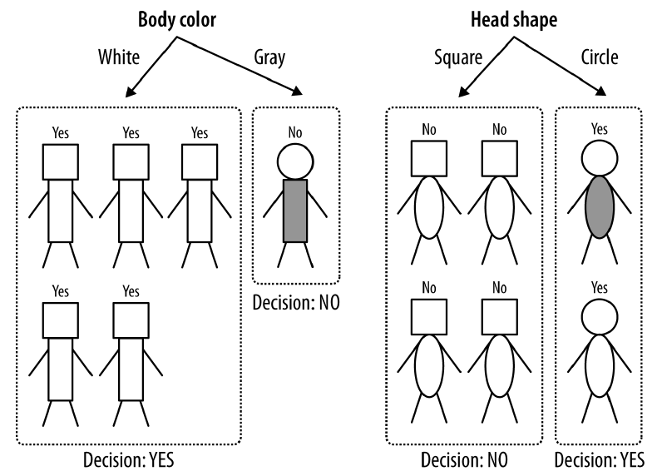
Classification Task
Attributes:
- head-shape: square, circular
- body-shape: rectangular, oval
- body-color: gray, white
Class:
- write-off: Yes, No
write-off: Yes or No?

Slide 6
Classification: Definition
Given a collection of records (training set), we find a model for the class attribute as a function of the values of other attributes
Each record contains a set of attributes, and one of the attributes is the class
Previously unseen records should be assigned a class as accurately as possible
A test set is used to determine the accuracy of the model. Usually, the given data set is divided into training and test sets, with the training set used to build the model and the test set used to validate it

Slide 7

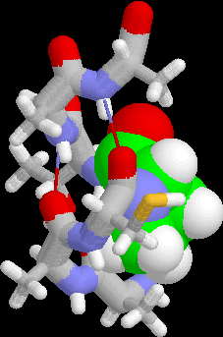
Examples of Classification
Predicting tumor cells as benign or malignant
Classifying credit card transactions as legitimate or fraudulent
Classifying secondary structures of protein as alpha-helix, beta-sheet, or random coil
Categorizing news stories as finance, weather, entertainment, sports, etc.

Slide 8
Classification Techniques
Decision Trees
Naïve Bayes
k-Nearest Neighbor Methods
Support Vector Machines
Rule-Based Methods
Bayesian Networks
Neural Networks
Frequent Pattern-Based
…
Not covered in this class

Slide 9
Contents
Basic Concepts
Decision Tree Induction
GINI Index (CART)
Information Gain / Gain Ratio (ID3, C4.5)
Overfitting and Other Issues
Model Evaluation

Slide 10
An Example of the Decision Tree
categorical
categorical
continuous
Splitting Attributes
class
Refund
Yes
No
NO
MarSt
Single, Divorced
Married
TaxInc
NO
< 80K
> 80K
NO
YES
Model: Decision Tree
Training Data

Slide 11
Another Example of the Decision Tree
categorical
categorical
continuous
class
MarSt
Single, Divorced
Married
NO
Refund
Yes
No
NO
TaxInc
< 80K
> 80K
NO
YES
There could be more than one tree that fits the same data!

Slide 12
Decision Tree Classification
Decision Tree

Slide 13
Applying Model to Test Data
Test Data
Start from the root of tree.
Refund
Yes
No
No
NO
MarSt
Married
Assign Cheat to “No”
Single, Divorced
Married
TaxInc
NO
< 80K
> 80K
NO
YES

Slide 14
Decision Tree Classification
Decision Tree

Slide 15
Decision Tree Induction
Hunt’s Algorithm (one of the earliest)
Basis of many existing decision tree algorithms, including the ID3, C4.5, and CART
CART
ID3, C4.5
SLIQ, SPRINT

Slide 16
Hunt’s Algorithm
Refund
Don’t
Cheat
Yes
No
Don’t
Cheat
Don’t
Cheat
Refund
Refund
Yes
No
Yes
No
Don’t
Cheat
Marital
Status
Don’t
Cheat
Marital
Status
Single,
Divorced
Single,
Divorced
Married
Married
Cheat
Don’t
Cheat
Taxable
Income
Don’t
Cheat
< 80K
>= 80K
Don’t
Cheat
Cheat

Slide 17
Tree Induction
Greedy strategy
Split the records based on an attribute test that optimizes certain criterion
Issues
Determine how to split the records
How to specify the attribute test condition?
How to determine the best split?
Determine when to stop splitting

Slide 18
How to Specify Test Condition?
Depends on attribute types
Nominal
Ordinal
Continuous
Depends on number of ways to split
2-way split
Multi-way split

Slide 19
Splitting Based on Nominal Attributes
Multi-way split: Use as many partitions as distinct values
Binary split: Divide values into two subsets; need to find optimal partitioning
CarType
Family
Luxury
Sports
CarType
CarType
{Sports, Luxury}
OR
{Family, Luxury}
{Family}
{Sports}

Slide 20
Splitting Based on Ordinal Attributes
Multi-way split: Use as many partitions as distinct values
Binary split: Divide values into two subsets; need to find optimal partitioning
What about this split?
Size
Small
Large
Medium
Size
Size
{Small, Medium}
OR
{Medium, Large}
{Large}
{Small}
Size
{Small, Large}
{Medium}

Slide 21
Splitting Based on Continuous Attributes
Consider all possible splits and finds the best cut
Discretization

Slide 22
Tree Induction
Greedy strategy
Split the records based on an attribute test that optimizes certain criterion
Issues
Determine how to split the records
How to specify the attribute test condition?
How to determine the best split?
Determine when to stop splitting

Slide 23
How to Determine the Best Split (1/2)
Before Splitting: 10 records of class 0, 10 records of class 1
Which test condition is the best?

Slide 24
How to Determine the Best Split (2/2)
Using a greedy approach, nodes with homogeneous class distribution are preferred
We need a measure of node impurity
Non-homogeneous,
High degree of impurity
Homogeneous,
Low degree of impurity

Slide 25
How to Find the Best Split
Before Splitting:
M0
A?
B?
Yes
No
Yes
No
Node N1
Node N2
Node N3
Node N4
M1
M2
M3
M4
M12
M34
Gain = M0 – M12 vs M0 – M34

Slide 26
Measures of Node Impurity
Gini Index
Information Gain
Gain Ratio

Slide 27
Contents
Basic Concepts
Decision Tree Induction
GINI Index (CART)
Information Gain / Gain Ratio (ID3, C4.5)
Overfitting and Other Issues
Model Evaluation

Slide 28
Measure of Impurity: GINI
Gini Index for a given node t :
(NOTE: p( j | t) is the relative frequency of class j at node t)
Maximum (1 - 1/n_{c}) when records are equally distributed among all classes, implying least interesting information
Minimum (0.0) when all records belong to one class, implying most interesting information

Slide 29
Examples for Computing GINI
P(C1) = 0/6 = 0 P(C2) = 6/6 = 1
Gini = 1 – P(C1)² – P(C2)² = 1 – 0 – 1 = 0
P(C1) = 1/6 P(C2) = 5/6
Gini = 1 – (1/6)² – (5/6)² = 0.278
P(C1) = 2/6 P(C2) = 4/6
Gini = 1 – (2/6)² – (4/6)² = 0.444

Slide 30
Splitting Based on GINI
Used in CART, SLIQ, SPRINT
When a node p is split into k partitions (children), the quality of split is computed as,
where, n_{i} = number of records at child i,
n = number of records at node p

Slide 31
Binary Attributes: Computing GINI Index
We split into two partitions
Larger and purer partitions are sought for
B?
Yes
No
Node N1
Node N2
Gini(N1) = 1 – (5/7)² – (2/7)² = 0.408
Gini(N2) = 1 – (1/5)² – (4/5)² = 0.320
Gini(Children) = 7/12 * 0.408 + 5/12 * 0.320 = 0.371

Slide 32
Categorical Attributes: Computing Gini Index
For each distinct value, we gather counts for each class in the dataset and use the count matrix to make decisions
Multi-way split
Two-way split
(find the best partition of values)

Slide 33
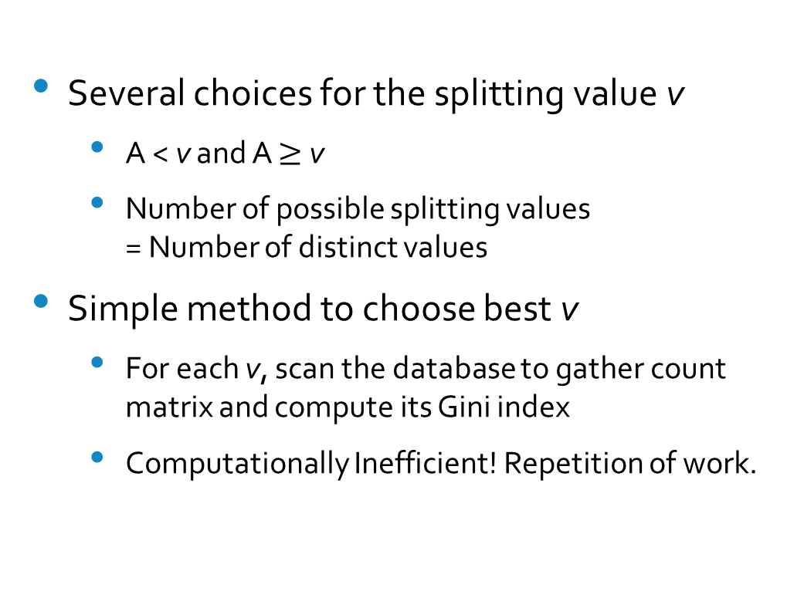
Continuous Attributes: Computing Gini Index (1/2)
Several choices for the splitting value v
A < v and A $≥$ v
Number of possible splitting values = Number of distinct values
Simple method to choose best v
For each v, scan the database to gather count matrix and compute its Gini index
Computationally Inefficient! Repetition of work.

Slide 34
Continuous Attributes: Computing Gini Index (2/2)
For efficient computation: for each attribute,
Sort the attribute on values
Linearly scan these values, each time updating the count matrix and computing gini index
Choose the split position that has the least gini index
Sorted Values
Split Positions

Slide 35
Drawback of the Gini Index
Paul C. Taylor and Bernard W. Silverman, "Block Diagrams and splitting criteria for classification trees," Statistics and Computing 3:147-161, 1993
Bias towards equally-sized subsets
Concentration upon pure offspring
Assume that a data set is dominated by class 1 and class 2 (7 classes)
Option 1: segregating classes 1 and 2 as early as possible ⇐ Favored
Option 2: isolating classes 1 and 2 from the other five and then segregating classes 1 and 2 ⇐ Could be better
31
x₆
43
22
x₁
52
x₁
x₄
Favored
Could be better

Slide 36
Algorithm CART
Pseudo code
Find each attribute’s best split
The best split point is the one that decreases the gini index most when the node is split according to it
Find the node’s best split
Among the best splits found in step 1, choose the one that has the least gini index
Split the node using its best split found in step 2 if the stopping rules are not satisfied

Slide 37
Contents
Basic Concepts
Decision Tree Induction
GINI Index (CART)
Information Gain / Gain Ratio (ID3, C4.5)
Overfitting and Other Issues
Model Evaluation

Slide 38
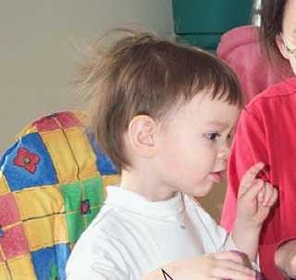
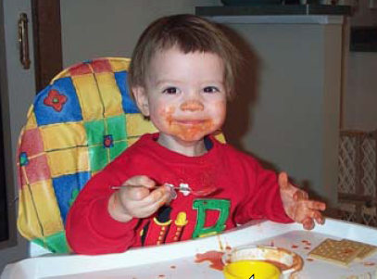
Entropy
Low Entropy
High Entropy
the values (locations of soup) sampled entirely from within the soup bowl
the values (locations of soup) unpredictable... almost uniformly sampled throughout our dining room
From Prof. Moore’s tutorial: http://www.autonlab.org/tutorials/infogain11.pdf

Slide 39
Alternative Splitting Criteria Based on INFO
Entropy at a given node t:
(NOTE: p( j | t) is the relative frequency of class j at node t)
Measures homogeneity of a node
Maximum (log n_{c}) when records are equally distributed among all classes, implying least information
Minimum (0.0) when all records belong to one class, implying most information
Entropy based computations are similar to the GINI index computations

Slide 40
Examples for Computing Entropy
P(C1) = 0/6 = 0 P(C2) = 6/6 = 1
Entropy = – 0 log₂ 0 – 1 log₂ 1 = – 0 – 0 = 0
P(C1) = 1/6 P(C2) = 5/6
Entropy = – (1/6) log₂ (1/6) – (5/6) log₂ (5/6) = 0.65
P(C1) = 2/6 P(C2) = 4/6
Entropy = – (2/6) log₂ (2/6) – (4/6) log₂ (4/6) = 0.92

Slide 41
Information Gain
Parent Node p is split into k partitions;
n_{i} is number of records in partition i
Measures the reduction in the entropy caused by the split; choose the split that achieves most reduction (maximizes GAIN)
Used in ID3
Disadvantage: tends to prefer splits that result in large number of partitions, each being small but pure

Slide 42
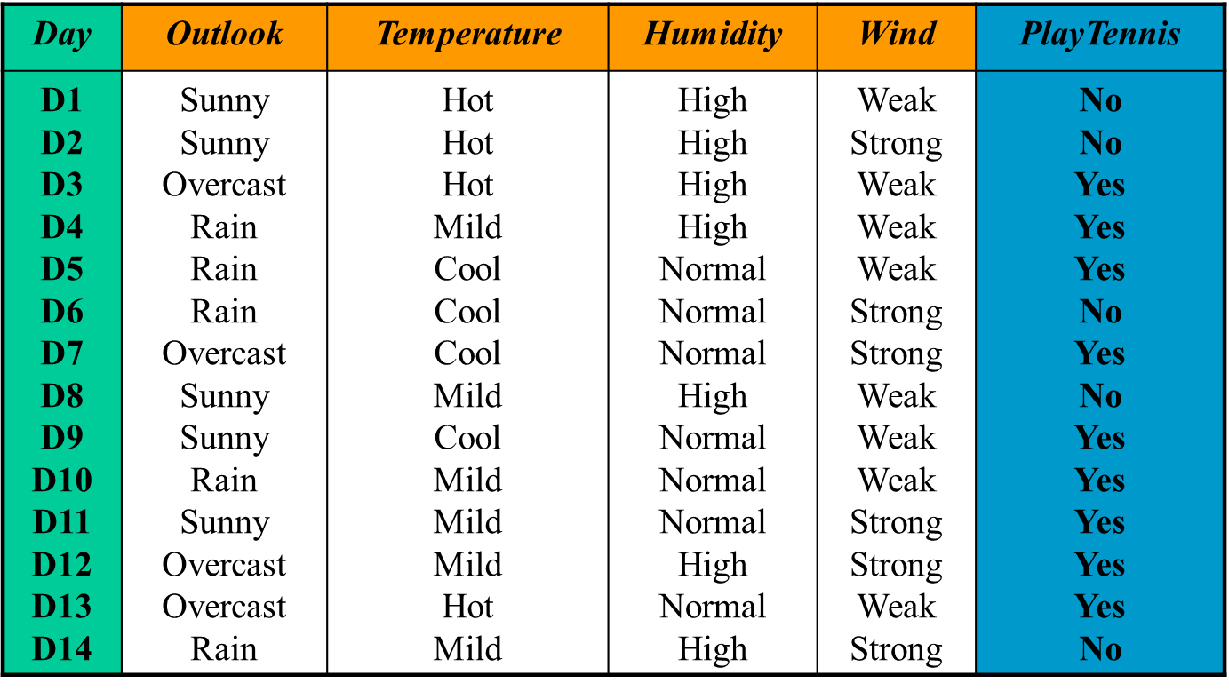
Play Tennis Example (1/15)

Slide 43
Play Tennis Example (2/15)
Final decision tree by ID3
Outlook
Sunny
Overcast
Rain
Humidity
YES
Wind
High
Normal
Strong
Weak
NO
YES
NO
YES

Slide 44
Play Tennis Example (3/15)
Entropy D

Slide 45
Play Tennis Example (4/15)
[9+,5-] : E = 0.940
Wind
Weak
Strong
Attribute Wind
D = [9+,5-]
D_{weak} = [6+,2-]
D_{strong}=[3+,3-]
[6+,2-] : E = 0.811
[3+,3-] : E = 1.0

Slide 46
Play Tennis Example (5/15)
[9+,5-] : E = 0.940
Attribute Humidity
D_{high} = [3+,4-]
D_{normal}=[6+,1-]
Humidity
High
Normal
[3+,4-] : E = 0.985
[6+,1-] : E = 0.592
∑
|
Dv
|
Gain
=
−
(
D
,
Hum
)
Entropy
(
D
)
Entropy
(
Dv
)
∈
|
D
|
v
{
high
,
normal
}
=
−
7
−
7
Entropy
(
D
)
Entropy
(
D
)
Entropy
(
D
)
14
high
14
normal
=
−
7
−
7
0
.
940
0
.
985
0
.
592
14
14
=
0
.
151

Slide 47
Play Tennis Example (6/15)
S=[9+,5-]
E=0.940
Attribute Outlook
Outlook
Over
cast
Sunny
Rain
[2+, 3-]
[4+, 0]
[3+, 2-]
E=0.971
E=0.0
E=0.971
Gain(S,Outlook)
=0.940-(5/14)*0.971-(4/14)*0.0 – (5/14)*0.971
=0.246

Slide 48
Play Tennis Example (7/15)
Best split
Gain(D, Outlook) = 0.246
Gain(D, Humidity) = 0.151
Gain(D, Wind) = 0.048
Gain(D, Temperature) = 0.029
[9+,5-] : E = 0.940
Outlook
Sunny
Rain
Overcast
[2+,3-] : (D1, D2, D8, D9, D11)
[4+,0-] : (D3, D7, D12, D13)
YES
[3+,2-] : (D4, D5, D6, D10, D14)

Slide 49
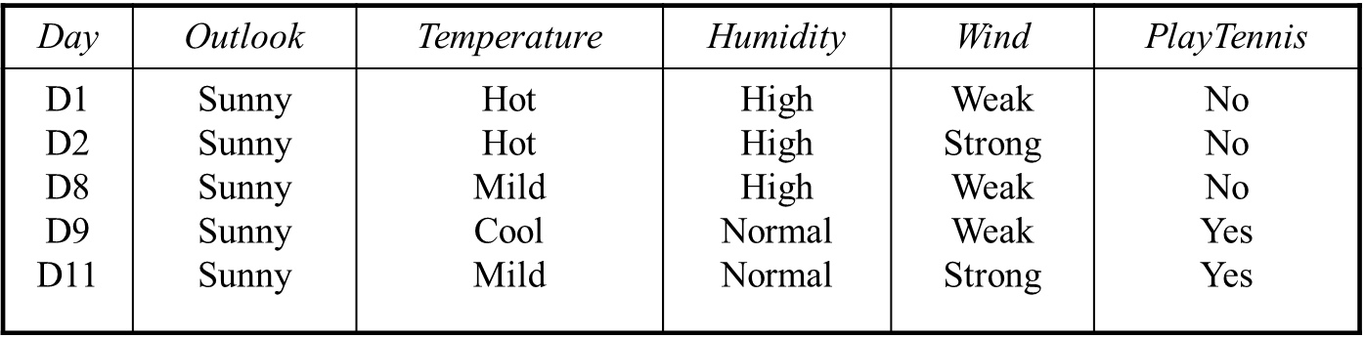
Play Tennis Example (8/15)
Entropy D_{sunny}

Slide 50
Play Tennis Example (9/15)
[2+,3-] : E = 0.971
Wind
Weak
Strong
Attribute Wind
D_{weak} = [1+,2-]
D_{strong}=[1+,1-]
[1+,2-] : E = 0.918
[1+,1-] : E = 1.0

Slide 51
Play Tennis Example (10/15)
[2+,3-] : E = 0.971
Humidity
High
Normal
Attribute Humidity
D_{high} = [0+,3-]
D_{normal}=[2+,0-]
[0+,3-] : E = 0.00
[2+,0-] : E = 0.00

Slide 52
Play Tennis Example (11/15)
Best split
Gain(D, Humidity) = 0.971
Gain(D, Wind) = 0.020
Gain(D, Temperature) = 0.571
[9+,5-] : E = 0.940
Outlook
Sunny
Overcast
Rain
Humidity
YES
[3+,2-] : (D4, D5, D6, D10, D14)
High
Normal
NO
YES

Slide 53
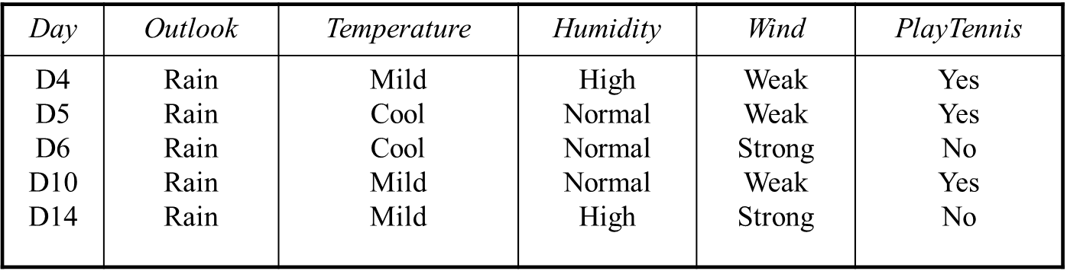
Play Tennis Example (12/15)
D_{rain}
Entropy D_{rain}

Slide 54
Play Tennis Example (13/15)
Attribute Wind
D_{weak} = [3+,0-]
D_{strong}=[0+,2-]
[3+,2-] : E = 0.971
Wind
Weak
Strong
[3+,0-] : E = 0.00
[0+,2-] : E = 0.00

Slide 55
Play Tennis Example (14/15)
[2+,3-] : E = 0.971
Attribute Humidity
D_{high} = [1+,1-]
D_{normal}=[2+,1-]
Humidity
High
Normal
[1+,1-] : E = 1.00
[2+,1-] : E = 0.918

Slide 56
Play Tennis Example (15/15)
Best split
Gain(D, Humidity) = 0.020
Gain(D, Wind) = 0.971
Gain(D, Temperature) = 0.020
Outlook
Sunny
Overcast
Rain
Humidity
YES
Wind
High
Normal
Strong
Weak
NO
YES
NO
YES

Slide 57
Thank You!
Questions?

