Slide 1
Classification (Bayes, Lazy)
Data Mining* (CSC521)
Dr M Muzammal
*The instructor thanks Dr Jae-Gil Lee for sharing the lecture slides.

Slide 2

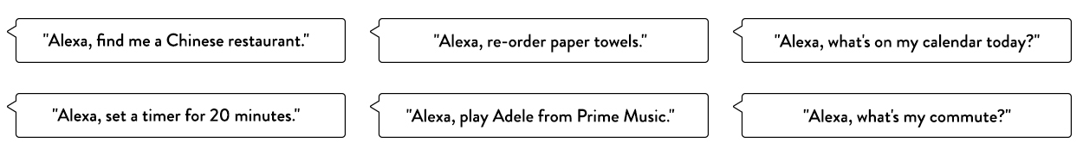
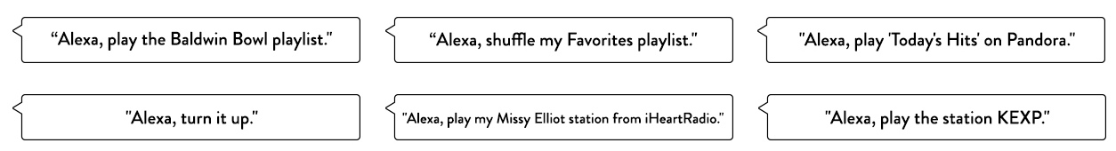
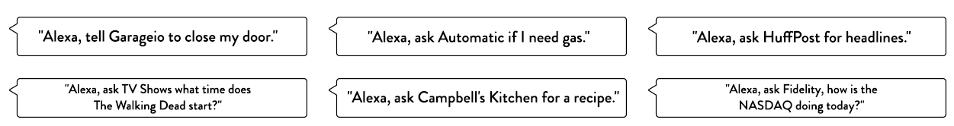
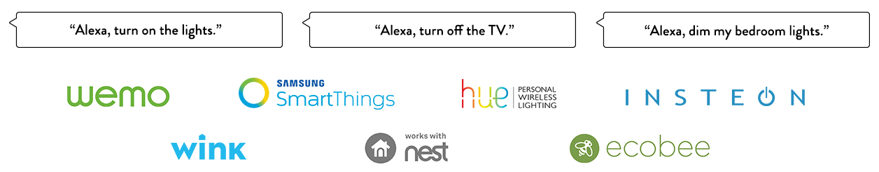
At the Beginning
Wireless speaker and voice command device from Amazon.com

Slide 3
Contents
Decision Tree Induction
Bayes Classification
k-Nearest Neighbor Classification
Support Vector Machines (SVM)
Ensemble Methods

Slide 4
Bayes Classifier
A probabilistic framework for solving classification problems
Conditional probability:
Bayes theorem:

Slide 5
Rule of Multiplication
The probability that Events A and B both occur is equal to the probability that Event A occurs times the probability that Event B occurs, given that A has occurred.
P(A ∩ B) = P(A) P(B|A)

Slide 6
Example: Rule of Multiplication
An urn contains 6 red marbles and 4 black marbles. Two marbles are drawn without replacement from the urn. What is the probability that both of the marbles are black?

Slide 7
Example: Rule of Multiplication
An urn contains 6 red marbles and 4 black marbles. Two marbles are drawn without replacement from the urn. What is the probability that both of the marbles are black?
Let A = the event that the first marble is black; and
let B = the event that the second marble is black
P(A) = 4/10 (4 out of 10 in the urn are black)
P(B|A) = 3/9 (3 out of 9 in the urn are black now)
P(A ∩ B) = P(A) P(B|A) P(A ∩ B) = (4/10) * (3/9) = 12/90 = 2/15

Slide 8
Bayes Classifier
A probabilistic framework for solving classification problems
Conditional probability:
Bayes theorem:

Slide 9
Example (1): Bayes Theorem
A doctor knows that meningitis causes stiff neck 50% of the time ⇒ P(S|M)=0.5
Prior probability of any patient having meningitis is 1/50,000 ⇒ P(M) = 1/50000
Prior probability of any patient having stiff neck is 1/20 ⇒ P(S) = 1/20
If a patient has stiff neck, what’s the probability he/she has meningitis? ⇒ P(M|S) ?

Slide 10
Example (2): Bayes Theorem
Anka is getting married tomorrow, at an outdoor ceremony in the Hills. In recent years, it has rained only 5 days each year. Unfortunately, the weatherman has predicted rain for tomorrow. When it actually rains, the weatherman correctly forecasts rain 90% of the time. When it doesn't rain, he incorrectly forecasts rain 10% of the time. What is the probability that it will rain on the day of Marie's wedding?

Slide 11
Example (2): Bayes Theorem
The sample space is defined by two mutually-exclusive events – it rains or it does not rain.
Additionally, a third event occurs when the weatherman predicts rain.
Event A₁. It rains on Marie's wedding.
Event A₂. It does not rain on Marie's wedding.
Event B. The weatherman predicts rain.

Slide 12
Example (2): Bayes Theorem
P( A₁ ) = 5/365 =0.0136985 [It rains 5 days out of the year.]
P( A₂ ) = 360/365 = 0.9863014 [It does not rain 360 days out of the year.]
P( B | A₁ ) = 0.9 [When it rains, the weatherman predicts rain 90% of the time.]
P( B | A₂ ) = 0.1 [When it does not rain, the weatherman predicts rain 10% of the time.]

Slide 13
Example (2): Bayes Theorem
Compute P( A₁ | B ), the probability it will rain on the day of Anka's wedding
given a forecast for rain by the weatherman

Slide 14
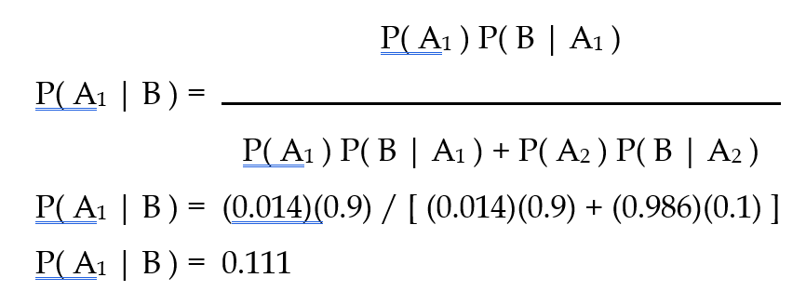
Example (2): Bayes Theorem
Compute P( A₁ | B ), the probability it will rain on the day of Anka's wedding
given a forecast for rain by the weatherman
Even when the weatherman predicts rain, it only rains only about 11% of the time.

Slide 15
Example (2): Bayes Theorem
Even when the weatherman predicts rain, it only rains only about 11% of the time.

Slide 16
Bayesian Classifiers (1/2)
Consider each attribute and class label as random variables
Given a record with attributes (A₁, A₂,…,A_{n})
The goal is to predict the class C
Specifically, we want to find the value of C that maximizes P(C| A₁, A₂,…,A_{n} )
Can we estimate P(C| A₁, A₂,…,A_{n} ) directly from data?

Slide 17
Bayesian Classifiers (2/2)
Approach
Compute the posterior probability P(C | A₁, A₂, …, A_{n}) for all values of C using the Bayes theorem
Choose the value of C that maximizes P(C | A₁, A₂, …, A_{n})
Equivalent to choosing the value of C that maximizes P(A₁, A₂, …, A_{n} | C) P(C) since P(A₁, A₂, …, A_{n}) is constant for all classes
How to estimate P(A₁, A₂, …, A_{n} | C )?

Slide 18
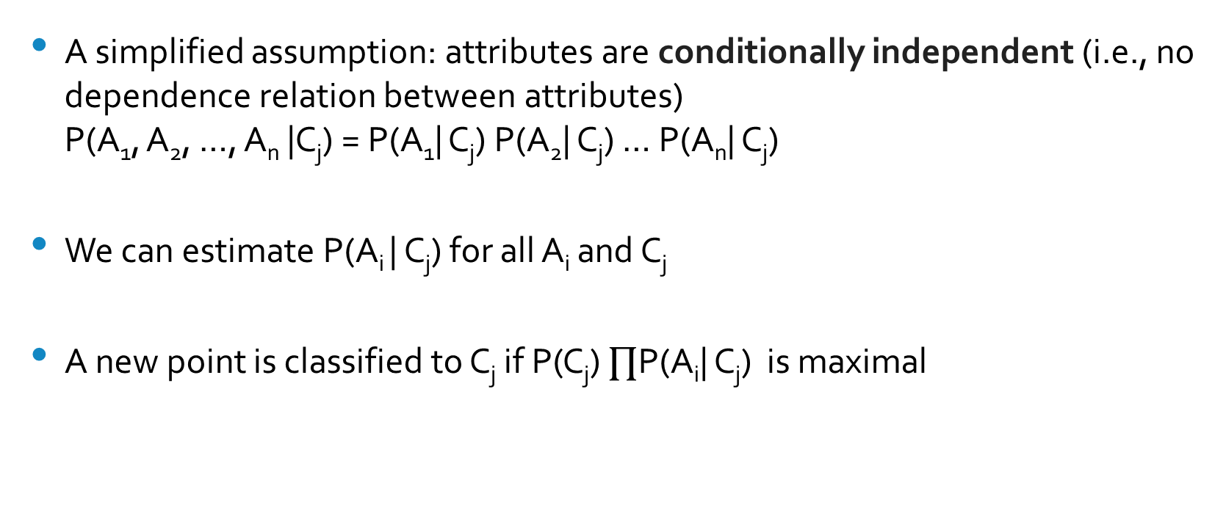
Naïve Bayes Classifier
A simplified assumption: attributes are conditionally independent (i.e., no dependence relation between attributes) P(A₁, A₂, …, A_{n} |C_{j}) = P(A₁| C_{j}) P(A₂| C_{j}) … P(A_{n}| C_{j})
We can estimate P(A_{i} | C_{j}) for all A_{i} and C_{j}
A new point is classified to C_{j} if P(C_{j}) $∏$P(A_{i}| C_{j}) is maximal

Slide 19
How to Estimate Probabilities from Data? (1/3)
For discrete attributes: P(A_{i} | C_{k}) = |A_{ik}|/ N_{c}
where |A_{ik}| is number of instances that has the attribute A_{i} and belongs to the class C_{k}
e.g., P(Status=Married|No) = 4/7

Slide 20
How to Estimate Probabilities from Data? (2/3)
For continuous attributes:
Assume the attribute follows a normal distribution
Use data to estimate parameters of the distribution (e.g., mean and standard deviation)
Once the probability distribution is known, we can use it to estimate the conditional probability P(A_{i} | C)
e.g., see the next page

Slide 21
How to Estimate Probabilities from Data? (3/3)
Normal distribution:
One for each (A_{i}, c_{j}) pair
e.g., (Income, Class=No)
If Class=No
sample mean = 110
sample variance = 2975

Slide 22
An Example
Given a test record:
Naïve Bayes Classifier:
P(X | Class=No) = P(Refund=No | Class=No) × P(Married | Class=No) × P(Income=120K | Class=No) = 4/7 × 4/7 × 0.0072 = 0.0024
P(X | Class=Yes) = P(Refund=No | Class=Yes) × P(Married | Class=Yes) × P(Income=120K | Class=Yes) = 1 × 0 × 1.2 × 10⁻⁹ = 0
Since P(X|No)P(No) > P(X|Yes)P(Yes)
0.0024 * 7/10 0 * 3/10
Therefore P(No|X) > P(Yes|X) => Class = No
P(Refund=Yes|No) = 3/7
P(Refund=No|No) = 4/7
P(Refund=Yes|Yes) = 0/3
P(Refund=No|Yes) = 3/3
P(Martial Status=Single|No) = 2/7
P(Martial Status=Divorced|No) = 1/7
P(Martial Status=Married|No) = 4/7
P(Martial Status=Single|Yes) = 2/3
P(Martial Status=Divorced|Yes) = 1/3
P(Martial Status=Married|Yes) = 0/3
Taxable income: If class=No: sample mean = 110
sample variance = 2975
If class=Yes: sample mean = 90
sample variance = 25

Slide 23
M-Estimate of Conditional Probability
If one of the conditional probability is zero, then the entire expression becomes zero
Probability estimation:
c: number of classes
p: prior probability
m: parameter

Slide 24
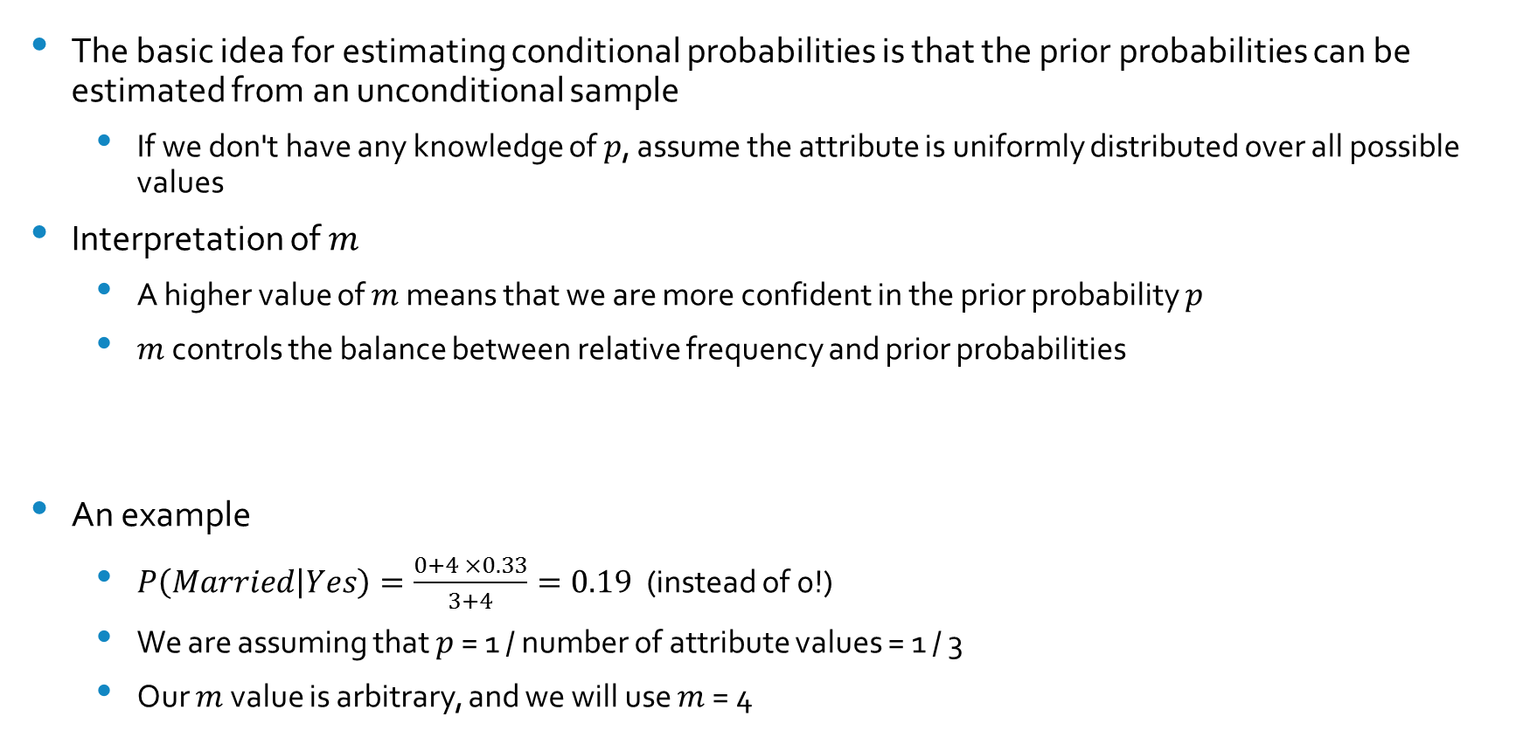
M-Estimate
The basic idea for estimating conditional probabilities is that the prior probabilities can be estimated from an unconditional sample
If we don't have any knowledge of $p$, assume the attribute is uniformly distributed over all possible values
Interpretation of $m$
A higher value of $m$ means that we are more confident in the prior probability $p$
$m$ controls the balance between relative frequency and prior probabilities
An example
$P\left(Married | Yes\right)=\frac{0+4 ×0.33}{3+4}=0.19$ (instead of 0!)
We are assuming that $p$ = 1 / number of attribute values = 1 / 3
Our $m$ value is arbitrary, and we will use $m$ = 4

Slide 25
Summary of Naïve Bayes
Robust to isolated noise points
Able to handle missing values by ignoring the instance during probability estimate calculations
Robust to irrelevant attributes
If X_{i} is an irrelevant attribute, P(X_{i} | Y) becomes almost uniformly distributed
Independence assumption may not hold for some attributes

Slide 26
Contents
Decision Tree Induction
Bayes Classification
k-Nearest Neighbor Classification
Support Vector Machines (SVM)
Ensemble Methods

Slide 27
Lazy vs. Eager Learning
Lazy vs. eager learning
Lazy learning (e.g., instance-based learning): simply stores training data and waits until receiving new data to classify
Eager learning (the above discussed methods): constructs a classification model before receiving new data to classify
Efficiency
Lazy: less time in training but more time in predicting
Accuracy
Lazy: can model complex decision spaces that may not be easily described by other learning algorithms
Eager: must commit to a single hypothesis that covers the entire instance space

Slide 28
Lazy Learner: Instance-Based Methods
Instance-based learning
We store training examples and delay the processing (lazy evaluation) until a new instance must be classified
It is called instance-based because it constructs hypotheses directly from the training instances themselves
One advantage that instance-based learning has over other methods is its ability to adapt its model to previously unseen data
Typical approaches
k-nearest neighbor approach
Case-based reasoning

Slide 29
Nearest Neighbor Classifiers
An intuitive idea
If it walks like a duck and quacks like a duck, then it’s probably a duck
Compute Distance
Test Record
Training Records
Choose the k “nearest” records

Slide 30
Overview
Input
A set of stored records
A distance metric to compute the distance between records
The number k of nearest neighbors to retrieve
Prediction
Compute the distance to other training records
Identify k nearest neighbors
Use the class labels of the NNs to determine the class label of an unknown record (e.g., the majority vote)

Slide 31
k-Nearest Neighbors
k-nearest neighbors of a record x are the data points that have the k smallest distance to x

Slide 32
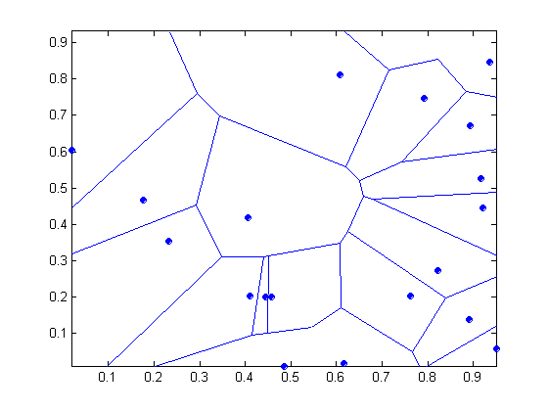
1-Nearest Neighbor
Voronoi Diagram

Slide 33
k-NN Classification
Compute the distance between two points
e.g., Euclidean distance
Determine the class from the nearest neighbor list
Take the majority vote of class labels among the k-nearest neighbors
Weigh the vote according to distance: weight factor w = 1/d²

Slide 34
Issues (1/2)
The value of k
If k is too small, classification is sensitive to noise points
If k is too large, a neighborhood may include points from other classes

Slide 35
Issues (2/2)
Scaling
Attributes may have to be scaled to prevent distance measures from being dominated by one of the attributes
e.g.,
The height of a person may vary from 1.5m to 1.8m
The weight of a person may vary from 90lb to 300lb
The income of a person may vary from $10K to $1M
High-dimensional data
Curse of dimensionality
Can produce counter-intuitive results

Slide 36
Thank You!
Questions?

