Slide 1
Digital Portfolio
STUDENT NAME: Imrankhan
REGISTER NO AND NMID: autunm1455unmcsa07
DEPARTMENT:BSC COMPUTER SCIENCE 2ND YEAR
COLLEGE: Tagore arts and college/Madras University

Slide 2
PROJECT TITLE
PERSONAL PORTFOLIO

Slide 3


AGENDA
Problem Statement
Project Overview
End Users
Tools and Technologies
Portfolio design and Layout
Features and Functionality
Results and Screenshots
Conclusion
Github Link
3/21/2024 Annual Review

Slide 4

PROBLEM STATEMENT
In the digital era, a normal resume is not enough to highlight one’s skills, projects, and achievements. Recruiters prefer a professional online presence. As a Computer Science student, I needed a platform to effectively showcase my learning, technical skills, and personal projects. This created the need for a personal portfolio website.

Slide 5

PROJECT OVERVIEW
This project is a personal portfolio website designed to showcase my academic background, technical skills, and projects in a professional way. The website includes sections such as About Me, Skills, Projects, and Contact. It provides an online platform where recruiters, teachers, or peers can quickly know about my capabilities.
The portfolio is simple, responsive, and user-friendly, built using modern web technologies.

Slide 6

WHO ARE THE END USERS?
Recruiters / Hiring Managers – To review my skills and projects.
Teachers / Mentors – To evaluate my academic and technical progress.
Peers / Collaborators – To explore my work and collaborate on projects.
General Visitors – Anyone who wants to know about my background and capabilities.

Slide 7

TOOLS AND TECHNIQUES
Frontend: HTML, CSS, JavaScript
Design & Styling: Bootstrap / Tailwind CSS (if used)
Code Editor: VS Code
Version Control: Git & GitHub (for hosting)

Slide 8
POTFOLIO DESIGN AND LAYOUT
Homepage: Clean introduction with my name and role.
About Me: Brief background, education, and interests.
Skills Section: Technologies and tools I know.
Projects Section: Showcase of academic and personal projects.
Contact Section: Email, phone, and social links for communication.
Layout Style: Simple, responsive, and user-friendly design with easy navigation.
8

Slide 9
FEATURES AND FUNCTIONALITY
Responsive Design – Works on mobile, tablet, and desktop.
Navigation Menu – Easy access to all sections.
About Section – Quick introduction about me.
Skills Section – Highlights technical skills.
Projects Showcase – Displays academic and personal projects.
Contact Form / Links – Allows visitors to reach me directly.
Simple & Clean UI – User-friendly layout for smooth experience.

Slide 10
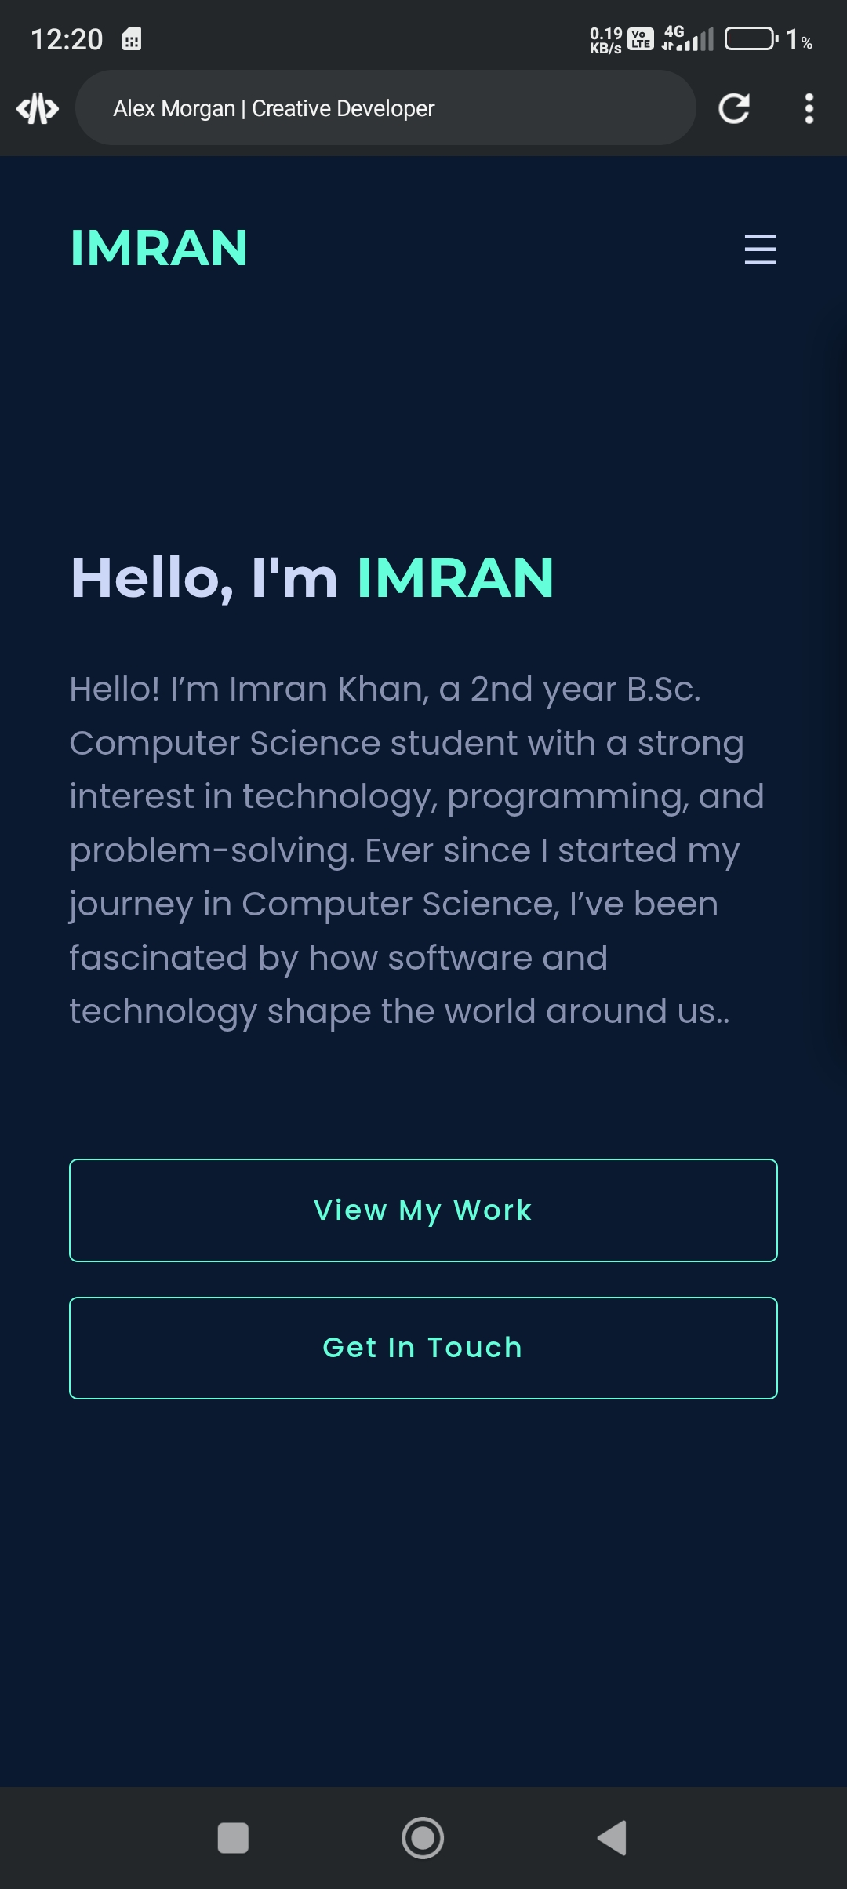
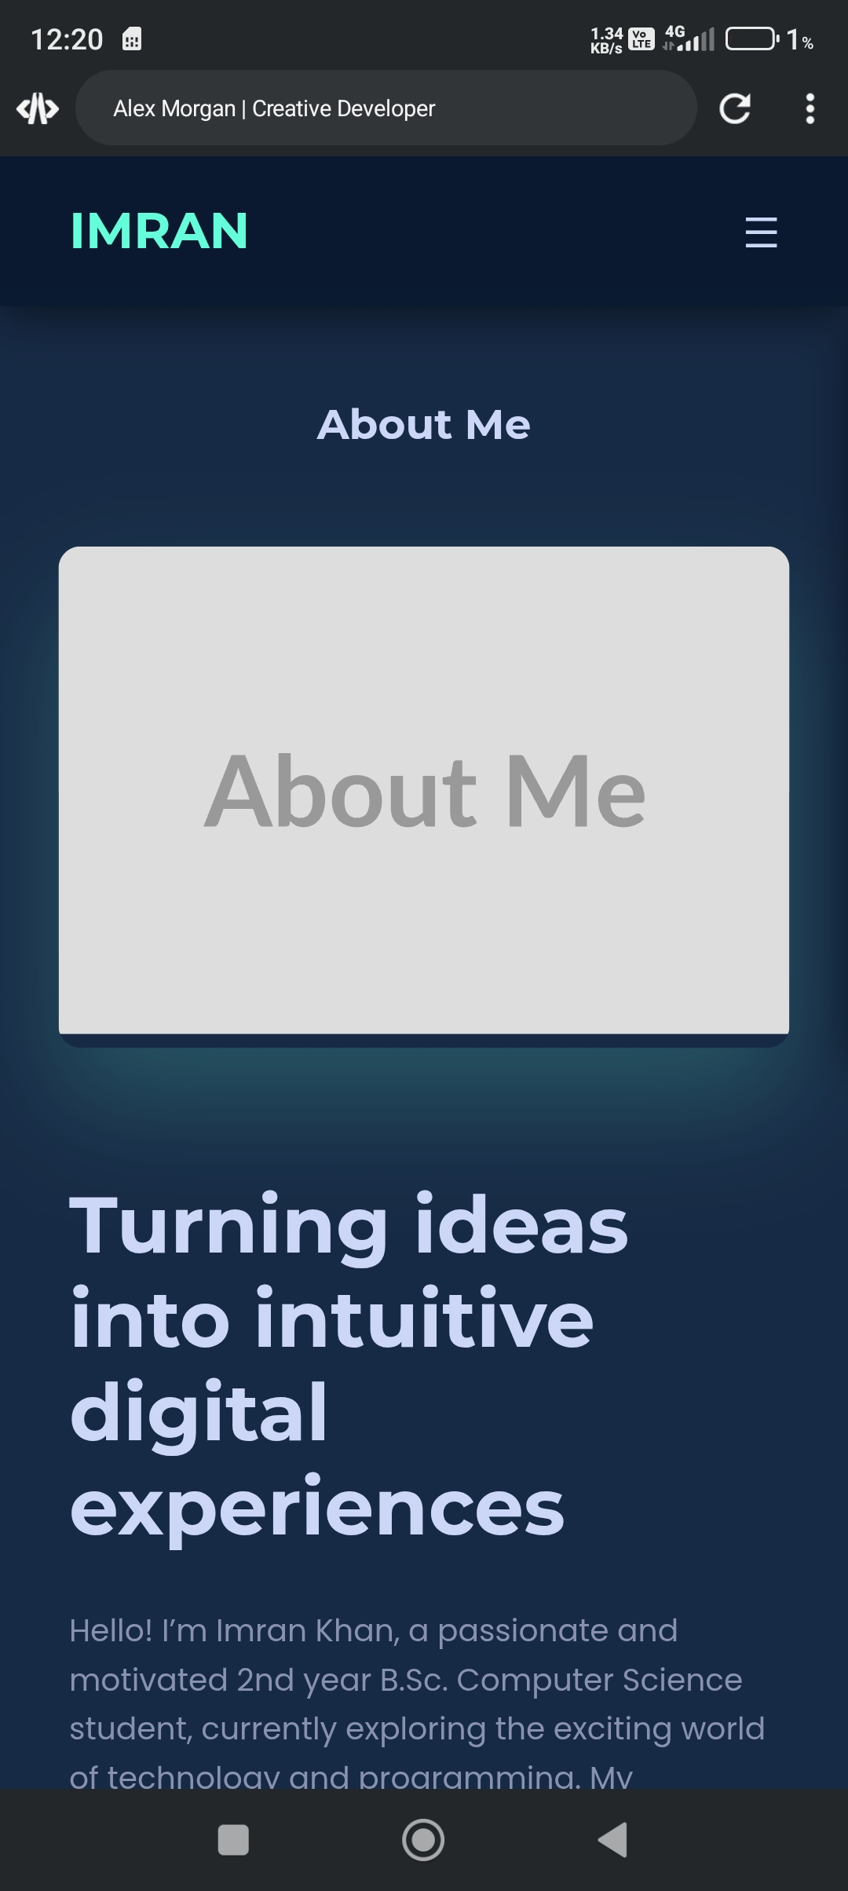
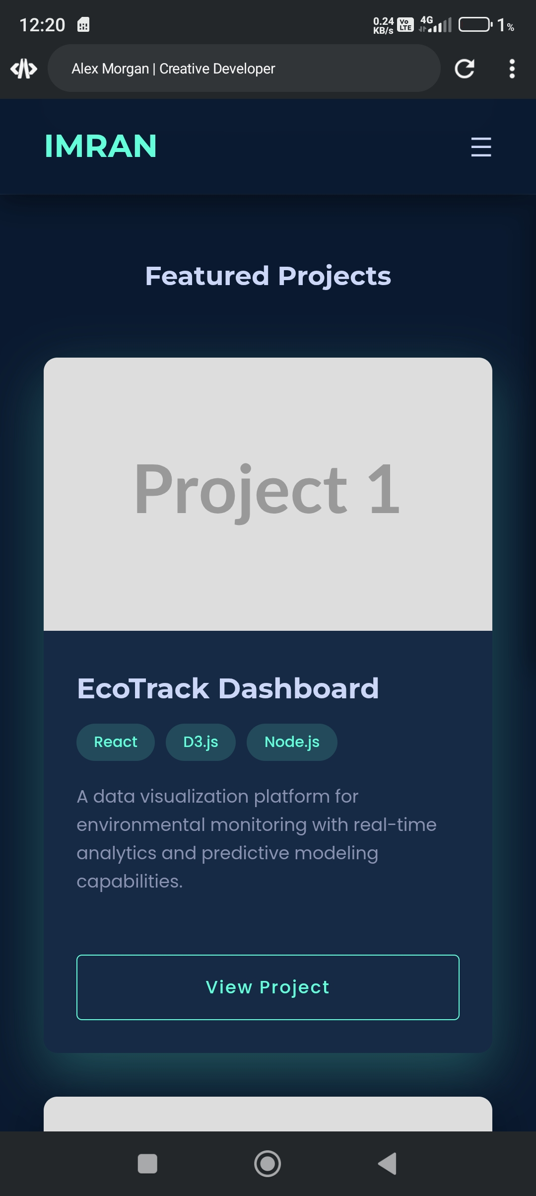

RESULTS AND SCREENSHOTS
3/21/2024 Annual Review
10

Slide 11
CONCLUSION
This portfolio website provides me with a professional online presence where I can showcase my skills, projects, and achievements. It serves as a digital resume, making it easier for recruiters, teachers, and collaborators to know about my work.
11

