Slide 1

The Seasons
Imran

Slide 2

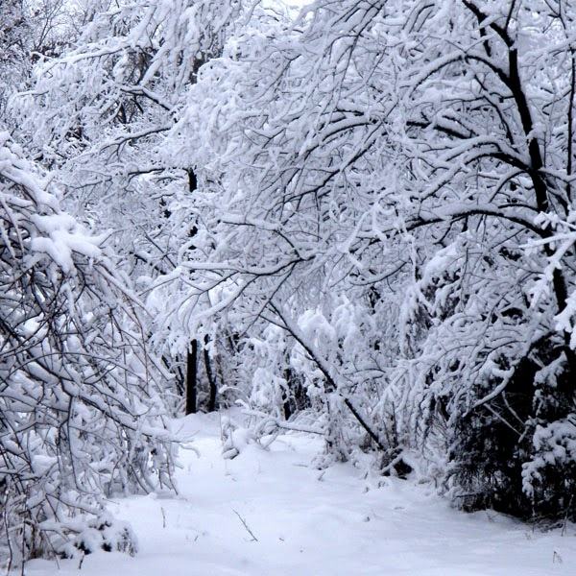
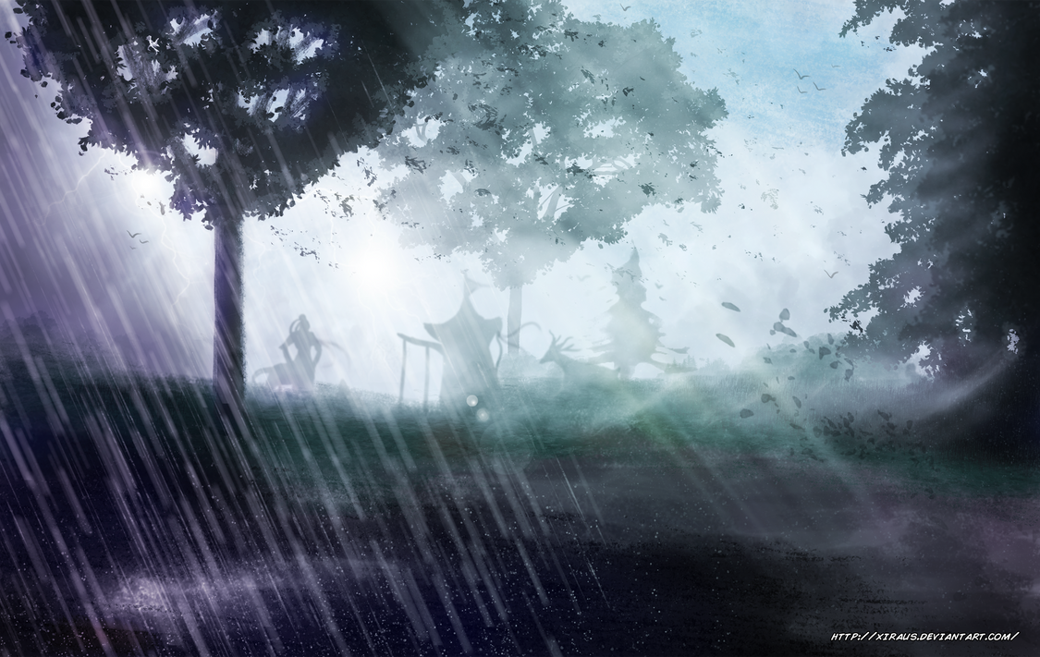
Comparing Winter & Summer
Winter
Cold
Snow
Summer
Hot
Rain
This Photo by Unknown Author is licensed under CC BY-NC
This Photo by Unknown Author is licensed under CC BY-NC
This Photo by Unknown Author is licensed under CC BY-NC-ND

Slide 3
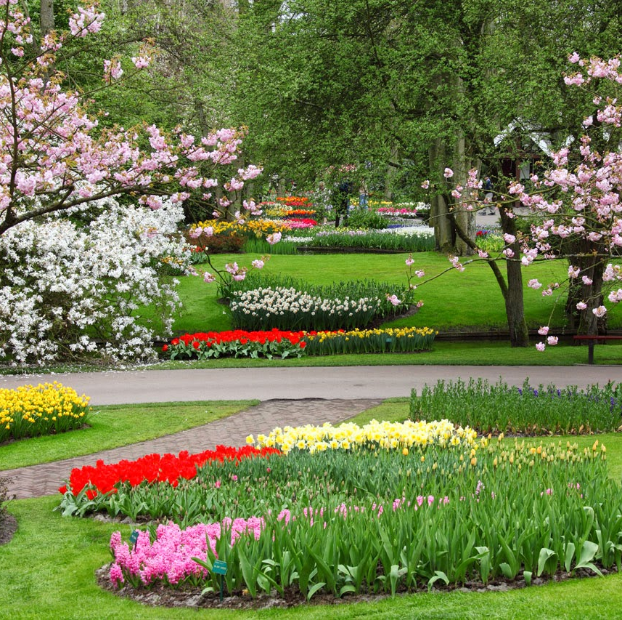
Spring
Warmer
This Photo by Unknown Author is licensed under CC BY

