Slide 1

ReactJS
Redux Deep Dive
Session-01
Thanos is on a mission to make his website standout from his rest of universe with ReactJS
Notes:
Add one logo

Slide 2
React JS
Session-01
Redux Deep Dive
Notes:
Add one logo

Slide 3
What is “Redux”?
A state management system for cross-component or app-wide state

Slide 4
What Is Cross-Component / App-Wide State?
Local State
Cross-Component State
App-Wide State
State that belongs to a single component
State that affects multiple components
State that affects the entire app (most/ all components)
E.g. listening to user input in a input field; toggling a ”show more” details field
E.g. open/ closed state of a modal overlay
E.g. user authentication status
Should be managed component-internal with useState() / useReducer()
Requires “prop chains” / “prop drilling”
Requires “prop chains” / “prop drilling”
OR: React Context or Redux

Slide 5
What is “Redux”?
A state management system for cross-component or app-wide state
Don’t we have “React Context” already?

Slide 6
React Context – Potential Disadvantages
Complex Setup / Management
Performance
In more complex apps, managing React Context can lead to deeply nested JSX code and / or huge “Context Provider” components
React Context is not optimized for high-frequency state changes

Slide 7

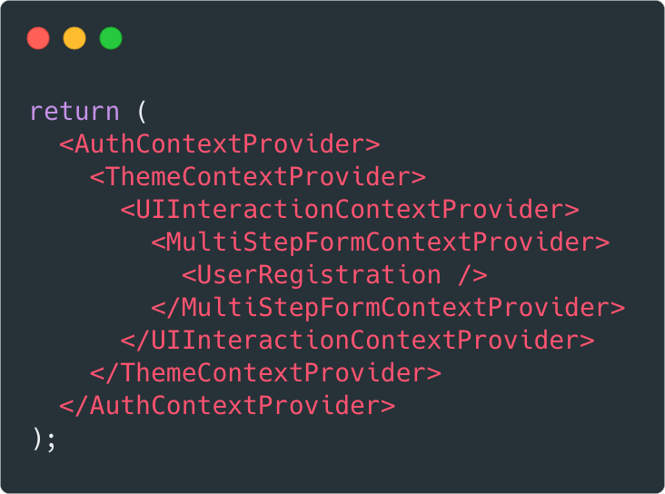
React Context – Complex Setup

Slide 8

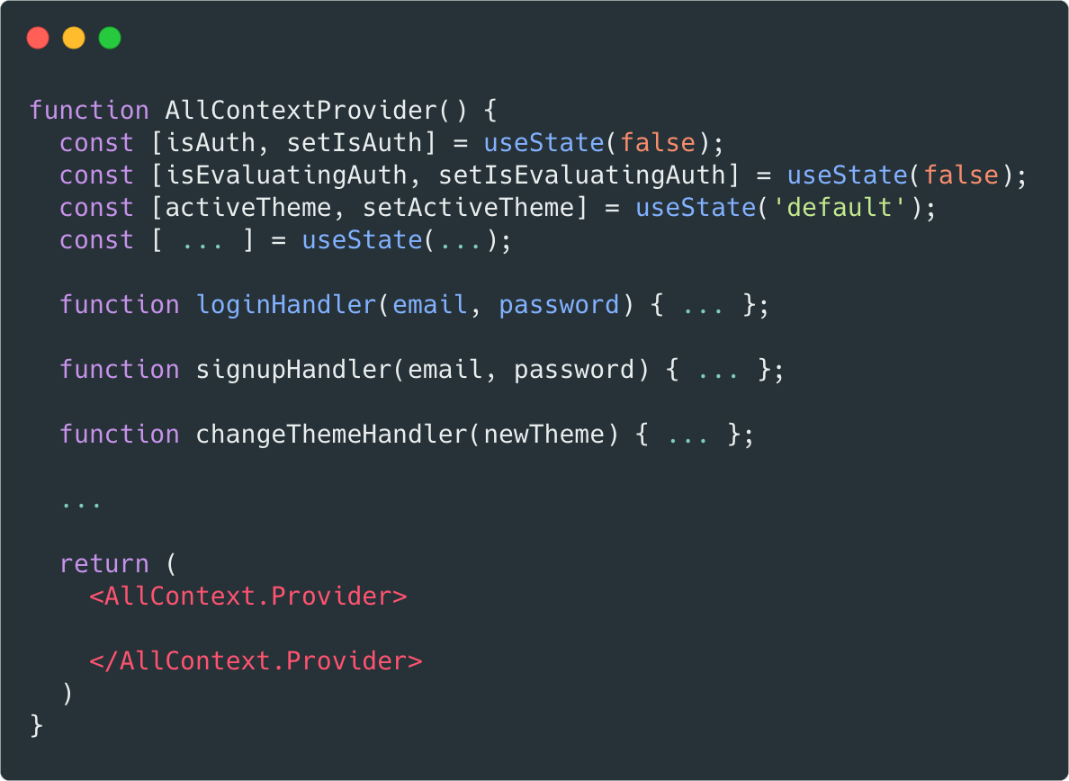
React Context – Complex Setup

Slide 9

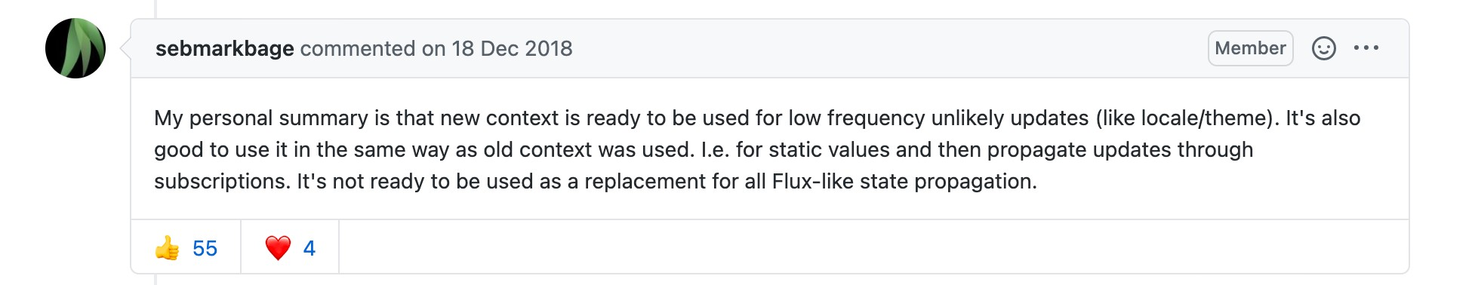
React Context – Performance

Slide 10
Core Redux Concepts
NOT useReducer() ➔
“Reducer Functions” are a general concept
Reducer Function
Forwarded to
Mutates (= changes) Store Data
Action
Central Data (State) Store
Subscription
Dispatch
Components

Slide 11
The Reducer Function
Should be a pure function
Same input leads to same output
Inputs: Old State + Dispatched Action
Output: New State Object

Slide 12
The Role Of Immutability
State updates must be done in an immutable way!
Objects and arrays are reference values in JavaScript
Changes made to an object
property affect ALL places where the object gets used
New object / array copies (also of nested objects / arrays) must be created when producing a new state

Slide 13

Notes:
What are some good examples of using it

Slide 14
Q & A

