Slide 1
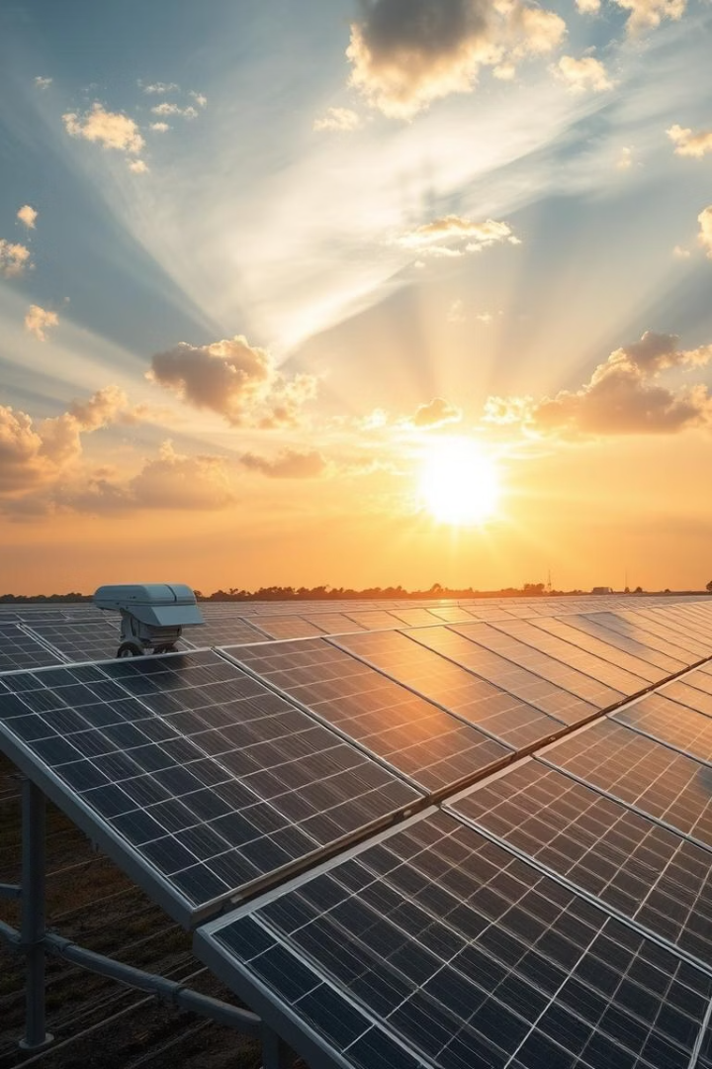

AI-Powered Solar Tracking: Optimizing Energy Capture
Welcome to our presentation on the development and impact of an intelligent solar tracking system using artificial neural networks. This project demonstrates how AI can significantly enhance solar energy capture efficiency while reducing costs.
We'll explore the technical aspects of our system, analyze real-world impacts, examine economic benefits, and discuss future developments in the solar sector. Our findings show promising results that could reshape the renewable energy landscape.
by Md Aamir Imran

Slide 2
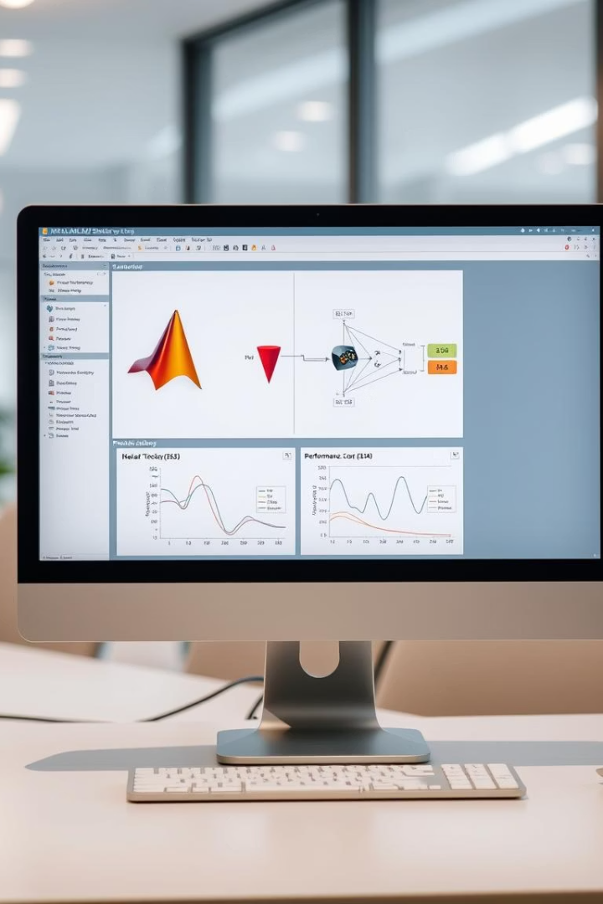



Project Overview & Methodology
Objective
Methodology
Develop intelligent solar tracking using artificial neural network control to optimize energy capture efficiency
MATLAB/Simulink simulation integrating physical modeling of PV panels and actuators with neural network controller
Key Results
23% energy gain versus fixed systems, 1.5° tracking accuracy (MAE), and 20% better cloudy-day performance compared to traditional trackers

Slide 3
Real-World Operational Improvements
Energy Yield Increase
Case Study: Gujarat
Case Study: Maharashtra
Implementation of tracking systems in utility-scale plants has demonstrated consistent energy yield increases of 15-30%, significantly improving plant output efficiency.
AI forecasting implementation reduced prediction gaps by 30%, allowing for better grid integration and resource planning.
AI-driven maintenance protocols boosted generation by 15% through optimized cleaning schedules and predictive maintenance.

Slide 4
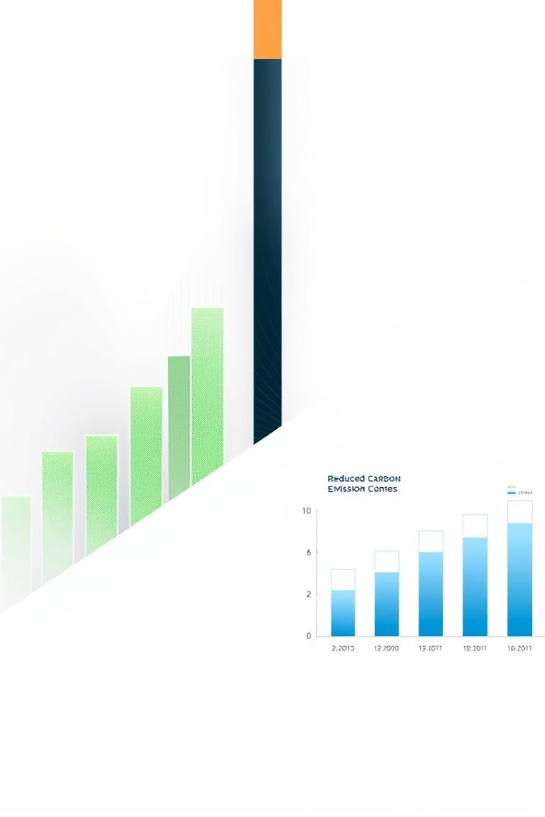
Economic & Environmental Benefits
Investment Returns
LCOE Reduction
While trackers add approximately 10% to capital expenditure, they deliver over 20% output gain, resulting in improved return on investment for solar projects.
Levelized Cost of Energy reduction of $0.03-$0.05/kWh for tracked versus fixed systems, making solar more competitive with conventional energy sources.
Carbon Impact
The efficiency gains from tracking systems prevent approximately 2.1 tons of CO₂ emissions per megawatt per year, contributing to climate change mitigation efforts.

Slide 5
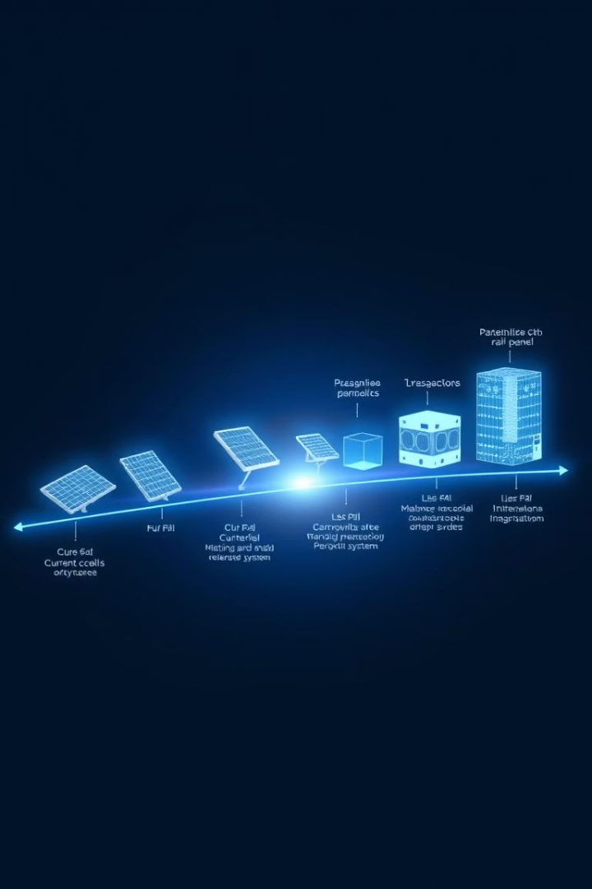



Technology Roadmap & Market Trends
Present - 2025
AI-optimized tracking systems and floating solar farms providing 10% cooling boost and land savings
2025 - 2027
AI-optimized microgrids with 25% maintenance cost reduction and improved grid integration
2026 - 2030
Perovskite cells reaching 35%+ efficiency, revolutionizing solar panel performance
Global tracker shipments increased 40% year-over-year to 95GW in 2023, with India targeting an ambitious 280GW solar capacity by 2030.

Slide 6








Cost Structure & Projections
Drive Systems
AI Controller
30% of total tracker system cost
15% of total tracker system cost
Mechanical Structure
Sensors
45% of total tracker system cost
10% of total tracker system cost
For a utility-scale 100MW plant, the tracker premium costs $8M-$10M but generates an annual revenue gain of $2.4M (based on 20% output boost at $0.05/kWh), resulting in a payback period of 3.5-4 years.

Slide 7

Strategic Recommendations
Hybrid Tracking Systems
Combine AI prediction with sensor feedback to achieve 5-8% additional yield over standard tracking systems. This approach optimizes performance across varying weather conditions.
Storage Integration
Pair tracking systems with emerging Na-ion batteries (projected at $75/kWh by 2025) to enable 24-hour energy dispatchability, addressing intermittency challenges.
Government Policy Alignment
Leverage Production Linked Incentive schemes, such as India's $2.6B allocation for solar manufacturing, to reduce implementation costs and accelerate adoption.

Slide 8

Cost-Benefit Analysis
23%
Energy Gain
Increased capture vs. fixed systems
3.5-4
Years
Typical payback period
$2.4M
Annual Revenue
For 100MW plant with trackers
2.1
Tons CO₂
Emissions prevented per MW yearly
The financial analysis demonstrates that despite the higher initial investment, AI-powered tracking systems deliver substantial returns through increased energy production and operational efficiencies. Environmental benefits further enhance the value proposition by contributing to sustainability goals.

Slide 9






Conclusion & Future Outlook
40%+ System Efficiency
Potential by 2030
Integrated Technologies
Perovskite + AI + Floating platforms
Current AI Tracking System
23% energy gain, 1.5° accuracy
Our AI-powered solar tracking system demonstrates measurable improvements in energy capture while aligning with global solar industry trends. The technology provides both immediate benefits and a foundation for future advancements.
Implementation alongside emerging technologies like perovskite cells and floating platforms could achieve system efficiency exceeding 40% by 2030, revolutionizing the economics and environmental impact of solar energy.

