Slide 1
Unit Testing using Spock

Slide 2

Imran Mir
Imran Mir
Technology Lead
To The New
Twitter: imirimran
LinkedIn: www.linkedin.com/in/imran-mir-81254010

Slide 3
Highlights
Spock and its advantages
Spock basics
Data driven testing
Spock Mocking
Extensions

Slide 4
Unit testing always takes a back seat
Does not provide short term gratification
Consumes resources -Time and Money
Tooling is not great
Verbosity of code
Verbosity in reports
Notes:
We end up copy pasting lot of tests
Can lead to refactoring nightmare

Slide 5
Spock
A testing framework for Java and Groovy applications
Based on Groovy
Compatible with JUnit
Helps writing expressive tests in less time
Notes:
The applications can contain both java and groovy or mix of both
Groovy is a productive dynamic programming language built on top of java. In shortcut we acheive a lot by writing lesser lines of code
Compatibility: IDE that supports JUnit can support Spock as well. IntelliJIdea/Eclipse
It reduces the number of lines of code considerable. Less code is more readable
Less effort in writing unit tests - Productive TDD

Slide 6
Setup
For java apps
Groovy
Spock
cglib
Notes:
Java 6, 7, 8
Groovy 2, 2.3 and 2,4

Slide 7
Do I need to learn Groovy to learn spock
Very small learning curve for Java developers
You just need to get used to a different tune of Java
Notes:
A java developer can easily read the Groovy code

Slide 8
Groovy
Powerful optionally typed, dynamic language, with static-typing and static compilation capabilities
Notes:
Show groovyConsole for optional typing and duck typing
Why do people like dynamic lang

Slide 9
Spock Basics

Slide 10
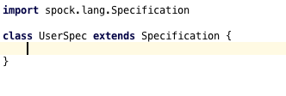
Spec
Notes:
We call test specs

Slide 11

Fixture methods

Slide 12
JUnit Test case
Notes:
Hard to read
Underscores are hard to type

Slide 13
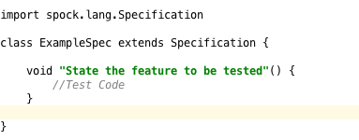
Feature Methods
Notes:
Test method name - No camalcase, No Underscores.. Text is more readable than them
User readability

Slide 14
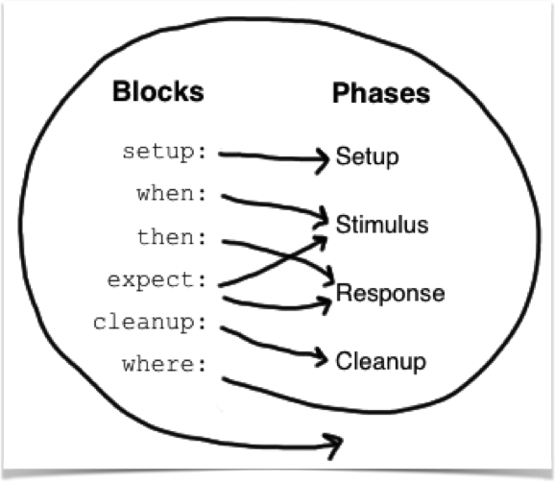
Blocks
Notes:
Feature methods consists of blocks
Conceptual phases of feature methods
Blocks are DSLs
Atleast ONE explicti block must be present
AnonymousSpec
Some more examples and description for blocksis needed

Slide 15

Reports
Notes:
Show on Groovy console
Power Asserts

Slide 16
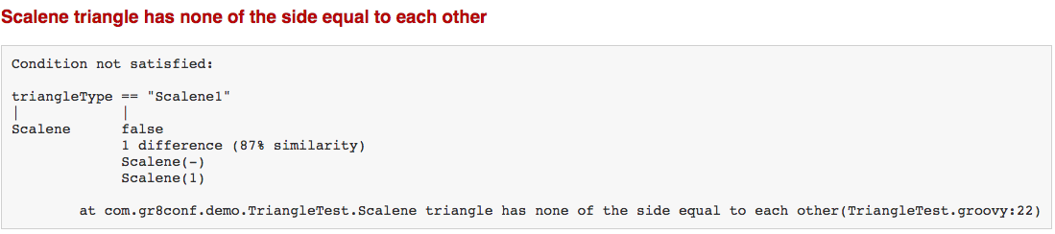
Notes:
Hint where things are wrong

Slide 17
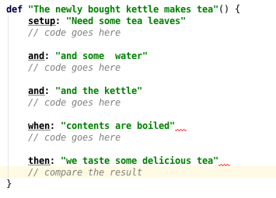
Best Documentation

Slide 18
Testing exception conditions
An exception is thrown
An exception is not thrown

Slide 19
Data Driven Testing
Spock separates data from code
Notes:
UserTest
Show groovy console of optional typing of a function call
Mixing data with code can only increase the complexity in the tests.
You may find it easier to copy code, but it is
Verbose
Hard to read
Test become hard to debug and manage
---Isolated Execution of Iterations in Spock tables----

Slide 20
Spock Extensions
Hook into the spec’s lifecycle to enrich or alter its behavior:
IgnoreRest
Ignore
IgnoreIf
Requires
PendingFeature
Stepwise
ConfineMetaClassChanges
Subject
Notes:
Stepwise - execute tests in order of their declaration

Slide 21
Interaction Based Testing
Explores how the object(s) under specification interact by way of method calls
Notes:
emerged in the Extreme Programming (XP) community in the early 2000’s.
Using JDK dynamic proxies and cglib proxies (rather than metaprogramming) to enable working with java code
Just to Isolate a piece of code from the rest

Slide 22

Mocks and Stubbing
Focus is on the behaviour rather than the state of objects
Mocks listen to the interactions
Notes:
Explain Publisher and Subscriber code

Slide 23

Stubbing

Slide 24
Partial mocking
Spy
Notes:
Spy = Partial mocking
GroovyMock - for Groovy code...can even stub the functions inserted due to metaProgramming

Slide 25
Extending Spock
We can create our own extensions

Slide 26
QUESTIONS ?

Slide 27
References
http://spockframework.org
https://meetspock.appspot.com/
https://github.com/imranmir/gr8conf-spock-demo
https://github.com/kensipe/spock-javaone2014

