Slide 1
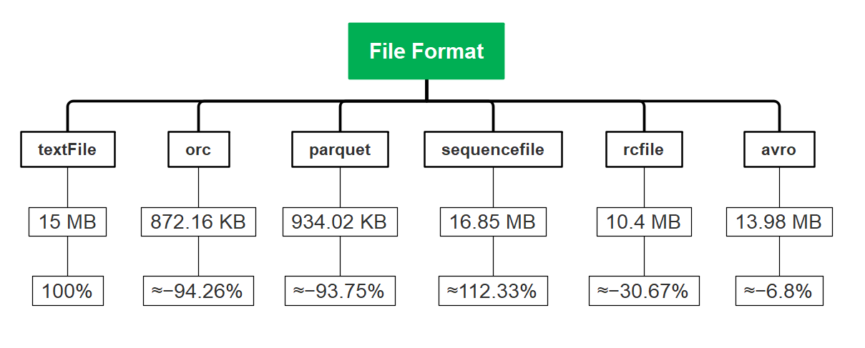

File Format Compression in Hive
/imrannazer/Data-Engineer

Slide 2
File Format Compression in Hive
File Properties
File Format | Columnar Storage | Row Format | Compression | Splittable | Schema Evolution | Hive Support
TextFile | No | Yes | No | Yes | No | Native
ORC | Yes | No | Yes | Yes | Yes | Native
Parquet | Yes | No | Yes | Yes | Yes | Native
SequenceFile | No | Yes | Yes | Yes | No | Native
RCFile | No | Yes | Yes | Yes | No | Native
Avro | Yes | No | Yes | Yes | Yes | External
Note: This table was generated by ChatGPT; please verify it on your side
/imrannazer/Data-Engineer

Slide 3
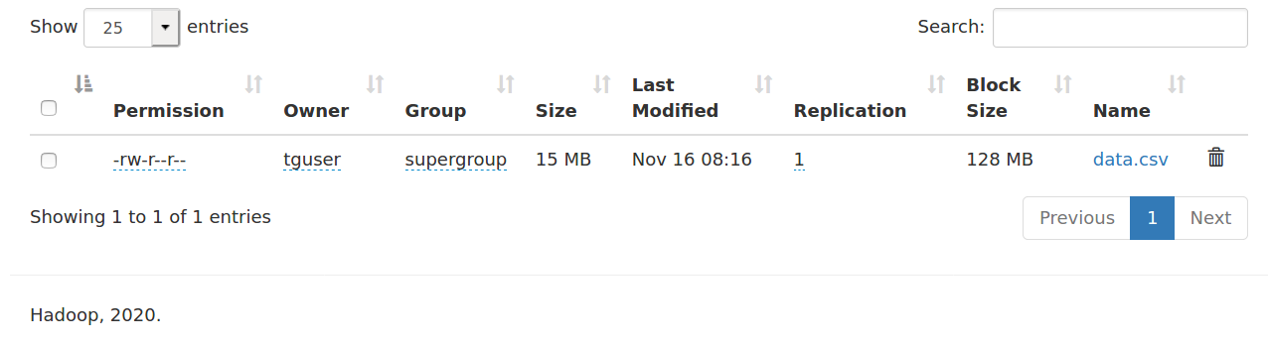
File Format Compression in Hive
textFile
/imrannazer/Data-Engineer

Slide 4
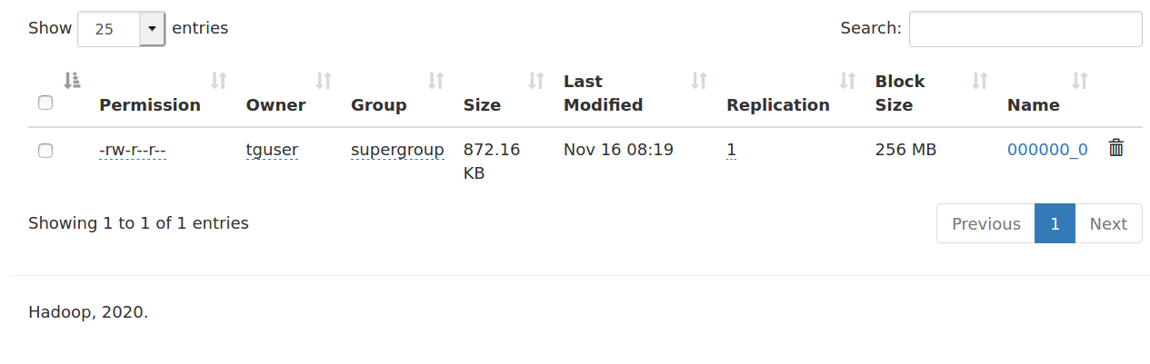
File Format Compression in Hive
orc
/imrannazer/Data-Engineer

Slide 5

File Format Compression in Hive
parquet
/imrannazer/Data-Engineer

Slide 6

File Format Compression in Hive
sequencefile
Note: SequenceFile is a key value-based file format
/imrannazer/Data-Engineer

Slide 7

File Format Compression in Hive
rcfile
/imrannazer/Data-Engineer

Slide 8

File Format Compression in Hive
avro
/imrannazer/Data-Engineer

Slide 9
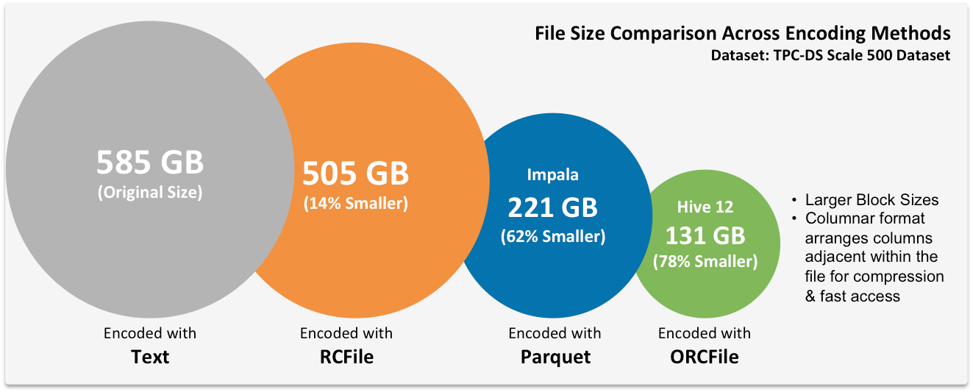
File Format Compression in Hive
Input File Formats in Hadoop
/imrannazer/Data-Engineer

