Slide 2
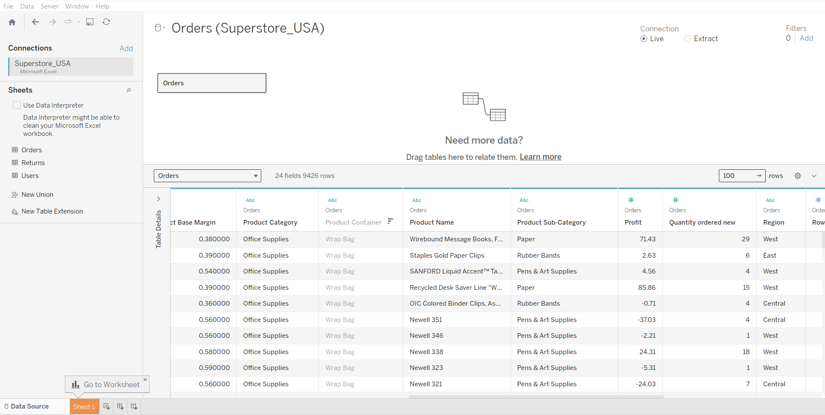
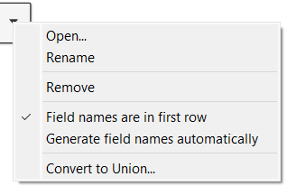
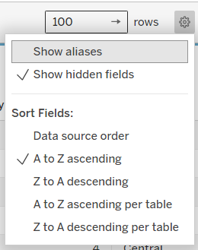
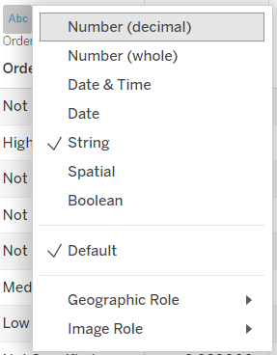
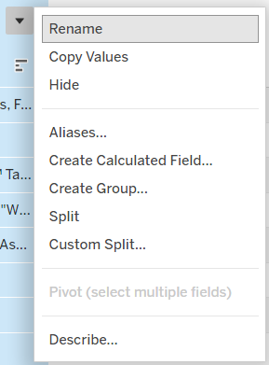

Slide 3
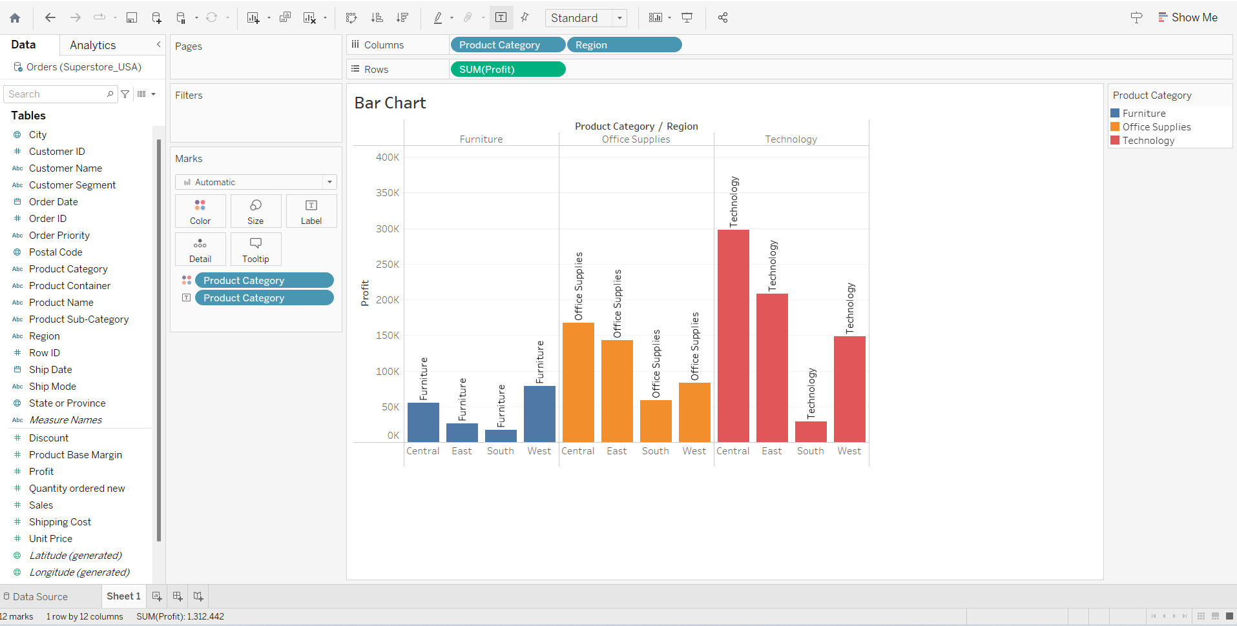
Sheet Title
Legend
Dimension
Measure

Slide 4


TABLEAU file extensions .twb Vs .twbx
.twb : Only the visualization, Dashboard, etc.
.twbx : Workbook and the underly extracted data

Slide 5
We can use Tableau both versions Tableau Desktop and Tableau public on same time

Slide 6
Tableau Desktop Vs Tableau Public
Aspect | Tableau Desktop | Tableau Public
Cost | Paid software, requires a license | Free to use
Data Sources | Wide range of data sources, including databases and spreadsheets | Limited to cloud-based data sources a
Data Privacy | Supports sensitive and private data | Data is public and can be accessed by anyone
Publishing | Can publish workbooks to Tableau Server or Tableau Online for private sharing | Publishes to the Tableau Public cloud platform for public access
Data Size | No limitations on data size | Limited to 10 million rows of data
Offline Access | Can work offline without an internet connection | Requires an internet connection to access and publish data
Export Options | Various export options, including PDF, image, and data files | Limited export options, mainly to PDF and images
Customization | Offers more advanced customization options | Limited customization compared to Tableau Desktop
Support and Training | Access to Tableau support and extensive training resources | Limited support and training options compared to Tableau Desktop
Licensing | Requires a paid license for full features | No license required, free to use

Slide 7
Time Series in Tableau

Slide 8
Trend and Seasonality
Trend an increasing or decreasing pattern over a period of time
Seasonality is a cycle pattern that repeats after a certain period of time repeats
Granularity
It is the scale or level of detail in a set of data.
+ YEAR (Order Date)
+ QUARTER (Order Date)
+ MONTH (Order Date)
DAY (Order Date)

