Slide 1
CHARACTERIZATION OF DISTRIBUTED SYSTEMS
From Chapter 1 of Distributed Systems Concepts and Design,4th Edition,
By G. Coulouris, J. Dollimore and T. Kindberg
Published by Addison Wesley/Pearson Education June 2005

Slide 2
Topics
CHARACTERIZATION OF DISTRIBUTED SYSTEMS
Defining Distributed Systems Resource sharing and the Web Design Challenges of Distributed Systems
Couloris,Dollimore and Kindberg Distributed Systems: Concepts & Design Edn. 4 , Pearson Education 2005

Slide 3
What is Distributed System
A distributed system is a collection of independent computers that appears to its users as a single coherent system.
This definition has two aspects:
  The first one deals with hardware: the machines are autonomous
  The second one deals with software: the users think they are dealing with a single system.
One important characteristic of a distributed system is that the differences between the various computers and the way in which they communicate are hidden from the users
Another important characteristic is that users and applications can interact with a distributed system in a consistent and uniform way, regardless of where and when interaction takes place.

Slide 4
Continue…
Distributed systems are often organized by means of a layer of software that is logically placed between a higher level layer consisting of users and applications and a layer underneath consisting of operating system.
For example, consider a network of workstations in a university. In addition to each user’s PC there might be a pool of processors in the machine room that are not assigned to specific users but are allocated dynamically as needed. Such a system might have a single file system, with all files accessible from all machines using the same path name.
If the system as a whole looks and acts like a classical single-processor timesharing system, it qualifies as a distributed system

Slide 5
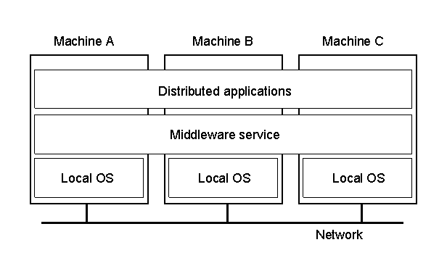
Continue…
1.1
A distributed system organized as middleware
Note that the middleware layer extends over multiple machines

Slide 6
Defining Distributed Systems
CHARACTERIZATION OF DISTRIBUTED SYSTEMS
Networks of computers are everywhere! Examples of networks of computers are: Mobile phone networks Corporate networks Factory networks Campus networks Home networks In-car networks On board networks in aero planes and trains
Couloris,Dollimore and Kindberg Distributed Systems: Concepts & Design Edn. 4 , Pearson Education 2005

Slide 7
Properties of Distributed Systems
CHARACTERIZATION OF DISTRIBUTED SYSTEMS
Our definition of distributed systems has the following significant properties: Concurrency Tasks carry out independently No global clock Tasks coordinate their actions by exchanging messages
Couloris,Dollimore and Kindberg Distributed Systems: Concepts & Design Edn. 4 , Pearson Education 2005

Slide 8
Properties Distributed Systems
CHARACTERIZATION OF DISTRIBUTED SYSTEMS
Independent Failures Faults in the network result in the isolation of the computers that are connected to it. Each component of the system can fail independently, leaving the others still running.
Couloris,Dollimore and Kindberg Distributed Systems: Concepts & Design Edn. 4 , Pearson Education 2005

Slide 9
General Examples of Distributed Systems
CHARACTERIZATION OF DISTRIBUTED SYSTEMS
Internet Intranets Mobile networks
Couloris,Dollimore and Kindberg Distributed Systems: Concepts & Design Edn. 4 , Pearson Education 2005

Slide 10
General Examples of Distributed Systems
CHARACTERIZATION OF DISTRIBUTED SYSTEMS
The Internet The Internet is a vast interconnected collection of computer networks of many different types. Multimedia services are available in the Internet enabling users to access audio and video data including music, radio, TV channels, phone, and video conferencing. (Figure 1)
Couloris,Dollimore and Kindberg Distributed Systems: Concepts & Design Edn. 4 , Pearson Education 2005

Slide 11
General Examples of Distributed Systems
CHARACTERIZATION OF DISTRIBUTED SYSTEMS
intranet

ISP



backbone
satellite link
desktop computer:
server:
network link:
Figure 1. A typical portion of the Internet
Couloris,Dollimore and Kindberg Distributed Systems: Concepts & Design Edn. 4 , Pearson Education 2005

Slide 12
General Examples of Distributed Systems
CHARACTERIZATION OF DISTRIBUTED SYSTEMS
Intranet An intranet is a portion of the Internet that is separately administered and has a boundary that can be configured to enforce local security policies. (Figure 2)
Couloris,Dollimore and Kindberg Distributed Systems: Concepts & Design Edn. 4 , Pearson Education 2005

Slide 13
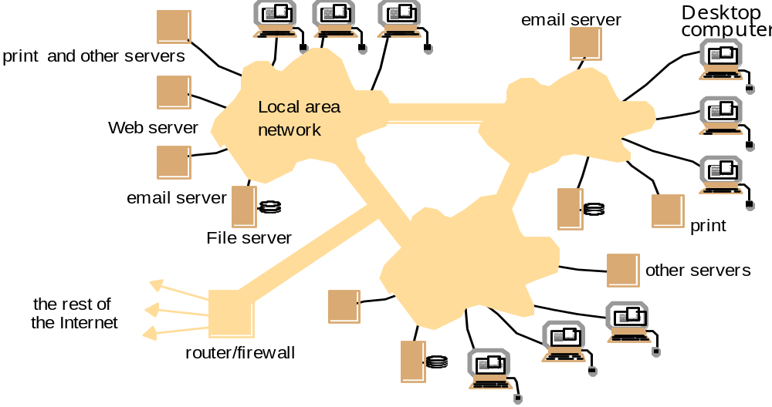
General Examples of Distributed Systems
CHARACTERIZATION OF DISTRIBUTED SYSTEMS
Figure 2. A typical Interanet
Couloris,Dollimore and Kindberg Distributed Systems: Concepts & Design Edn. 4 , Pearson Education 2005

Slide 14
General Examples of Distributed Systems
CHARACTERIZATION OF DISTRIBUTED SYSTEMS
Mobile networks Technological advances in device miniatorization and wireless networking have led increasingly to the integration of small and portable computing devices into distributed systems. These devices include: Laptop computers
Couloris,Dollimore and Kindberg Distributed Systems: Concepts & Design Edn. 4 , Pearson Education 2005

Slide 15
General Examples of Distributed Systems
CHARACTERIZATION OF DISTRIBUTED SYSTEMS
Handheld devices Personal digital assistants(PDAs) Mobile phones Pagers Video cameras Digital cameras
Couloris,Dollimore and Kindberg Distributed Systems: Concepts & Design Edn. 4 , Pearson Education 2005

Slide 16
General Examples of Distributed Systems
CHARACTERIZATION OF DISTRIBUTED SYSTEMS
Wearable devices Smart watches with functionality similar to a PDA Devices embedded in appliances Washing machines Hi-fi systems Cars Refrigerators (Figure 3)
Couloris,Dollimore and Kindberg Distributed Systems: Concepts & Design Edn. 4 , Pearson Education 2005

Slide 17
Mobile and Ubiquitous Computing
The portability of many of these devices, together with their ability to connect conveniently to networks in different places, makes mobile computing possible.
Mobile computing (also known as nomadic computing) is the performance of computing tasks while the user is on move, or visiting places other than their usual environment.
In mobile computing, users who are away from their “home” intranet are still provided with access to resources via the devices they carry with them.
They can continue to access the Internet; and there is increasing provision for users to utilize resources such as printers that are conveniently nearby as they move around. This is known as location aware or context-aware computing.

Slide 18
Ubiquitous Computing
Ubiquitous computing is the harnessing of many small, cheap computational devices that are present in users’ physical environments, including the home, office and even natural setting.
The term “ubiquitous” is intended to suggest that small computing devices will eventually become so pervasive in everyday objects that they are scarcely noticed. That is, the computational behavior will be transparently and intimately tied up with their physical function.
The presence of computers everywhere only becomes useful when they can communicate with one another. For example, it would be convenient for users to control their washing machine and their hi-fi system from a “universal remote control”.

Slide 19
Mobile and Ubiquitous Computing
Ubiquitous and mobile computing overlap, since the mobile user can in principle benefit from computers that are everywhere. But they are distinct in general.
Ubiquitous computing could benefit users while they remain in a single environment such as the home or hospital.
Mobile computing has advantages even if it involves only conventional discrete computers and devices such as laptop or printers.

Slide 20
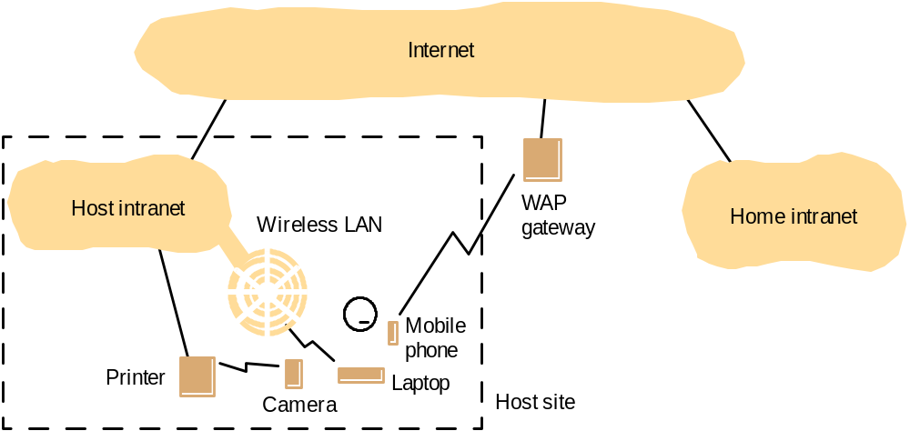
General Examples of Distributed Systems
CHARACTERIZATION OF DISTRIBUTED SYSTEMS
Figure 3. Portable and handheld devices in a distributed system.
Couloris,Dollimore and Kindberg Distributed Systems: Concepts & Design Edn. 4 , Pearson Education 2005

Slide 21
System Models
Minicomputer model
Workstation model
Workstation-server model
Processor-pool model
Cluster model
Grid Model

Slide 22
Minicomputer Model
Mini-
computer
ARPA
net
Mini-
computer
Mini-
computer
Extension of Time sharing system
  User must log on his/her home minicomputer.
  Thereafter, he/she can log on a remote machine by telnet.
Resource sharing
  Database
  High-performance devices

Slide 23
Workstation Model
Workstation
Workstation
100Gbps
LAN
Workstation
Workstation
Workstation
Process migration
  Users first log on his/her personal workstation.
  If there are idle remote workstations, a heavy job may migrate to one of them.
Problems:
  How to find am idle workstation
  How to migrate a job
  What if a user log on the remote machine

Slide 24
Workstation-Server Model
Client workstations
  Diskless
  Graphic/interactive applications processed in local
  All file, print, http and even cycle computation requests are sent to servers.
Server minicomputers
  Each minicomputer is dedicated to one or more different types of services.
Client-Server model of communication
  RPC (Remote Procedure Call)
  RMI (Remote Method Invocation)
    A Client process calls a server process’ function.
    No process migration invoked
    Example: NSF
Workstation
Workstation
Workstation
100Gbps
LAN
Mini-
Computer
file server
Mini-
Computer
http server
Mini-
Computer
cycle server

Slide 25
Processor-Pool Model
Clients:
  They log in one of terminals (diskless workstations or X terminals)
  All services are dispatched to servers.
Servers:
  Necessary number of processors are allocated to each user from the pool.
Better utilization but less interactivity
100Gbps
LAN
Server 1
Server N

Slide 26
Cluster Model
Workstation
Client
  Takes a client-server model
Server
  Consists of many PC/workstations connected to a high-speed network.
  Puts more focus on performance: serves for requests in parallel.
Workstation
Workstation
100Gbps
LAN
http server2
http server1
http server N
Master
node
Slave
1
Slave
2
Slave
N
1Gbps SAN

Slide 27
Other Examples of Distributed Systems
CHARACTERIZATION OF DISTRIBUTED SYSTEMS
Cluster A type of parallel or distributed processing system, which consists of a collection of interconnected stand-alone computers cooperatively working together as a single, integrated computing resource. The computers may be standard per uniprocessor or multiprocessor. A cluster can be used for providing highly scalable services such as search engines provide for users all over the Internet.
Couloris,Dollimore and Kindberg Distributed Systems: Concepts & Design Edn. 4 , Pearson Education 2005

Slide 28
Other Examples of Distributed Systems
CHARACTERIZATION OF DISTRIBUTED SYSTEMS
Grid A type of parallel and distributed system that enables the sharing, selection, and aggregation of geographically distributed autonomous resources dynamically at runtime depending on their availability, capability, performance, cost, and users' quality-of-service requirements.
Couloris,Dollimore and Kindberg Distributed Systems: Concepts & Design Edn. 4 , Pearson Education 2005

Slide 29
Goal of a Distributed System
A distributed system should easily connect users to resources;
It should hide the fact that resources are distributed across a network
It should be open
It should be scalable
Notes:
---y-----------------_

Slide 30
Design Challenges of Distributed Systems
CHARACTERIZATION OF DISTRIBUTED SYSTEMS
Designers of distributed systems need to take the following challenges into account: Heterogeneity Heterogeneous components must be able to interoperate. Openness Interfaces should allow components to be added or replaced. Security The system should only be used in the way intended.
Couloris,Dollimore and Kindberg Distributed Systems: Concepts & Design Edn. 4 , Pearson Education 2005

Slide 31
Design Challenges of Distributed Systems
CHARACTERIZATION OF DISTRIBUTED SYSTEMS
Scalability System should work efficiently with an increasing number of users. System performance should increase with inclusion of additional resources. Failure handling Failure of a component (partial failure) should not result in failure of the whole system.
Couloris,Dollimore and Kindberg Distributed Systems: Concepts & Design Edn. 4 , Pearson Education 2005

Slide 32
Design Challenges of Distributed Systems
CHARACTERIZATION OF DISTRIBUTED SYSTEMS
Transparency Distribution should be hidden from the user as much as possible.
Couloris,Dollimore and Kindberg Distributed Systems: Concepts & Design Edn. 4 , Pearson Education 2005

Slide 33
Heterogeneity
CHARACTERIZATION OF DISTRIBUTED SYSTEMS
The Internet enables users to access services and run applications over a heterogeneous collection of computers and networks. Heterogeneity applies to all of the following: Networks Hardware architectures Operating systems Programming languages
Couloris,Dollimore and Kindberg Distributed Systems: Concepts & Design Edn. 4 , Pearson Education 2005

Slide 34
Heterogeneity
CHARACTERIZATION OF DISTRIBUTED SYSTEMS
Although the Internet consists of many different sorts of networks, their differences are masked by the fact that all of the computers attached to them use the same Internet protocols to communicate with one another. Data type such as integers may be represented in different ways on different sorts of hardware, these differences in representation must be dealt with if messages are to be exchanged between programs running on different hardware. Although the operating systems of all computers on the Internet need to include an implementation of the Internet protocols, they do not necessarily all provide the same application programming interface to these protocols. For example, the calls for exchanging message in UNIX are different form the calls in Windows. Different programming languages use different representations for characters and data structures such as array and records. These differences must be addressed if programs written in different languages are to be able to communicate with one another.

Slide 35
Heterogeneity
CHARACTERIZATION OF DISTRIBUTED SYSTEMS
Middleware Middleware applies to a software layer. Middleware provides a programming abstraction. Middleware masks the heterogeneity of the underlying networks, hardware, operating systems and programming languages. The Common Object Request Broker (CORBA) is a middleware example. Some middleware such as Java Remote Method Invocation (RMI) supports only a single programming language. Most middleware is implemented over the Internet protocols, which themselves mask the differences of the underlying networks.

Slide 36
Heterogeneity
CHARACTERIZATION OF DISTRIBUTED SYSTEMS
Mobile code Mobile code is the code that can be sent from one computer to another and run at the destination. Java applets are the example of mobile codes. Code suitable for running on one computer is not necessarily suitable for running on another because executable programs are normally specific both to the instruction sets and to the host operating system. For example, exe. file sent as an e-mail attachments by Windows user will not run on Linux or Macintosh computer

Slide 37
Heterogeneity
CHARACTERIZATION OF DISTRIBUTED SYSTEMS
Virtual machine Virtual machine provides a way of making code executable on any hardware. The compiler for a particular language generates code for a virtual machine instead of a particular hardware order code. For example, the Java compiler produces code for the Java virtual machine, which needs to be implemented once for each type of hardware to enable Java program to run. But the Java solution is not generally applicable to program written in other languages.

Slide 38
Openness
CHARACTERIZATION OF DISTRIBUTED SYSTEMS
Distributed systems must be extensible. Openness of a computer system is the characteristic that determines whether the system can be extended and re-implemented in various ways. An open distributed system is a system that offers services according to standard rules that describe the syntax and semantics of those services. In computer networks, standard rules govern the format, contents and meaning of messages sent and received. Such rules are formalized in protocols.

Slide 39
Openness
CHARACTERIZATION OF DISTRIBUTED SYSTEMS
In distributed systems, services are generally specified through interface, which are often described in an Interface Definition Language (IDL) The first step in openness is publishing the documentation of software components and interfaces of the components to make them available to software developers. However, the publication of interfaces is only the starting point for adding and extending services in a distributed system. The challenge to designers is to tackle the complexity of distributed systems consisting of many components engineered by different people.

Slide 40
Openness
The developers of Internet protocols introduced a series of documents called “Requests For Comments” or RFCs, each of which is known by numbers.
The specifications of the Internet communication protocols were published in this series in the early 1980s, followed by specification for applications that run over them, such as file transfer, email and telnet by the mid 1980s.
This practice is continued and forms the basis of the technical documentation of the Internet.
RFCs are not only the means of publication. For example, CORBA is published through a series of technical documents, including a complete specification of the interfaces of its services.
Systems that are designed to support resource sharing in this way are termed open distributed system to emphasize the fact that they are extensible.

Slide 41
Openness
To summarize:
  Open systems are characterized by the fact that their key interfaces are published
  Open distributed systems are based on the provision of a uniform communication mechanism and published interfaces for access to shared resources.
  Open distributed system can be constructed from heterogeneous hardware and software, possibly from different vendors. But the conformance of each component to the published standard must be carefully tested and verified if the system is to work correctly.

Slide 42
Transparency
A distributed system that is able to present itself to users and applications as if it were only a single computer system is said to be transparent.
With transparency the system is perceived as a whole rather than a collection of independent components.
The ANSA Reference Manual [ANSA 1989] and the International Organization for Standardization’s Reference Model for Open Distributed Processing (RM-ODP) [ISO 1992] identify eight forms of transparency.

Slide 43
Transparency in a Distributed System
Transparency | Description
Access | Hide differences in data representation and how a resource is accessed
Location | Hide where a resource is located
Migration | Hide that a resource may move to another location
Relocation | Hide that a resource may be moved to another location while in use
Replication | Hide that a resource may be replicated
Concurrency | Hide that a resource may be shared by several competitive users
Failure | Hide the failure and recovery of a resource
Persistence | Hide whether a (software) resource is in memory or on disk
Different forms of transparency in a distributed system

Slide 44
Transparency
The two most important transparencies are access and location transparency; their presence or absence most strongly affects the utilization of distributed resources. They are sometimes referred to together as network transparency.
As an illustration of access transparency, consider a graphical user interface with folders, which is the same whether the files are inside the folder are local or remote.
URLs are location transparent because the part of URL that identifies a web server domain name refers to a computer name in a domain, rather than to a Internet address.

Slide 45
Security
CHARACTERIZATION OF DISTRIBUTED SYSTEMS
Security of a computer system is the characteristic that the resources are accessible to authorized users and used in the way they are intended. Security for information resources has three components: Confidentiality Protection against disclosure to unauthorized individual.

Slide 46
Security
CHARACTERIZATION OF DISTRIBUTED SYSTEMS
Integrity Protection against alteration or corruption. Availability Protection against interference with the means to access the resources.

Slide 47
Security
CHARACTERIZATION OF DISTRIBUTED SYSTEMS
Security Mechanisms are: Encryption Authentication Authorization
Couloris,Dollimore and Kindberg Distributed Systems: Concepts & Design Edn. 4 , Pearson Education 2005

Slide 48
Security challenges
CHARACTERIZATION OF DISTRIBUTED SYSTEMS
Denial of service attacks Denial of service attacks is an attempt to make a computer resource unavailable to its intended users. This can be achieved by bombarding the service with such a large number of pointless requests that the serious users are unable to use it.
Couloris,Dollimore and Kindberg Distributed Systems: Concepts & Design Edn. 4 , Pearson Education 2005

Slide 49
Security challenges
Security of mobile code
  Mobile code needs to be handled with care.
    E.g. receiving an executable program as an electronic mail attachment to display an interesting picture but in reality it may access local resources, or perhaps be part of a denial of service attack.

Slide 50
Scalability
Scalability of a system can be measured along at least three different dimensions:
  First, a system can be scalable with respect to its size, meaning that we can easily add more users and resources to the system
  Second, a geographically scalable system is one in which the users and resources may lie far apart.
  Third, a system can be administratively scalable, meaning that it can still be easy to manage even if it spans many independent administrative organizations.

Slide 51
Scalability
CHARACTERIZATION OF DISTRIBUTED SYSTEMS
Scalable distributed systems operate effectively and efficiently at many different scales, ranging from a small Intranet to the Internet. Scalable distributed systems remain effective when there is a significant increase in the number of resources and the number of users.

Slide 52
Scalability
CHARACTERIZATION OF DISTRIBUTED SYSTEMS
Challenges of designing scalable distributed systems are: Controlling the cost of physical resources Cost should linearly increase with the system size. For example, the frequency with which files are accessed in an intranet is likely to grow as the number of users and computer increases. It must be possible to add server computers to avoid performance bottleneck that would arise if a single file server had to handle all file access requests. In general, for a system with n users to be scalable, the quantity of physical resources required to support them should be at most O(n)--- that is, proportional to n.

Slide 53
Scalability
Controlling the performance loss
  Consider a table with the correspondence between the domain names of computers and their IP address held by the DNS, which is used mainly to look up DNS names.
  Algorithm that use hierarchic structures scale better than those that use linear structures.
  But even in hierarchic structures an increase in size will result in some loss in performance.
  For example, in hierarchically structured data, search performance loss due to data growth should not be beyond O(log n), where is the size of data.
  For a system to be scalable, the maximum performance loss should not be more than that

Slide 54
Scalability
CHARACTERIZATION OF DISTRIBUTED SYSTEMS
Preventing software resources running out An example is the numbers used as Internet addresses (IP)(32 bit->128-bit) Y2K like problem. Avoiding performance bottlenecks Using decentralized algorithms to avoid having performance bottlenecks. Caching and replication in Web are examples of providing scalability.
Couloris,Dollimore and Kindberg Distributed Systems: Concepts & Design Edn. 4 , Pearson Education 2005

Slide 55
Failure handling
CHARACTERIZATION OF DISTRIBUTED SYSTEMS
Failures in distributed systems are partial, that is some components fail while others continue to function. Techniques for dealing with failures: Detecting failures Some failures can be detected. E.g. Checksums can be used to detect corrupted data in a file or message. Masking failures E.g. Retransmission of corrupt messages File can be written to a pair of disks so that if one is corrupted, the other may be correct
Couloris,Dollimore and Kindberg Distributed Systems: Concepts & Design Edn. 4 , Pearson Education 2005

Slide 56
Failure handling
CHARACTERIZATION OF DISTRIBUTED SYSTEMS
Tolerating failures E.g. Exception handling E.g. Timeouts Recovery from Failure Recovery involves the design of software so that the state of permanent data can be recovered or “roll back” after the server has crashed.
Couloris,Dollimore and Kindberg Distributed Systems: Concepts & Design Edn. 4 , Pearson Education 2005

Slide 57
Failure handling
CHARACTERIZATION OF DISTRIBUTED SYSTEMS
Redundancy Services can be made to tolerate failure by the use of redundant components. Consider the following examples: There should always be at least two different routes between any two routers in the Internet. In DNS, every name table should be replicated in at least two different servers. A database may be replicated in several servers to ensure that the data remain accessible after the failure of any single server
Couloris,Dollimore and Kindberg Distributed Systems: Concepts & Design Edn. 4 , Pearson Education 2005

Slide 58
Concurrency
CHARACTERIZATION OF DISTRIBUTED SYSTEMS
With concurrency, services and applications can be shared by clients in a distributed system. For an object to be safe in a concurrent environment, its operations must be synchronized in such a way that its data remains consistent.
Couloris,Dollimore and Kindberg Distributed Systems: Concepts & Design Edn. 4 , Pearson Education 2005

Slide 59
Concurrency
CHARACTERIZATION OF DISTRIBUTED SYSTEMS
Concurrency can be achieved by standard techniques such as semaphores, which are used in most operating systems.
Couloris,Dollimore and Kindberg Distributed Systems: Concepts & Design Edn. 4 , Pearson Education 2005

