Slide 1
Lets Start!
IT-4105: Management Information System

Slide 2
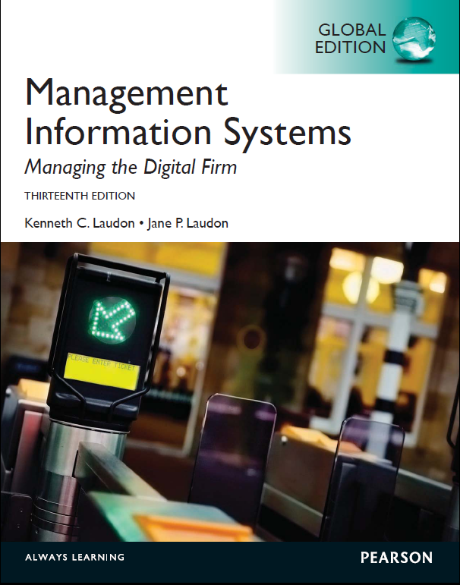
http://www.learnr.pro/view/book/59277-management-information-systems#19444:88337.65538875014

Slide 3
Chapter One
Information Systems in Global Business Today

Slide 4
The Role of Information Systems in Business Today
  Information meaningful data (facts)
  Societies mainly depend on the information
  Information support to achieve desired objectives
    Planning, organizing, decision making, …
  IS process (handle) the data to be useful information
    Through H/W, S/W, telecommunication, DB
  IS computer systems related to process data and provide required information
  ATMs, airline reservation systems, course reservation systems
DATA
PROCESS
INFORMATION

Slide 5
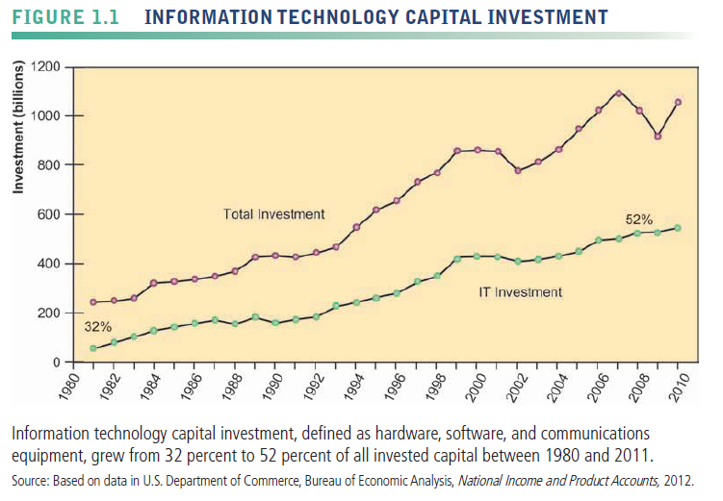
The Role of Information Systems in Business Today
IS play vital role in business today

Slide 6
The Role of Information Systems in Business Today
How IS transforming business
  Increased technology investments
  IS provide economic value to business
  Increased responsiveness to customer demands
  Shifts in media and advertising and commerce
  New federal security and accounting laws required
Globalization opportunities
  Internet reduced costs of operating, on global scale
    Customers and firms
    Using foreign markets, easily replicate service
    E.g. Google and ebay

Slide 7
The Role of Information Systems in Business Today
What’s new in management information systems?
There are three interrelated changes in the technology area:
  The emerging mobile digital platform,
  the growing business use of "big data,"
  the growth in “cloud computing,”

Slide 8
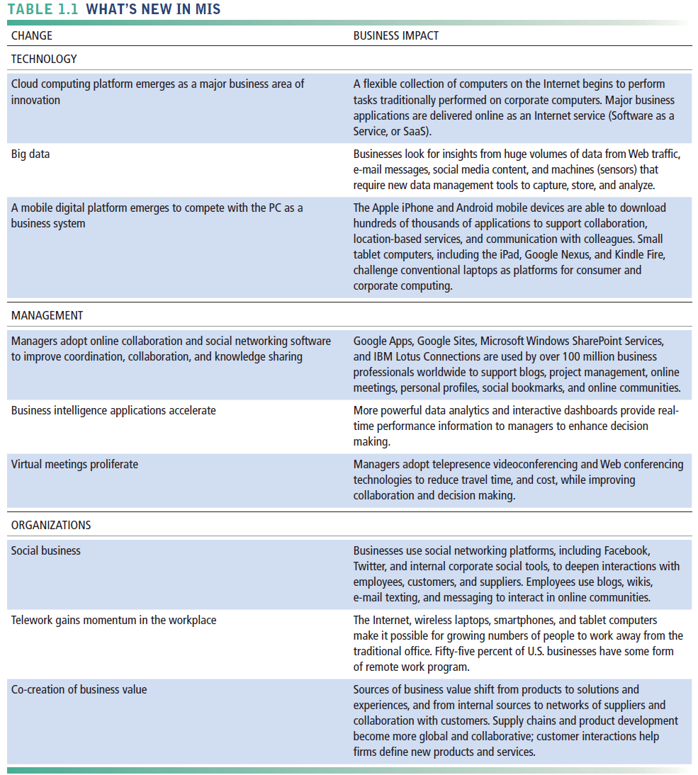

Slide 9
The Role of Information Systems in Business Today
Emerging digital firm
  It’s significant business relationships are digitally enabled and mediated
  It’s core business processes are accomplished through digital networks
  Key corporate assets are managed digitally
Digital firms offer greater flexibility in organization and management
  Time shifting, space shifting
Cisco Systems, 3M, and IBM, are close to becoming digital firms

Slide 10
Business process
Business process : tasks, rules, behaviors that been developed to produce business results.
eg.
  Developing new product
  Creating market plan
  Hiring an employee
  Considered source of competitive strength
  IS automate many business process

Slide 11
The Role of Information Systems in Business Today
Business firms invest heavily in information systems to achieve six strategic business objectives:
  Operational excellence
  New products, services, and business models
  Customer and supplier intimacy
  Improved decision making
  Competitive advantage
  Survival

Slide 12
The Role of Information Systems in Business Today
Operational excellence:
  Improvement of efficiency of operation to attain higher profitability
  Information technology tool to achieving greater efficiency and productivity
  >Practice business and management behavior based on IT.
  E.g. Wal-Mart’s RetailLink system links suppliers to stores for superior replenishment system
New products, services, and business models:
  Business model: describes how company produces, delivers, and sells product or service to create wealth
  Information systems and technology a major enabling tool for new products, services, business models
    E.g. Apple’s iPod, iTunes and Netflix’s Internet-based DVD rentals

Slide 13
The Role of Information Systems in Business Today
Customer and supplier intimacy:
  Serving customers well leads to customers returning, which raises revenues and profits
    E.g. High-end hotels that use computers to track customer preferences and use to monitor and customize environment
  Intimacy with suppliers allows them to provide vital inputs, which lowers costs
    E.g. J.C.Penney’s information system which links sales records to contract manufacturer
Improved decision-making
  Without accurate information:
    Managers must use forecasts, best guesses, luck
    Leads to:
      Overproduction, underproduction of goods and services
      Misallocation of resources
      Poor response times
    Poor outcomes raise costs, lose customers
  IS provide real-time data for making decisions
  E.g. Airtel’s Web-based digital dashboard to provide managers with real-time data on customer complaints, network performance, line outages, etc.

Slide 14
The Role of Information Systems in Business Today
Competitive advantage
  Achieve higher sales and profit through using IS by:
    Doing things better
    Charging less for superior products
    real time Responding
  Using the internet is competitive advantage
  E.g. Dell: Consistent profitability over 25 years; Dell remains one of the most efficient producer of PCs in world.
  But Dell has lost some of its advantages to fast followers-- HP
Survival
  Information technologies are necessity of doing business
  May be:
    Industry-level changes, e.g. Citibank’s introduction of ATMs
    Governmental regulations requiring record-keeping
      E.g. Toxic Substances Control Act, Sarbannes-Oxley Act

Slide 15
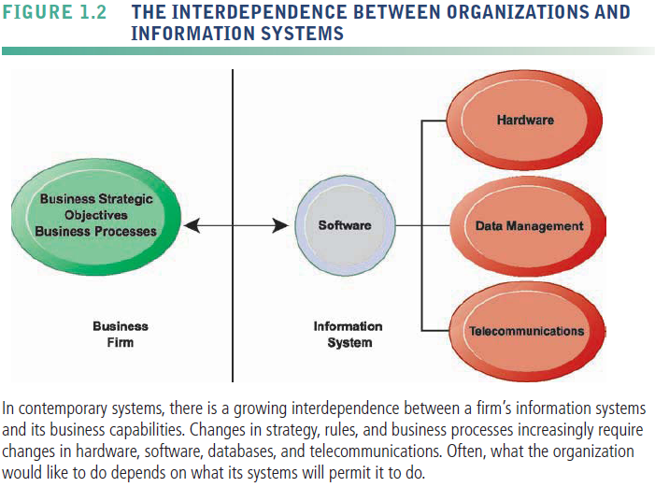
The Role of Information Systems in Business Today

Slide 16
Perspectives on Information Systems
Information system:
  Set of interrelated components
  Collect, process, store, and distribute information
  →By computers and software as a tool
  Support decision making, coordination, control, problem analysis and create new product
  Provide solutions to challenges in business Env.
Information vs. data
  Data are streams of raw facts
  Information is data shaped into meaningful form

Slide 17
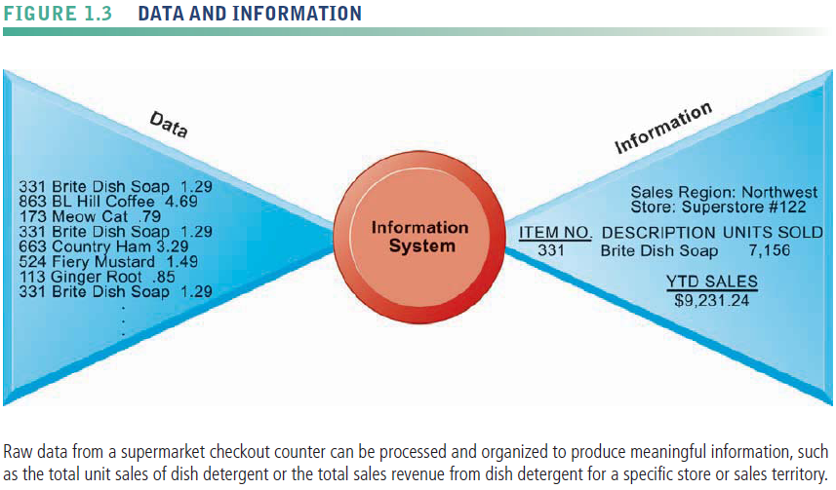
Perspectives on Information Systems

Slide 18
Perspectives on Information Systems
Information system: activities produce required information
  Input: Captures raw data from organization or external environment
  Processing: Converts data into meaningful form
  Output: Transfers processed information to people or activities that use it
  Feedback: Output returned to appropriate members of organization to help evaluate or correct input stage
Computer/Computer program vs. information system
  Computers and software are technical foundation and tools to store and process information
  similar to the material and tools used to build a house
  Cannot produce required information to a particular organization

Slide 19
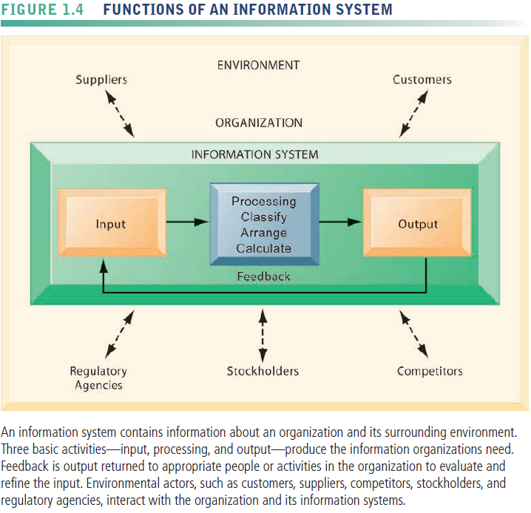
Perspectives on Information Systems

Slide 20
Perspectives on Information Systems
Dimensions (boarders) of IS
  Understanding of IS dimensions is IS literacy
  Where computer literacy is focus on primarily on knowledge of IT
  MIS try to achieve this boarders, deals with behavioral and technical issues surrounding development, use and impact of IS in the firm

Slide 21
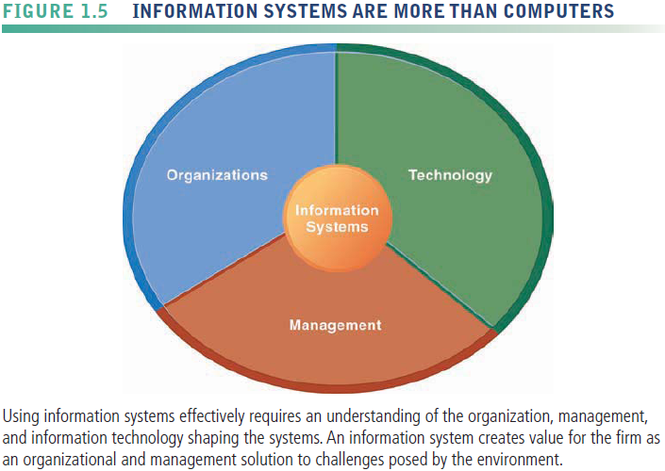
Perspectives on Information Systems

Slide 22
Perspectives on Information Systems
Organizational dimension of IS
  structure: different levels and specialties
    hierarchy of authority, responsibility: Senior Middle Operational management, Knowledge service Data workers
  business process: Organization coordinate its work through its hierarchy and business process
  Culture : ways of doing things, part is embedded in IS.
  Experts are employed and trained for different business functions (tasks):
    Sales and marketing
    Human resources
    Finance and accounting
    Production and manufacturing

Slide 23
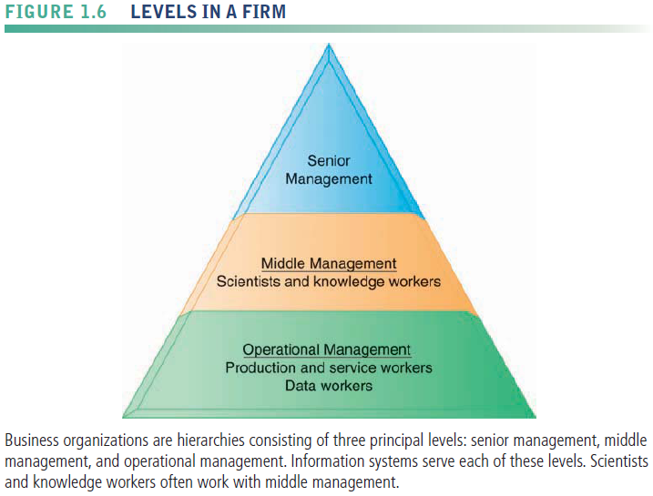
Perspectives on Information Systems

Slide 24
Perspectives on Information Systems
Management dimension
  Make decisions, formulate action plan and solve organizational problem
  Managers set organizational strategy for responding to business challenges
  In addition, managers must act creatively:
    Creation of new products and services
    Occasionally re-creating the organization
Technology dimension
  Computer hardware
  Software: instructions that control H/W
  Data management technology: S/W governing data
  Networking and telecommunications technology
    H/W and S/W link pieces of H/W and transfer data: Network, Internet, intranets and extranets, WWW
  IT infrastructure: platform that the firm can built on its IS

Slide 25
Perspectives on Information Systems
Business perspective on IS:
  IS instrument for creating value to firms
  Investments in IS result in superior returns:
    Increases productivity and revenue
  IS provides information that helps managers making better decisions and improve the execution of business process
  Value of IS
Business information value chain
  Raw data acquired and transformed through stages that add value to that information
  Value of information system determined by its ability to result in better decisions, greater efficiency of business process, and higher profits
Business perspective: Calls attention to organizational and managerial nature of information systems

Slide 26
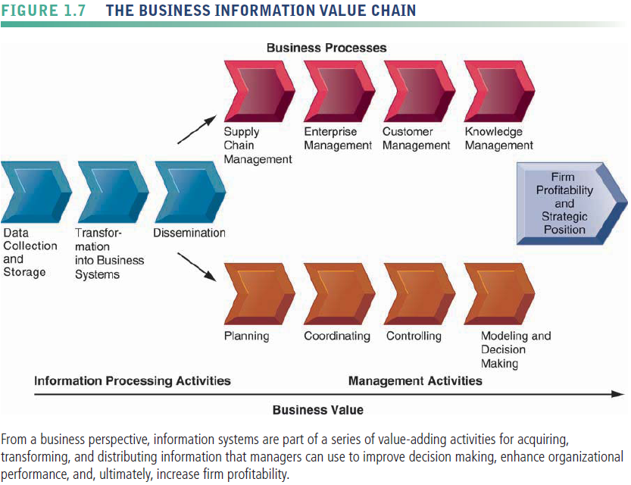
Perspectives on Information Systems

Slide 27
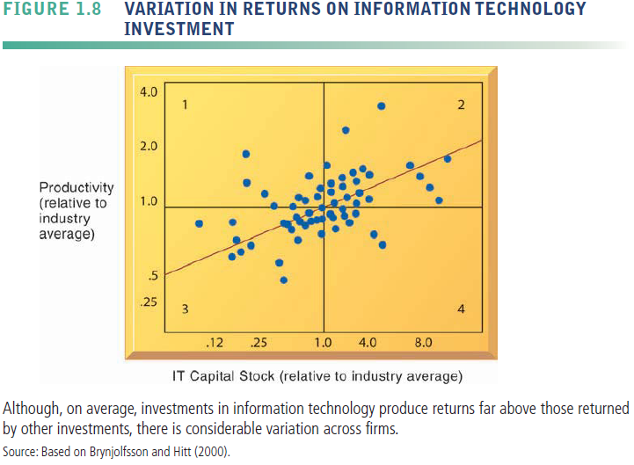
Perspectives on Information Systems

Slide 28
Perspectives on Information Systems
Investing in information technology does not guarantee good returns
Considerable variation in the returns firms receive from systems investments
Factors:
  Adopting right business model according (suite) to new technology
  complementary investments (business processes, models, management behavior and culture)

Slide 29
Perspectives on Information Systems
Complementary assets:
  Assets required to derive value from a primary investment
  Firms supporting their technology investments with investment in complementary assets receive superior returns
    E.g.: invest in technology and the people to make it work properly
Complementary assets include:
  Organizational investments, e.g.
    Appropriate business model
    Efficient business processes
  Managerial investments, e.g.
    Incentives for management innovation
    Teamwork and collaborative work environments
  Social investments, e.g.
    The Internet and telecommunications infrastructure
    Technology standards

Slide 30
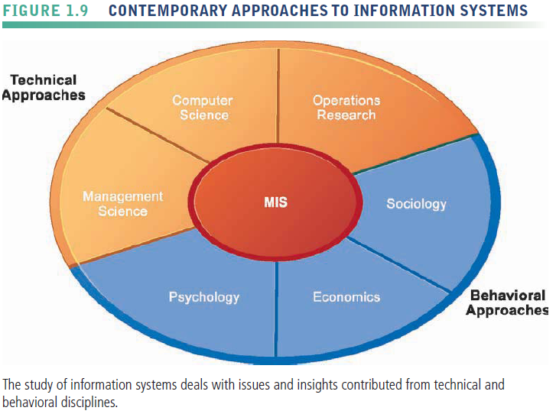
Perspectives on Information Systems

Slide 31
Contemporary Approaches to Information Systems
Technical approach: Emphasizes mathematically based models
    Computer science theories of commutation ,data storage
    management science: models of DM and practices
    operations research: optimizing selected parameters of org.
Behavioral approach: Behavioral issues such strategic business integration, implementation...
    Psychology: how decision makers use formal information
    Economics: how IS change the control and cost structures
    Sociology: how system affect individuals and groups

Slide 32
Contemporary Approaches to Information Systems
Management Information Systems
  Use of computer-based information systems in business firms
  Combines work of CS, management, and operating research toward developing system solutions to real word problems
  Concerned with behavioral issues of development, use and impact of IS
main actors
  Suppliers of hardware and software
  Business firms
  Managers and employees
  Firm’s environment (legal, social, cultural context)

Slide 33
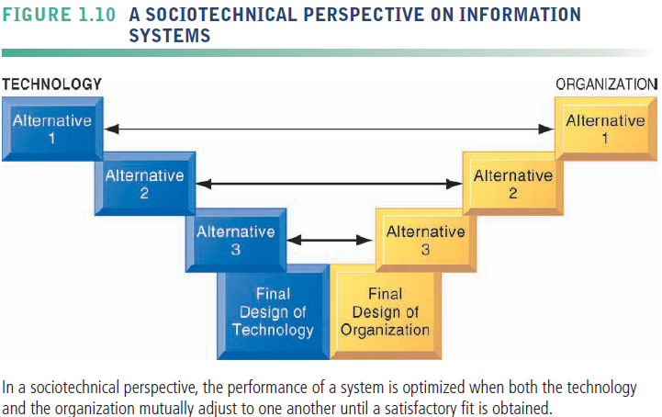
Contemporary Approaches to Information Systems

