Slide 1
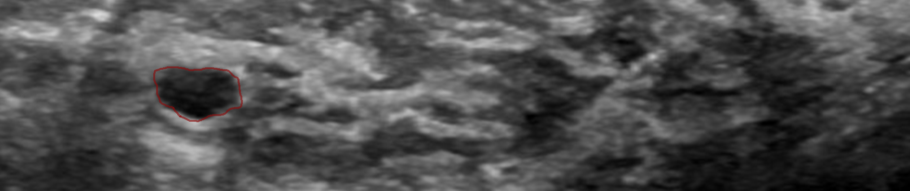
Automatic Diagnosis of Breast Cancer | IUSS 23-24
Presented by
Rahman, Md Imranur
Notes:
The competition is designed to challenge participants to build a machine learning model capable of automatically distinguishing between benign and malignant breast lesions in ultrasound studies.

Slide 2
Objective
Develop a machine learning model that can automatically distinguish between malignant and benign breast tumor in ultrasound (US) studies.

Slide 3
Dataset Description
Total : 1112 data
Label: Two labels
1. Benign
2. Malignant
Notes:
Total samples: 1112 ultrasound studies.
Labels: Two categories – Benign and Malignant.
The dataset is designed in a way where multiple segmented lesions might exist within a single study. For instance, if a study has more than one lesion, it may contain multiple files, such as “benign (25)_mask” and “benign (25)_mask_1”.
Each lesion is represented with a segmentation mask, which is a binary image where:
White pixels (1) indicate the region of interest—the lesion itself.
Black pixels (0) represent the background or irrelevant parts of the image.

Slide 4
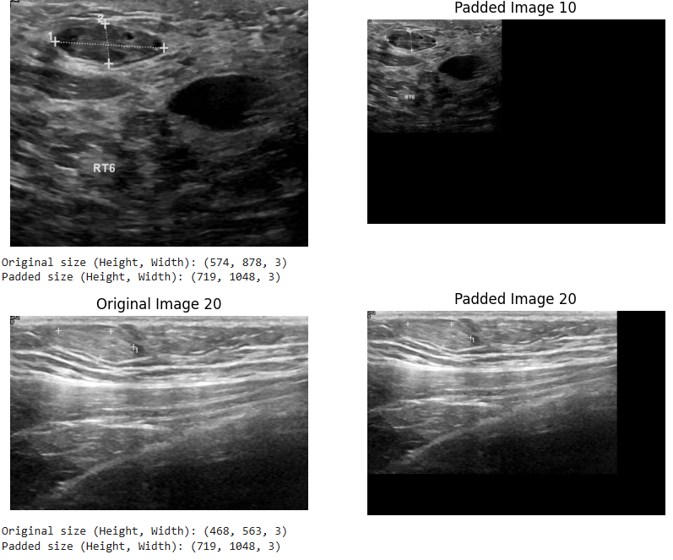
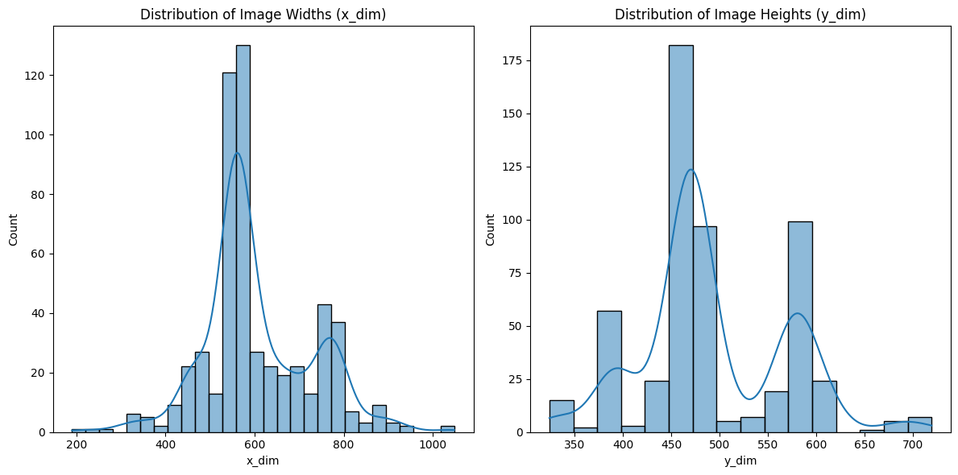
Image Sizes Before and After Padding
Image Size Analysis

Slide 5
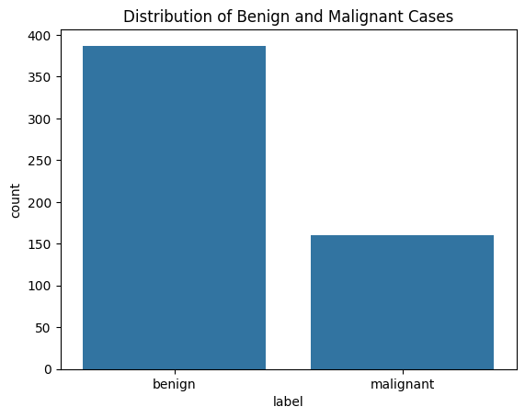
Class Distribution

Slide 6
Key Challenges
Imbalanced Data
Perfect Model

Slide 7
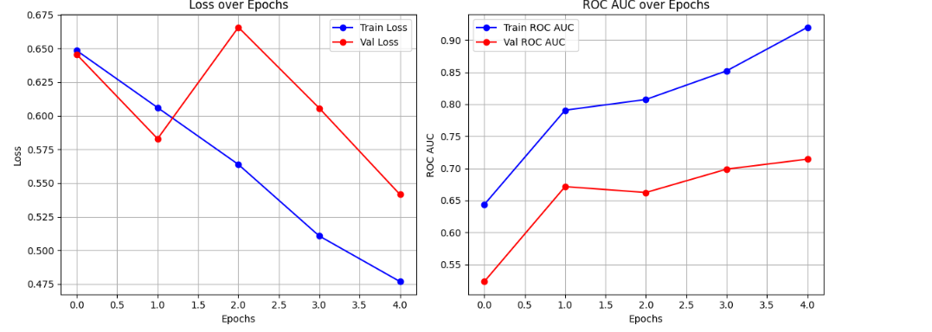
Simple CNN without Data augmentation

Slide 8
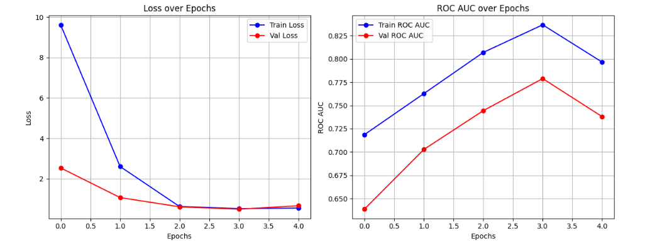
Hyperparameter tuning

Slide 9
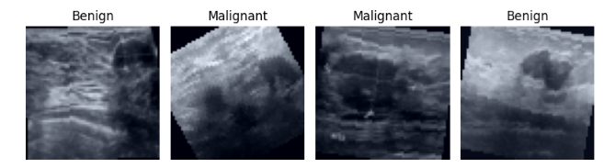
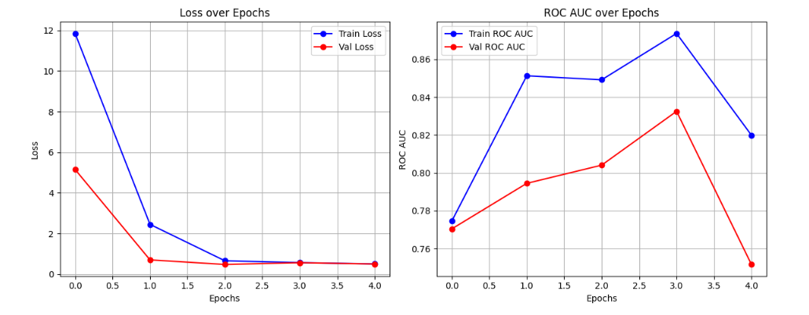
Data augmentation:
CNN

Slide 10
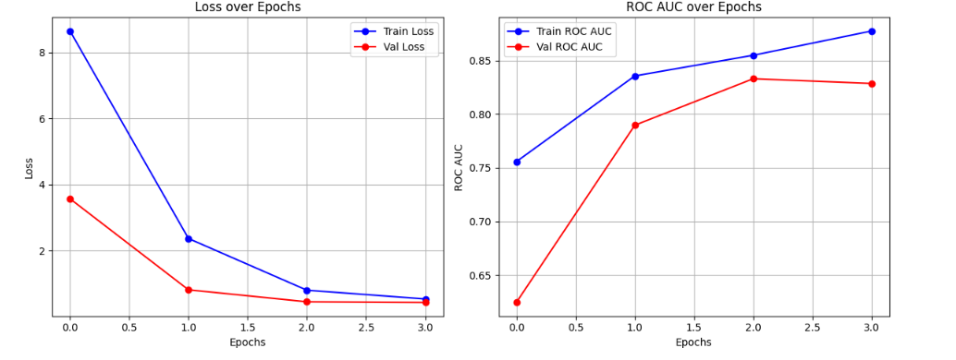
Tuning Hyperparameters

Slide 11
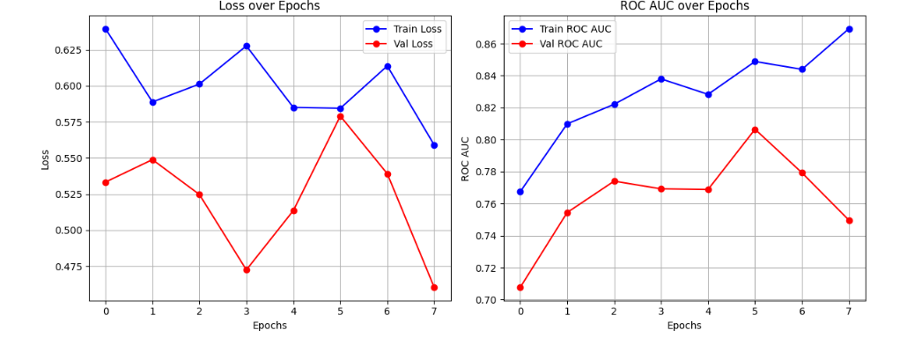
ResNet 50

Slide 12
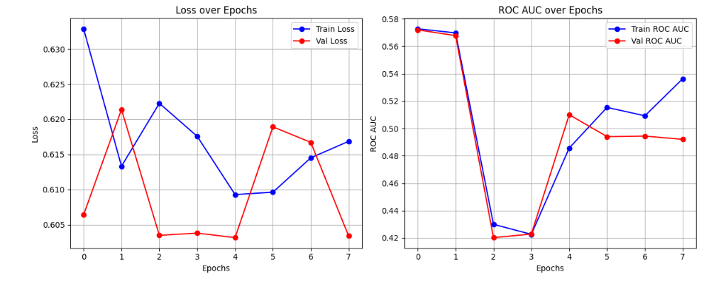
Transformers:
1. The Vision Transformer (ViT)

Slide 13
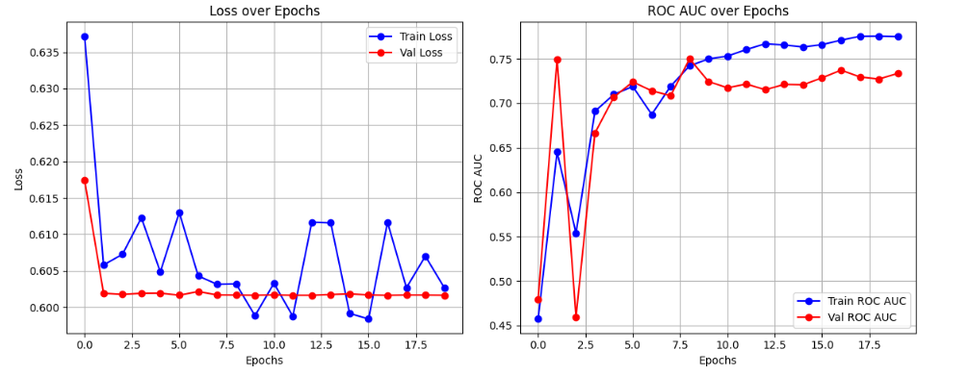
Tuning hyperparameters of ViT

Slide 14
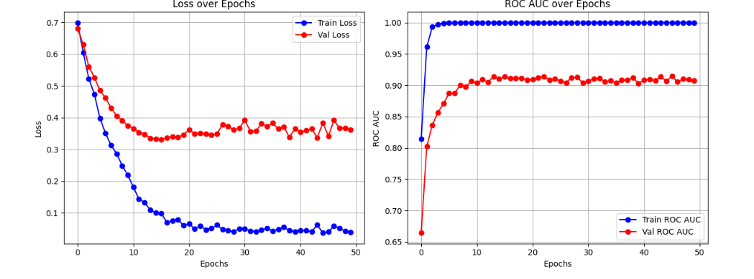
DenseNet:

Slide 15
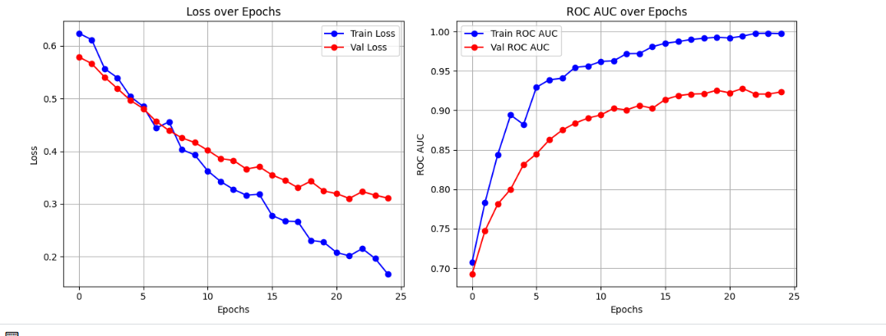
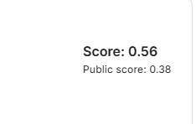
After tuning

Slide 16
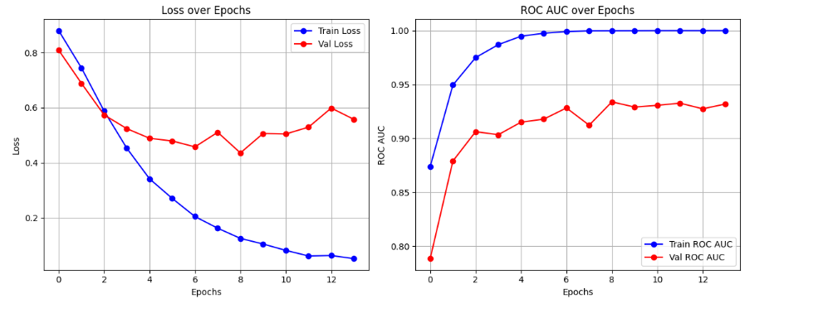
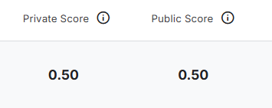
ViT with a fusion approach
ROC AUC of 0.93

Slide 17
Thank you

