Slide 1
Automatic Speech Recognition using Connectionist Temporal Classification (CTC)
https://keras.io/examples/audio/ctc_asr/
Dr. Mohamed Reda Bouadjenek
School of Information Technology, Faculty of Sci Eng & Built Env
reda.bouadjenek@deakin.edu.au
visualizations adapted from https://distill.pub/2017/ctc//

Slide 2

Automatic Speech Recognition using CTC
Introduction

Slide 3
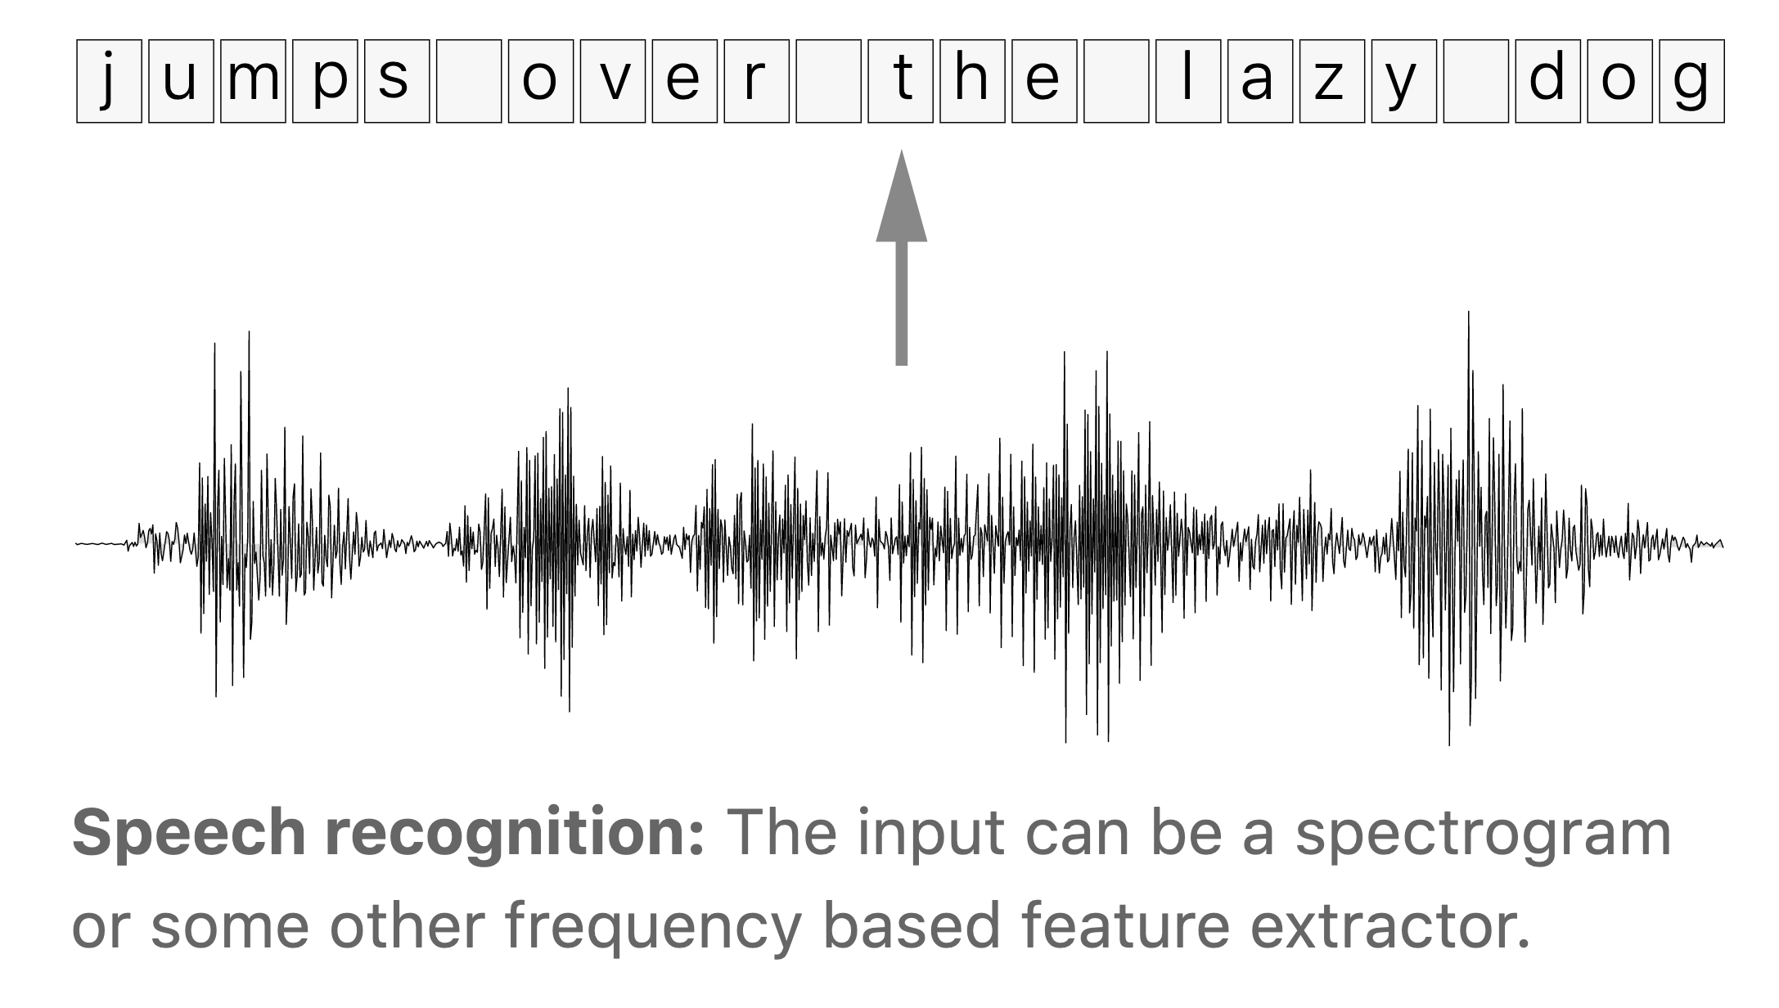
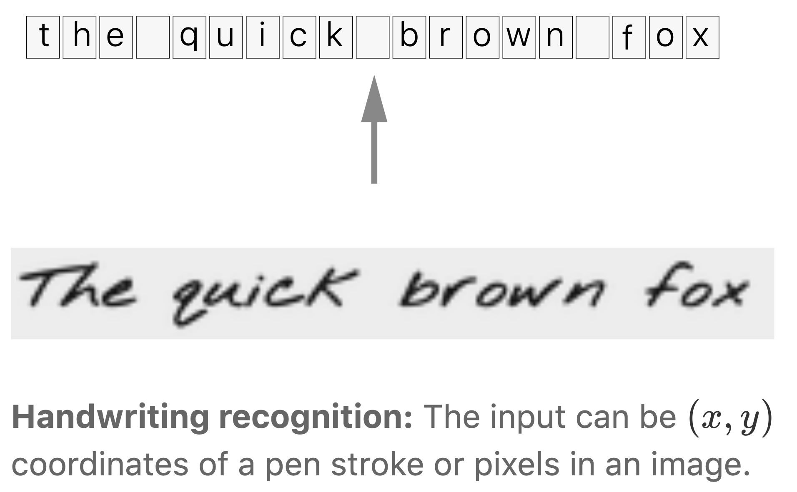
The alignment problem
We have a data set of speech, handwriting, other sequential data and the corresponding transcripts
Problem: we don’t know how the outputs align to the inputs
i.e., which frame(s) of the input correspond to which output frame

Slide 4
The alignment problem: Naïve solutions
We could devise a rule like “one character corresponds to ten inputs”.
But people’s rates of speech vary, so this type of rule can always be broken.
Another alternative is to hand-align each character to its location in the audio.
May work well, but we’d know the ground truth for each input time-step
For any reasonably sized dataset this is prohibitively time consuming.

Slide 5
Solution: Connectionist Temporal Classification (CTC) is a way to get around not knowing the alignment between the input and the output

Slide 6
Problem definition
Given:
A sequence X=[x₁​,x₂​,…,x_{T}​] (audio)
The corresponding output sequence Y=[y₁​,y₂​,…,y_{U}​] (transcript)
We want to find an accurate mapping from X to Y
Challenges:
Both X and Y can vary in length
The ratio of the lengths of X and Y can vary.
We don’t have an accurate alignment (correspondence of the elements) of X and Y
The CTC algorithm overcomes these challenges and for a given X it gives an output distribution over all possible Y
We can use this distribution either to infer a likely output or to assess the probability of a given output.
Notes:
Not all ways of computing the loss function and performing inference are tractable. We’ll require that CTC do both of these efficiently.

Slide 7

Automatic Speech Recognition using CTC
The Algorithm

Slide 8
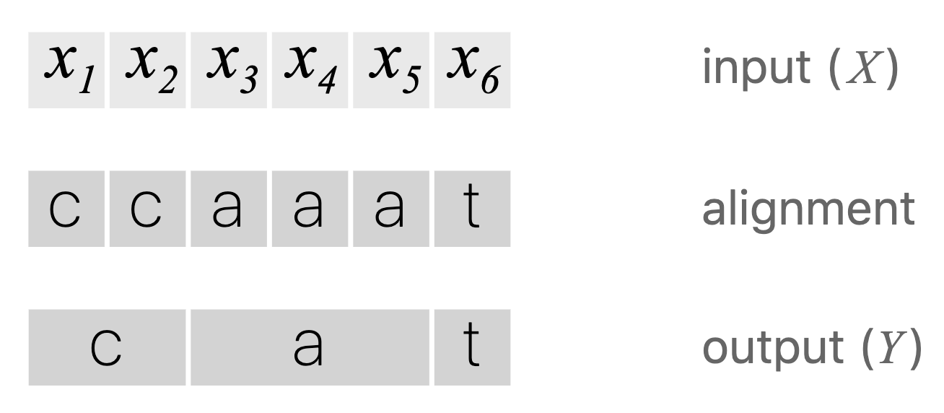
The algorithm: Alignment
Assume the input has length six and Y = [c, a, t]. One way to align X and Y is to assign an output character to each input step and collapse repeats
This approach has two problems:
It doesn’t make sense to force every input step to align to some output
We have no way to produce outputs with multiple characters in a row.
The alignment [h, h, e, l, l, l, o] collapses to “helo”

Slide 9
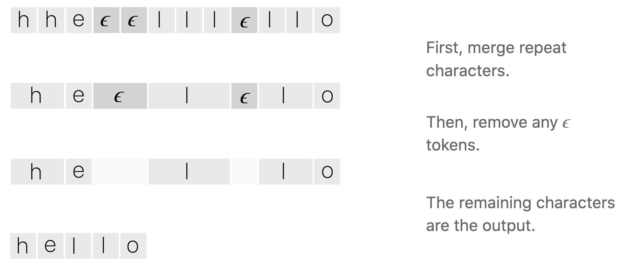
The algorithm: CTC Alignment
CTC introduces a new token ϵ called the blank token
The ϵ token doesn’t correspond to anything
We allow any alignment which maps to Y after merging repeats and removing ϵ tokens:
Notes:
If Y has two of the same character in a row, then a valid alignment must have an epsilon between them. With this rule in place, we can differentiate between alignments which collapse to “hello” and those which collapse to “helo”.

Slide 10
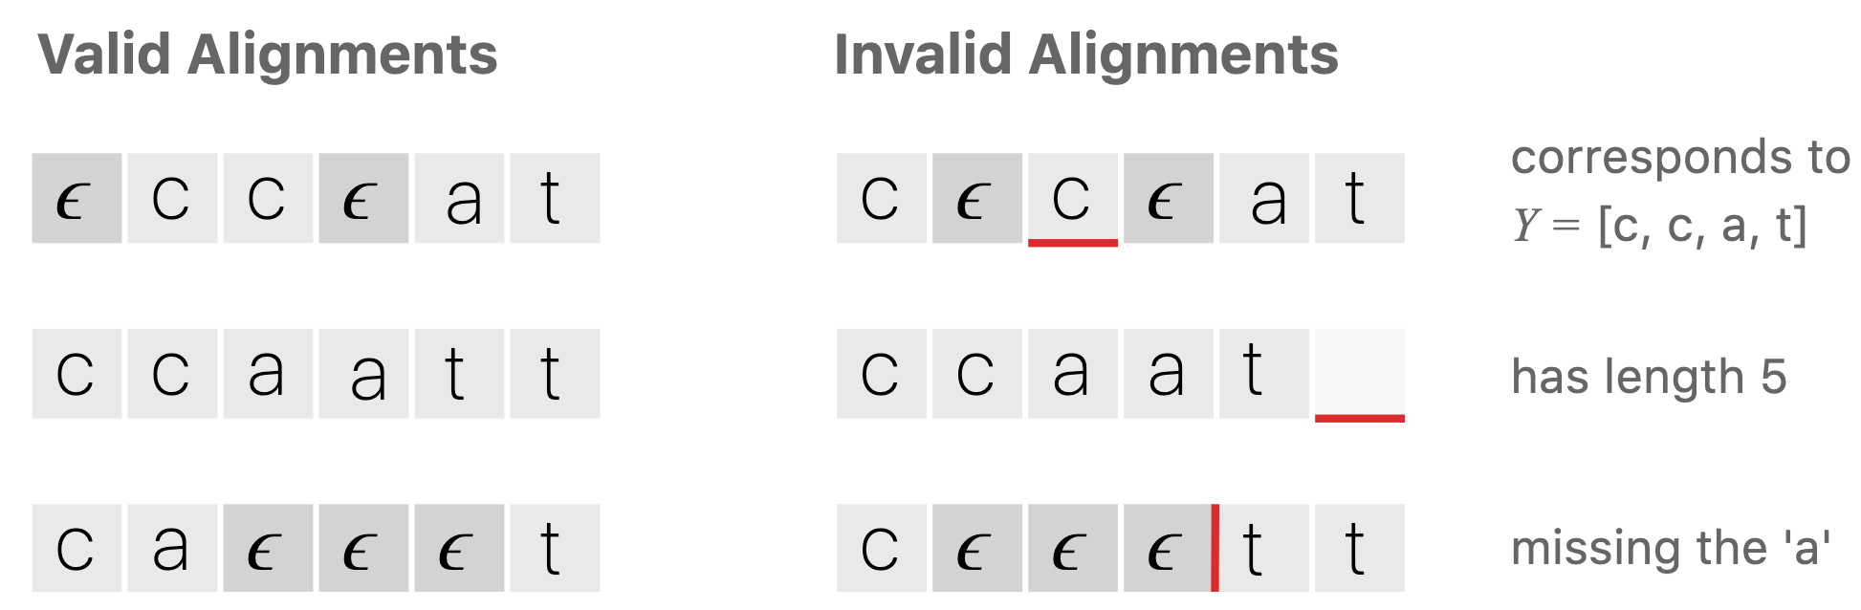
The algorithm: CTC Alignment Examples

Slide 11
The algorithm: CTC Alignment Properties
The allowed alignments between X and Y are monotonic.
If we advance to the next input, we can keep the corresponding output the same or advance to the next one.
The alignment of X to Y is many-to-one.
One or more input elements can align to a single output element but not vice-versa.
The length of Y cannot be greater than the length of X.

Slide 12
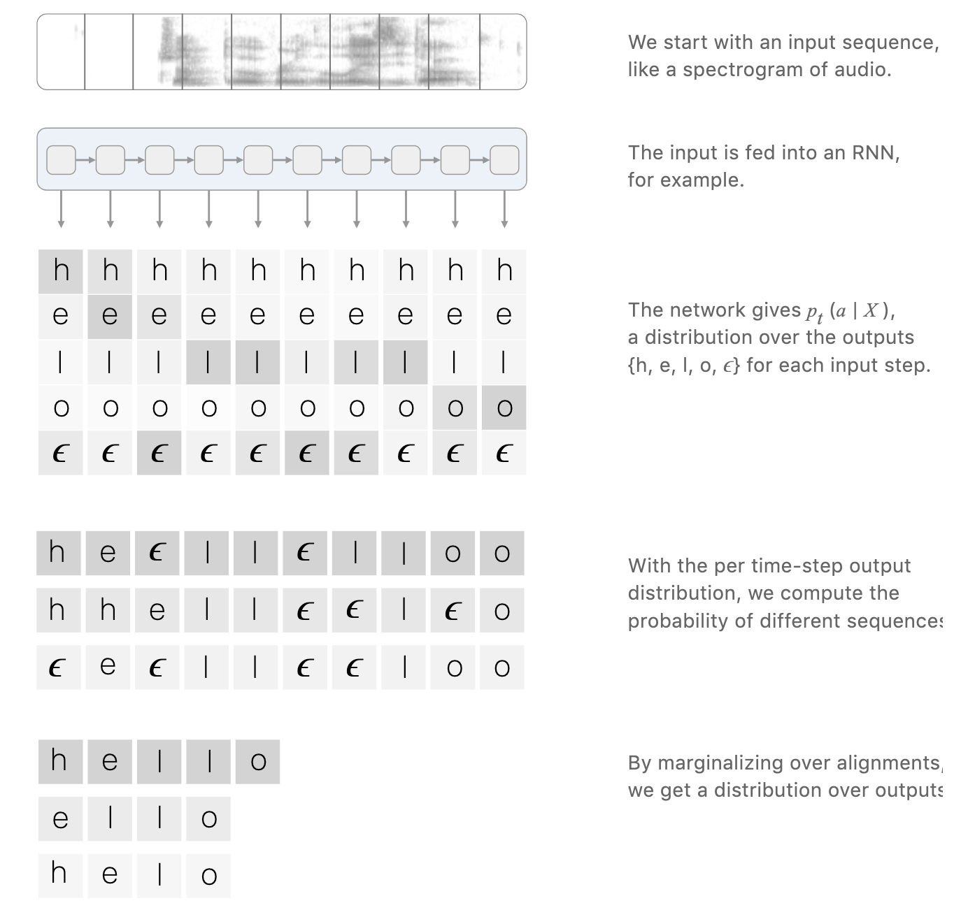
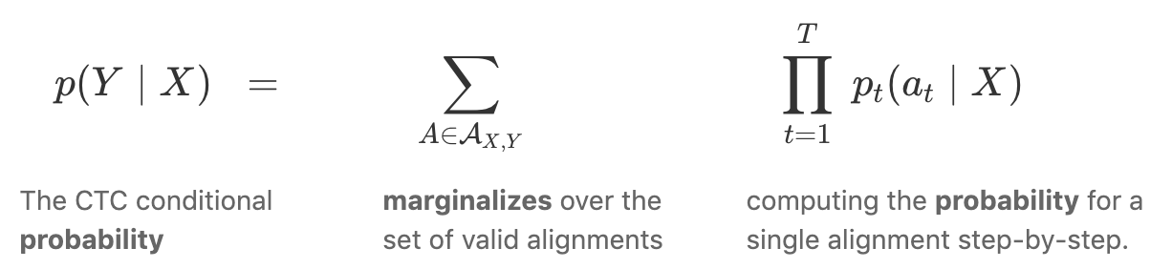
The algorithm: Loss Function
The CTC alignments gives us a probability of an output sequence
The CTC objective for a single (X,Y) pair is:

Slide 13
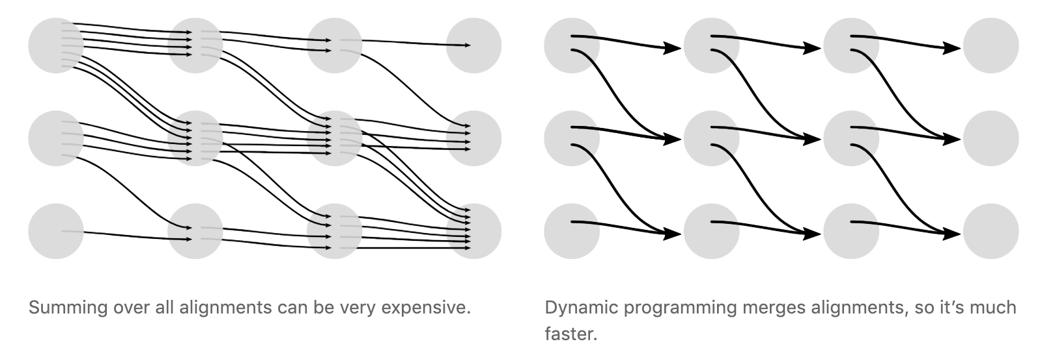
The algorithm: Loss Function
The CTC loss can be very expensive to compute.
A brute force approach that computes the score for each alignment is expensive
There can be a massive number of alignments.
We can compute the loss faster with a dynamic programming algorithm
If two alignments have reached the same output at the same step, they can be merged

Slide 14
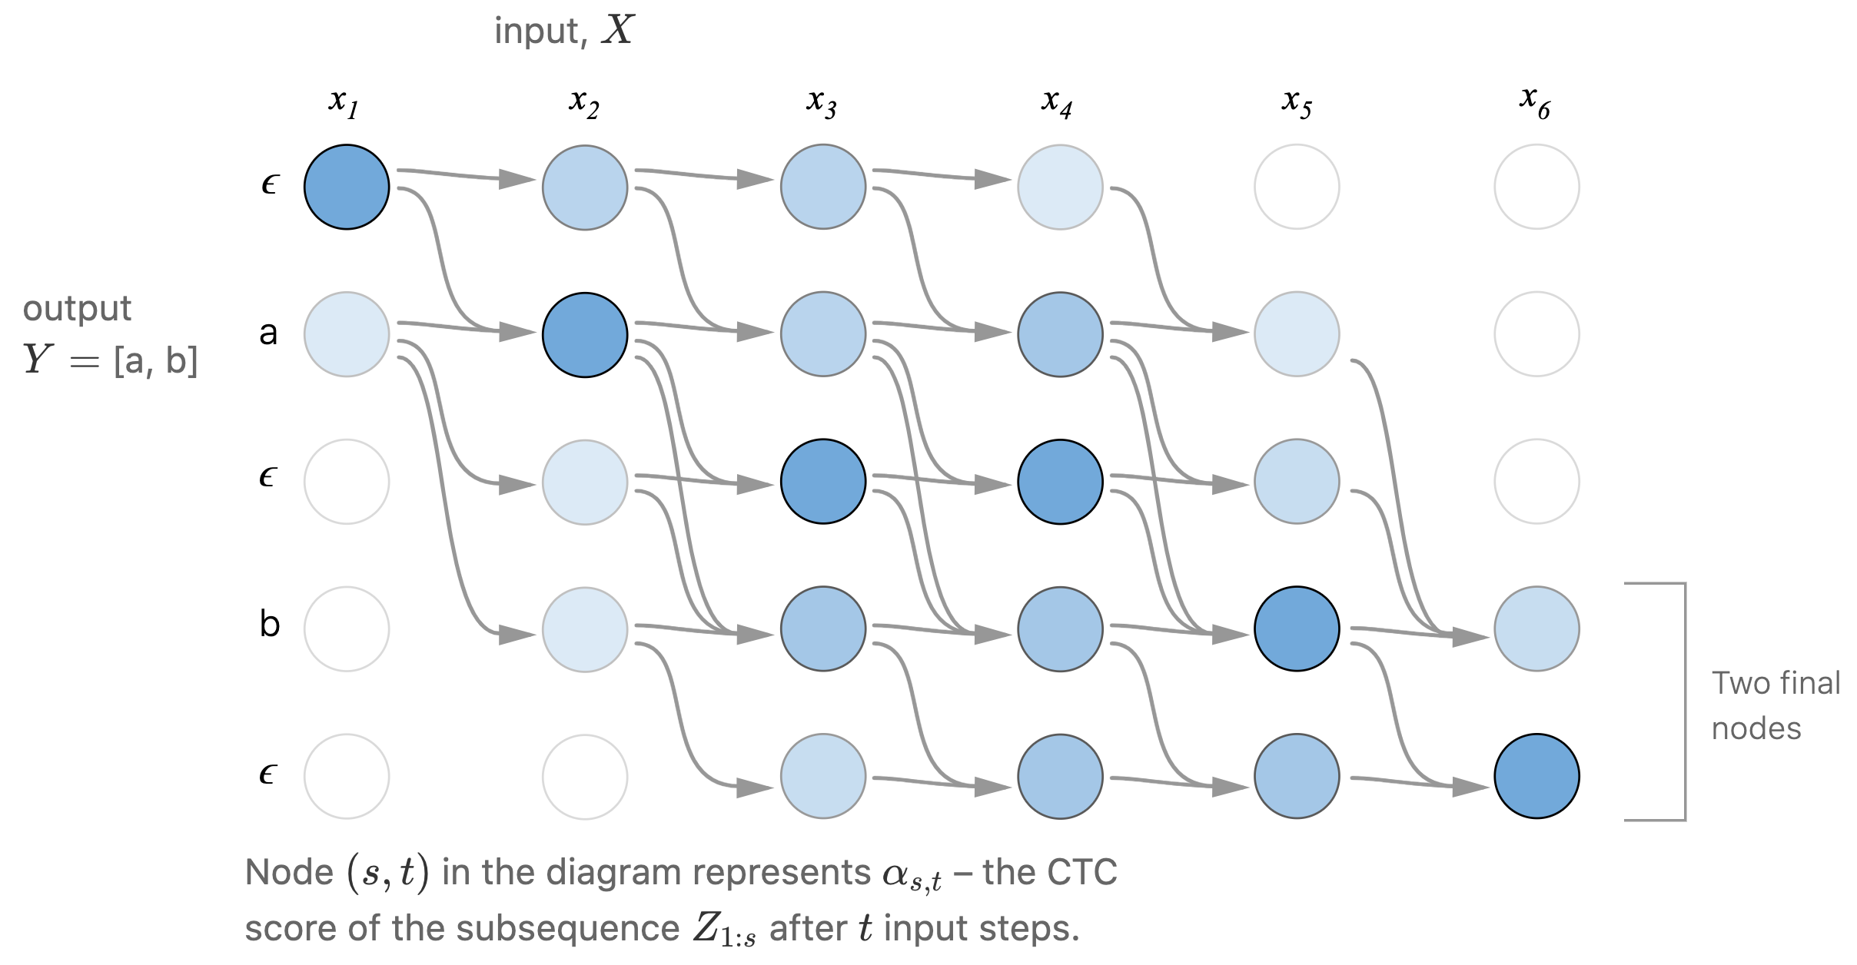
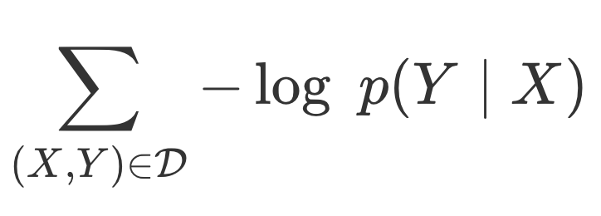
The algorithm: Loss Function
Example of the computation performed by the dynamic programming algorithm
Every valid alignment has a path in this graph.
For a training set D, the loss function is:
The CTC loss function is differentiable since it’s just sums and products of probabilities

Slide 15
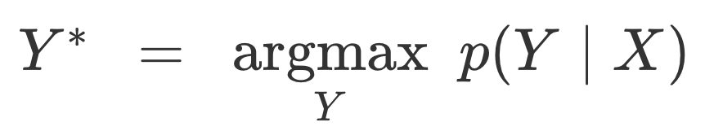
The algorithm: Inference
Find a likely output for a given input by solving:
Need to settle for an approximate solution, too expensive to search for the true max
One heuristic is to take the most likely character at each output

Slide 16
The algorithm: Inference
Problems?
Does not take into account that the same output Y could be produced by two different alignments
[a,a] and [a,a,a] individually have lower probability than [b,b], but combined higher and they collapse to [a]
With this heuristic, [b] gets picked

Slide 17
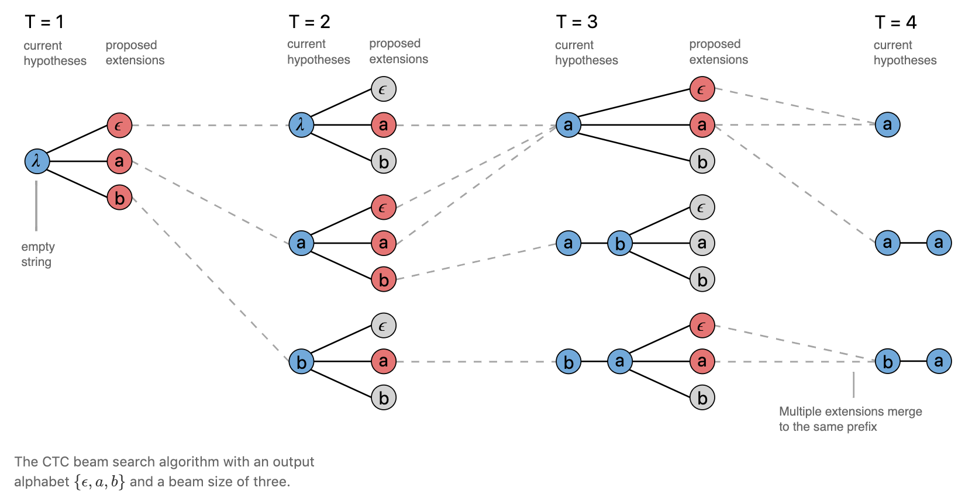
The algorithm: Inference
A better heuristic is to use modified beam search
Can exchange speed for asymptotically better solution

Slide 18

Demo

