Slide 1

Inductive Moment Matching
Linqi Zhou, Stefano Ermon, Jiaming Song
ICML 2025
Muhammad Imran Hossain
800430917

Slide 2

OUTLINE
Motivation & Problem
Background: Interpolants (DDIM/FM/EDM) & MMD
IMM Core Idea & Objective (inductive matching)
IMM Loss (multi-particle MMD)
Training Algorithm (practical knobs)
Experimental Setup (Dataset)
Results & Ablations
Key Takeaways
Future Work

Slide 3
Motivation & Problem
Three Desirable Properties (Trilemma):
  High Quality: Produces sharp, realistic images (low FID).
  Fast Sampling: Generates images in one or a few steps.
  Stable Training: Easy to train, doesn't collapse.
The Trade-Off:
  Diffusion/Flow Models: High Quality, but Slow (100s of steps).
  Distillation (e.g., DMD): Faster, but Unstable, requires pre-training.
  Consistency Models (CMs): Fast from scratch, but can be Unstable.
IMM's Promise: A single-step or few steps method that achieves all three goals.

Slide 4
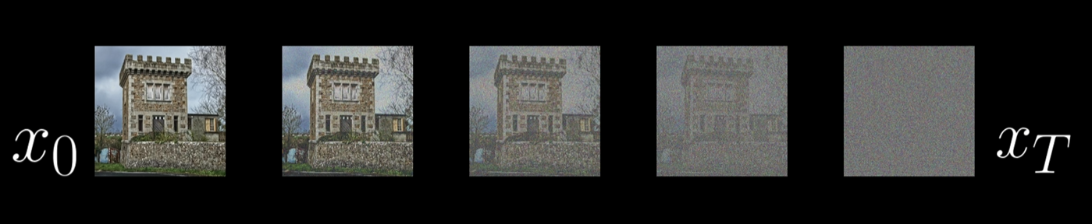

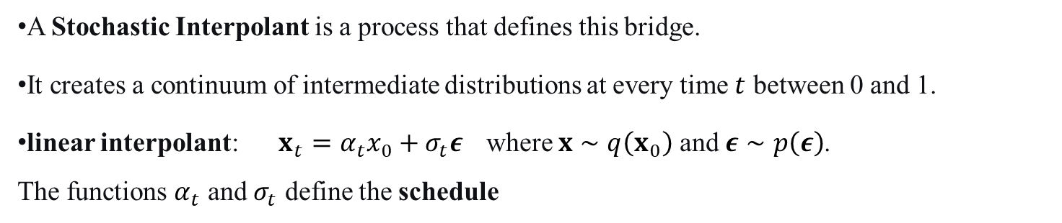




Background: Path Noise to Data
$f_{θ}^{ s∣t}$(Student)
$$x_{s}$$
$$x_{r}$$
$$x_{t}$$
$f_{θ^{−}}^{ r∣t}$​, $f_{θ^{−}}^{ s∣r}$(Teacher / stop-grad)
A Stochastic Interpolant is a process that defines this bridge.
It creates a continuum of intermediate distributions at every time $t$ between 0 and 1.
linear interpolant: $x_{t}=α_{t}x_{0}+σ_{t}ε$where $x∼q\left(x_{0}\right)$ and $ε∼p\left(ε\right)$.
The functions $α_{t}$ and $σ_{t}$ define the schedule

Slide 5

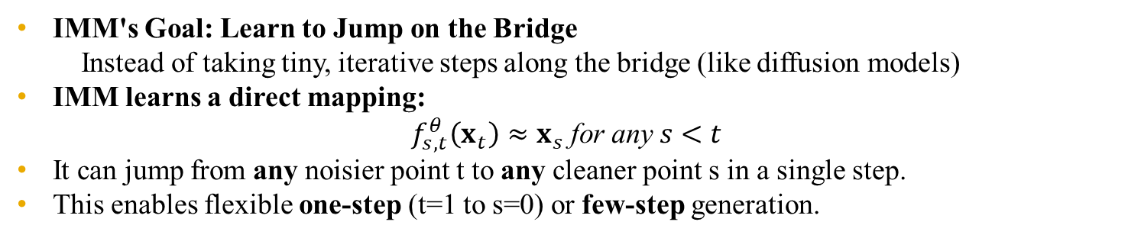

Background: Path Noise to Data
$f_{θ}^{ s∣t}$(Student)
$$x_{s}$$
$$x_{r}$$
$$x_{t}$$
$f_{θ^{−}}^{ r∣t}$​, $f_{θ^{−}}^{ s∣r}$(Teacher / stop-grad)
IMM's Goal: Learn to Jump on the Bridge
Instead of taking tiny, iterative steps along the bridge (like diffusion models)
IMM learns a direct mapping:
$$f_{s,t}^{θ}\left(x_{t}\right)≈x_{s} \text{for} \text{any} s<t$$
It can jump from any noisier point t to any cleaner point s in a single step.
This enables flexible one-step (t=1 to s=0) or few-step generation.

Slide 6
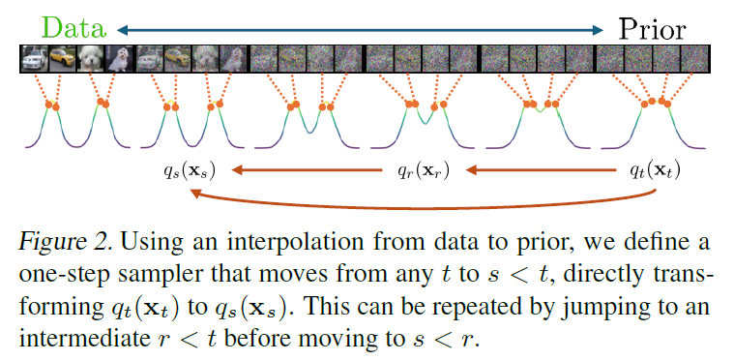
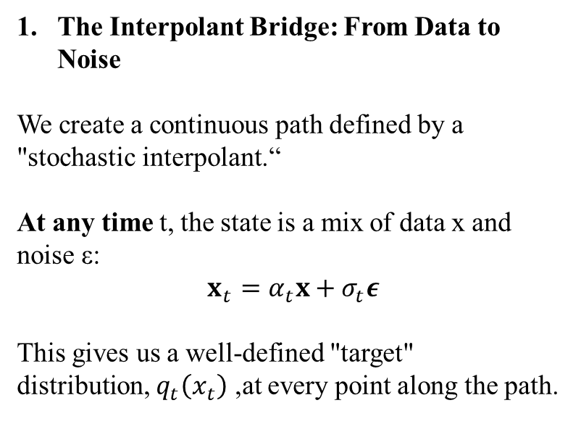
Building a Predictable Path
The Interpolant Bridge: From Data to Noise
We create a continuous path defined by a "stochastic interpolant.“
At any time t, the state is a mix of data x and noise ε:
$$x_{t}=α_{t}x+σ_{t}ε$$
This gives us a well-defined "target" distribution, $q_{t}\left(x_{t}\right)$ ,at every point along the path.

Slide 7
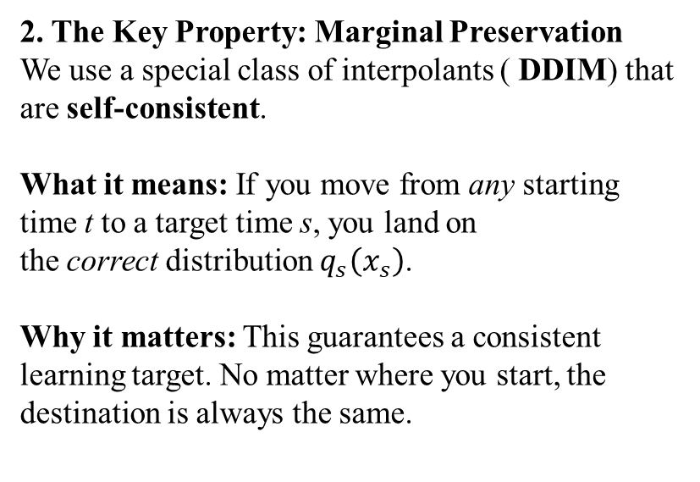
Building a Predictable Path
2. The Key Property: Marginal Preservation
We use a special class of interpolants ( DDIM) that are self-consistent.
What it means: If you move from any starting time t to a target time s, you land on the correct distribution $q_{s}\left(x_{s}\right)$.
Why it matters: This guarantees a consistent learning target. No matter where you start, the destination is always the same.

Slide 8
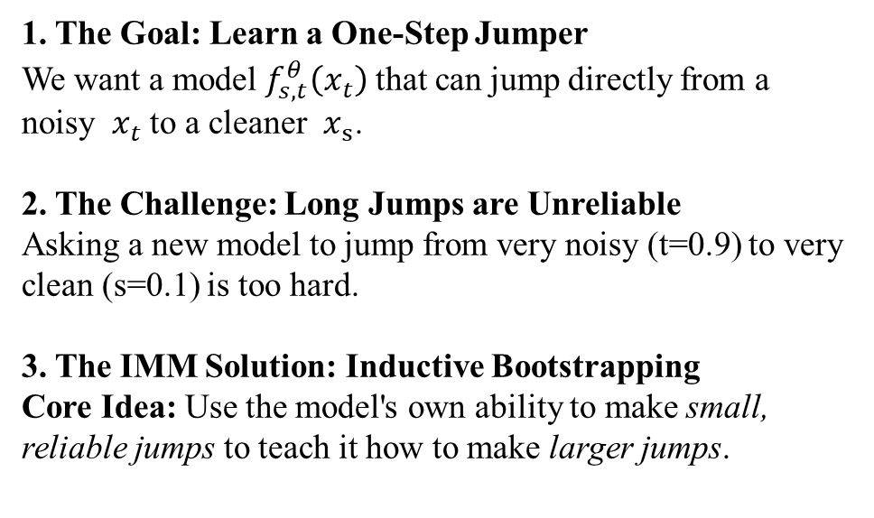
The Algorithm: Learning by Induction
1. The Goal: Learn a One-Step Jumper
We want a model $f_{s,t}^{θ}\left(x_{t}\right)$that can jump directly from a noisy $x_{t}$to a cleaner $x_{s}$.
2. The Challenge: Long Jumps are Unreliable
Asking a new model to jump from very noisy (t=0.9) to very clean (s=0.1) is too hard.
3. The IMM Solution: Inductive Bootstrapping
Core Idea: Use the model's own ability to make small, reliable jumps to teach it how to make larger jumps.

Slide 9
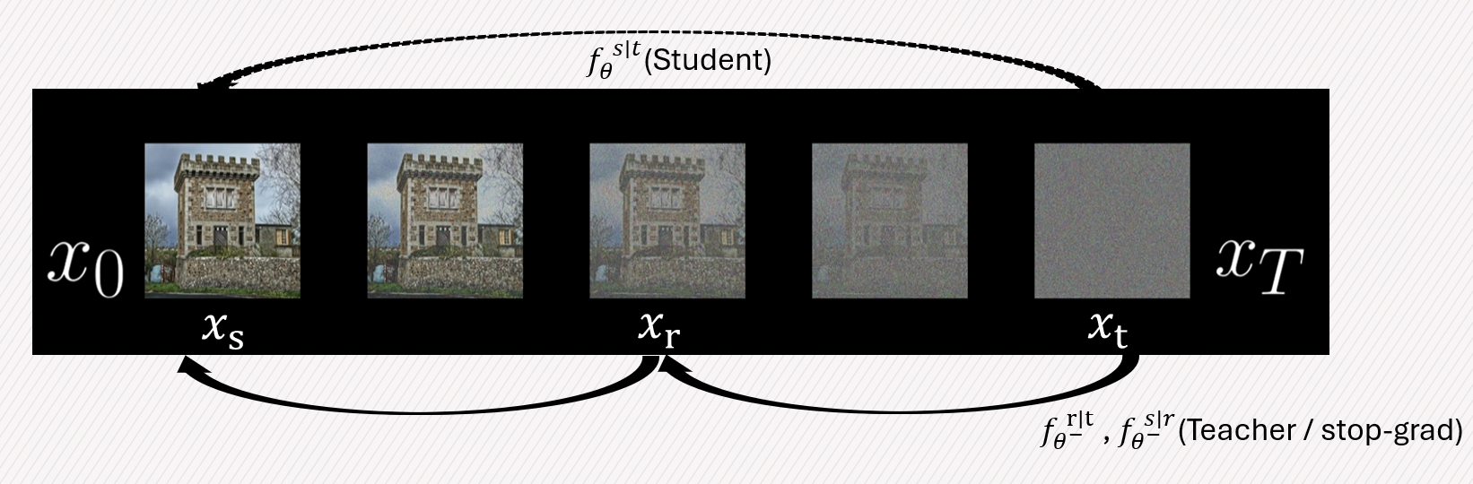
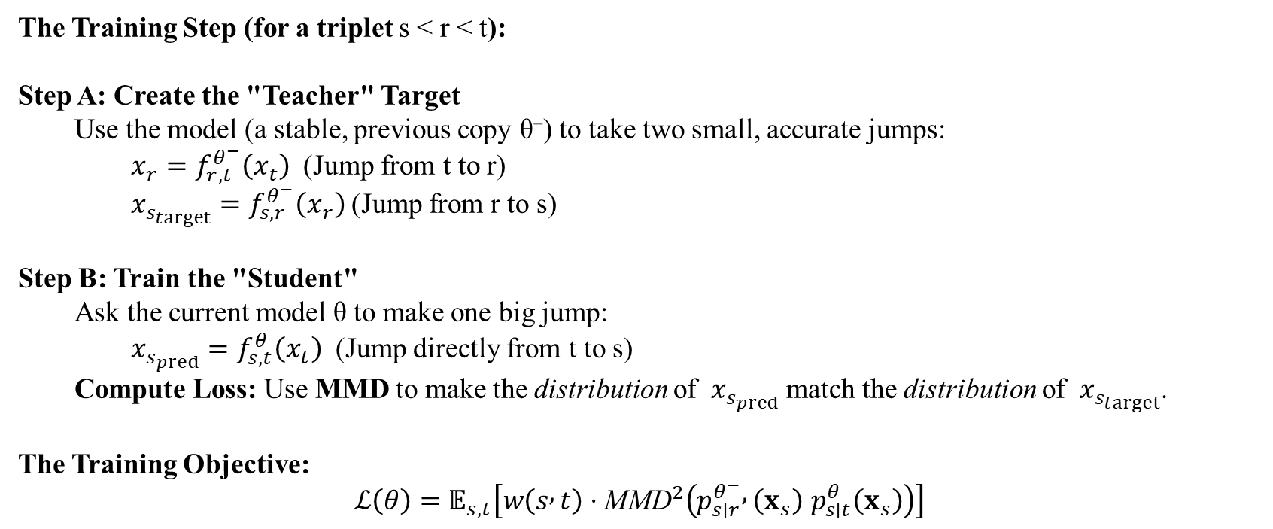
The Algorithm: Learning by Induction
The Training Step (for a triplet s < r < t):
Step A: Create the "Teacher" Target
  Use the model (a stable, previous copy θ⁻) to take two small, accurate jumps:
    $x_{r}=f_{r,t}^{θ^{−}}\left(x_{t}\right)$ (Jump from t to r)
    $x_{s_{target}}=f_{s,r}^{θ^{−}}\left(x_{r}\right)$(Jump from r to s)
Step B: Train the "Student"
  Ask the current model θ to make one big jump:
    $x_{s_{pred}}=f_{s,t}^{θ}\left(x_{t}\right)$ (Jump directly from t to s)
  Compute Loss: Use MMD to make the distribution of $x_{s_{pred}}$match the distribution of $x_{s_{target}}$.
The Training Objective:
$$ℒ\left(θ\right)=𝔼_{s,t}\left[w\left(s , t\right)⋅{\text{MMD}}^{2}\left(p_{s∣r}^{θ^{−}} , \left(x_{s}\right) p_{s∣t}^{θ}\left(x_{s}\right)\right)\right]$$

Slide 10
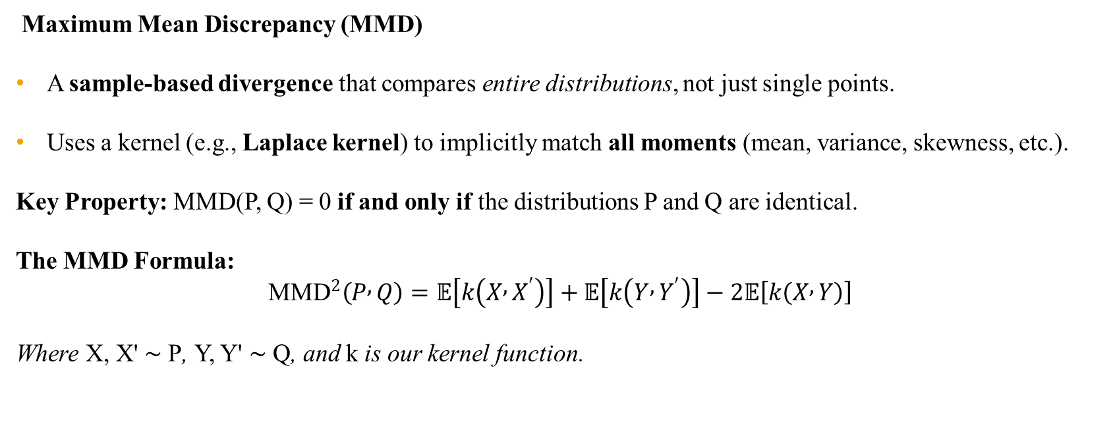
IMM Solution: Maximum Mean Discrepancy (MMD)
Maximum Mean Discrepancy (MMD)
A sample-based divergence that compares entire distributions, not just single points.
Uses a kernel (e.g., Laplace kernel) to implicitly match all moments (mean, variance, skewness, etc.).
Key Property: MMD(P, Q) = 0 if and only if the distributions P and Q are identical.
The MMD Formula:
$${\text{MMD}}^{2}\left(P , Q\right)=𝔼\left[k\left(X , X^{′}\right)\right]+𝔼\left[k\left(Y , Y^{′}\right)\right]−2𝔼\left[k\left(X , Y\right)\right]$$
Where X, X' ∼ P, Y, Y' ∼ Q, and k is our kernel function.

Slide 11
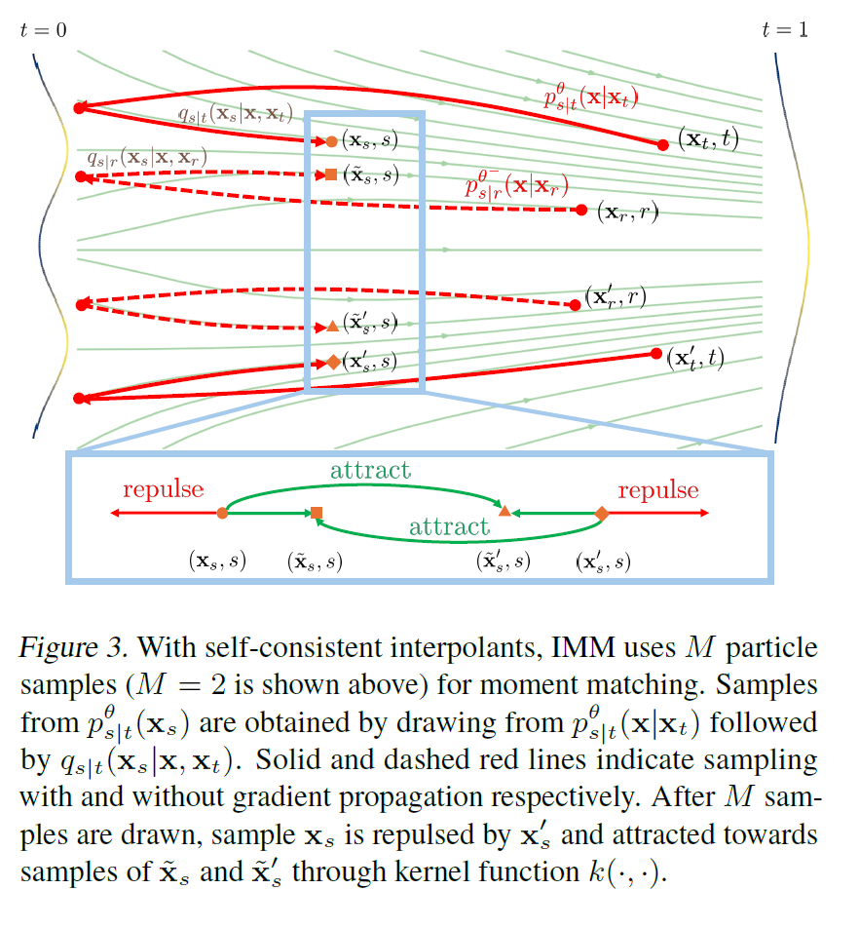
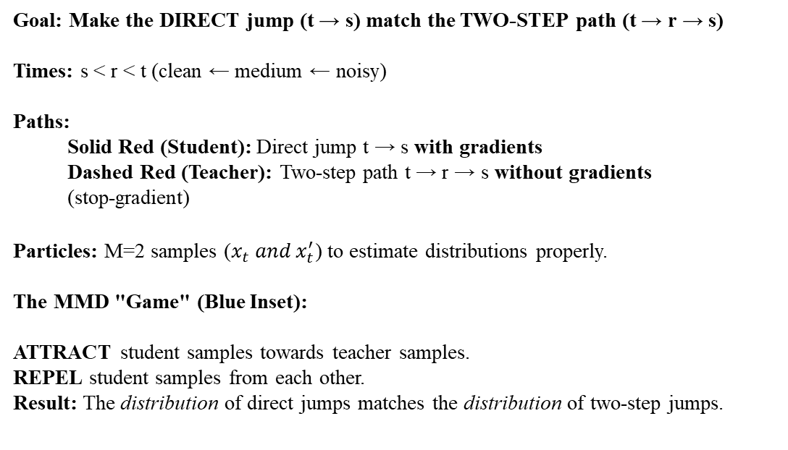
IMM Training Loop in Action
Goal: Make the DIRECT jump (t → s) match the TWO-STEP path (t → r → s)
Times: s < r < t (clean ← medium ← noisy)
Paths:
  Solid Red (Student): Direct jump t → s with gradients
  Dashed Red (Teacher): Two-step path t → r → s without gradients
  (stop-gradient)
Particles: M=2 samples ($x_{t} and x_{t}^{′}$) to estimate distributions properly.
The MMD "Game" (Blue Inset):
ATTRACT student samples towards teacher samples.
REPEL student samples from each other.
Result: The distribution of direct jumps matches the distribution of two-step jumps.

Slide 12
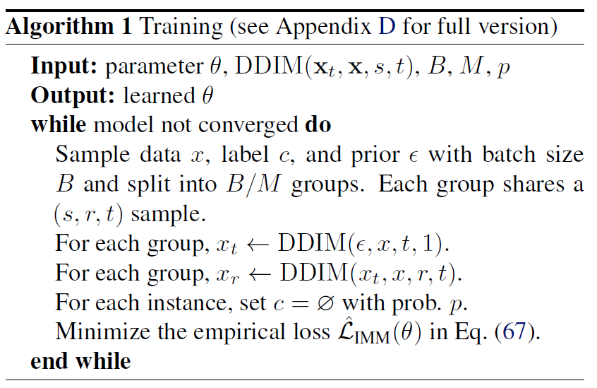
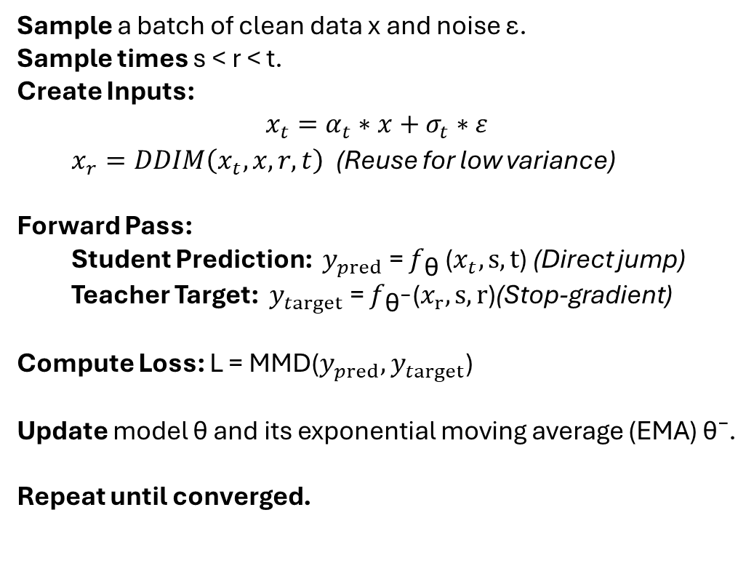
IMM Training Algorithm
Sample a batch of clean data x and noise ε.
Sample times s < r < t.
Create Inputs:
$$x_{t}=α_{t}∗x+σ_{t}∗ε$$
  $x_{r}=DDIM\left(x_{t},x,r,t\right)$ (Reuse for low variance)
Forward Pass:
  Student Prediction: $y_{pred}$= $f_{\text{θ}}$($x_{t},s,t$) (Direct jump)
  Teacher Target: $y_{target}$= $f_{\text{θ}\text{⁻}}\text{(}x_{r},s,\text{r}\text{)}$(Stop-gradient)
Compute Loss: L = MMD($y_{pred},y_{target}$)
Update model θ and its exponential moving average (EMA) θ⁻.
Repeat until converged.

Slide 13
Experimental Setup & Key Results
Datasets: CIFAR-10, ImageNet-256x256
Baselines: Diffusion models, GANs, Consistency Models (CMs), other distillation methods.
Metrics: Fréchet Inception Distance (FID) ↓, Inference Steps ↓

Slide 14
Experimental Setup & Key Results
Model | Dataset | FID | Steps
IMM | CIFAR-10 | 1.98 | 2
ECT (Previous SOTA) | CIFAR-10 | 2.11 | 2
IMM | ImageNet-256 | 1.99 | 8
DiT-XL (Diffusion) | ImageNet-256 | 2.27 | 250
Shortcut (Scratch) | ImageNet-256 | 3.80 | 128

Slide 15
Societal, Ethical & Environmental Impacts
Positive:
Democratizes content creation by making high-quality generation accessible without massive compute for inference.
Faster synthesis can accelerate creative workflows and research.
Negative & Considerations:
Potential for misuse in creating deepfakes and misinformation.
Copyright concerns regarding training data and generated content.
Impact on creative industries.
Environmental:
Training: Still requires significant computational resources.
Inference: Drastically reduces the energy cost of generating images compared to many-step models, making deployment more sustainable.

Slide 16
Key Takeaways
IMM is a novel, stable, and powerful framework for training few-step generative models from scratch.
It resolves the trade-offs between quality, speed, and stability better than prior methods.
It provides a unifying perspective, showing that Consistency Models are a specific, less stable instance of the IMM framework.
It achieves state-of-the-art results, enabling high-fidelity image generation in as few as 2-8 steps.

Slide 17
Future Work
Exploring with different kernels.
Applying IMM to other domains (video, audio), and further improving sample quality at the very lowest step counts
Fine-grained event typing via semi-supervised classifier heads.

Slide 18

Thank You

Slide 19

Any Question?

