Slide 1
New York Collision Risk Insurance Pricing
Imran Rizki Putranto
Cambridge Advance Online

Slide 2
Current Situation

Slide 3
Insurance Policy Pricing
Flat rate of $30 based on expected maximum of 1200 collisions per day.
Number of Customers Taking Policy
Only 30% of 20,000 daily customers are willing to pay $30 for the policy
Collision Costs
On average, each collision costs $500
Company Expenses
8% of customers encounter a collision, with 10% of the collision costs being covered by the company

Slide 4
$100,000
Currently generated per day from insurance policy sales

Slide 5
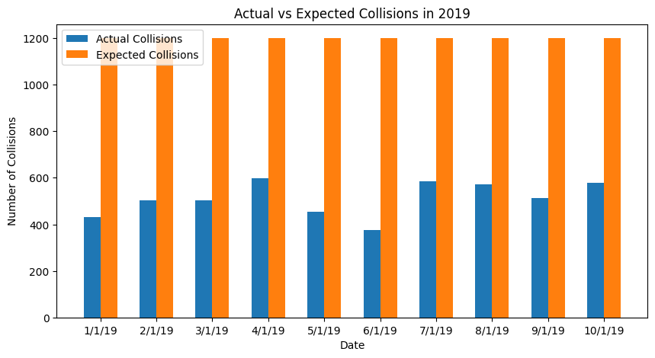
Number of Collisions
Actual Collisions vs Expected Collisions
1200 expected collisions a day is much higher than the actual number of collisions
Inflated policy prices
Lowering expected collisions based on model predictions can also lower policy prices
* Graph for first 10 days of 2019

Slide 6
80%
Customers willing to pay if prices were more competitive
*compared to just 30% currently

Slide 7
Can We Increase Profit Generation?

Slide 8
Regression Models
Predict relationships between some input value and continuous output value

Slide 9
Why Use Regression Models
01
02
03
Objective and Unbiased
Data-Driven Insights
Quantifiable Performance
Designed to make predictions based on quantitative data without personal biases or emotions
Extracts insights directly from data, allowing us to leverage the full potential of information provided
Provides quantifiable measures of predictive performance, allowing for the assessment of the model’s accuracy and reliability objectively

Slide 10
Regression Models
Get weather predictions
Extract and Clean Data
Set Inputs
Set Policy Prices for Each Day
Get Predictions for Number of Collisions
Put Into Regression Model

Slide 11
Getting Weather Data Predictions
day | year | mo | da | collision_date | temp | dewp | slp | visib | wdsp | mxpsd | gust | max | min | prcp | sndp | fog | NUM_COLLISIONS
2 | 2019 | 1 | 1 | 01/01/2019 | 50.5 | 43.2 | 1009.8 | 7 | 999.9 | 999.9 | 999.9 | 57.9 | 36 | 1.08 | 999.9 | 0 | 430
3 | 2019 | 1 | 2 | 02/01/2019 | 38 | 23.2 | 1024.2 | 10 | 999.9 | 999.9 | 999.9 | 57.9 | 35.1 | 0.06 | 999.9 | 0 | 502
4 | 2019 | 1 | 3 | 03/01/2019 | 41.1 | 29.4 | 1015.8 | 9.9 | 999.9 | 999.9 | 999.9 | 44.1 | 35.1 | 0 | 999.9 | 0 | 504
5 | 2019 | 1 | 4 | 04/01/2019 | 39.7 | 26.4 | 1014.8 | 9.9 | 999.9 | 999.9 | 999.9 | 46 | 35.1 | 0 | 999.9 | 0 | 598
6 | 2019 | 1 | 5 | 05/01/2019 | 44.2 | 41 | 1003.3 | 5.3 | 999.9 | 999.9 | 999.9 | 46.9 | 35.1 | 0.22 | 999.9 | 0 | 455
7 | 2019 | 1 | 6 | 06/01/2019 | 43.5 | 30 | 1010.6 | 10 | 999.9 | 999.9 | 999.9 | 48.9 | 37.9 | 0.28 | 999.9 | 0 | 376
Variables used within the raw dataframe
Data must be cleaned before being fed into regression model
Regression model tries to find relationships between one or more variables and number of collisions
Values in red are missing data and cannot be used

Slide 12
Regression Models Built
01
02
03
Single Input Linear Model
Multiple Input Linear Model
Deep Learning Neural Network Model
Establishes a linear relationship between a single input variable to the number of collisions
Extends the concept of the single-input model to include multiple inputs
Multiple layers to establish complex and non-linear relationships between input variables and the number of collisions
Helps capture more complex relationships
Determines relationships that may not be directly apparent to humans

Slide 13
Regression Models
 | Single Input Model | First Multi Input Model | Second Multi Input Model | DNN Model
Number of Input Variables | One | Five | Nine | Nine
Relationship Complexity | Linear | Linear | Linear | Non-Linear
Reason for Choice | Strongest correlation between Day and number of collisions (0.47 out of 1) | Four other variables had reasonably strong linear correlations to collisions (but not as strong as Day) | Tested out if remaining variables had any effect on model’s accuracy | Tested to determine any non-linear relationships between each variable and the number of collisions

Slide 14
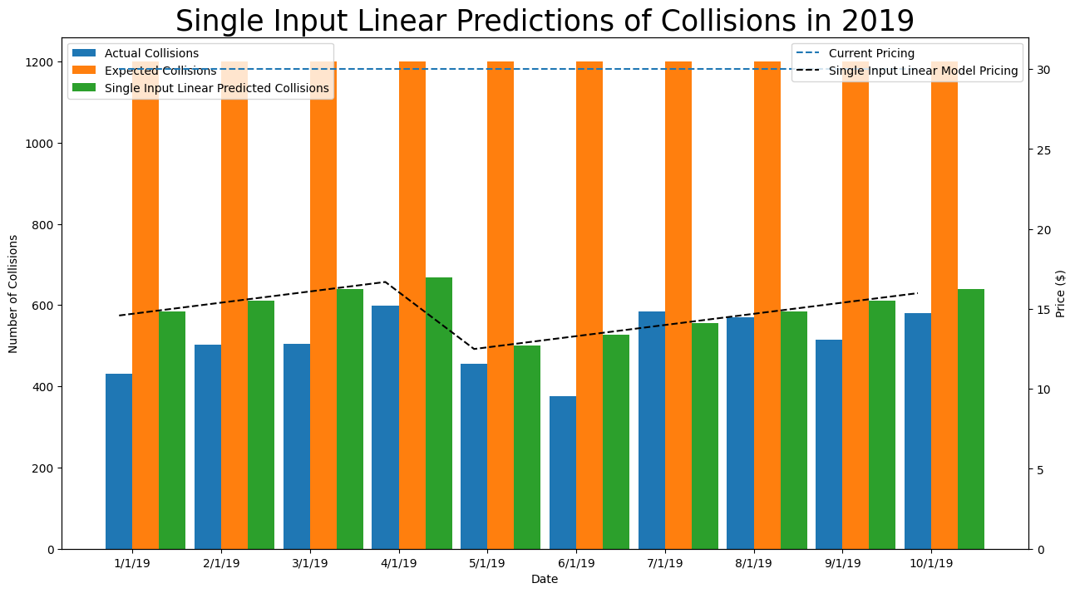
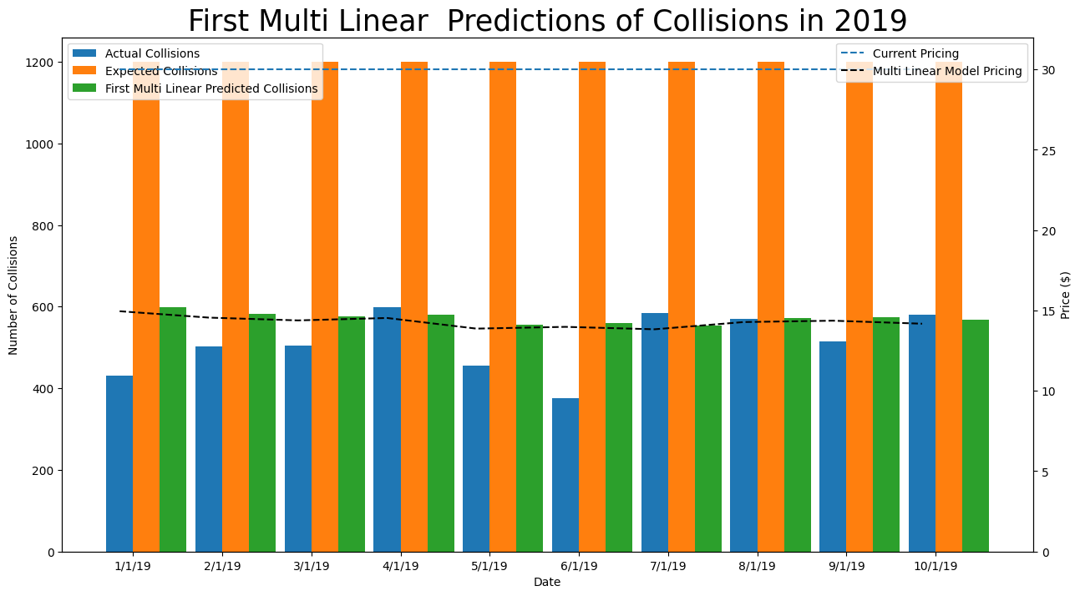
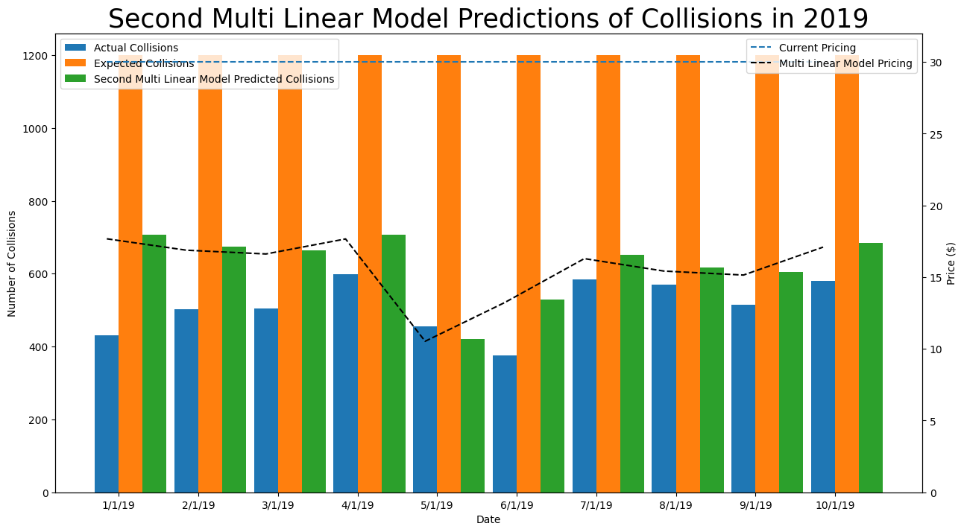
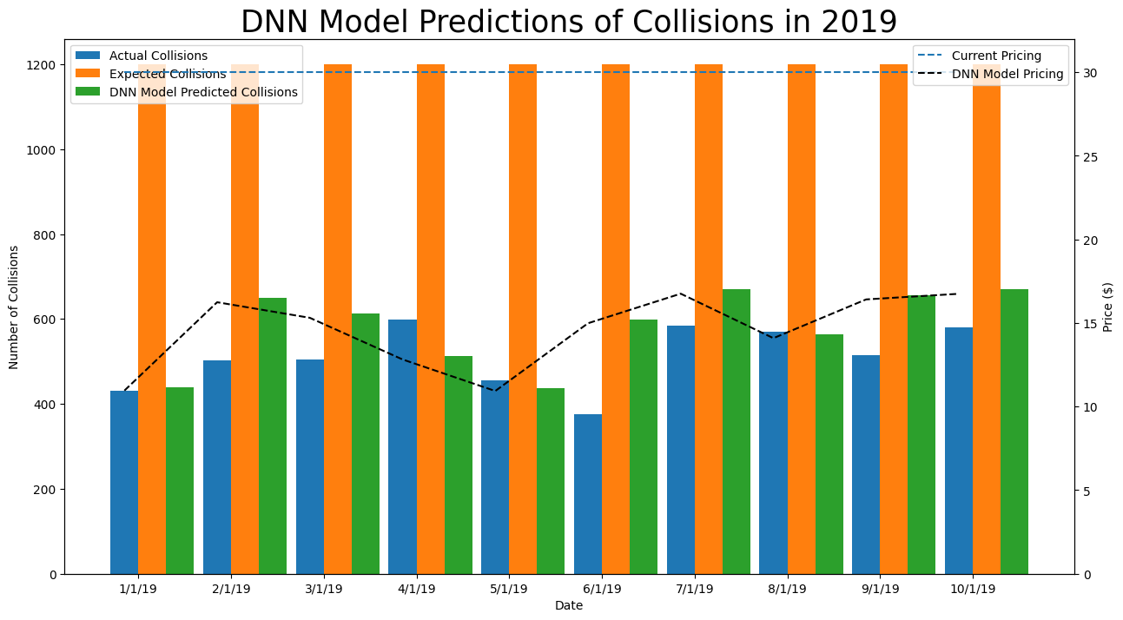
*Test run on 12:30, 13/08/2023

Slide 15
Key Takeaways
01
02
03
Predictions always lower than expected amount of 1200
Model outputs never too far off actual results
All models result in reduced daily policy prices
*based on existing data

Slide 16
Income and Profitability
Increase profitability using predictions generated by these models?

Slide 17
Income and Profitability
*Numbers based on 2019 data; Values depend on the trial run | Current Pricing | Single Input Model | First Multi Input Model | Second Multi Input Model | DNN Model
Average Number of Daily Collisions | 1200 | 584 | 565 | 658 | 652
Average Daily Policy Price | $30 | $14.6 | $14.1 | $16.4 | $16.3
Average Daily Revenue | $180,000 | $233,433 | $226,120 | $263,190 | $260,883
Average Daily Profit | $100,000 | $153,433 | $146,120 | $183,189 | $180,883

Slide 18
Main Assumptions
01
02
Policy prices vary linearly with predicted number of collisions
Profit calculations assume that 80% of customers take the policy

Slide 19
Recommendations and Next Steps
Address Missing Data
Refine Cost-Benefit Analysis
Fix and replace any missing values with actual values if possible
Improve the profit calculation method to ensure realistic and reliable numbers
01
02
03
04
Address Assumptions
Optimise model training procedures
Optimise relationship of price with collisions to increase profits while maximising the number of customers taking the policy
Model training procedures must be optimised further to ensure the most accurate and reliable results (especially for the DNN model)

Slide 20
Thank You

