Slide 1
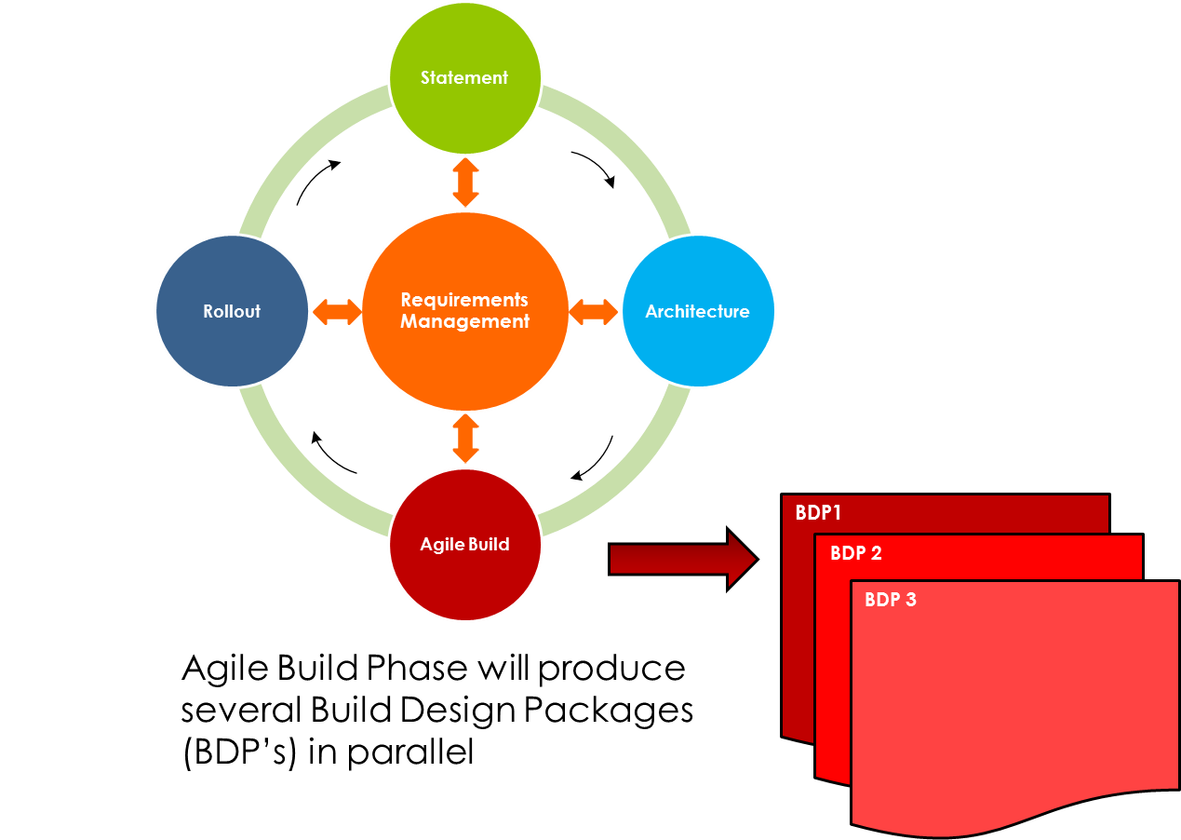

Slide 2
Continuous Build Stream Agile Build Phase
Continuous Build Stream Agile Build Phase
Continuous Build Stream
BDP 1
BDP 2
BDP 3

