Slide 1
Accident Severity Report

Slide 2
Accident Severity Report
Contents
Introduction
Data
Methodology
Results – KNN, Decision Tree & Logistic Regression
Conclusion
Discussion

Slide 3
Introduction
Many accidents occurring due to various factors which cause a loss of property and life itself.
This report is produced with an objective to reduce such occurrences by providing the stakeholders with prediction and likelihood of accident given the environmental factors such as weather and lighting.
This will help deter accidents which can be avoided if correct information is available at the correct time.
This would be helpful to the police department, road authorities and mainly drivers.

Slide 4
Data
Data is used from Seattle’s City police department from 2004 to 2020 with over 194,000 records. The main fields which will be observed to achieve our objective would be the location of the accident, severity and the lighting conditions. This will help us predict a severity code which could indicate the level of danger of traveling at a given time. The code ranges from 0 to 4 with following explanation :
0: Little to no Probability (Clear Conditions)
1: Very Low Probability — Chance or Property Damage
2: Low Probability — Chance of Injury
3: Mild Probability — Chance of Serious Injury
4: High Probability — Chance of Fatality

Slide 5
Methodology
Used Python – Jupyter Notebook (Pandas, Numpy & Sklearn)
- Machine learning Models
KNN
Decision Tree
Logistic Regression

Slide 6
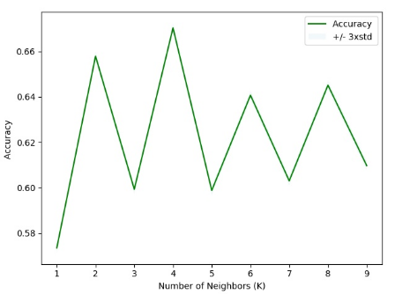
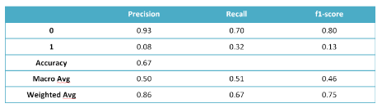
Results - KNN
k-Nearest Neighbor: K nearest neighbors is a simple algorithm that stores all available cases and classifies new cases based on a similarity measure (based on distance)
The best K appears to be 4 with below results

Slide 7
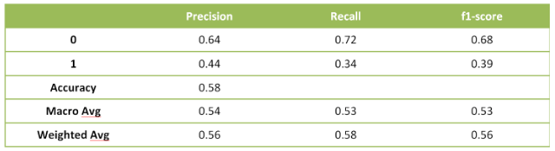
Results – Decision Tree
The Decision Tree Analysis breaks down a data set into smaller subsets while at the same time an associated decision tree is incrementally developed. The final result is a tree with decision nodes and leaf nodes.

Slide 8
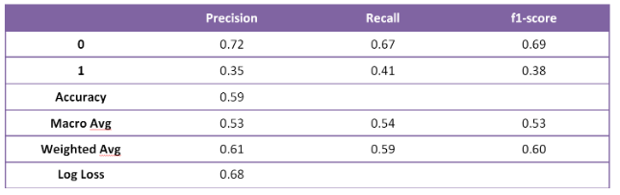
Results – Logistic Regression
Logistic regression is a statistical model that in its basic form uses a logistic function to model a binary dependent variable

Slide 9
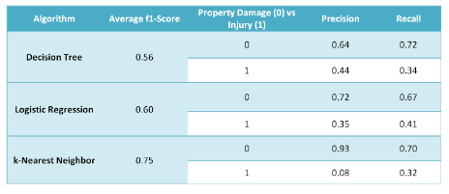
Conclusion
- Descision Tree – Percision
- Logisitic Regression – Recall
- KNN – F1
To be used in combination.

Slide 10
Discussion
In future, such reports should be evaluated regularly to help deter the increase in accidents and help save loss of property and life.

