Slide 1


Bkash.
Online Banking System
Presented by:
Imranul Islam Shihab
(232-35-733)
Meherab Hasan Fahim
(232-35-670)
liakat hossain
(232-35-642)

Slide 2
1
Overview
Agenda ->
2
Features
3
Limitations

Slide 3
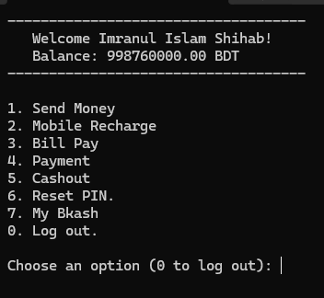
Overview
Terminal Based
Tech Stack C
Basic Functionalities

Slide 4
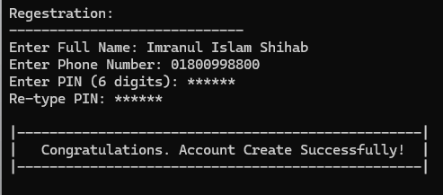
Features
# User Registration

Slide 5
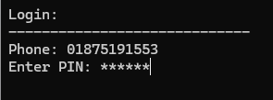
Features
# User Login

Slide 6
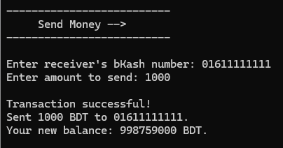
Features
#1. Send Money

Slide 7
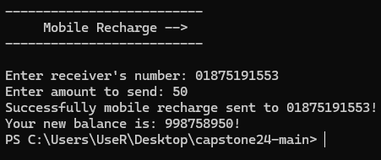
Features
#2. Mobile Recharge

Slide 8
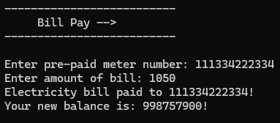
Features
#3. Bill Pay

Slide 9
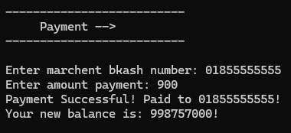
Features
#4. Payment

Slide 10
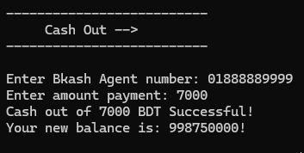
Features
#5. Cash Out

Slide 11
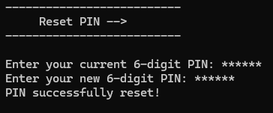
Features
#6. Reset PIN

Slide 12
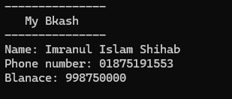
Features
#7. My Bkash

Slide 13
Limitations.
Graphical representation is missing.
2-Step Verification missing.
Time consuming to switch function.

Slide 14

Thank You.

