Slide 1
National RMNCHAY-ARM Findings of the SIP project
Lulu M Muhe, MD,PHD (Professor)
SIP stands for “Study of Illness in Preterms”
Based on 19 published articles, & 1 pending

Slide 2

Collaborating Institutions
Bill and Melinda Gates Foundation
RTI International, USA
Columbia University, US
Geneva University
Nehru Medical College, India
IsGlobal Barcelona, Spain
AAP, USA
AAU (TAH, GMH)
Jimma University
St. Paul’s Hospital
Gondar University
Zewditu Hospital
Makelle Hospital
EPS
FMOH

Slide 3
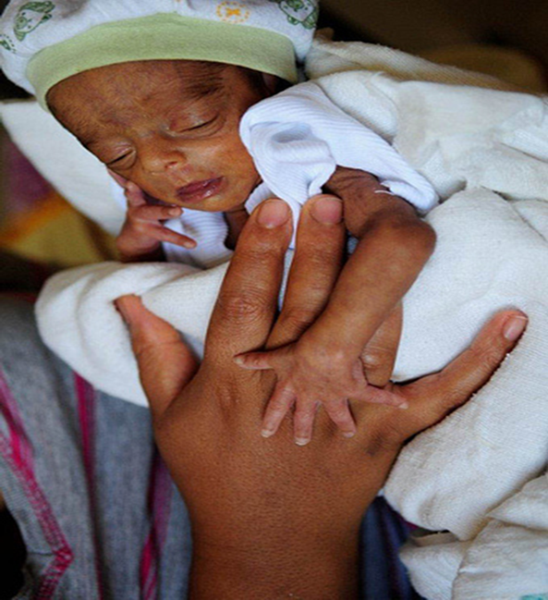
Primary objective of the SIP project
To determine the major causes of death in preterm hospitalized infants in Ethiopia based on standard protocols.

Slide 4
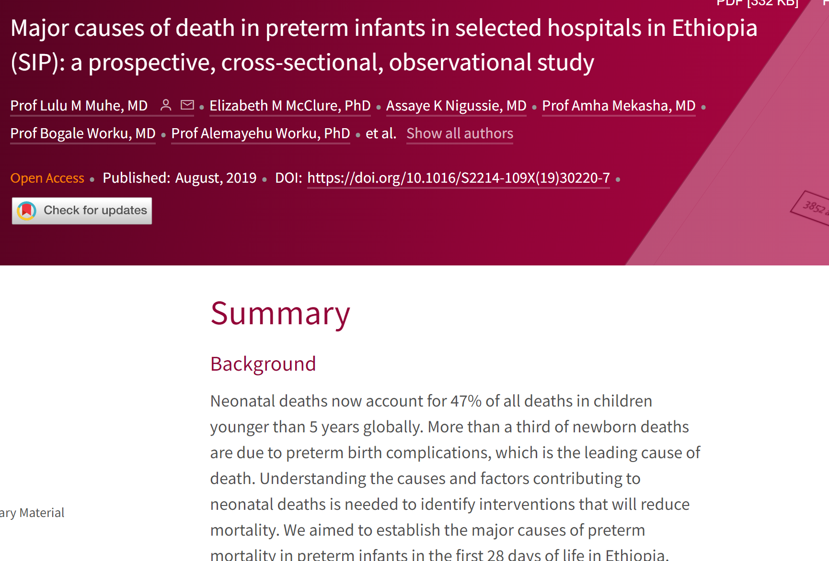
Why determining the major causes of preterm morality is significant
Every year, an estimated 15 million infants are born preterm (before 37 completed weeks of gestation),
In 2017, 2.5 million newborn deaths occurred globally accounting for 47% of under-five deaths. Just over one third of these deaths resulted from preterm-related causes.
Complications of preterm birth are the leading cause of under-five mortality (18%).
Accurate data on the COD could facilitate the development of interventions and the prioritization of scarce resources to implement the package at scale. To address the gaps in data on causes of death among preterm births, we conducted a study to describe the major causes of preterm mortality in Ethiopia.

Slide 5
Secondary objectives
To identify maternal/obstetric factors for preterm birth, preterm complications and mortality
To assess clinical events against final diagnosis and outcomes such as hypothermia, malnutrition, etc.
To compare standard autopsy with Minimally Invasive Tissue sampling
To assess blood/CSF culture positive sepsis and susceptibility profiles
To assess chest x-ray positivity for RDS
To compare ultrasound positive IVH diagnoses with autopsy proven cases

Slide 6
Background: Under-five Mortality (71% Reduction since 1990) (FMOH of Ethiopia)

Slide 7
Distribution of Primary COD of Preterm Infants (N=1109)

Slide 8
Distribution of Contributory Causes of Death of Preterm Infants-Maternal Conditions (N=1109)*
Contributory COD | <28 weeks | 28-31 weeks | 32->35 weeks | 35- <37 weeks | All
Pre-eclampsia and eclampsia | 11(4.8%) | 117(51.1%) | 90(39.3%) | 11(4.8%) | 229 (21%)
Antenatal hemorrhage | 10(11.8%) | 46(54.1%) | 20(23.5%) | 9(10.6%) | 85 (8%)
Maternal fever | 3(7.7%) | 15(38.5%) | 18(46.2%) | 3(7.7%) | 39 (4%)
Chorioamnionitis | 7(13.5%) | 26(50.0%) | 15(28.9%) | 4(7.7%) | 52 (5%)
Cord prolapsed | 0 | 4(36.0%) | 3(27.3%) | 4(36.4%) | 11
Signs of fetal distress | 0 | 5(55.6%) | 2(22.2%) | 2(22.2%) | 9
Obstructed labor | 0 | 2(50.0%) | 0 | 2(50%) | 4
Others | 21(7.5%) | 126(44.8%) | 95(33.8%) | 39(13.9%) | 281

Slide 9
Distribution of Contributory Causes of Death of Preterm Infants- Neonatal Conditions (N=1109)*
Contributory COD | <28 weeks | 28-31 weeks | 32-<35 weeks | 35- <37 weeks | All (N)
Hypothermia | 71 (9.2%) | 369 (47.9%) | 237 (30.8%) | 93 (12.1%) | 770 (69%)
Apnoea | 38 (10.6%) | 185 (51.4%) | 109 (30.3%) | 28 (7.8%) | 360(32%)
RDS | 29 (8.4%) | 166 (48.3%) | 104 (30.2%) | 45 (13.1%) | 344 (31%)
Sepsis | 14 (8.5%) | 73 (44.5%) | 52 (31.7%) | 25 (15.2%) | 164
Hyperbilirubinemia (Jaundice) | 10 (8.2%) | 43 (35.2%) | 44 (36.1%) | 25 (20.5%) | 122
Anemia | 10 (9.8%) | 45 (44.1%) | 32 (31.4%) | 15 (14.7%) | 102
Asphyxia | 7 (7.1%) | 47 (47.5%) | 34 (34.3%) | 11 (11.1%) | 99
Hypoglycemia | 4 (5.4%) | 30 (40.5%) | 26 (35.1%) | 14 (18.9%) | 74
IVH | 6 (8.8%) | 37 (54.4%) | 21 (30.9%) | 4 (5.9%) | 68
Pneumonia | 5 (8.9%) | 19 (33.9%) | 19 (33.9%) | 13 (23.2%) | 56

Slide 10
Admission hypothermia vs mortality
Temperature | # preterms | # Died | % died | OR | P-value
36.5-37.5ºCelsius | 710 | 136 | 19.15 | Reference (normal)
36.0-36.4ºCelsius | 603 | 144 | 23.88 | 1.32 | 0.038
35.0-35.9ºCelsius | 1,023 | 278 | 27.17 | 1.57 | 0.000
34.0-34.9ºCelsius | 848 | 270 | 31.84 | 1.97 | 0.000
33.0-33.9ºCelsius | 345 | 139 | 40.29 | 2.85 | 0.000
32-32.9ºCelsius | 166 | 105 | 63.25 | 7.26 | 0.000
<32ºCelsius | 6 | 3 | 50 | 4.22 | 0.08
Data missing | 94 | 18
Total | 3852 | 1,091 | 28.3

Slide 11
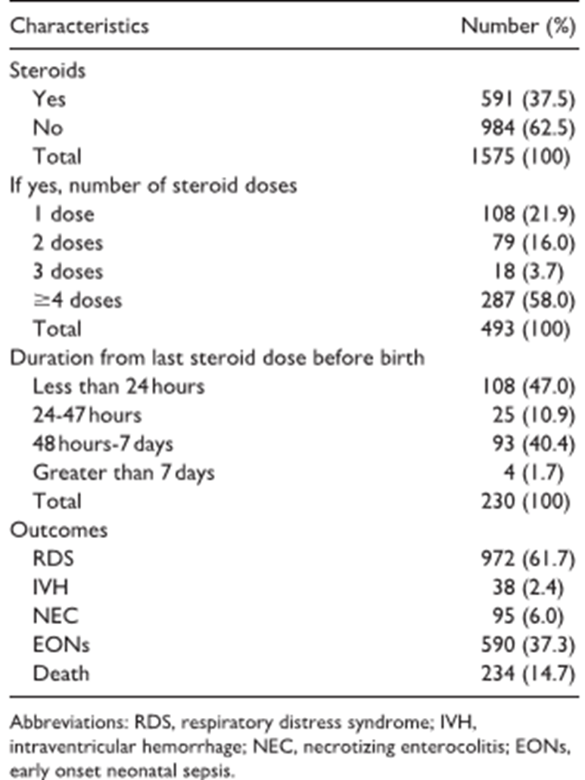


Slide 12
SIP recommendations
To have a POLICY DIALOGUE with policy makers to make sure that the necessary policy and practice- change including review and revision of hospital clinical management protocols are happening
To strengthen the supportive infrastructure and HIGH IMPACT LOW COST INTERVENTIONS including:
skin-to-skin thermal care (KMC), expand/strengthen warm chain system
early and exclusive breastfeeding, parenteral nutrition,
blended oxygen, bubble CPAP for preterms and
Strengthen diagnostics including introducing a new pathological tool – MITS (Minimally Invasive Tissue Sampling
To improve CAPACITY OF HEALTH PROFESSIONALS to provide adequate and advanced inpatient quality newborn care, including infection prevention and control activities
To strengthen and IMPROVE TREATMENT OF THE COMMON CAUSES OF PRETERM NEONATAL DEATHS by ensuring access to CPAP, effective antibiotics (by monitoring antimicrobial susceptibility regularly) and prompt and effective resuscitation.
To strengthen the COMMUNITY BASED NEWBORN CARE approach and community engagement; Using the existing Health Extension platform, to strengthen the social mobilization activities.

Slide 13
Dissemination workshop
Produce policy brief for dialogue with policy makers
Identify areas which can be incorporated to the current available guidelines and protocols
Identify potential areas for implementation research

Slide 14
Dissemination workshop
Plenary presentations – summary of the 5 articles, literature review of recent publications after SIP, grey literature in regional and federal MOH documents, etc.)
Hypothermia - prevention and care
Nutritional interventions
RDS, oxygen delivery, blended oxygen and CPAP
Hospital infection control (and monitoring of microbial resistance)
ANC dexamethasone use to accelerate lung maturity
Group work on each of the topic areas
Current situation in Ethiopia: What are the barriers and potential solutions for scale up in Ethiopia?
Are there low-cost innovations that can help boost implementation?
Group identified gaps and suggestions at policy level, facility level and community level
Any funding opportunities for implementation research of a package of prevention and treatment
Discussions on way forward and closing with recommendations

Slide 15
Hypothermia
Problems identified:
High prevalence of hypothermia at tertiary facilities (80%)
Low coverage of known interventions for thermal control. This is primarily due to poor health care providers behaviour and poor health care seeking behaviour of the communities
Hypothermia in Preterm Newborns: Impact on Survival. https://journals.sagepub.com/doi/full/10.1177/2333794X20957655
Policy level interventions
Review and revise current guideline on thermal control and hypothermia management to initiate continuous KMC i.e., Immediate KMC, conventional KMC and community KMC at discharge or at home (This may require IR)
Initiate integrated refresher training and provide necessary supplies and conduct supportive supervision regularly (TSS)
Potential implementation research
Continuous KMC (immediate KMC followed by community KMC)
Introduction of new tool and technology for thermal control

Slide 16
Hypothermia
Facility readiness (actions at the facility level)
• Increase the number of trained staff at all levels
• Provide regular refresher trainings at all levels
• Identify essential supplies for thermal control and ensure regular availability
Demand generation (improve service utilization)
• Provide refresher training to HEWs
• Awareness creation at the community level on prevention and control of hypothermia
• Improve access for thermal control with emphasis at PHC and HP level
• Train and deploy the Women Development Group to steer the overall health care work for preterm babies at the community level

Slide 17
Sepsis, bacterial isolates, and antimicrobial resistance
Problems identified:
Alarmingly high prevalence of AMR (more than 80% resistance to recommended antibiotics- ampicillin and gentamicin)
High prevalence of hospital acquired infections
Shortage of recommended second-level antibiotics
Bacterial Isolates and Resistance Patterns in Preterm Infants with Sepsis in Selected Hospitals in Ethiopia: A Longitudinal Observational Study. DOI:10.1177/2333794X20953318
Policy level interventions
•Review and revise the national guideline for first-line & second-line antibiotics to treat neonatal sepsis/PSBI
•Review and revise the national guideline on infection prevention and control (developing/including NICU IPC guidelines as it is a specialized unit)
•Develop a national neonatal sepsis screening and diagnostic tool
•Strengthen AMR surveillance at national and sub-national levels sentinel sites including health centers and health posts where empirical sepsis treatment with ampicillin-gentamicin combination is practiced
Potential implementation research ideas
•Develop and test new screening tool for neonatal sepsis at the hospital level (such as serial micro-ESR, C-reactive protein, procalcitonin, and other acute phase reactants)
•Evaluate a package of interventions to reduce mortality from sepsis (PSBI) at NICU’s in higher hospitals versus primary level

Slide 18
Sepsis, bacterial isolates, and antimicrobial resistance
Facility readiness (actions at the facility level)
Increase the number of trained staff at all levels
Provide regular refresher training at all levels
Ensure regular supply of first line and second-line antibiotics
Ensure supplies for infection prevention and control (water supply, soap, disinfectants etc)
Reinforce quality assurance and control measures on infection prevention activities
Demand generation (improve service utilization)
Provide refresher training to HEWs on early screening, management and referral and AMR, infection prevention and control and rational use of antibiotics
Improve access to neonatal sepsis screening and management through task shifting and management
Improve community awareness on danger signs of sepsis and improve health care seeking behaviour of the community.
Train and deploy women development group

Slide 19
Respiratory Distress Syndrome (RDS)
Problems identified:
Lack of recognition of RDS as a major newborn health problem despite being responsible for 45% of preterm deaths
Low coverage of interventions targeting prevention and management of RDS
Major causes of death in preterm infants in selected hospitals in Ethiopia (SIP): a prospective, cross-sectional, observational study. https://www.thelancet.com/journals/langlo/article/PIIS2214-109X(19)30220-7/fulltext
Policy level interventions:
Develop a national operational guideline for prevention and management of RDS at all levels
Develop criteria to diagnose RDS
Avail the necessary inputs and supplies that are necessary to prevent and manage RDS at all levels including supply of oxygen and CPAP equipment
Potential implementation research:
Introduction of non-invasive (aerosolized) surfactant at hospital level
Evaluate and monitor the outcome of preterm infants with RDS managed using CPAP at scale

Slide 20
Respiratory Distress Syndrome (RDS)
Facility readiness (actions at the facility level)
Increase the number of trained staff at all levels on oxygen administration, use of pulse oximetry, use of CPAP machine.
Provide regular refresher training at all levels on RDS prevention and management
Ensure regular supply of oxygen concentrator, nasal prongs, blended oxygen supply, pulse oximeters, apnoea monitors, CPAP machines
Monitor arterial blood gas/capillary blood gas analysis machines and conduct proper interpretation to prevent and manage oxygen toxicity
Establish central equipment maintenance system at all levels for all problems
Demand generation (improve service utilization)
• Refresher training of HEWs on prevention and management of preterm complications
• Improve access for prevention and management of preterm complications

Slide 21
Preterm nutrition
Problems identified:
High prevalence of extrauterine growth restriction
Delayed initiation of enteral feeding
Lack of breast milk fortification guideline
Lack of parenteral nutrition service for preterm infants
Lack of breast milk bank
Preterm Nutrition and Clinical Outcomes. https://journals.sagepub.com/doi/10.1177/2333794X20937851
Policy level interventions
Develop operational guideline for preterm nutrition care and management
Establish breast milk bank at national and regional levels

Slide 22
Preterm nutrition
Facility readiness (actions at the facility level)
Include Preterm nutrition management in the pre-service training Program: Increase the number of trained staff on preterm nutrition including early initiation of breast feeding, growth monitoring and nutritional interventions.
Provide regular refresher training on growth monitoring and management of preterm nutrition at all levels
Ensure regular supply of breast milk fortification, parenteral nutrition supplies, preterm feeding equipment and supplies etc.
Demand generation (improve service utilization)
Provide Refresher training for HEWs on growth monitoring and management of preterm nutrition
Improve access and quality for prevention and management of preterm nutrition.
Potential Implementation Research ideas
The use of growth curve in NICU, calculating the percentage of weight loss- would it improve the nutritional support?
Rapid advancement of BM feeding, higher versus standard volume (? RCT)
Operational feasibility of breast milk fortification in the Ethiopian context

Slide 23
Antenatal corticosteroids
Problems identified:
Low coverage at the national and sub-national level
Most deliveries happening at PHC level
Lack of clarity on the global standard recommendations and use of ANCS
Antenatal Steroid Utilization in Ethiopia. https://journals.sagepub.com/doi/10.1177/2333794X21990344
Policy level interventions
Clarifying message on standard recommendations of ANCC from HQ to all levels
Develop national screening protocol for Antenatal corticosteroids
Policy guidance for task shifting to allow PHCs to initiate Antenatal corticosteroids
Develop new training guidelines and provide training followed by provision of essential supplies and supportive supervision

Slide 24
Antenatal corticosteroids
Facility readiness (actions at the facility level)
Increase the number of trained staff at all levels
Provide regular refresher training at all levels
Ensure regular supply of dexamethasone
Initiate mobile applications for ANC corticosteroids
Strengthen the collaboration between obstetricians and paediatricians at facility level
Demand generation (improve service utilization)
Provide refresher training to HEWs on ANC, preterm delivery and use of antenatal corticosteroids
Improve access to ANC and service for preterm deliveries. Through task shifting
Potential Implementation Research ideas
Test for possible task shifting: Initiation of antenatal corticosteroids at PHC level (potential for RCT)

Slide 25
Cross-cutting interventions
Expansion and improvement of Infrastructure for newborn care (e.g., proximity of NICU to the delivery room, space versus number of babies, different rooms for different purposes).
Integrated cluster mentorship program for newborns through vertical integration and network of care
Develop and design for quality assurance and control programs for newborn health care at all levels.
Introduce digital technology to improve newborn health outcome
Design and develop monitoring learning and evaluation framework for newborn health at all levels.
Strengthen the communication and referral system for newborn health care

Slide 26
Thank you

