Slide 1
Start building a 3 node lab here
Play with Kubernetes:
https://dockr.ly/nigel
Instructions on how to build the lab are in lab.md on GH in the docs folder
Lab’s GitHub repo: https://github.com/nigelpoulton/k8s101/

Slide 2
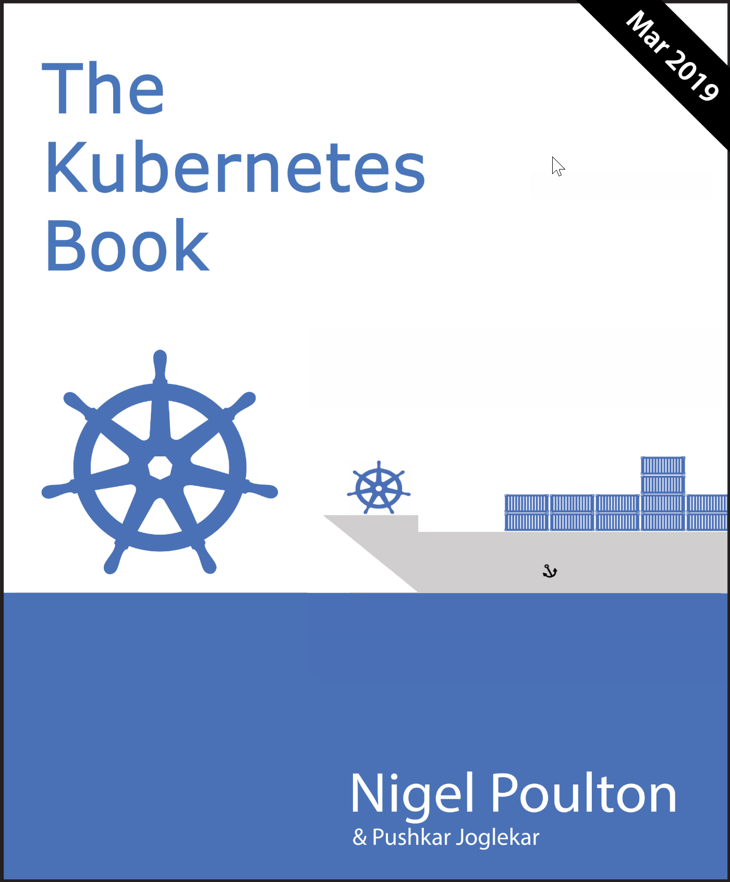


Courses
Getting Started with Kubernetes (pluralsight.com)
Amazon
Audible
Leanpub
Kubernetes Deep Dive (acloud.guru)
@nigelpoulton

Slide 3
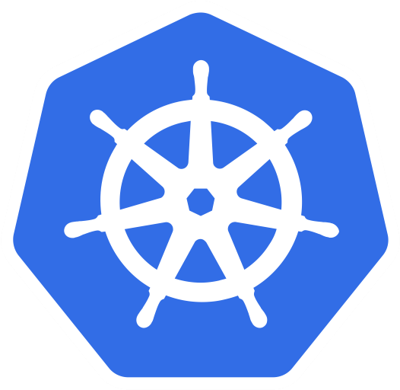
Cloud-native microservices app
Web
Indexer
Auth
RBAC
Store
Kubernetes
Infrastructure
(On-premises/cloud)

Slide 4
Cluster

Slide 5
Kubernetes cluster
Machine
Machine
Machine
Machine
Machine
Machine
Machine
Machine
Control plane
Data plane
Cluster brains
Cluster muscle

Slide 6
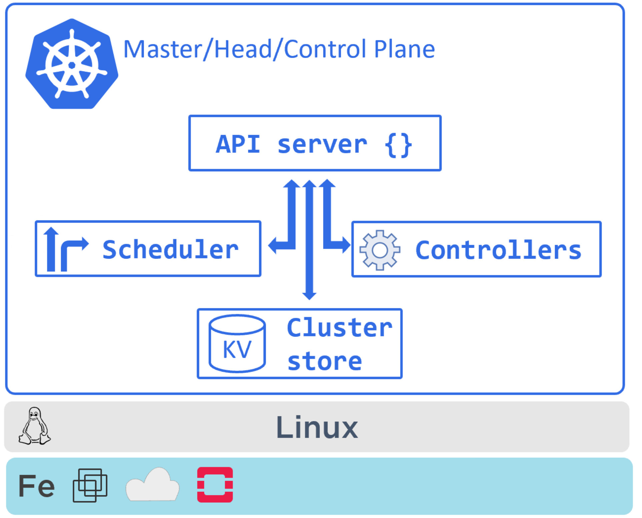

Slide 7
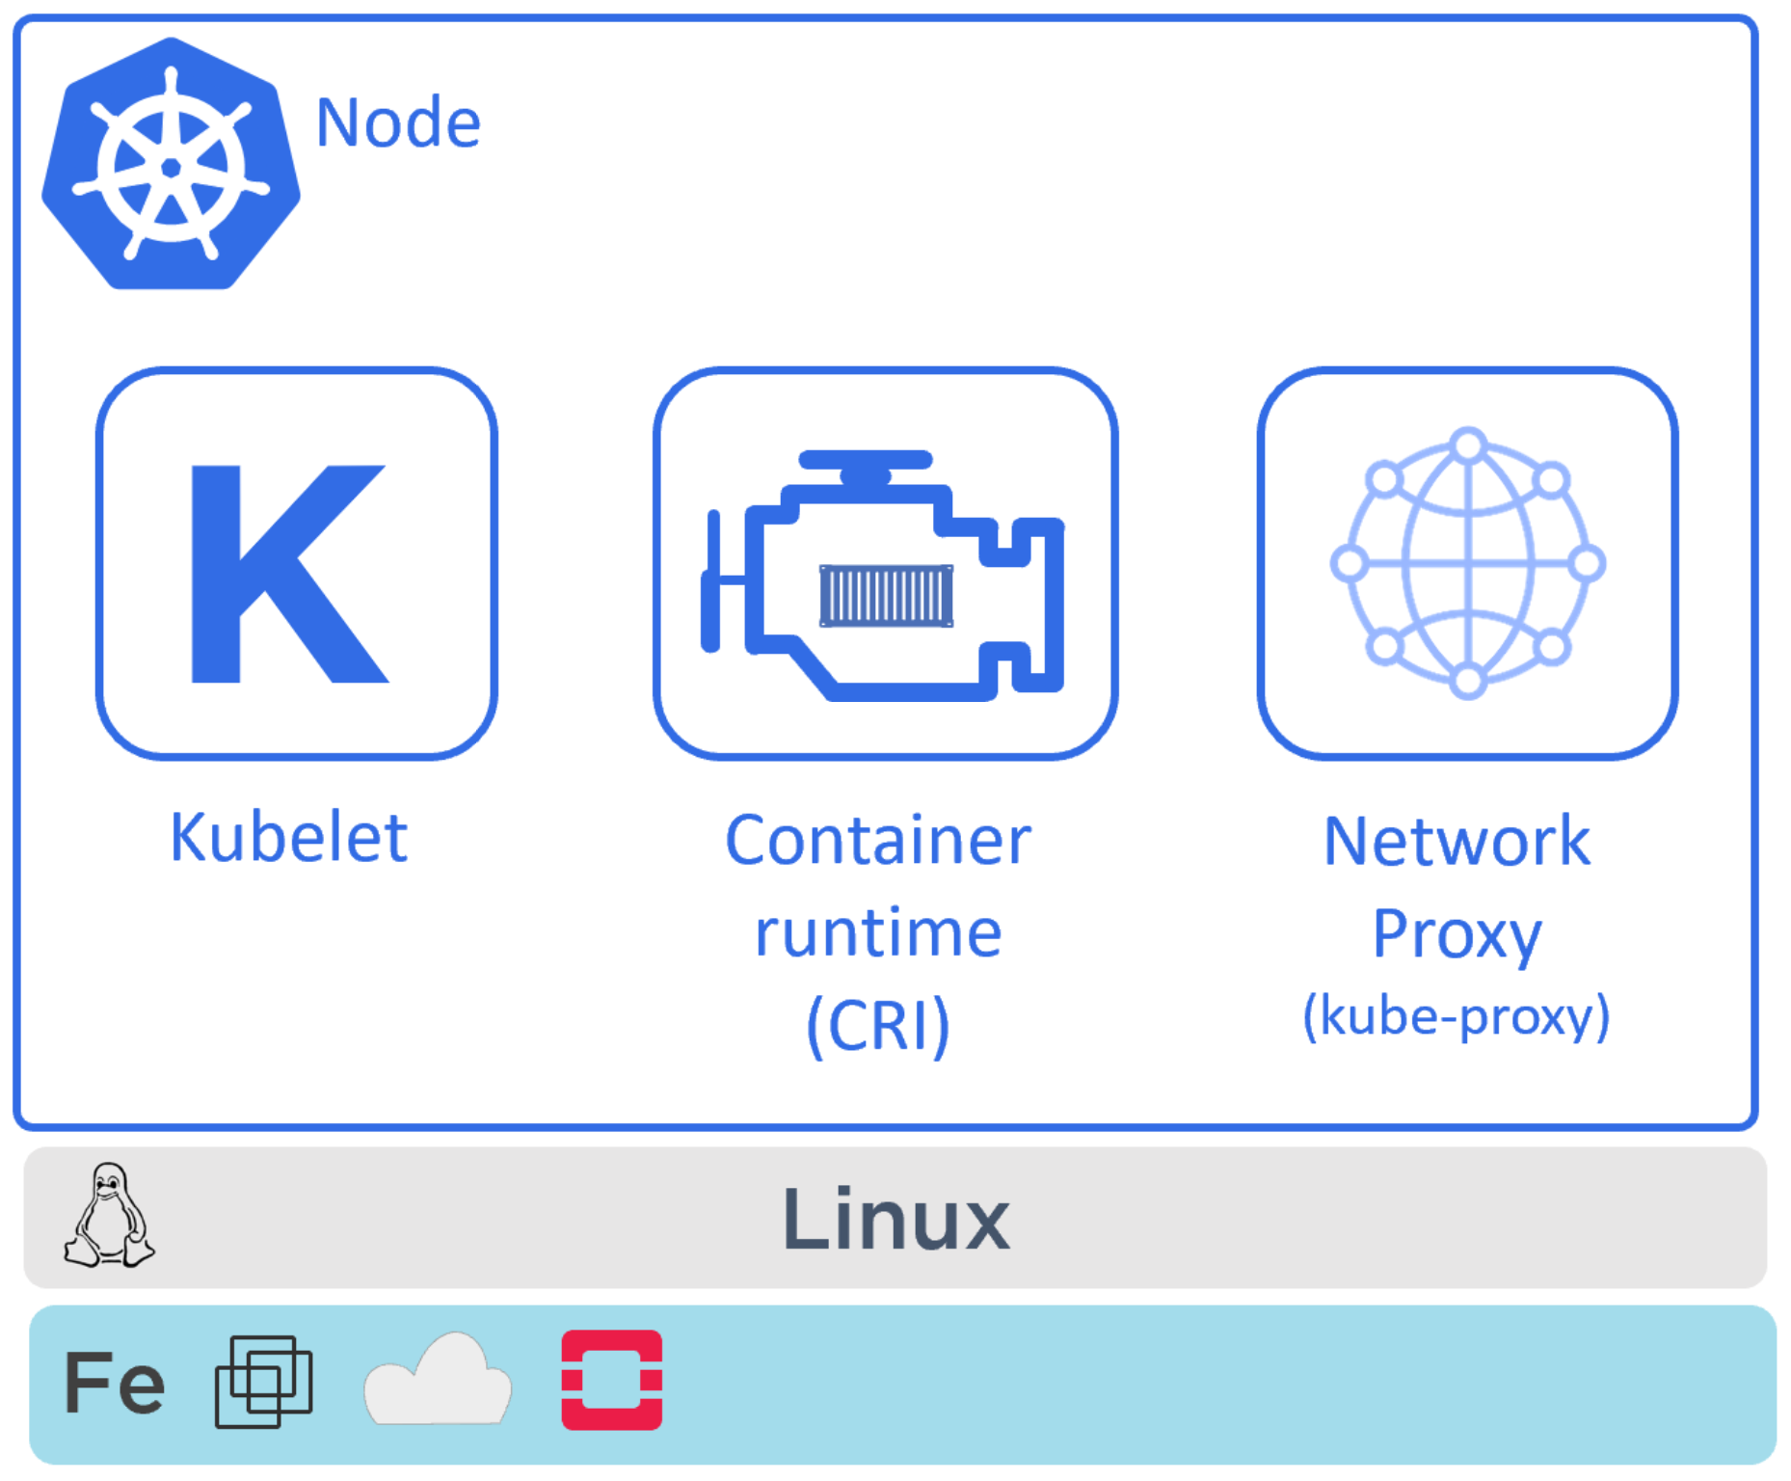

Slide 8
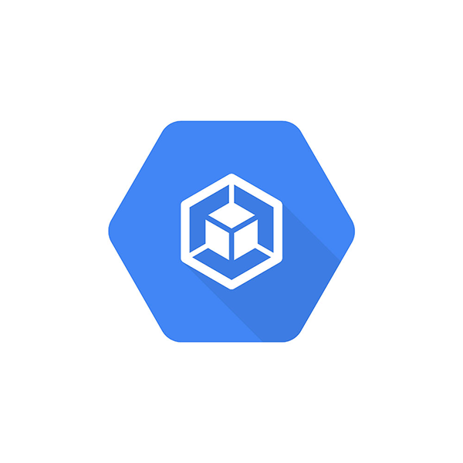

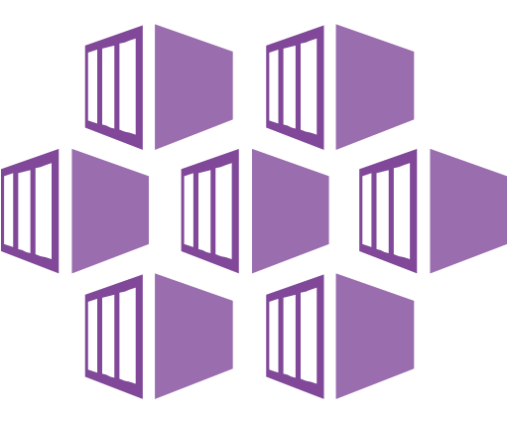
Hosted K8s services
Azure AKS
Google GKE

Slide 9
Kubernetes cluster
Machine
Machine
Machine
Machine
Machine
Machine
Machine
Machine
Control plane
Data plane

Slide 10
Kubernetes cluster
Kubernetes cluster
Master1
Master2
Master3
Node1
Node2
Node3
Node4
Node5
Control plane
Data plane

Slide 11
Kubernetes cluster
Hidden from you
Managed by cloud provider
Master1
Master2
Master3
Control plane
Exposed to you
Managed by you
Node1
Node2
Node3
Node4
Node5
Data plane

Slide 12
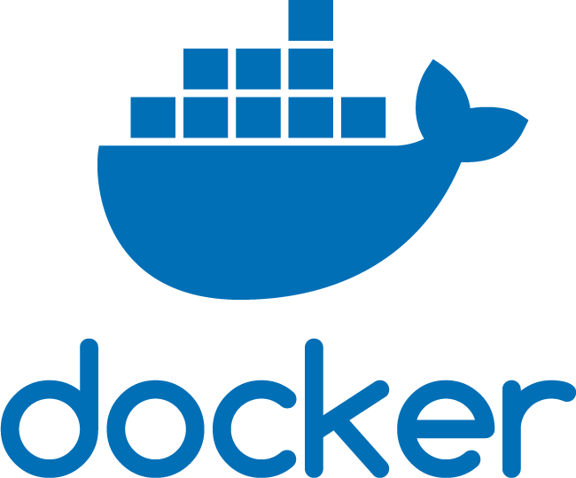


Kubernetes cluster
Master1
Master2
Master3
Node1
Node2
Node3
Node4
Node5
Runtime:
Runtime:
Runtime:
Runtime:
Runtime:
Control plane
Data plane
Masters
API server
Scheduler
Cluster store…
Worker nodes
Kubelet
Container runtime
User app

Slide 13
Application orchestrator

Slide 14
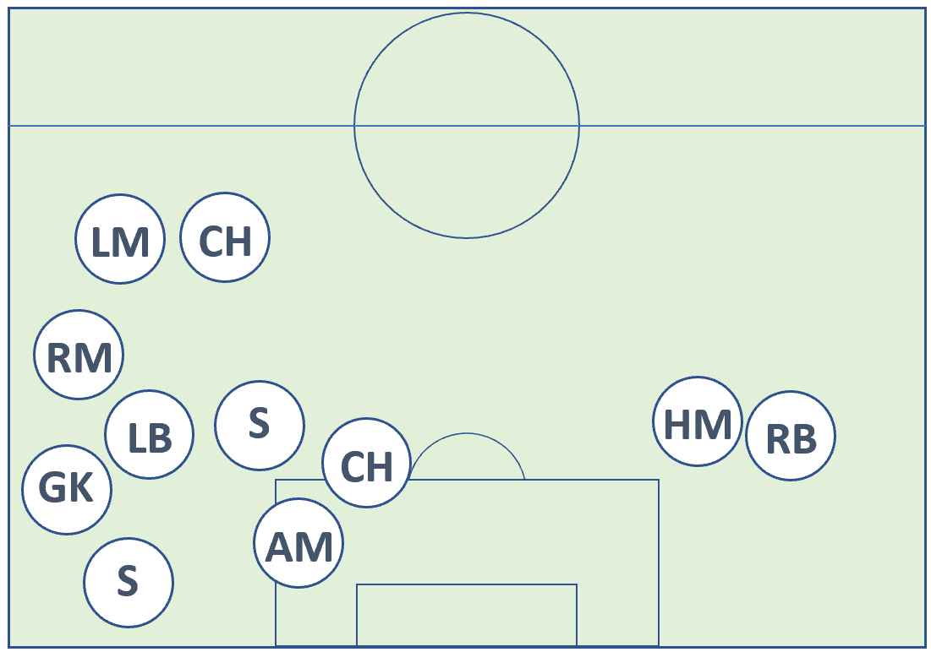

Slide 15
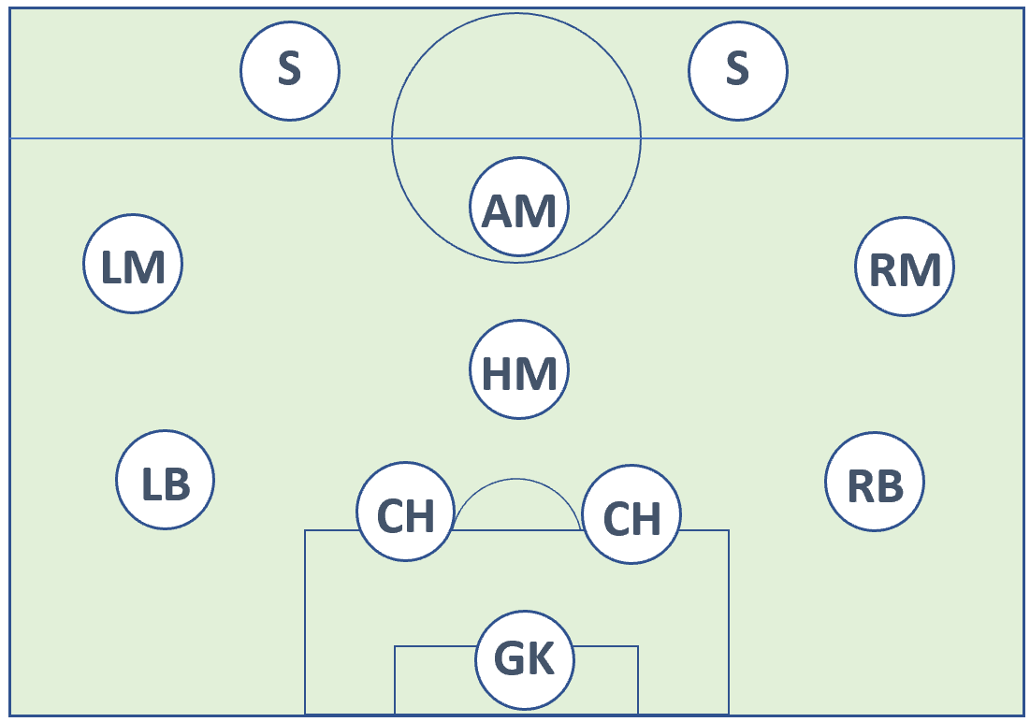
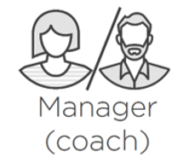
App
Orchestrator
Cluster

Slide 16
The Big Picture
From Code to Kubernetes
Idea
[Container registry]
package main
import (
"fmt"
"reflect"
)
func main() {…
Business
requirement

Slide 17
The Big Picture
From Code to Kubernetes
[Container registry]
package main
import (
"fmt"
"reflect"
)
func main() {…

Slide 18
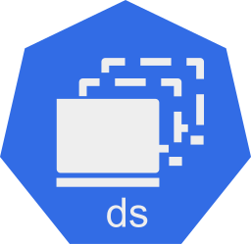
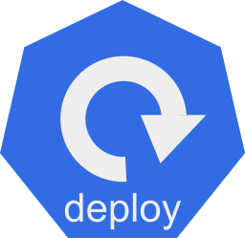
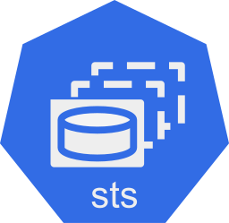
The Big Picture
From Code to Kubernetes
[Container registry]
package main
import (
"fmt"
"reflect"
)
func main() {…

Slide 19
The Big Picture
From Code to Kubernetes
[Container registry]
package main
import (
"fmt"
"reflect"
)
func main() {…
Coding
Docker
Kubernetes

Slide 20
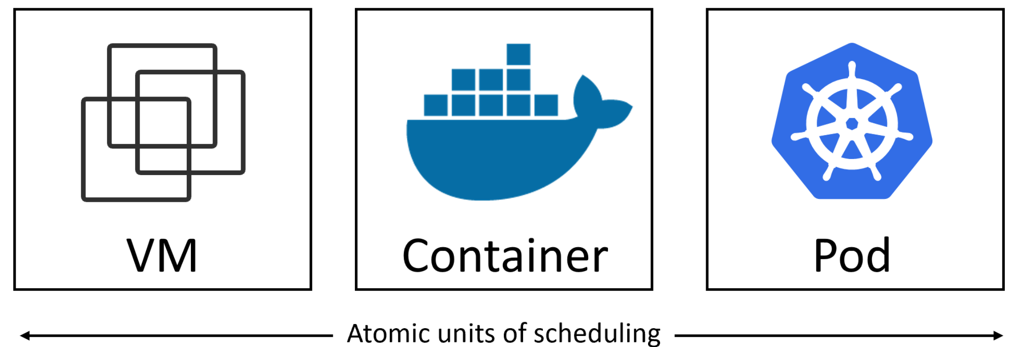

Slide 21
Declarative model
vs
Actual state
Desired state
I want:
10 running replicas
Exposed on port 8080
Based on xyz image
With app=web label
Currently running:
10 running replicas
Exposed on port 8080
Based on xyz image
With app=web label

Slide 22
Declarative model
vs
Actual state
Desired state
I want:
10 running replicas
Exposed on port 8080
Based on xyz image
With app=web label
Currently running:
8 running replicas
Exposed on port 8080
Based on xyz image
With app=web label

Slide 23
spec:
selector:
matchLabels:
app: web
replicas: 10
strategy:
type: RollingUpdate
template:
metadata:
labels:
app: web
zone: prod
version: v1
spec:
containers:
- image: nigelpoulton/k8sbook:latest
name: web-ctr
ports:
- containerPort: 8080

Slide 24
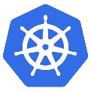

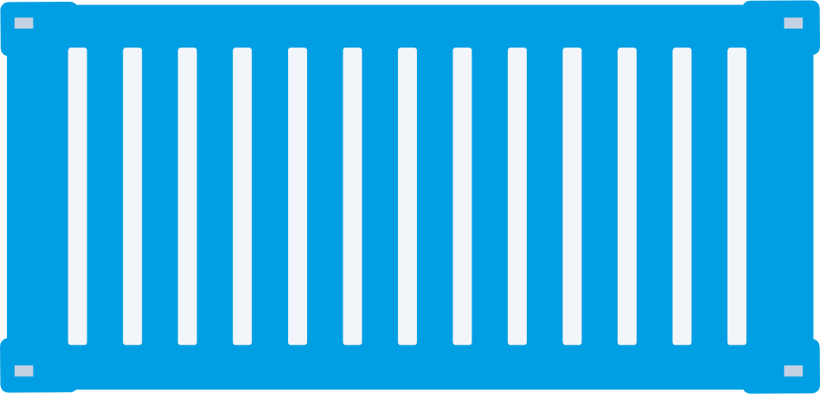

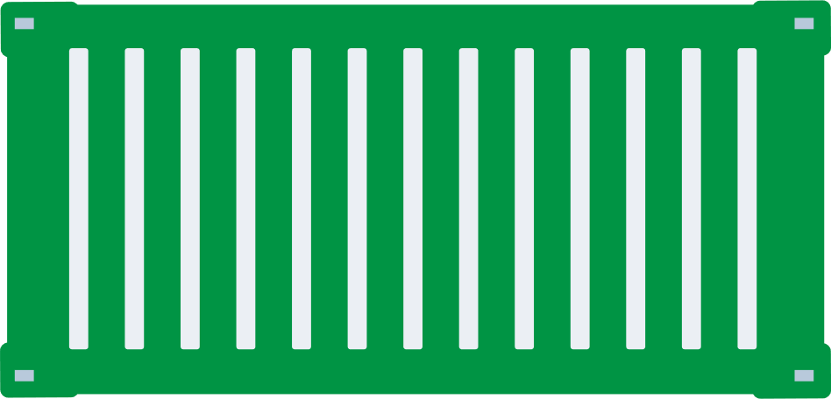


App
K8s
K8s
K8s
Cloud A
On-prem
Cloud B

Slide 25
App
K8s
K8s
K8s
Cloud A
On-prem
Cloud B

Slide 26
App
K8s
K8s
K8s
Cloud A
On-prem
Cloud B

Slide 27
App
K8s
K8s
K8s
Cloud A
On-prem
Cloud B

Slide 28
App
K8s
K8s
K8s
Cloud A
On-prem
Cloud B

Slide 29
Plan
Deploy an app as a Pod
Connect to the Pod
Demonstrate self-healing
Demonstrate scaling
Demonstrate using an external load-balancer
Demonstrate rolling updates

Slide 30
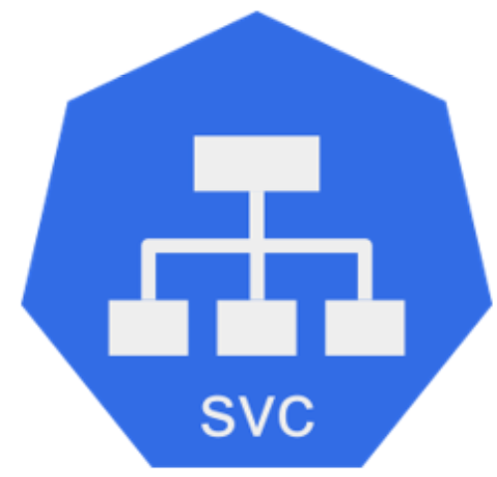
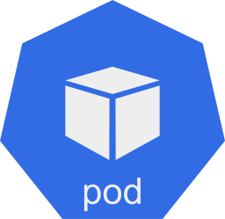
IP:port
Port: 8080
Pods: All with `app=web`
app=web
app=q
app=web
app=web
app=auth
app=web
app=web
app=db

Slide 31
Node:port
(node1:30001)
apiVersion: v1
kind: Service
metadata:
name: svc-np
labels:
app: web
spec:
type: NodePort
ports:
- port: 8080
nodePort: 30001
selector:
app: web
Port: 8080
Pods: All with `app=web`

Slide 32
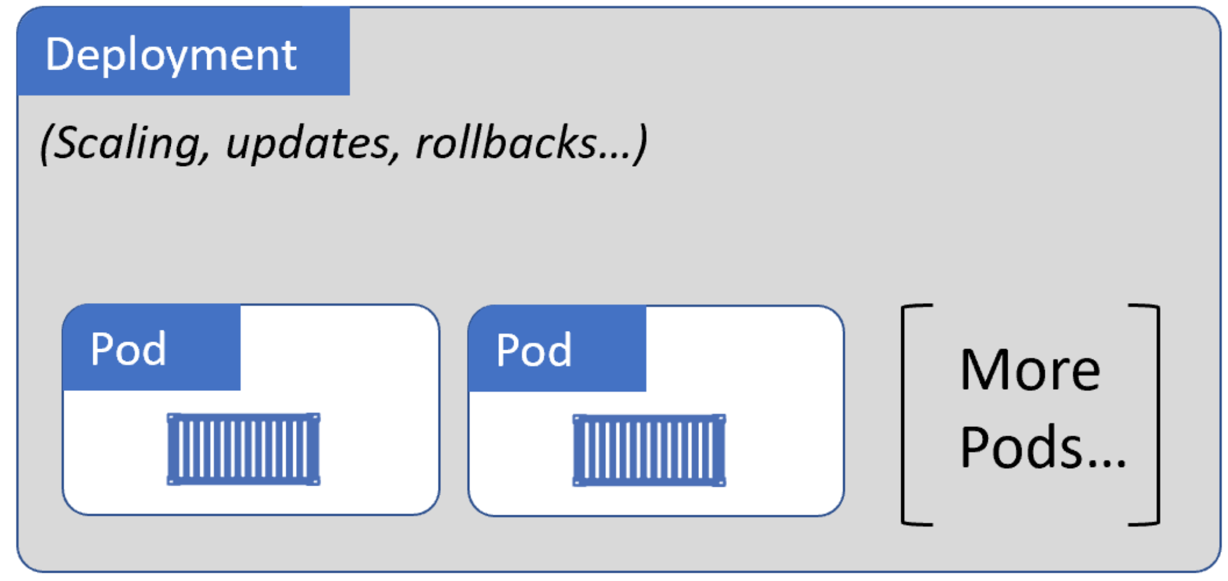

Slide 33
Courses
Getting Started with Kubernetes (pluralsight.com)
Amazon
Audible
Leanpub
Kubernetes Deep Dive (acloud.guru)
@nigelpoulton

