Slide 1
Overview
Login page
Admin login
Admin Profile
Add , Delete User
User login
Logout
UserX Profile
Tags List;
Delete;
Add to Search
Advance Search
Album is Selected
Page is Closed
Advance Search Button
Cancel
Returns to Album
Generic PopUp Alert (Error)
Error
PhotoDirectory
Clear Search
Search
Generic PopUp Alert (Confirmation)
Accepts/Decline Changes
MoveTo , Search, Add Photo, Delete, Copy, Paste
Caption/Recaption;
Delete from Tag;
Tags List;
Add to Tags
Cancel/End
Edit Tags Button
Edit Tags
Delete; Add Tags

Slide 2
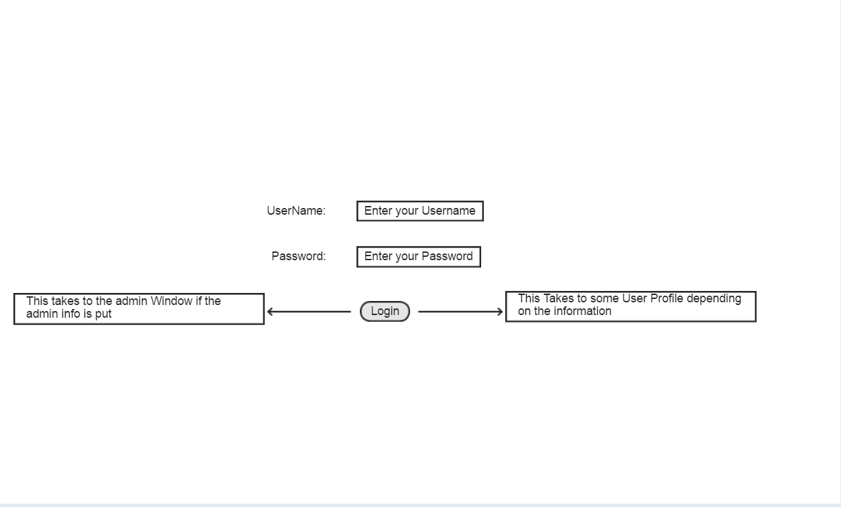

Slide 3
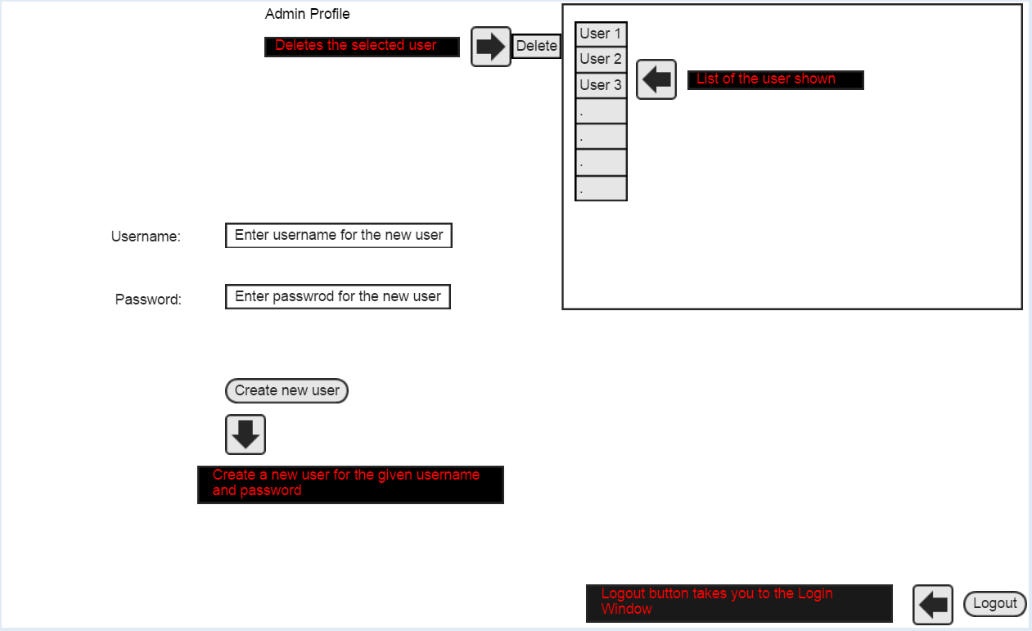

Slide 4
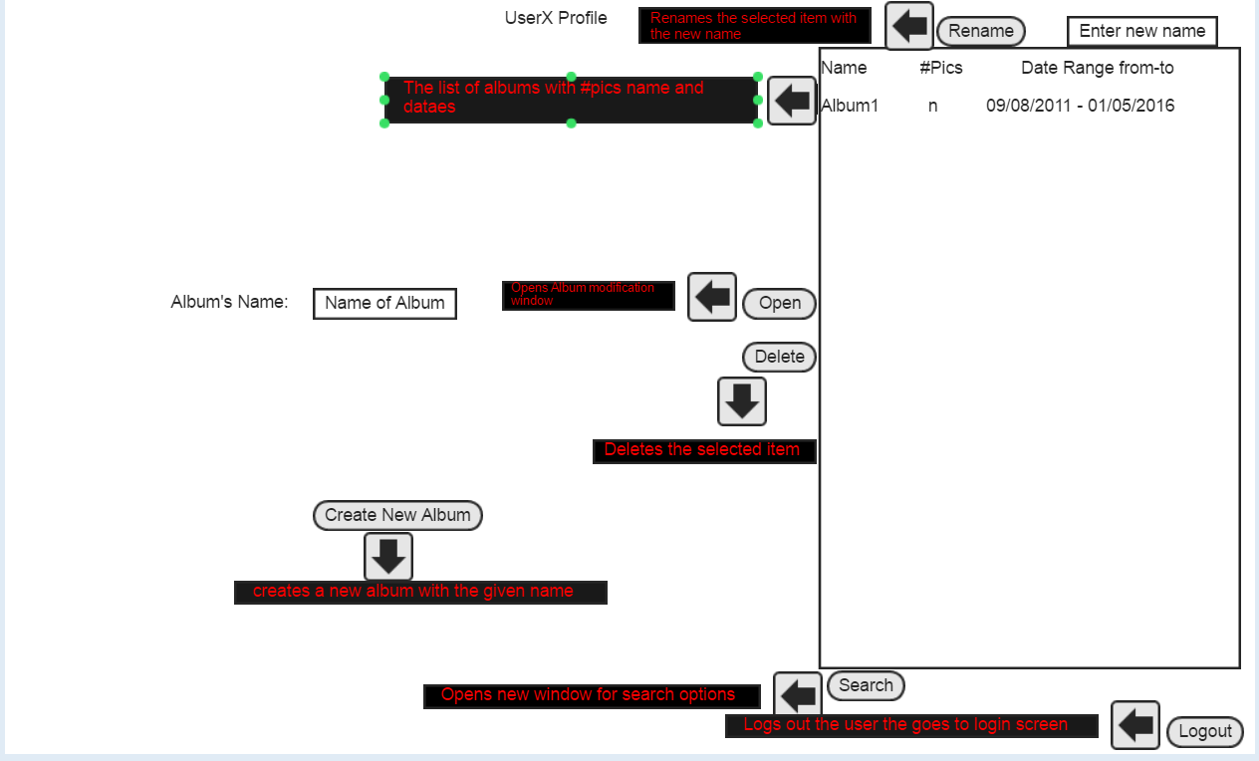

Slide 5
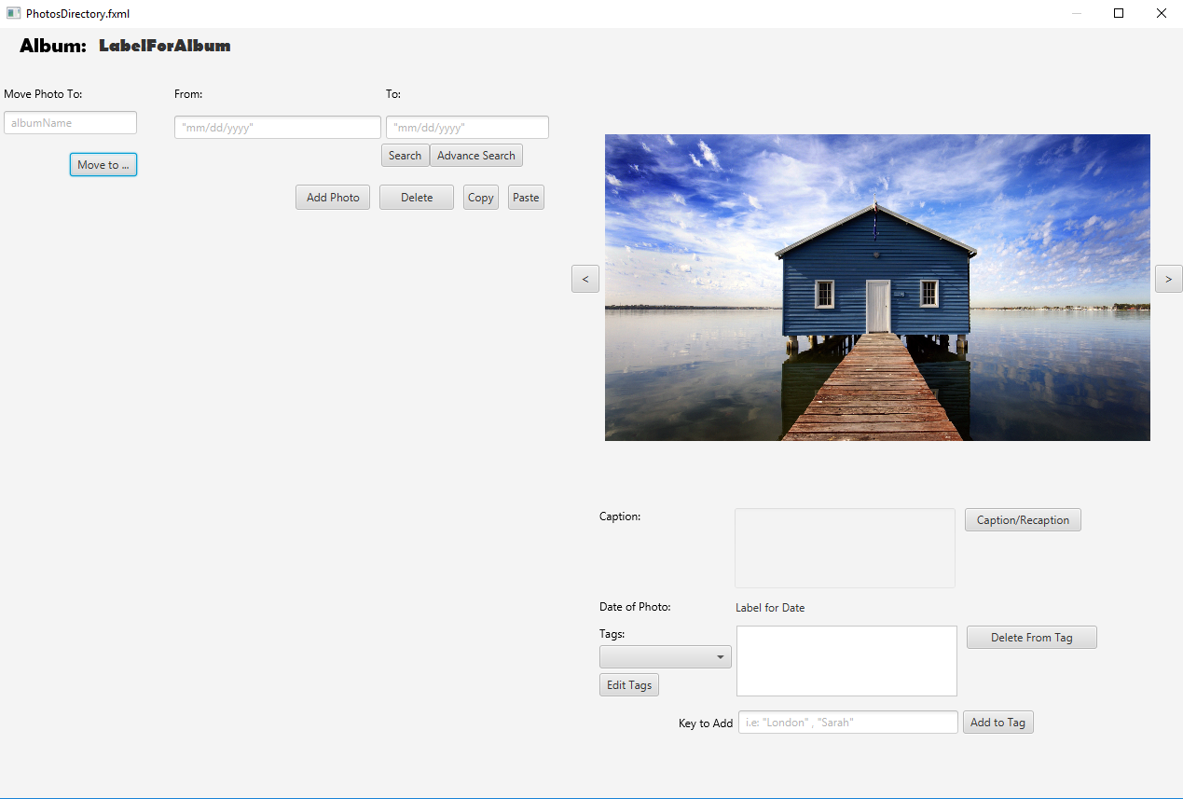
PhotosDirectory - Initial View [1]
Returns to Album Directory. All changes are saved for curr album
Move Function
Search Functions
Photo Display
Clear Search
Sample Photo
Edit Photo in Album Buttons
All Photos Will Be Displayed Here
Next Photo
Once a photo is selected
Goes to Previous Photo
Available photo description: caption, date of photo, tags

Slide 6
PhotoDirectory: Search Features
Opens Advance Search Page
2
1.) Error Handles (Popup):
-Wrong format
-No photos fit range
If successful the photos display will be updated to fit criteria
2.) Will return to the steady state in which all photos will be displayed
-this button will be added
-whether a previous search was or was not initiated will not added it.
1
Clear Search
Photos Will be Displayed Here Fitting the Date Search Criteria

Slide 7
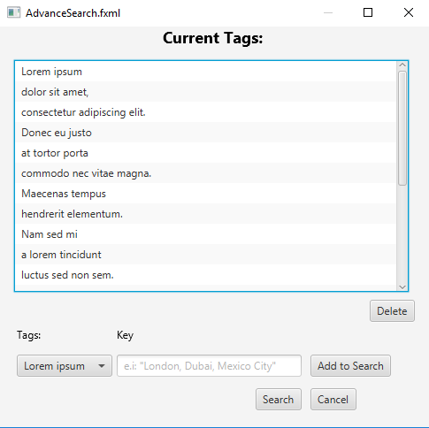
Advance Search
1.) Once user clicks on search a search fitting all tags – key(s) will be conducted and the display in PhotoDirectory will be updated.
-if error occurs pop will display Alert
Displays current tags, if any, and will refresh when new tag – key is added. Order does not matter.
Ex1: "Location: Mexico City; New York City"
Ex2: "Location: London
Removes selected tag
Will add search
List of Available Tags for all Photos in current Album
One or more keys can be used per tag as long as they are separated by ' ; '
Will close page, no search, clear all tag searches
1

Slide 8
PhotosDirectory – Move Function
Once a photo is selected user will input the album which they would like to move selected photo to
Photo(s) display (thumbnails)
If Successful photo will be added to selected album & current display will be updated
Errors:
-if no album exists
-if no photo is selected
NOTE: let's try to move more than one photo at a time.

Slide 9
PhotoAlbum – Photo Details
First click enables editing of the cation, to the left. Second click saves changes done to the caption
Date
List of Tags available for photo. Selected tag will display all keys connected to tag
Deletes key from current tag
Opens the edits tag page
Gets input from the text field to the right and will update the list of keys in tag

Slide 10
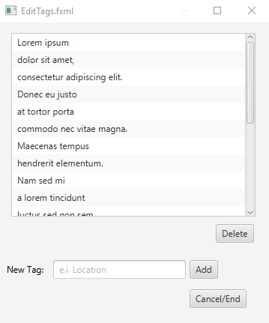
Edits Tags Page
Pop up Alerts will be displayed for errors and for confirmation.
Selected tag from list will be deleted when button is clicked; pop add will alert for confirmation
NOTE: Choice list of used tags in current album will be added allowing user to added tags previously used
Adds tag to list of tags; updates list of tags in photo and in album is new tag is added
All updates, if any are made
TextField

Slide 11
PhotoDirectory – Photo Edit Buttons
Will open up the users file directory from which the user can add images from.
Any violations will cause a pop up to occur
If success photo display will be updates and newly added photos will be uncaptioned
Selected photo will be deleted from photo album, displayed photos will be updated to remove empty spot
Selected photo, or photos(not sure if possible) a copy will be made of photo(s) and be held in copy bin
If copy bin is not empty photo will be added, pop-up alert will be displayed to confirm and if user wants to empty copy bin.
NOTE: perhaps a clear copy bin button can be created to remove all copied photos. A copy bin would allow for easy and quick copy/paste of multiple photos to multiple albums. E.i. two photos from album 1, one from album 2, all three can be paste at album 3
4
This is where photos will be displayed according to search criteria, if any.
1
2
3

