Slide 1
葛瑞格
Gergely Imreh
寫給我聽
Write me something

Slide 2
Why to write

Slide 3
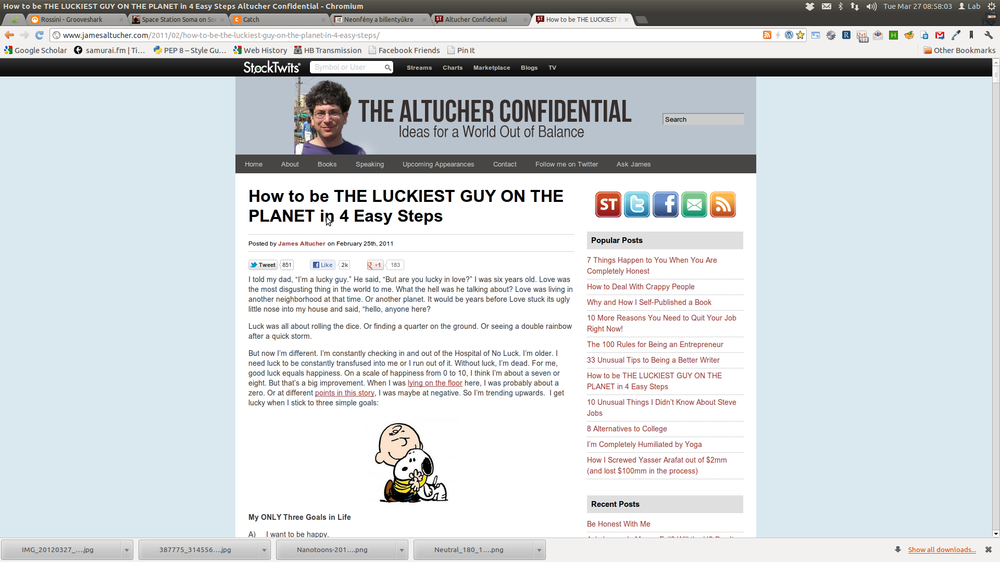
Idea muscle / James Altucher

Slide 4
Lists

Slide 5
Facebook comments

Slide 6

Facebook comments continue

Slide 7
Emails

Slide 8
Emails continue

Slide 9
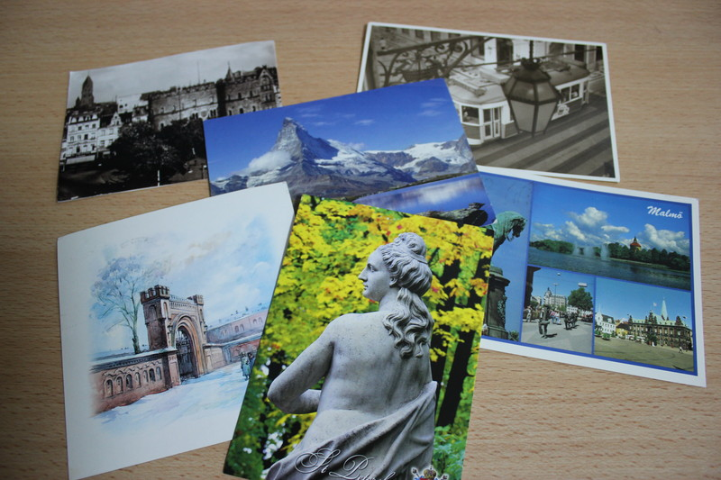
Postcards

Slide 10
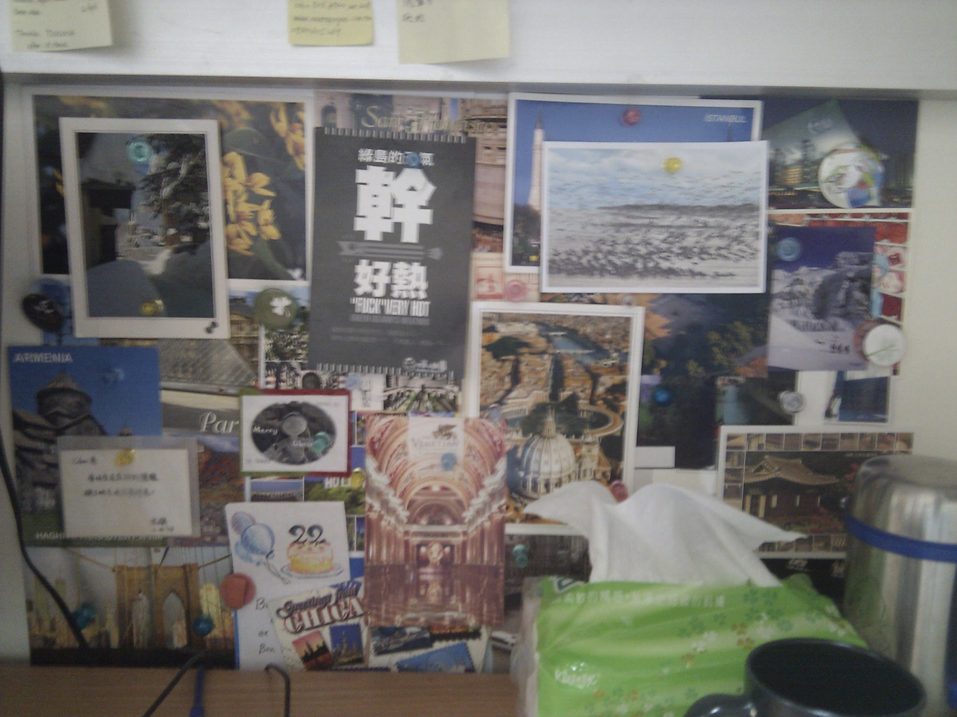
Postcards continue

Slide 11
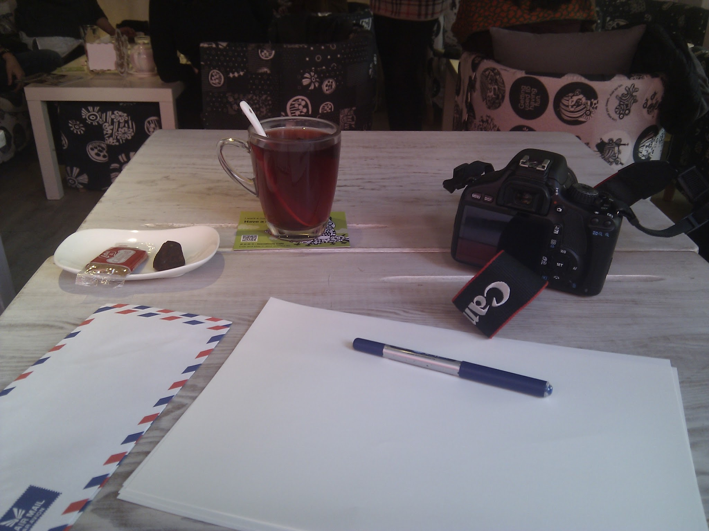
Letters

Slide 12
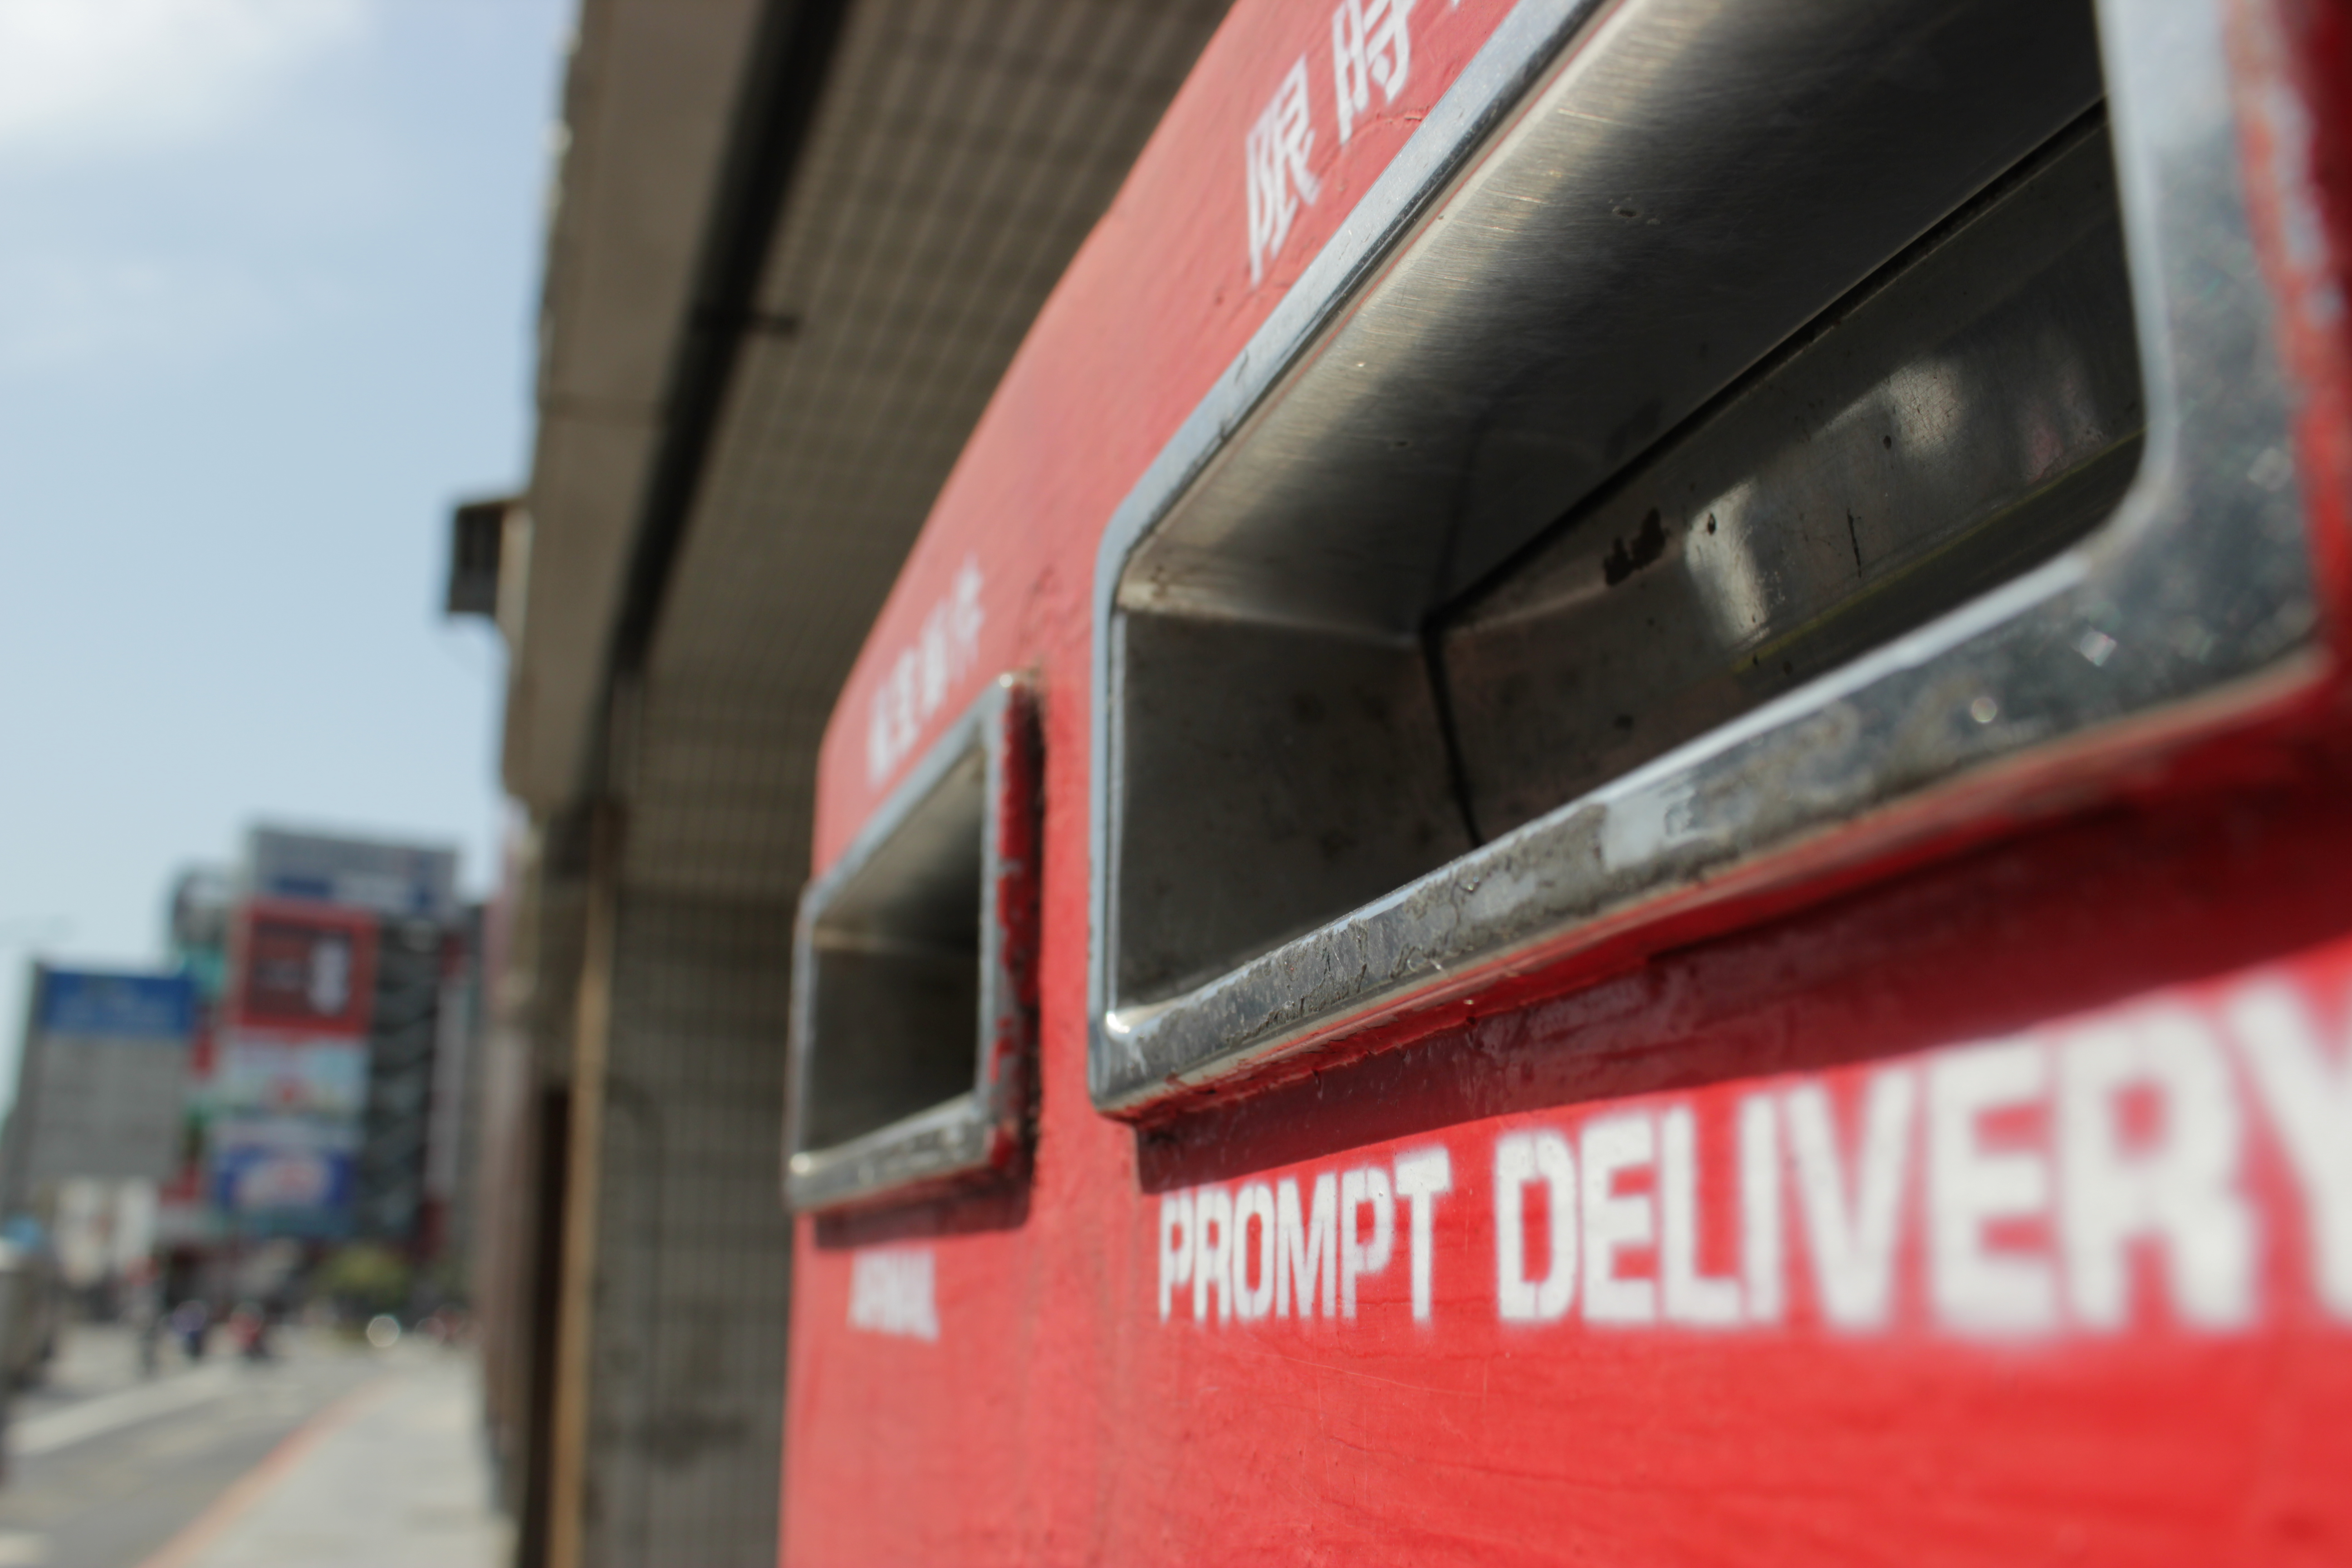
Letters continue

Slide 13
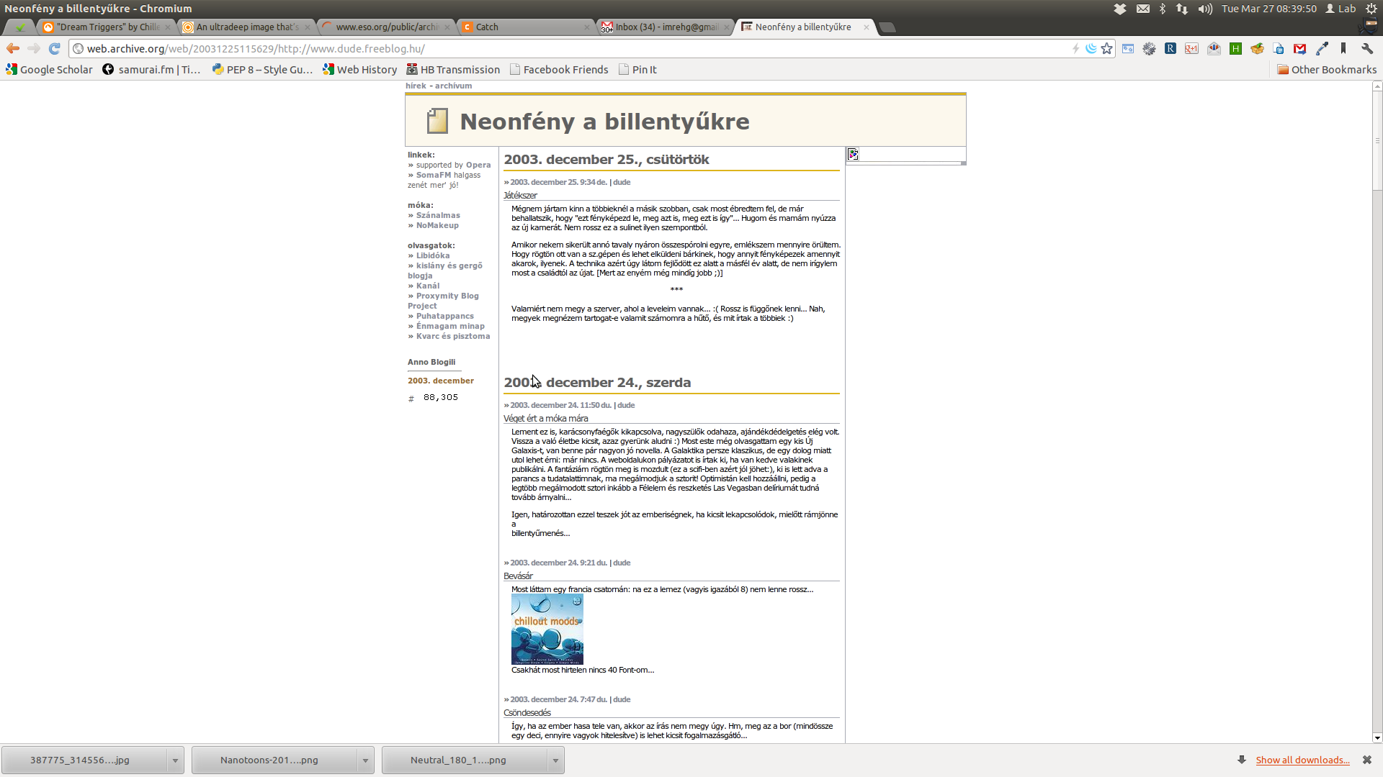
Blog

Slide 14
Blog continue
Dude.freeblog.hu
Clickedyclick.blogspot.com
Nametheplace.blogspot.com
Gergely.imreh.net/blog/
Fstaipei.wordpress.com
Ignitetaipei.tw
Playtivity.blogspot.com

Slide 15
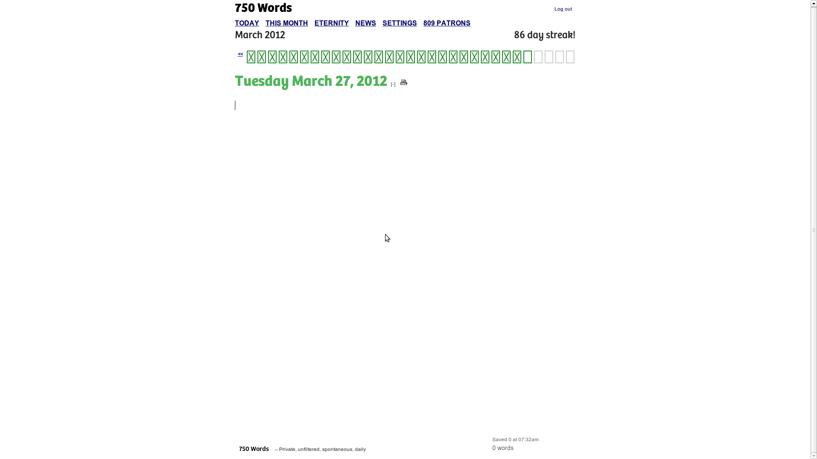
750 words

Slide 16
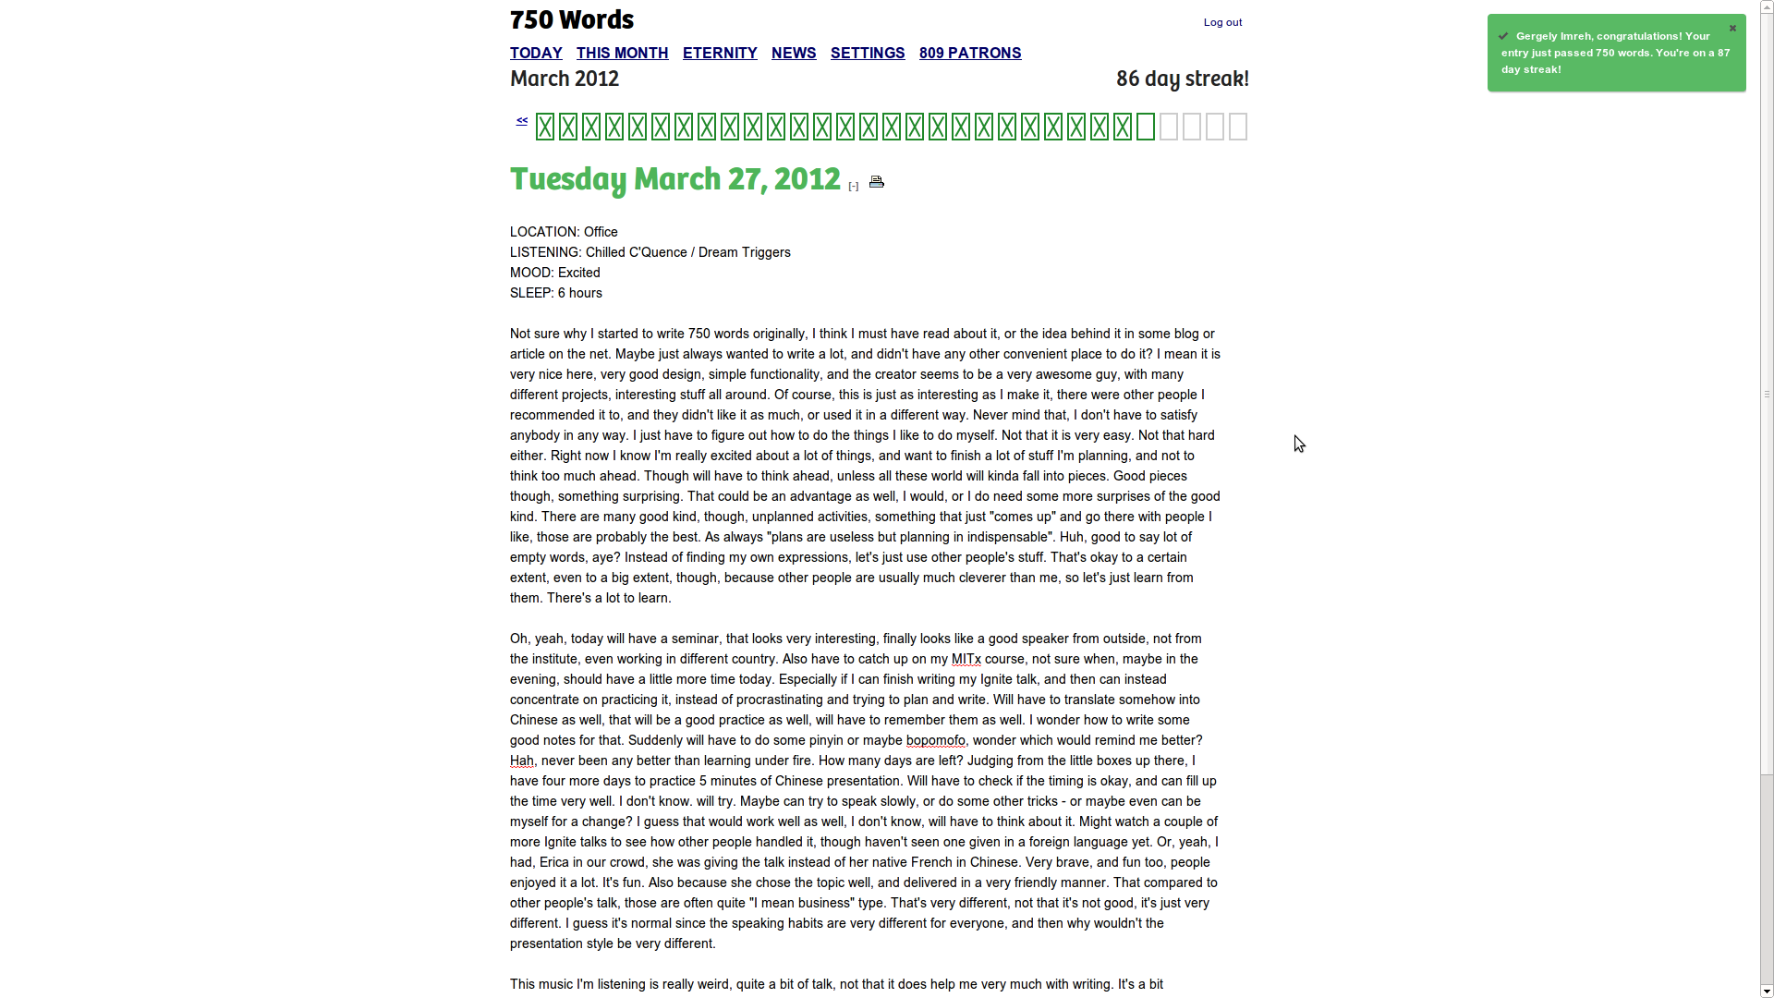
750 words
15 minutes
later

Slide 17
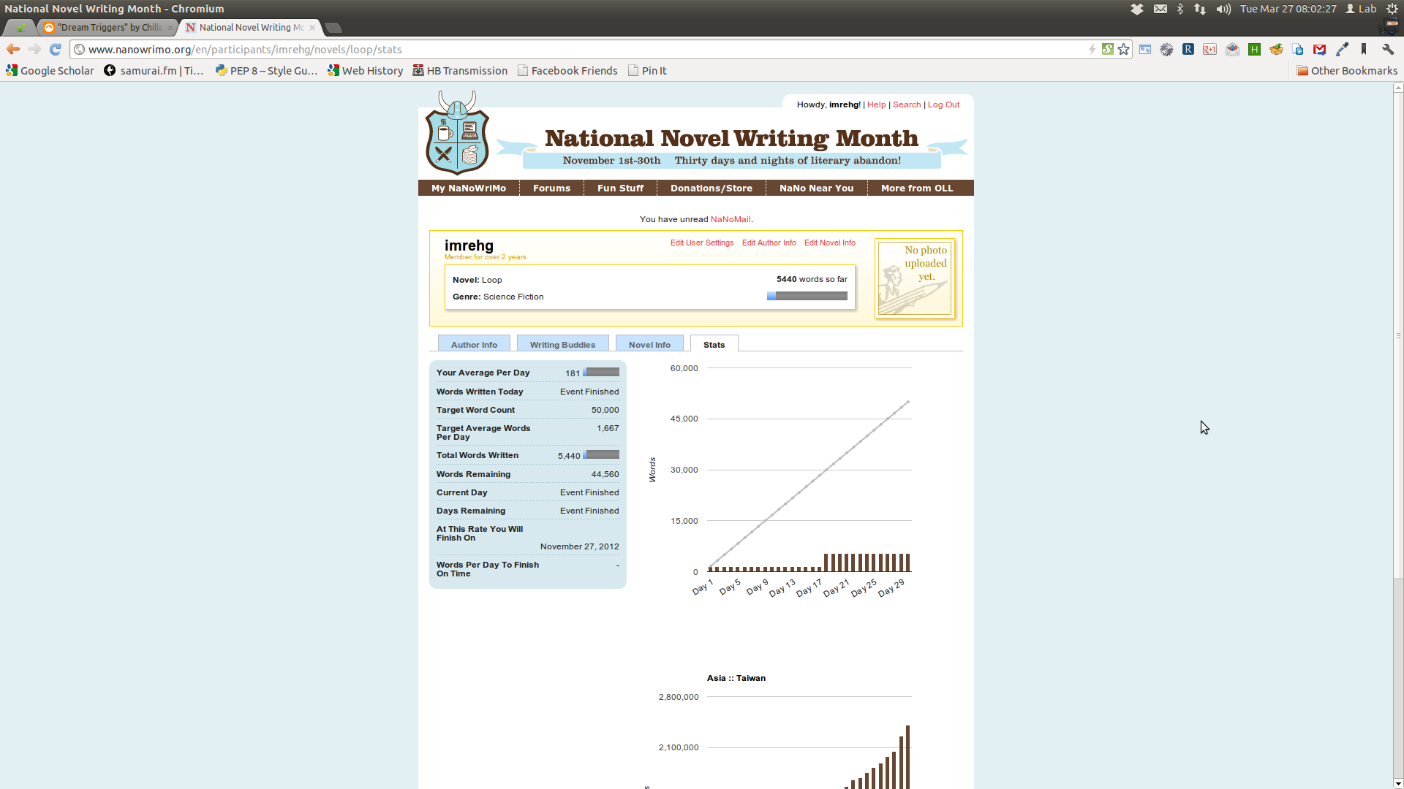
Nanowrimo

Slide 18
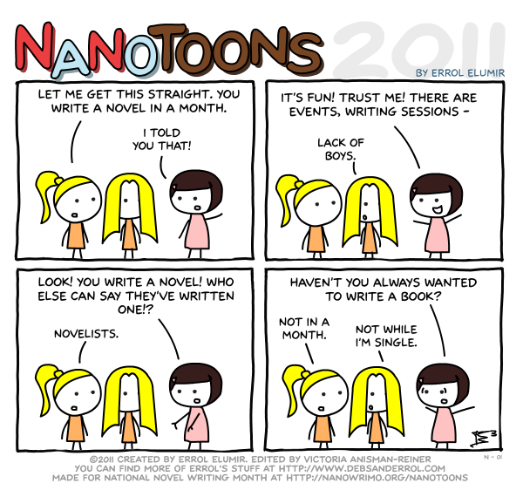
Nanowrimo fail

Slide 19
Notes for Ignite

Slide 20
Write me something:
imrehg@gmail.com

