Slide 1

Diabetes Progression Prediction Using Regression Models
Final Exam
Comparative Analysis of Machine Learning Regressors
Imran Khan
Houston City College
ITAI 1371 Intro to Machinelearning
5/3/2026
Professor Rao

Slide 2
Project Goal and Data
Predict diabetes progression after one year using regression models.
Use the diabetes dataset with 442 rows, 10 numeric features, and 1 target value.
Features include age, sex, BMI, blood pressure, and blood measurements s1 through s6.
Split the data into 70% training, 15% validation, and 15% testing.
The goal of the project was to train several regression models, compare their performance, and then test ensemble methods to see whether combining models could improve predictions. Since the dataset was already clean and numeric, the main preprocessing step was preparing the features and target and splitting the data into training, validation, and test sets.

Slide 3
Models Used
Linear Regression
Decision Tree Regressor
Random Forest Regressor
Gradient Boosting Regressor
K-Nearest Neighbors Regressor (KNN)
XGBoost
Voting_Top3 ensemble
Bayesian_Ensemble
Several regression models were trained to predict the target in different ways. After comparing the base models, two ensemble methods were tested: Voting_Top3, which averages the top three models, and Bayesian_Ensemble, which uses the predictions of the top three models as inputs to a Bayesian Ridge model.

Slide 4
Evaluation Metrics
MAE measures the average size of prediction errors. Lower is better.
MSE measures prediction error and penalizes larger mistakes more strongly. Lower is better.
R-squared shows how well the model explains the pattern in the data. Higher is better.
The models were compared using Mean Absolute Error, Mean Squared Error, and R-squared on both the validation and test sets. These metrics helped compare the models during development and also determine which one performed best on unseen data.

Slide 5
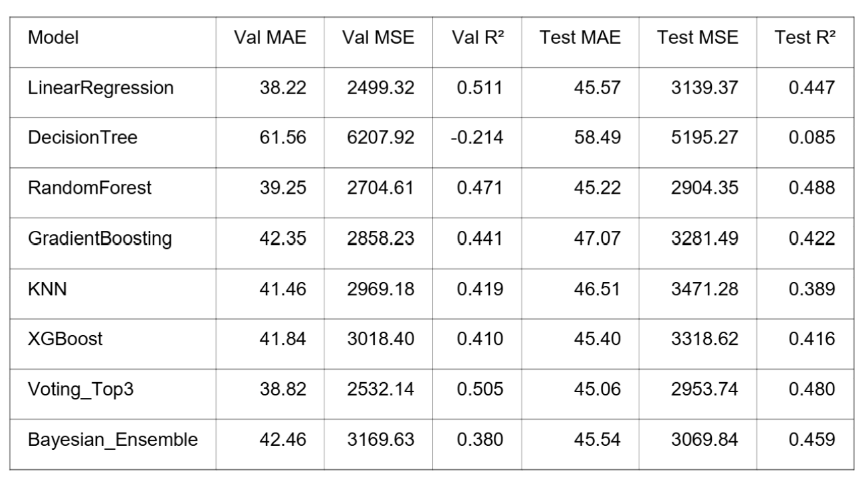
Results per Model This table summarizes the validation and test performance for all eight models in the project. It shows that several models performed reasonably well, but the strongest results came from Linear Regression, Random Forest, and Voting_Top3.

Slide 6
Best Validation and Test Results
Linear Regression performed best on the validation set.
Validation MSE: 2499.32
Validation R²: 0.511
Random Forest performed best on the test set.
Test MSE: 2904.35
Test R²: 0.488
On the validation set, Linear Regression was the strongest model because it had the lowest validation MSE and the highest validation R-squared. On the test set, Random Forest performed best overall, which means it gave the strongest predictions on new, unseen data.

Slide 7
Ensemble Model Analysis
Voting_Top3 test MSE: 2953.74 and test R²: 0.480.
Voting_Top3 was one of the strongest models in the project.
Bayesian_Ensemble test MSE: 3069.84 and test R²: 0.459.
Bayesian_Ensemble performed reasonably well, but it did not beat Voting_Top3.
The first ensemble method, Voting_Top3, performed very well and came close to Random Forest on the test set. The Bayesian_Ensemble also worked reasonably well, but it did not improve enough to outperform the simpler voting approach.

Slide 8
Why Random Forest Performed Best
Random Forest achieved the highest test R² and the lowest test MSE.
It can learn more complex and nonlinear patterns than Linear Regression.
Combining many decision trees likely helped it generalize better.
A likely reason Random Forest performed best is that it can capture nonlinear relationships in the data. Linear Regression works well when relationships are mostly straight and simple, but Random Forest has more flexibility because it combines many decision trees.

Slide 9
Visualizations Used
Target distribution
Correlation heatmap
Model comparison bar charts
Predicted-versus-actual scatter plot
Several visuals were added to the notebook to make the results easier to understand. These visuals helped explain the dataset, compare model performance more clearly, and show how well predictions matched actual target values.

Slide 10
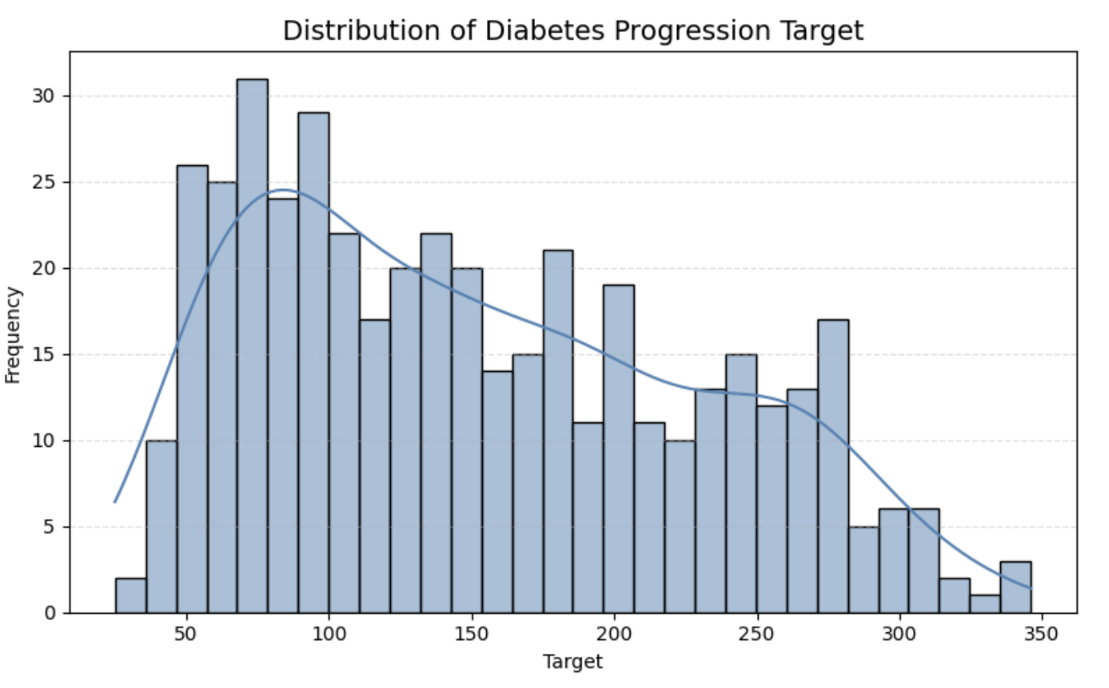
What the Diabetes Target Histogram Shows
Target means the diabetes progression score for each patient after one year.
Each bar counts how many patients have scores in that range.
Tall bars mean lots of patients are in that score group; short bars mean only a few are there.
The smooth line helps us see where most scores are clustered.
This helps us understand what kinds of values the model is trying to predict.
This graph is like sorting test scores into groups. Instead of grades, we are grouping diabetes progression scores to see where most patients land.
The target is the number we want the computer to predict, and in this project that number is the diabetes progression score. The histogram helps us quickly see whether most patients have middle scores, or whether a lot of them are very low or very high.
This chart shows how common different diabetes progression scores are in the dataset.

Slide 11
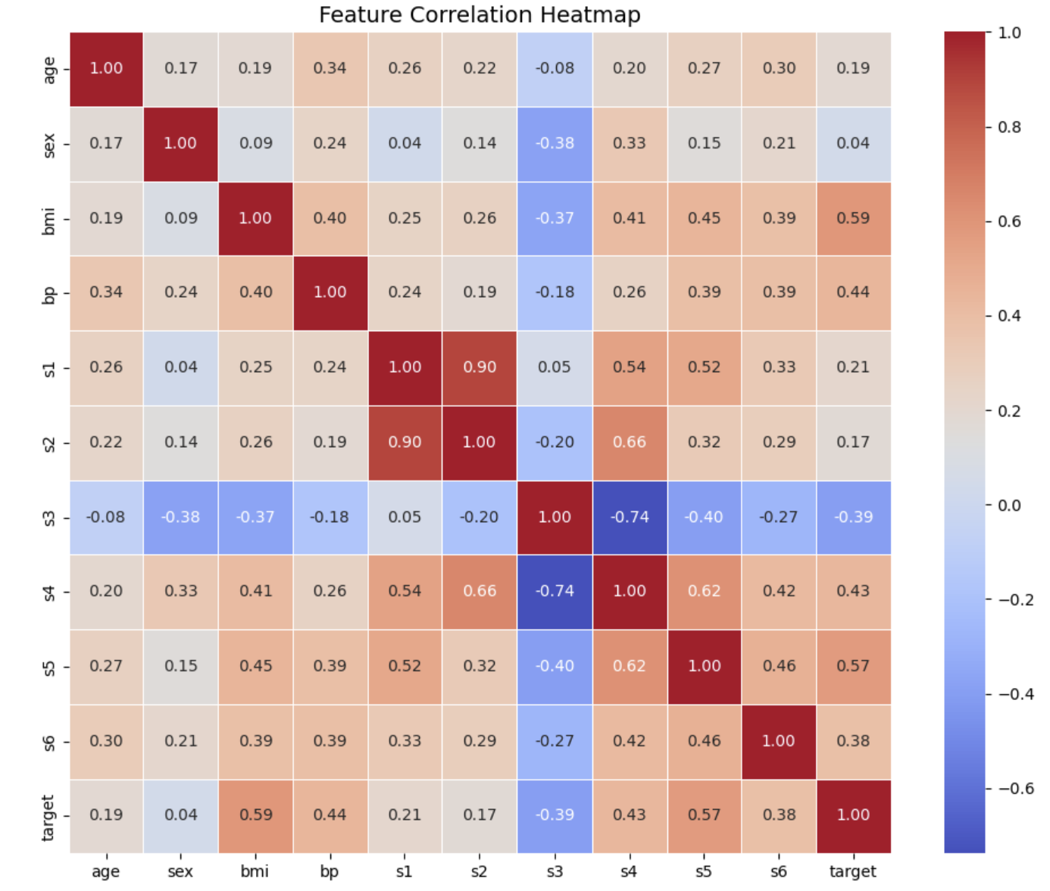
What the Feature Correlation Heatmap Shows
It compares every feature with every other feature in the dataset.
The colors and numbers show how strongly the columns are related.
Bigger positive numbers mean they rise together; negative numbers mean one rises while the other falls.
It helps us find which features connect most with the diabetes target value.
It also helps us notice if some features are very similar to each other.
The heatmap helps us see patterns before building the model. If a feature has a stronger correlation with the target, it may be more useful for prediction, and if two features are very strongly related to each other, they may be giving similar information.
This heatmap shows which features are most connected to each other and to the diabetes target.

Slide 12
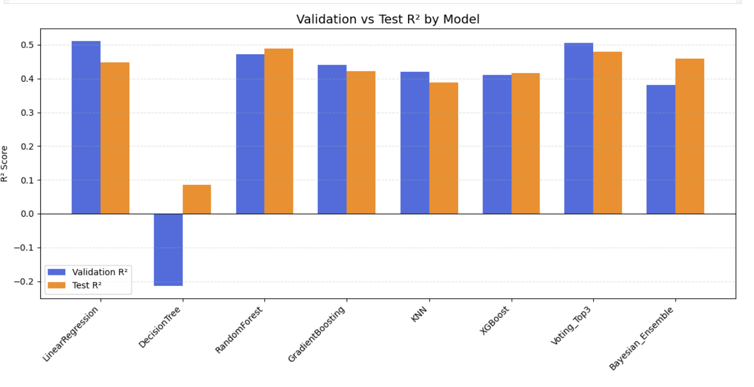
Validation vs Test R² by Model
This chart compares how well each model worked on practice data and new data.
Validation R² shows how good the model was during checking, and Test R² shows how good it was on data it had not seen before.
A higher R² score means the model made better predictions.
In this project, Linear Regression did best on validation data, but Random Forest did best on test data, which means it handled new data better.
This chart helps us compare model performance. Higher R² means better predictions. Linear Regression looked strongest at first, but Random Forest was better on the final test, so it was more reliable on new data.

Slide 13
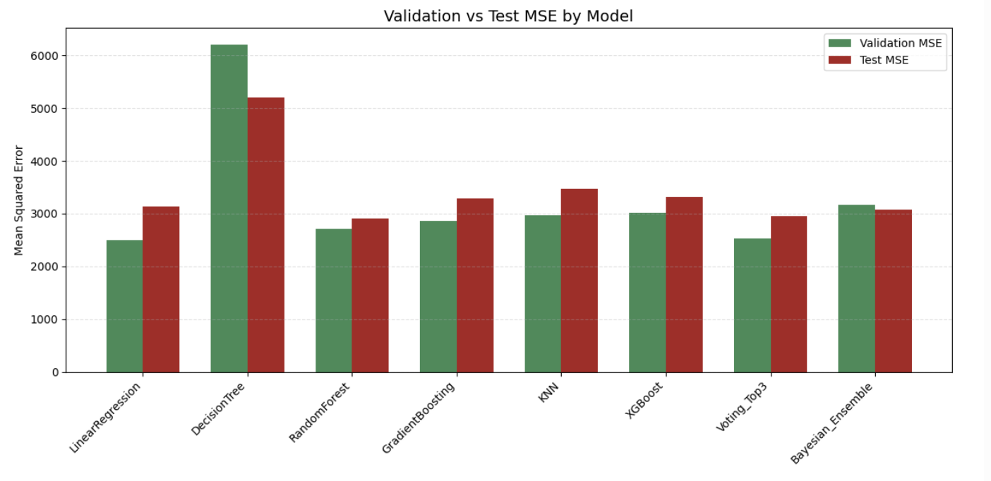
Validation vs Test MSE by Model
This chart shows how much error each model made on practice data and new data.
MSE means Mean Squared Error, which is a way to measure how far the predictions were from the real answers.
A lower MSE is better because it means the model made fewer mistakes.
In this project, Linear Regression had the lowest validation MSE, but Random Forest had the lowest test MSE, so it did better on new data.
This graph shows prediction mistakes for each model. Lower MSE means better predictions, and Random Forest made the fewest mistakes on the test data.
This chart compares how much error each model made. Lower MSE means the predictions were closer to the real values. Linear Regression looked best during validation, but Random Forest had the lowest error on the final test, so it handled new data better

Slide 14
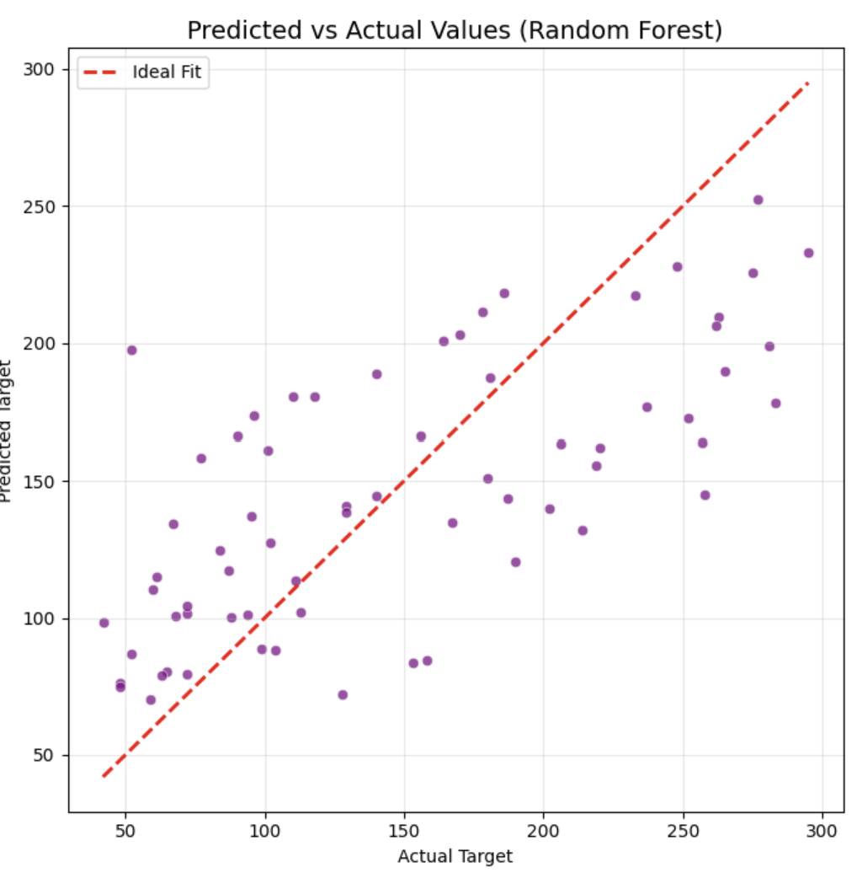
Predicted vs Actual Values (Random Forest)
This graph compares the real values to the values predicted by the Random Forest model.
Each dot is one example from the test data.
If a dot is close to the red line, the prediction was close to the real answer.
Since many dots are near the line, the Random Forest model made fairly accurate predictions, even though some points are farther away.
This scatter plot shows how close Random Forest predictions were to the real values. Dots near the red line mean better predictions
This graph checks how well Random Forest predicted the real outcomes. Each dot is one test example. When dots stay close to the red line, it means the model’s predictions were accurate. Since many dots are near the line, the model did a pretty good job.

Slide 15
Limitations and Future Improvements
Results were based on one train, validation, and test split.
Performance could change slightly with a different split.
Future work could use cross-validation, hyperparameter tuning, and feature engineering.
More advanced ensemble methods or additional regression datasets could also be tested.
This project produced useful results, but there are still ways to improve it. Future work could include cross-validation, hyperparameter tuning, feature engineering, and testing whether the same models perform well on other regression datasets.

Slide 16
Conclusion
The project successfully trained and compared multiple regression models.
Linear Regression performed best on validation data.
Random Forest performed best on the final test set.
Voting_Top3 was also strong and came close to Random Forest.
The project completed preprocessing, training, validation, ensembling, and final analysis successfully.
Overall, this project met the required regression workflow and clearly showed the strengths of different models. Linear Regression was best during model selection, but Random Forest was the strongest final model, and the Voting_Top3 ensemble also gave very competitive results.

