Slide 1
DATA STRUCTURE
I will, in fact, claim that the difference between a bad programmer and a good one is whether he considers his code or his data structures more important. Bad programmers worry about the code. Good programmers worry about data structures and their relationships.
Linus Torvalds, 2006

Slide 2
Textbook
Goodrich, M., Tamassia, R. and Mount D, Data Structures and Algorithms in C++/Java, 2nd Edition, 2016, Wiley.
Elliot B. Koffman, Paul A.T. Wolfgang, Objects, Abstraction, Data Structures and Design Using C++/Java, 1st Edition, 2005, Wiley Global Education.
T.H. Cormen, C.E. Leiserson, R.L. Rivest and C. Stein, Introduction to Algorithms, 3rd Edition, 2010, Prentice-Hall of India Learning Pvt. Ltd.

Slide 3
Goals of the Course
Become familiar with some of the fundamental data structures in computer science
Improve ability to solve problems abstractly
data structures are the building blocks
Improve ability to analyze your algorithms
prove correctness
gauge (and improve) time complexity

Slide 4
Algorithms
A finite sequence of instructions, each of which has a clear meaning and can be performed with a finite amount of effort in a finite length of time.

Slide 5
Algorithms
Given an algorithm to solve a particular problem, we are naturally led to ask:
What is it supposed to do?
Does it really do what it is supposed to do?
How efficiently does it do it?
The technical terms normally used for these three aspects are:
Specification: Formalize the crucial details of the problem that the algorithm is intended to solve.
Verification: Deals with checking the algorithm is indeed correct
Performance analysis: relates to the resources required by it.

Slide 6
Data Structure
For many problems, the ability to formulate an efficient algorithm depends on being able to organize the data in an appropriate manner.
The term data structure is used to denote a particular way of organizing data for particular
Ways to organize and store data
Data Storages
Ways to access and manipulate the stored data.
Methods to access storages
Many variations, each with advantages and disadvantages

Slide 7
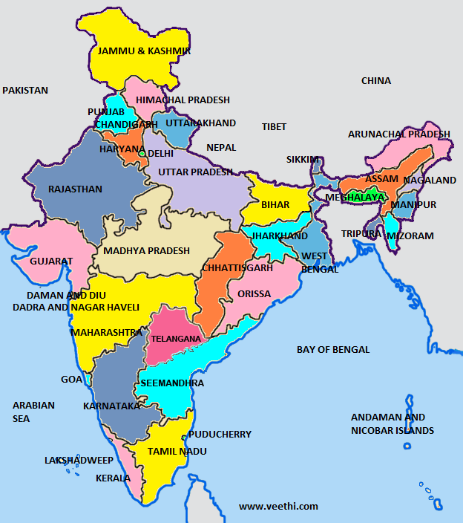
Example (adjacent states)

Slide 8
Problem
Definition: adjacency: if two states share a boundary, the two states are adjacent.
Given a state X, print a state Z that is not adjacent to X, but is adjacent to a state Y adjacent to X.
for example,
Input: Haryana
Output: Madhya Pradesh

Slide 9
Come up with Data Structures
Suppose you have only the following information
for each state x, the list of states that are adjacent to state x.
How are you going to store this adjacency information to solve the problem efficiently?

Slide 10
Come up with Data Structures
Different data structures lead to different ways to solve a given problem. (algorithms).
Different algorithms may give different efficiency (space and time).

Slide 11
First Topic
How to measure the efficiency of an algorithm.
Each data structure has a different use and application. So we will also study….
Applications (problems), algorithms.
Their efficiency.

Slide 12
Course outline
Data Structures
Arrays
Stacks, Queues
List
Priority queues
Search Trees
Graphs
etc …

Slide 13
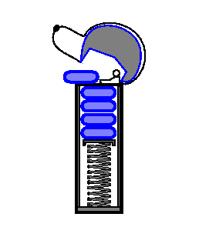
Stack
A container of objects that are inserted and removed according to the last-in-first-out (LIFO) principle.
Only the last (the most recently inserted) object can be removed.

Slide 14
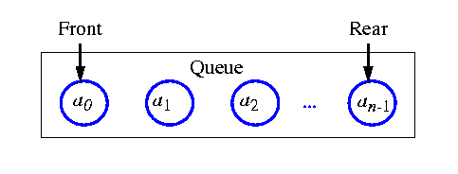
Queue
Differs from a stack in that its insertion and removal follows the first-in-first-out (FIFO) principle.
The element which has been in the queue the longest may be removed.

Slide 15
List
A collection of linearly arranged element (a linear order).
Provides methods for accessing, inserting, and removing arbitrary elements.
Notion of position, before and after.
Stacks and queues are a restricted form of a sequence.
Example,
A,B,C,D,E,F
a_1, a_2, a_3,…

Slide 16
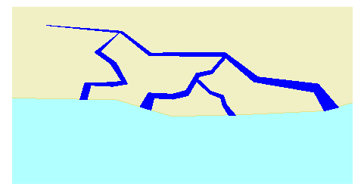
Tree
A collection of objects arranged in a hierarchical fashion.
E.g., organization of a corporation, a table of content, dos/unix file systems, family tree.
Notion of parents and children, root and leaves.

Slide 17
Priority queue
An abstract type for storing a collection of prioritized elements that supports arbitrary element insertion but support removal of elements only in order of priority.

Slide 18
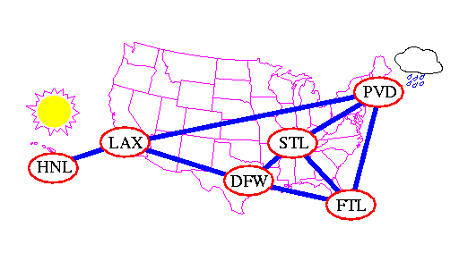
Graphs
Representing a way of connections or relationships between pairs of objects.

Slide 19
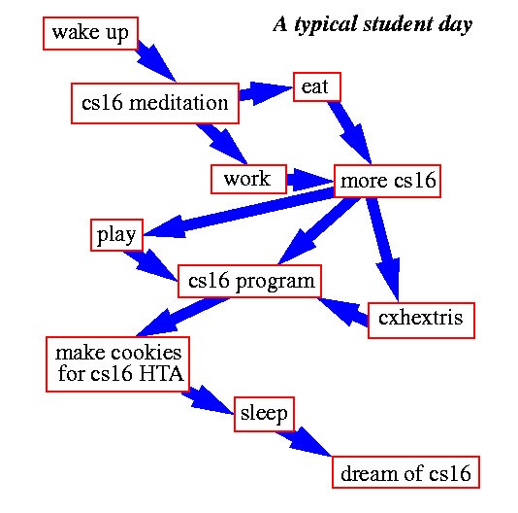
Graphs
Not only physical connectivity, but also logical relationship.

Slide 20
Algorithms and Applications
Every computer software uses some collections of data structures.
We will study algorithms to efficiently solve problems using various data structures.
Proof techniques for correctness or efficiency.

Slide 21
References
Data Structure and Algorithms for Electrical Engineering by Yung Yi

