Slide 1
Abstract Data Types

Slide 2
What is Abstraction?
Abstraction means displaying only essential information and hiding the details.
Smartphone
Make and Receive Calls
Take Photos
Use Map
Browse Internet
Send and Receive Messages

Slide 3
Abstraction Type
Procedural abstraction
Separates the purpose and use of a module from its implementation
A module’s specifications should
Detail how the module behaves
Identify details that can be hidden within the module
Data Abstraction
Data abstraction refers to providing only essential information about the data to the outside world, hiding the background details or implementation.

Slide 4
Abstract Data Types
Abstract data type (ADT)
An ADT is composed of
A collection of data
A set of operations on that data
Specifications of an ADT indicate
What the ADT operations do, not how to implement them
Implementation of an ADT
Includes choosing a particular data structure

Slide 5
Abstract Data Types
Typical operations on data
Add data to a data collection
Remove data from a data collection
Ask questions about the data in a data collection

Slide 6
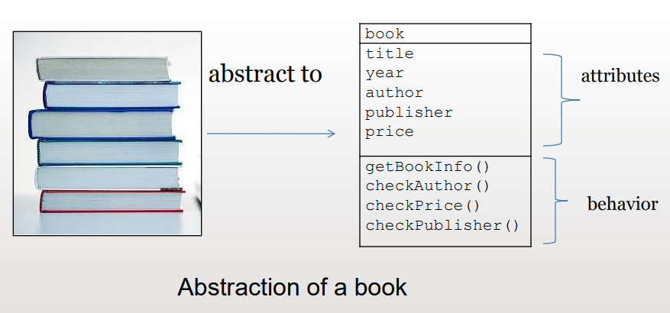
Abstract Data Type - Example

Slide 7
Advantages of Data Abstraction
Encapsulation
The process of combining data and functions into a single unit called class.
The programmer cannot directly access the data.
Data is only accessible through the functions present inside the class.
Data encapsulation is an important concept of data hiding.

Slide 8
Advantages of Data Abstraction
Modularity
Keeps the complexity of a large program manageable by systematically controlling the interaction of its components
Isolates errors
Eliminates redundancies
A modular program is
Easier to write
Easier to read
Easier to modify

Slide 9
Advantages of Data Abstraction
Procedural abstraction
Information hiding
Hides certain implementation details within a module
Makes these details inaccessible from outside the module

Slide 10
Abstract Data Types
Isolated tasks: the implementation of task T does not affect task Q

Slide 11
Abstract Data Types
The isolation of modules is not total
Methods’ specifications, or contracts, govern how they interact with each other

Slide 12
Abstract Data Types

Slide 13
Specifying ADTs
In a list
Except for the first and last items, each item has
A unique predecessor
A unique successor
Head or front
Does not have a predecessor
Tail or end
Does not have a successor

Slide 14
The ADT List
ADT List operations
Create an empty list
Determine whether a list is empty
Determine the number of items in a list
Add an item at a given position in the list
Remove the item at a given position in the list
Remove all the items from the list
Retrieve (get) the item at a given position in the list
Items are referenced by their position within the list

Slide 15
Common examples of ADTs:
Built-in types: boolean, integer, real, array
User-defined types: stack, queue, tree, list

Slide 16
Built-in ADTs
boolean
Values: true and false
Operations: and, or, not, nand, etc.
integer
Values: Whole numbers between MIN and MAX values
Operations: add, subtract, multiply, divide, etc.
arrays
Values: Homogeneous elements, i.e., array of X...
Operations: initialize, store, retrieve, copy, etc.

Slide 17
User-defined ADTs
stack
Values: Stack elements, i.e., stack of X...
Operations: create, dispose, push, pop, is empty, is full, etc.
queue
Values: Queue elements, i.e., queue of X...
Operations: create, dispose, enqueue, dequeue, is empty, is full, etc.
tree search structure
Values: Tree elements, i.e., tree of X
Operations: insert, delete, find, size, traverse (inorder, post-order, pre-order, level-order), etc.

Slide 18
Abstraction Implementation using Class
In C++, class defines a new data type
In a class there are data members and methods, which are called member functions.
By default, all members in a class are private
But it can also be specified as public
An object of the datatype is an instance of a class.

Slide 19
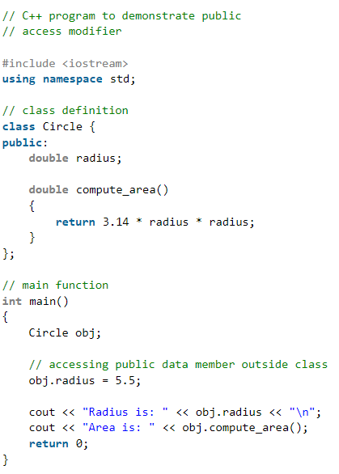
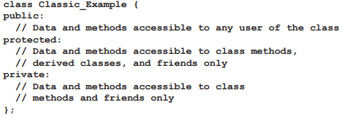
How to define a Class in C++?
Classes are containers for state variables and provide operations, i.e., methods, for manipulating the state variables
A class is separated into three access control sections:

Slide 20
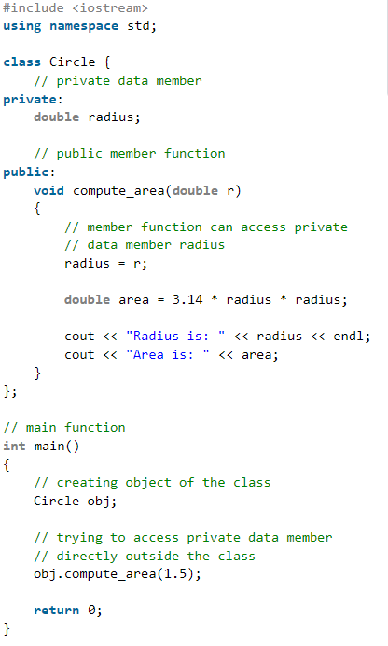
How to define a Class in C++?
Classes are containers for state variables and provide operations, i.e., methods, for manipulating the state variables
A class is separated into three access control sections:

Slide 21
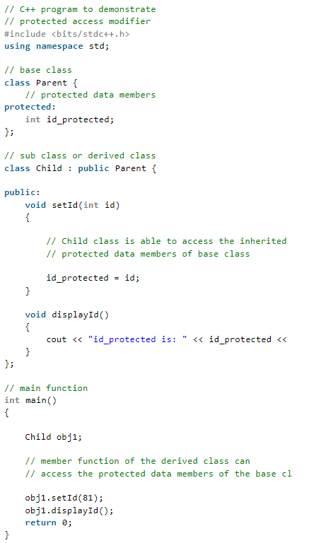
How to define a Class in C++?
Classes are containers for state variables and provide operations, i.e., methods, for manipulating the state variables
A class is separated into three access control sections:

Slide 22
Template

Slide 23
Templates
Function Overloading
function overloading allows the same function to act on different argument types:
int max(int a, int b) {
if (a > b) return a;
else return b;
}
float max(float x, float y) {
if (x > y) return x;
else return y;
}
both arguments are of the same type
This is useful, but we are duplicating code!

Slide 24
Function Templates
Templates let us write the two functions with no duplication:
Type parameter
template <class T>
T max(T x, T y) {
if (x > y) return x;
else return y;
}
The use of the word class here means
“any type”
Template parameters are place
holders for types and classes.
The compiler generates code for us when it comes across statements such as:
For each call, the compiler generates the complete function, replacing the type parameter with the type or class to which the arguments belong.
i = max(j, k);
24

Slide 25
Function Templates
More generally, a template may have several type parameters
Type parameters
template <class T, class U, class V>
Template parameters are place
holders for types and classes.

Slide 26
Templates
Function templates are a direct generalization of function overloading.
Function templates share source code among structurally similar families of functions.
Templates can also be used with classes.
We can create generic classes that handle different types of data.

Slide 27
Class Templates
Class templates
Allow type-specific versions of generic classes
Format:
template< class T >
class ClassName {
definition
}
Need not use "T", any identifier will work
To create an object of the class, type
ClassName< type > myObject;
Example: Stack< double > doubleStack;

Slide 28
Example of template

Slide 29
References
Introduction to Abstract Data Type & C++
Carrano, F.M. and Prichard, J.J., 2004. Data abstraction and problem solving with Java. Addison-Wesley.
CS 342: Object-Oriented Software Development Lab, C++ Support for Abstract Data Types, David L. Levine Christopher D. Gill Department of Computer Science Washington University, St. Louis

