Slide 1
Mill Street water main replacement
Council briefing
Department of Public Works
March 20, 2026

Slide 2
Why the project is needed
The main under Mill Street dates to 1954.
Three breaks since 2023, two of them in winter.
Repair cost has passed 40 percent of replacement cost.

Slide 3
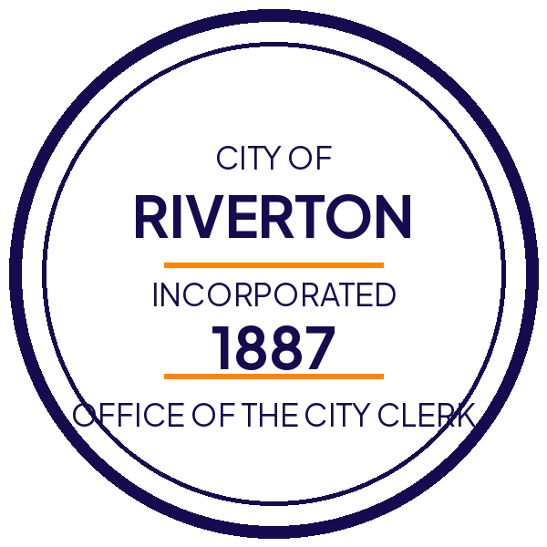
Scope of work
Roughly 1,800 feet, Water Street to Rail Avenue.
New 12-inch ductile iron main and 41 service connections.
Full-depth pavement restoration curb to curb.

Slide 4
Schedule and impact
Construction runs April 6 to May 15.
One lane, alternating, 7:00 a.m. to 5:00 p.m. weekdays.
Service interruptions up to six hours, 48 hours notice.

Slide 5
What we need from Council
Approve the construction contract at $1.84 million.
Authorize the detour on Water Street through May 15.
Questions to Public Works at (555) 555-0142.

