Slide 1
Data Protection Awareness
Notes:
Introduction – mute unless there's a question, feel free to unmute and interject. DPE are working in partnership with GDPRiS, they provide the platform (log breaches, sars, 3rd party suppliers, RoP and access training) we provide the DPO service.
Slides will be sent to Abbie for distribution following the session + answers to any questions.

Slide 2
Agenda Data Protection Education (DPE) as your DPO Part 1: Overview of GDPR including key terminology and best practice Part 2: DPE and the champions/core team
Notes:
Interactive so use the notes section and symbols i.e. raise your hands

Slide 3
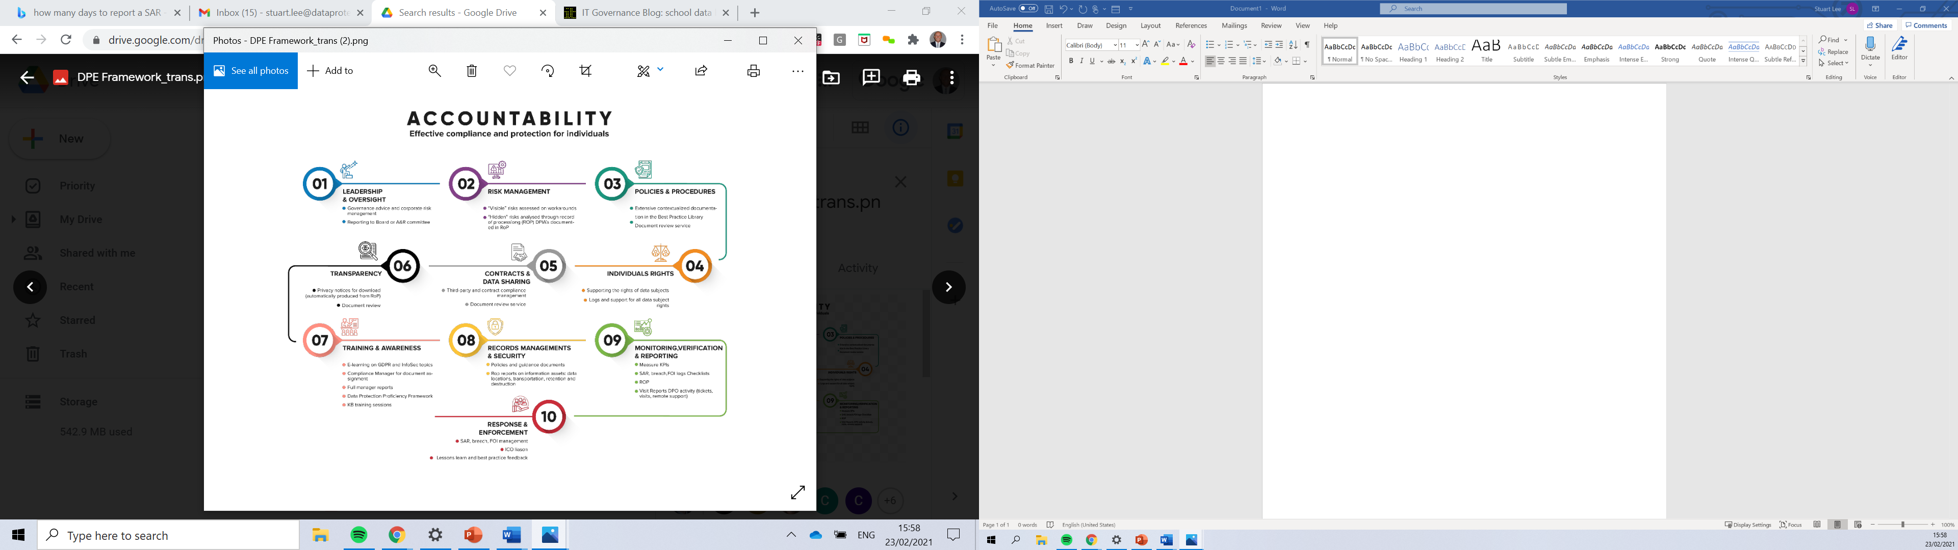
Notes:
Work at Trust level to develop your privacy program using a framework based on the ICO framework
This includes everything from e-learning training to onsite audits, SAR and breaches
01 Leadership & Oversight – Governance advice and corporate risk management – Reporting to Trust Board or Audit & Risk Committee
02 Risk Management – Visible risks assessed on walk arounds – Hidden risks analysed through RoP/DPIA’s
03 Policies & Procedures – Extensive contextualized documentation - document review service
04 Individuals Rights – supporting the rights of data subjects – logs and support for all data subjects rights
05 Contracts & Data Sharing – third-party and contract compliances management – document review service
06 Transparency – Privacy notices – document review
07 Training & Awareness – eLearning on GDPR – compliance management for document assignment – full manager reports – DP Proficiency Framework
08 Records Management & Security – policies and guidance documents – reports on information assets: data locations, transportation, retention and destruction
09 Monitoring, Verification and Reporting – Measure Key Performance Indicators – SAR, Breach, FOI logs checklists – RoP – Visit reports DPO activity (tickets, visits, remote support)
10 Response & Enforcement – FOI Management, ICO Logs, lesson learned, best practice and feedback

Slide 4
GDPR – How many of these terms are you already familiar with?
Personal Data | Data Subject | Controller and processor | Data Protection Officer (DPO)
Data Breach | Data subject rights | Information Commissioner’s Office (ICO) | Subject Access Request
Privacy Notice | Data Minimisation | Data Retention | Right to be Informed
Freely given, specific, informed and unambiguous | Kept in a form which permits identification of the data subjects for no longer than needed | 72 hours | Lawful Basis for Processing
Public task | 1 month | Special category data | Principles
Notes:
No one is expecting you to know all of these but you eventually will!
Explain the controller/processor part: Controller: determines the purposes and means of the processing and Controllers make decisions about processing activities. Processor acts on the controllers instructions.
The UK GDPR defines a processor as: 'processor' means a natural or legal person, public authority, agency or other body which processes personal data on behalf of the controller. Processors act on behalf of the relevant controller and under their authority.
Explain the role of the ICO – data governance, upholds the rights in the public interest.

Slide 5
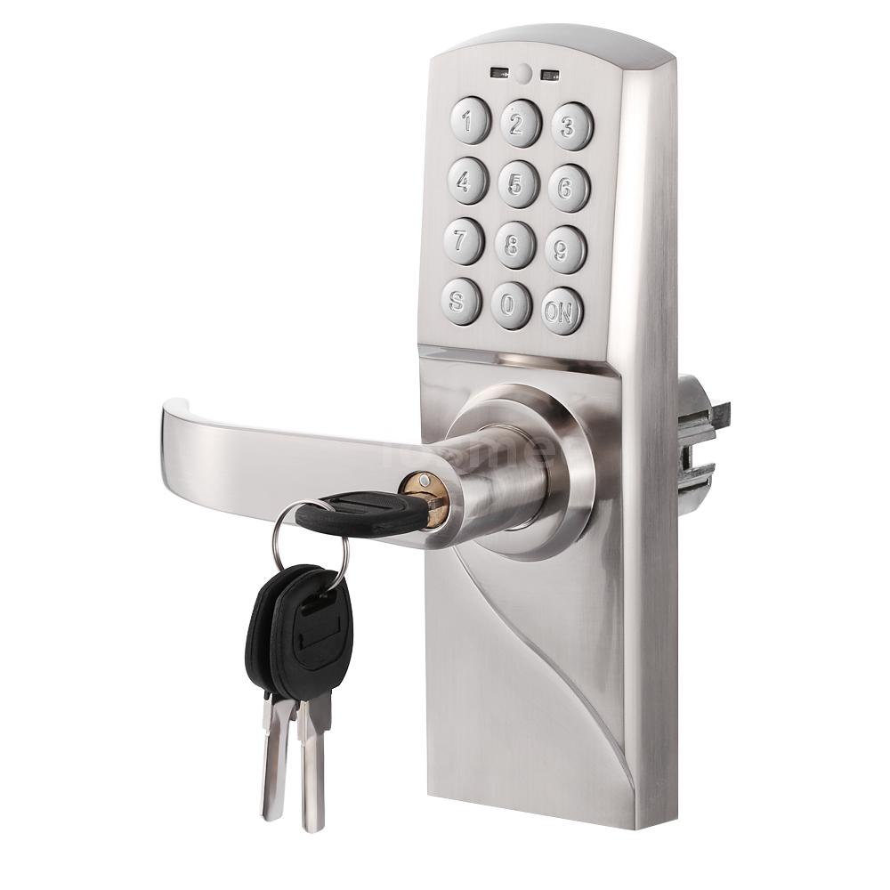
So how secure is data in your school?
Site security
Who has access to the school and what could they access freely?
If it was your data, would you like anyone to have open access to your information?
Notes:
Are cabinets secured at night, are sensitive folders added to secure storage, are laptops closed down and stored securely, are office doors locked at the end of each day and during holiday periods/weekends, are there access controls in place for unauthorized staff – information classification?

Slide 6
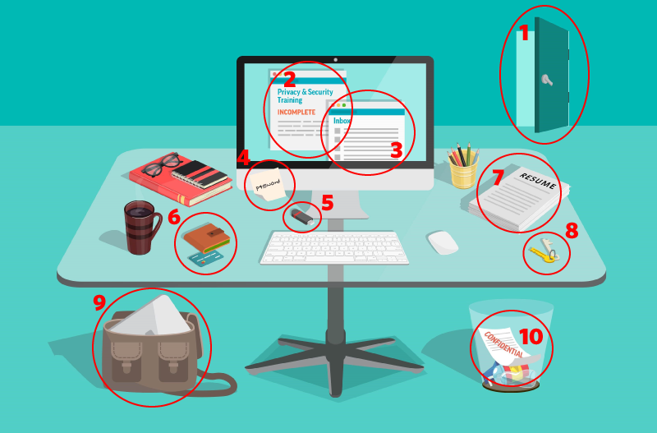
Let’s spot some issues in this typical office…
Incomplete Data Protection training
Computer unlocked & Emails left open
Office door is left unlocked
Password written on a post-it
Hard copy personal data left on the desk, not securely locked away
Keys to drawers/cabinet left on the desk
Confidential waste not been shredded
Personal belongings left unattended
USB drive left on the desk
Notes:
60 seconds – discuss with staff

Slide 7

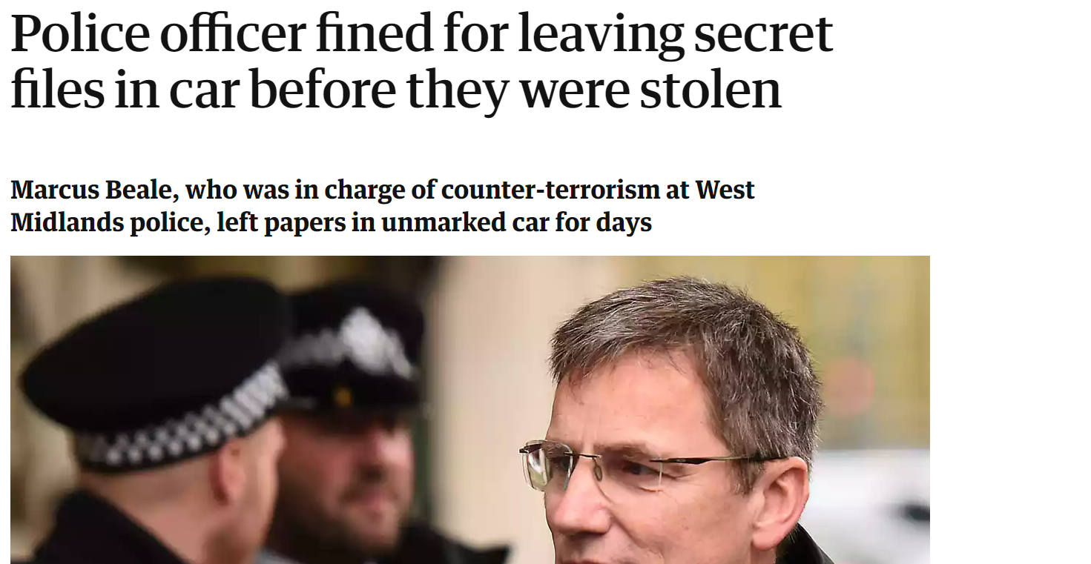
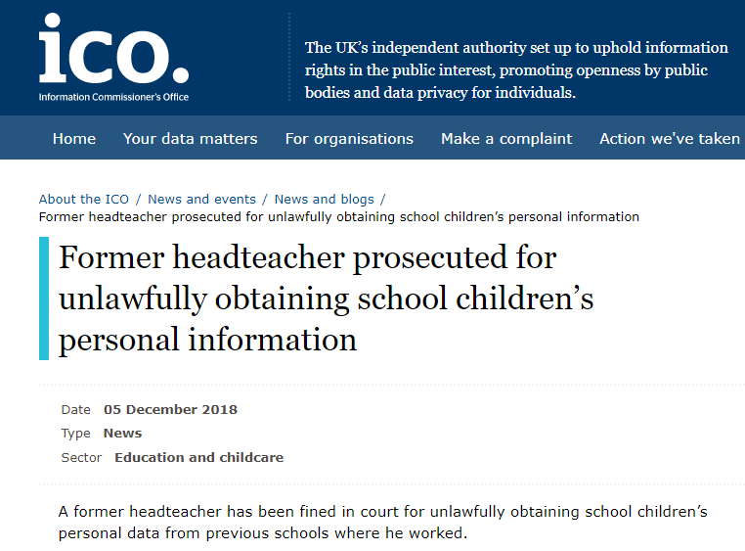
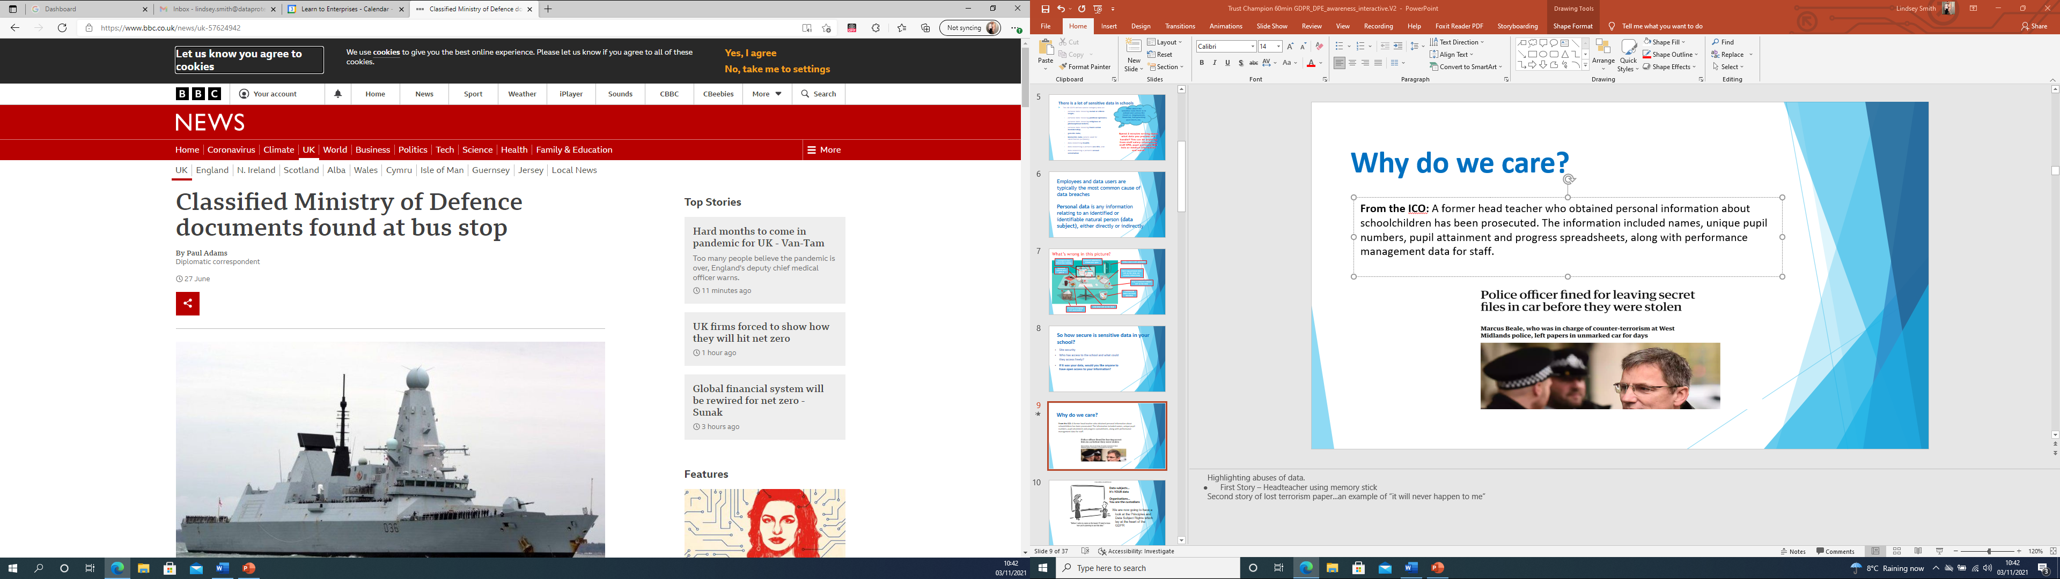
Why do we care?
Labour's shadow defence secretary, said he was surprised documents had got out of the Ministry of Defence at all.
Notes:
Highlighting abuses of data.
First Story – Headteacher using memory stick inc: names, unique pupil numbers, pupil attainment and progress and PM data for staff
Second story of lost terrorism paper...an example of “it will never happen to me”
Third Story – containing matters of national security - data being taken off site without prior permission or checks in place to ensure it was securely returned/destroyed

Slide 8
There is a lot of sensitive data in schools
Think about the sensitive data there is in school and across the Trust i.e. Employment, financial, Safeguarding and EHCPs etc.
The UK GDPR defines special category data as:
personal data revealing racial or ethnic origin;
personal data revealing political opinions;
personal data revealing religious or philosophical beliefs;
personal data revealing trade union membership;
genetic data;
biometric data (where used for identification purposes);
data concerning health;
data concerning a person’s sex life; and
data concerning a person’s sexual orientation
Notes:
Special category data requires greater safeguards in place – the GDPR defines these listed – consider your access controls and the ways you would share this data if required.

Slide 9
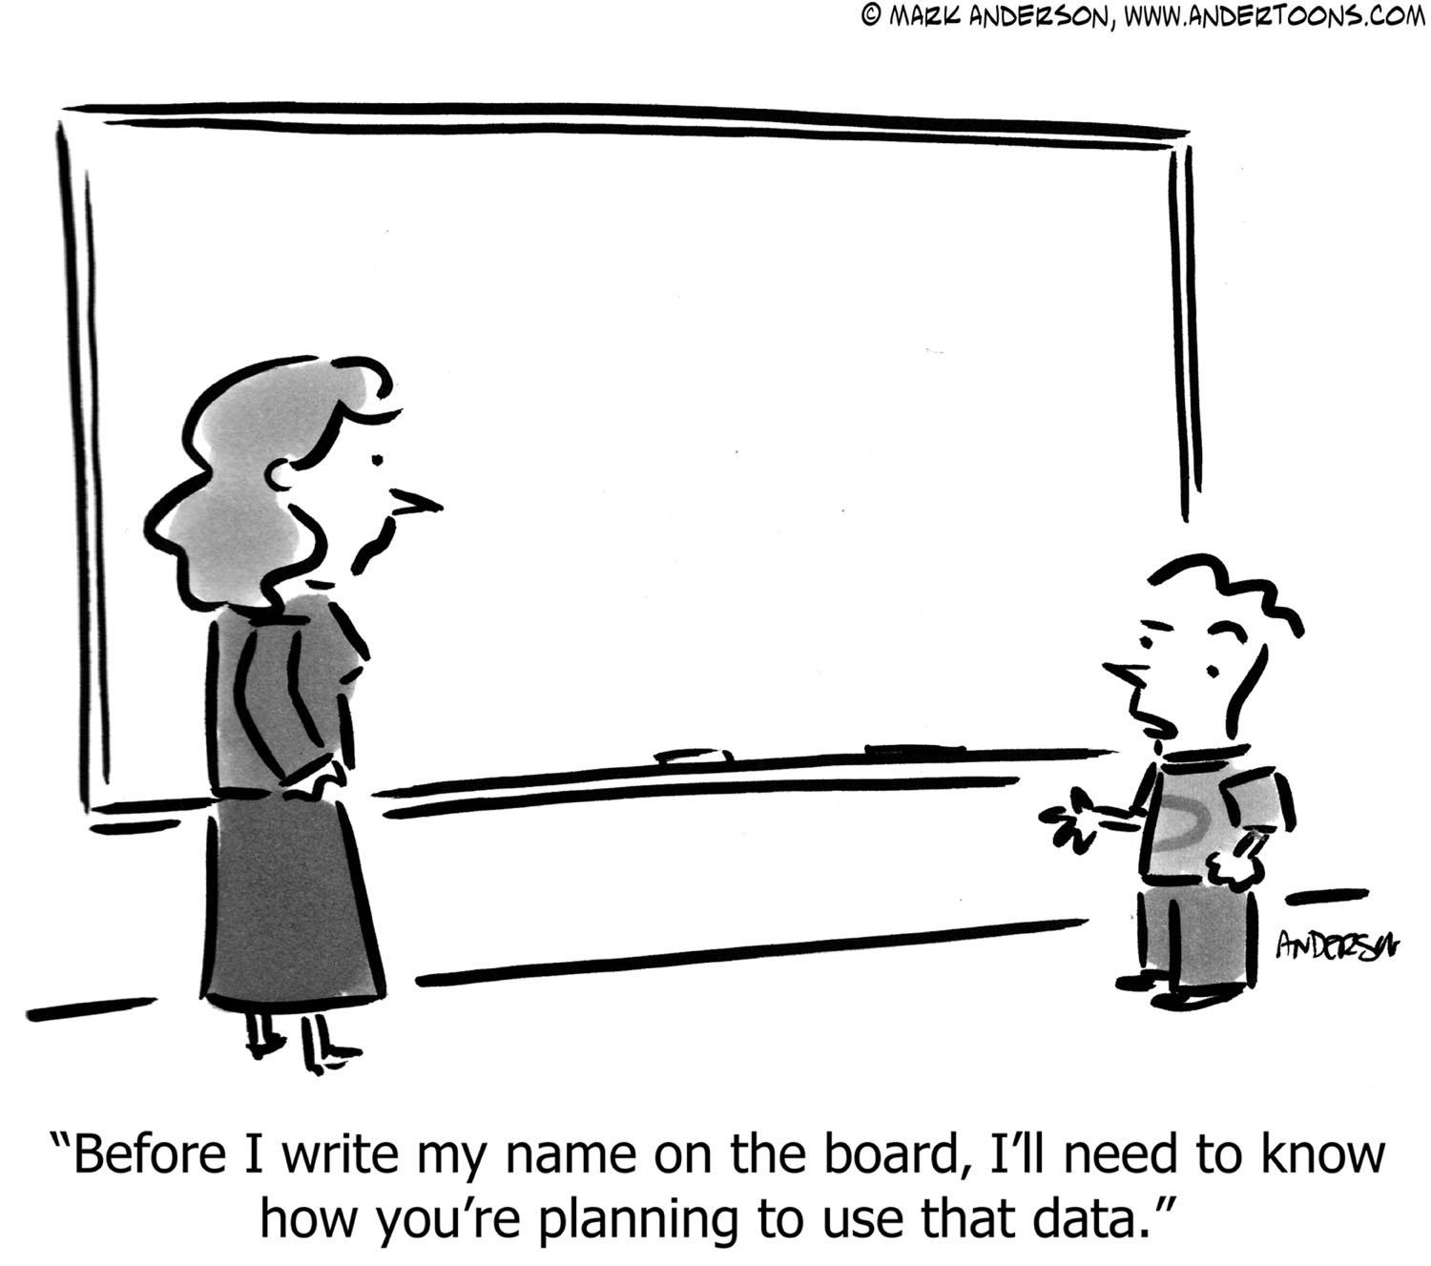
Data subjects…
It’s YOUR data
Organisations…
You are the custodians
We are now going to have a look at the Principles and Data Subjects Rights which lay at the heart of GDPR
Notes:
Data subject refers to any individual person who can be identified, directly or indirectly, via an identifier such as a name, an ID number, location data, or via factors specific to the person’s physical, physiological, genetic, mental, economic, cultural or social identity.

Slide 10

Preparing for Compliance
Personal data must be:
Processed lawfully fairly and transparently
For a specific purpose and not further processed (Purpose Limitation)
Kept to a minimum (Minimization)
Accurate and up-to-date
Retained only for as long as it is needed (Storage Limitation)
Integrity and confidentiality (Security)
Accountability
The
Six Data Principles
7 including accountability
Notes:
GDPR is principle based...it makes it aspirational....we have to demonstrate a commitment to GDPR
Lawfully fairly and transparently (Privacy and comms)
Collected for specified, explicit and legitimate purposes – and not further processed (Purpose limitation) Function creep prevention – signing in out of workplace for evacuation and not for punctuality
Adequate, relevant and limited to what’s necessary (data minimization)
Accurate and where necessary kept up to date (data collections etc)
Kept in a form which permits identification of data subjects for no longer than necessary
Processed in a manner that ensure appropriate security
Accountability with the above – take responsibility for what you do with personal data – treat others data the way you wish for yours to be treated.

Slide 11
Reasons to process data
Contractual (company/HR/salary/contract)
Consent (photos for the school website) – must be freely given, specific and informed and unambiguous
Legal obligation
Protecting vital interests (medical)
Public interest (most of your data)
Legitimate interest (Not normally public authorities. Must have a legitimate reason other than performing their tasks as a public authority)
6 Lawful Basis
for Data Processing
Notes:
Known as the lawful basis and if you were externally audited you would have to evidence this. DPE uses the record of processing activity to complete this task.
Contract - Such as employment contracts for staff.
Consent - Information Society Services: For children under the age of 13, this consent must be given by their parents. Consent may also be withdrawn. Ask where consent is used...no need for consent where a legal obligation exists (eg. medical - Children and families Act 2014) Consent must be explicit, freely given, unambiguous...and as easy to withdraw as it is to give
Legal obligation - Such as collecting attendance data for statutory returns.
Vital interests - Such as disclosing medical information to health professionals or information for references.
Public interest - This applies to data collected for statutory purposes. (ICO for schools “most, if not all of your data...”)
Legitimate interest - Such as for marketing purposes. If you do use email marketing, consent is the most appropriate basis for processing this data. Not really to be used by public authorities

Slide 12
Preparing for Compliance
Right to be informed (privacy statement)
Right of access (SAR)
Right of rectification (i.e. sent to third party)
Right of erasure (does not apply when processing for a public task)
Right to restrict processing (i.e. the data subject has contested accuracy)
Right to object (i.e. consent)
Right to data portability (i.e. move, copy or transfer personal data safely, securely and easily from one IT environment to another)
Rights in relation to automated decision making (i.e. computer algorithms, based upon existing data, without any human involvement)
The
Rights of Data Subjects
Notes:
Right of access relates to subject access requests and the data must be shared with the data subject within one month
Schools say that subject access requests tend to be
From parents when their child has had an issue with another child – issues over protecting the other child’s information here
From staff when there is a grievance
The GDPR has provisions on: automated individual decision-making (making a decision solely by automated means without any human involvement); and profiling (automated processing of personal data to evaluate certain things about an individual). Profiling can be part of an automated decision-making process. Psychometric profiling
The UK GDPR applies to all automated individual decision-making and profiling.
Article 22 of the UK GDPR has additional rules to protect individuals if you are carrying out solely automated decision-making that has legal or similarly significant effects on them.
You can only carry out this type of decision-making where the decision is:
necessary for the entry into or performance of a contract; or
authorised by domestic law applicable to the controller; or
based on the individual’s explicit consent.
You must identify whether any of your processing falls under Article 22 and, if so, make sure that you:
give individuals information about the processing;
introduce simple ways for them to request human intervention or challenge a decision;
carry out regular checks to make sure that your systems are working as intended.

Slide 13

How do you expect others to look after your data?
What would you do if you had a serious data breach?
Notes:
LETS now look at data breaches a bit more…
The one important take-away for staff...think about treating other people’s data, as you want yours to be treated. Think about privacy first.
If you went into your GP surgery would you expect to see your medical details up on the wall or a list of people with asthma – if you suffered asthma – would you expect your data to remain confidential?
I use the story of finding a Teacher Support Plan in the bin of an office. Would a teacher like that information to be thrown in a bin if it was about them? Ask what should happen to it

Slide 14

Employees and data users are typically the most common cause of data breaches. Personal data is any information relating to an identified or identifiable natural person (data subject), either directly or indirectly.
Notes:
Indirectly = identifier, be careful when dealing with SARs as even redacted information if not done correct could lead to identification of someone else. i.e. a specific job title – time to consider if identifying this person/these persons if they or anyone else is likely to be at risk of disclosing?

Slide 15

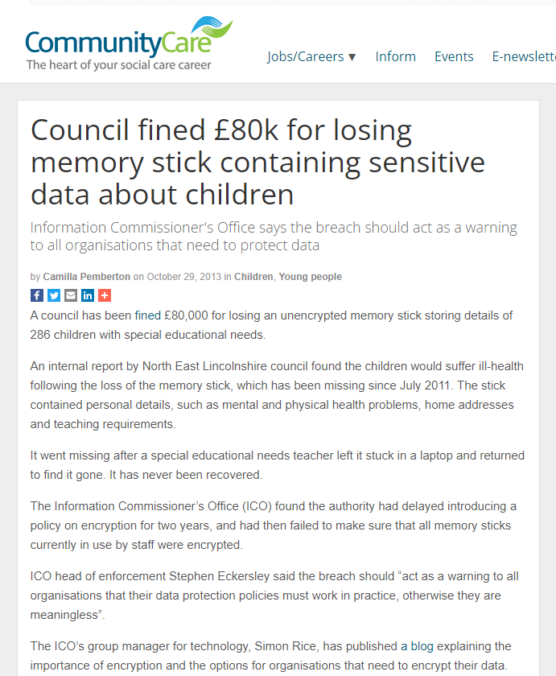
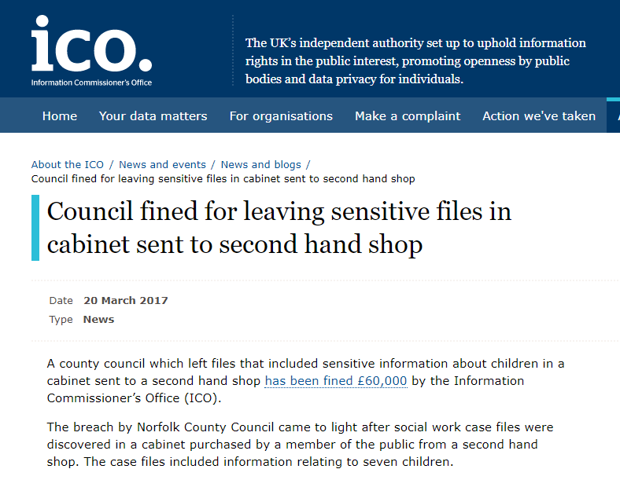
Breach Alert!
Notes:
First Story – council fined £60k for giving a dis-used cabinet to a second hand shop – sensitive data relating to 7 children was found slipped down the back of the hanging files.
Second Story – council fined £80k for losing a memory stick for 2 years!! before it was admitted – wasn’t encrypted, held data relating to over 280 SEN children.

Slide 16

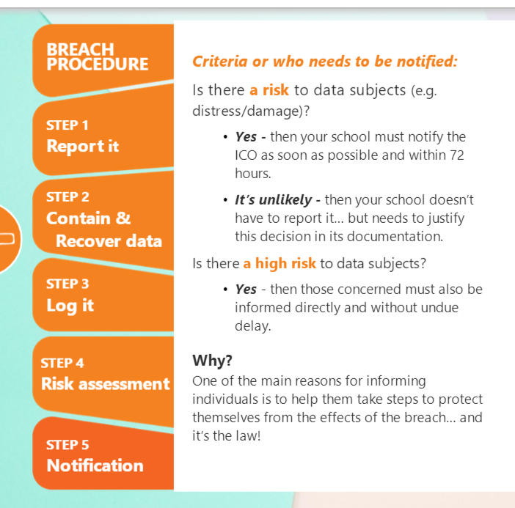
Protecting personal data
Serious breaches must be reported to the ICO within 72 hours.
Report all breaches to your DPO, DPE will work with you to decide if it needs reporting to the ICO
Notes:
Discussion – what are the implications of a breach? (Data subjects’ rights + reputation of school + possible fines) – when and how do they need to be reported (to ICO + to data subjects) – How would you manage this process in your school? Do you have a procedure for this?
Key message – The actions taken to safeguard personal data indicates that an organisation takes rights of pupils and staff. Seriously. Majority of breaches are down to human error or lack of awareness – importance of training

Slide 17
Type of data breaches reported to DPE
23 lost GCSE assessment papers
Missing / stolen laptops
Lost Safeguarding files
BCC emails
Sharing confidential information in online folders with parents
PC monitors in offices being viewed by members of the public
Unauthorised access to payroll system
SEN letter sent to wrong parent
Lost paperwork/job applications
Lost memory sticks
Incorrect group email configuration
Incorrect Google classroom configuration

Slide 18
What the ICO and auditors look for…
Data protection policies
Staff training
Processes for reporting and investigating incidents
Process for dealing with subject access requests
Policies for sharing data with third-parties
Data retention schedules
Record of Processing activities
DPIAs (Risk assessments) – especially with new technologies (due diligence)
Secure printing and secure disposal
USB sticks / laptops / device encryption
Physical and information security measures
Consent for photographs
CCTV policies and best practice
Email - content and cc’ing too many people
Not enough use of encrypted email where appropriate
Weak passwords / not changed regularly
Antivirus / firewalls / malware
Secure disposal
Offsite data handling & bring-your-own device
Secure paper storage
Notes:
Highlights from the ICO report

Slide 19
Subject Access Requests
Recognise it as a SAR
Validate identity and determine exactly what is required
Inform your DPO/log the SAR
Plan and complete collection and redaction of data
Use the DPE response letter (if appropriate)
SEND information
Keep a copy of what was sent
You would normally have 1 month to respond to a SAR
Notes:
Discussion – what are the implications of a breach? (Data subjects’ rights + reputation of school + possible fines) – when and how do they need to be reported (to ICO + to data subjects) – How would you manage this process in your school? Do you have a procedure for this?
Key message – The actions taken to safeguard personal data indicates that an organisation takes rights of pupils and staff. Seriously. Majority of breaches are down to human error or lack of awareness – importance of training

Slide 20
Quiz:
Is a processor an organisation or a person?
What is the time limit to report a serious data breach to the ICO?
What is the first step to take when a data breach has been identified:
Log it
Hide it
Report it
How many lawful basis are there?
What is the lawful basis used most in schools for processing data:
Consent
Public task
Contractual
Notes:
Organisation
72hrs
Report it
6 lawful bases (Contract, Consent, Legal Obligation, Vital Interests, Public Task, Legitimate Interest)
Public task

Slide 21
The role of core staff and champions

Slide 22

Notes:
GDPR is a long journey….

Slide 23
The role of core staff and champions – Step 1:
Complete e-learning training
Familiarise yourselves with using the GDPR reporting platform (GDPRiS) and reporting arrangements
Raising awareness in school and be advocates for data protection and best practice in handling personal and sensitive data
We are here to support you: dpo@dataprotection.education
Notes:
Needs to be driven at Trust level

Slide 24
Raising awareness across the Trust – step 2
Data protection training for all staff
Disseminate the data breach procedure to all staff
Disseminate the SAR procedure to key staff
Use staff briefings and communication tools to continue to raise awareness, especially when issues have been identified
Display DPE posters in schools
Keep a record of data breaches and SAR requests in your school by logging these on your GDPR Platform (GDPRiS)
If in doubt email: dpo@dataprotection.education
Never ignore!

Slide 25
Questions?
DPO@dataprotection.education
Tel: 0800 0862018
Notes:
Questions? If not now, get in touch.

