Slide 1

Metal Detector
Group No:- Tue-27
Project ID:- P-23
Abhishek Raj Soni(21d070006)
Roshan Kumar Meena(210070069)
Akhilesh Chauhan(21d070010)
Project Description – Our project was to make a Pulse Eddy current based Rebar Detector which can be used by structural audit engineers to find the location and depth of steel reinforcement bars in walls and concrete structure.

Slide 2
Demo video

Slide 3
Overview of Methodology
The PEC method utilizes time-varying magnetic field produced by an excitation coil (transmitter) to generate eddy currents in a metal. The eddy currents produced in a metal generate their own magnetic field, that opposes the secondary field generated by the receiver coil.
For detecting the different metal we are using control signal generator using comparator of which output changes accordingly by placing the metal near the coil and give the signal to LED to glow and further signal go into Raspberry Pico to display METAL DETECTED.
For differentiating the metal we used lock-in amplifier , LPF and comparator with level shifter.

Slide 4
Block Diagram of methodology
Instrumentation
Amplifier
Oscillator
Power Amplifier
Transmitter Coil
Receiver
Coil
Clock Generator
R Pi Pico
Comparator
Control Signal Generator
BPF
Display
Level Shifter
LPF
Comparator
Subtractor
Switching Circuits

Slide 5
Challenges faced during the project
Challanges | solution | Result
Coil orientation | Concentric Coils | Success
Power supply drops when connecting the coil(low resistance of coil) | Power resistor | success
Power Mosfet heat up much | Heat sink | Success
Depth of the metal | Increasing pk to pk of Oscillator | Failed
Showing –90 degree phase shift b/w Oscillator and BPF output signal in absent of metal | Changed the orientation | Failed
Power amplifier failed to give desired output waveform | Make the Power amplifier on general purpose PCB | Success
Complexity due to large circuitry. | Individual testing of each part and comparing the results. | Success

Slide 6
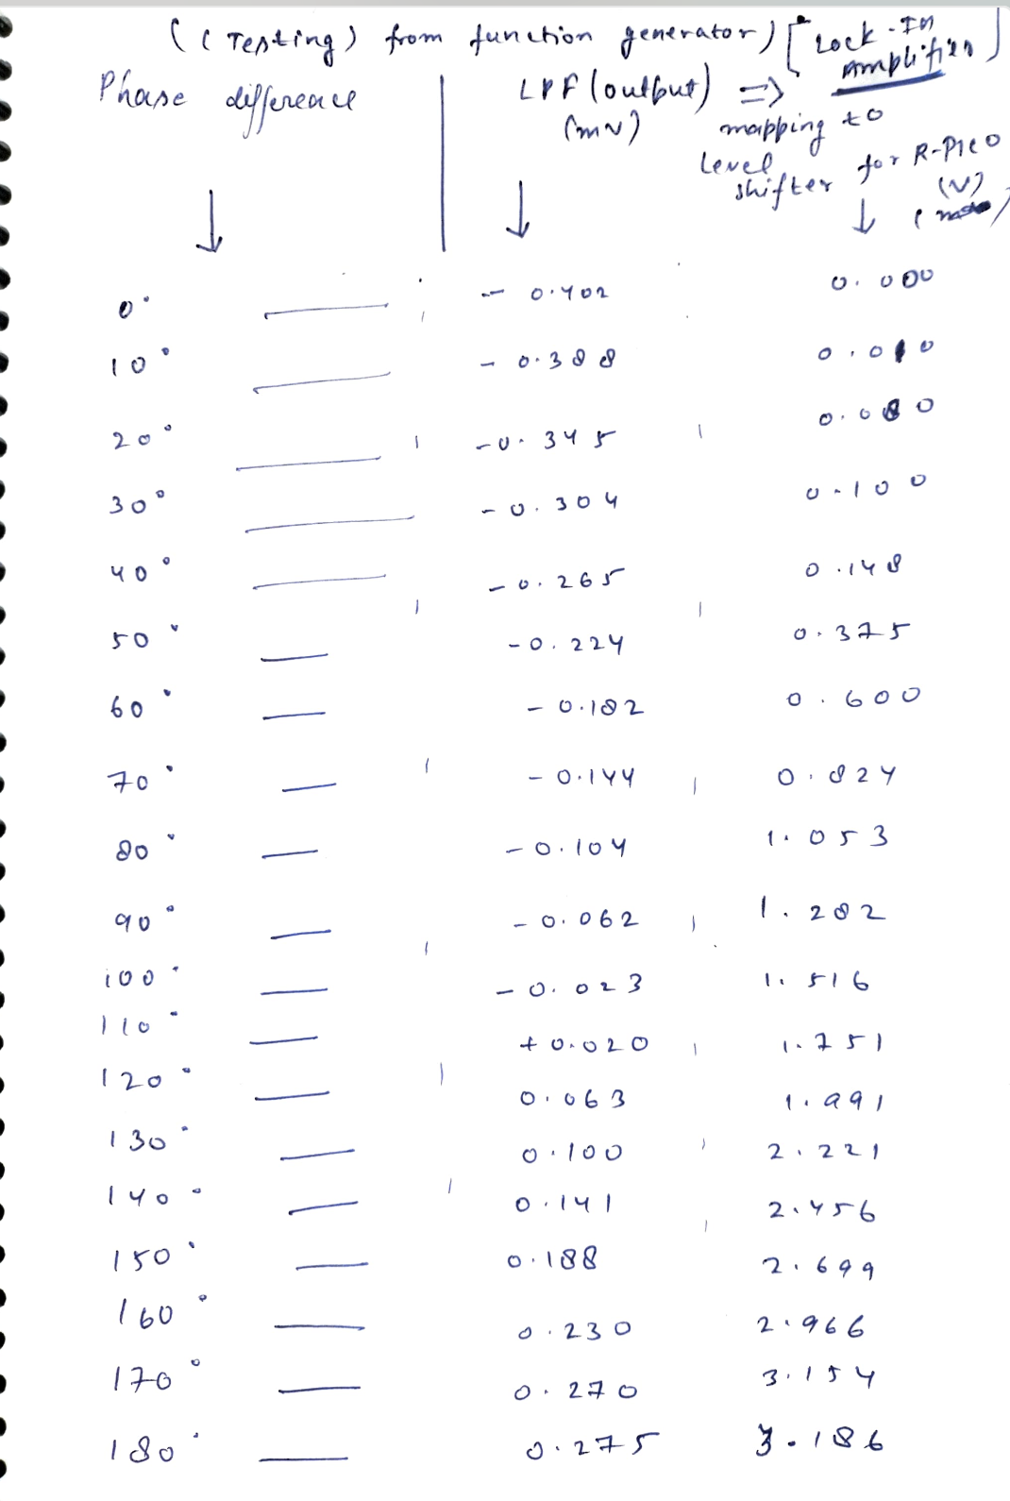
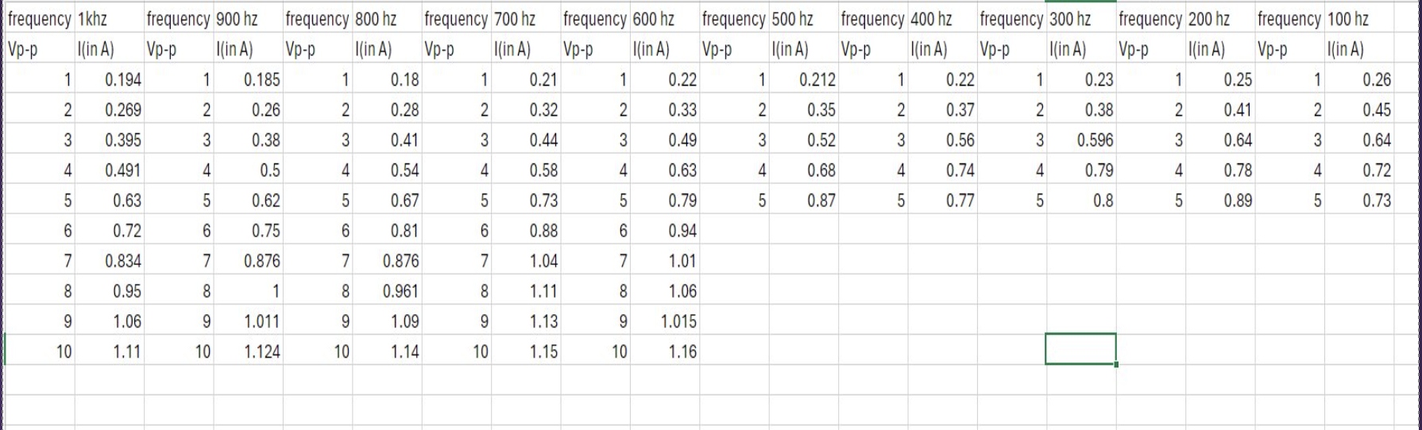
SOME IMPORTANT COMPONENTS OUTPUT
(Current in Transmitter coil Vs frequency of Oscillator)
LOCK-IN AMP (Phase difference Vs LPF Mean value mapping to R-Pico)

Slide 7
Individual contributions
Member | Contributions made over entire duration of project | Average hours spent on EDL per week in Jan and Feb 2024 (1st half) | Average hours spent on EDL per week in March and April 2024 (2nd half)
Roshan Kumar | Coil & current testing, PCB design, Breadboarding, final assembling and testing. | 9 | 24
Abhishek Raj Soni | Analog front-end design and testing, coil –shape and design, Lock-in Amp , algorithm development, final assembling on buff board and testing | 10 | 44
Akhilesh Chauhan | CAD design, Breadboarding | 6 | 18

Slide 8
Conclusion
When we put a metal closer to the TX coil, eddy current generate in the metal and it excite the TX coil and due to that we get an AC current in the coil which further amplified, filtered and received by the Control signal generator and the LED light glow, it shows the presence of the metal.
PCB design , Analog front end Design , Interfacing of Analog signals to microcontroller and Teamwork
Range of the detector can be increased, also we can differentiate the metal and show the result on display

