Slide 1
AUST | CSE 404 | Computer Graphics LAB Projection in openGL
Mohammad Imrul Jubair

Slide 2
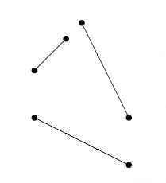
Something new………

Slide 3
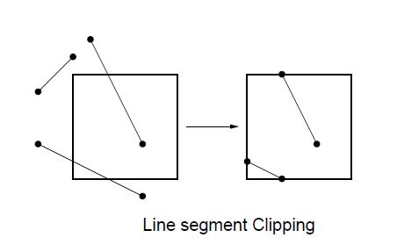
Clipping

Slide 4
Coordinate Systems
Screen Coordinates:
- to address the screen
World Coordinates:
user-defined
application specific coordinates
Window:
rectangular region of the world which is visible
Viewport:
rectangular region of the screen
to display window
(examples are coming…)

Slide 5

Coordinate Systems
World

Slide 6

Coordinate Systems
Window
Clipped !
World

Slide 7
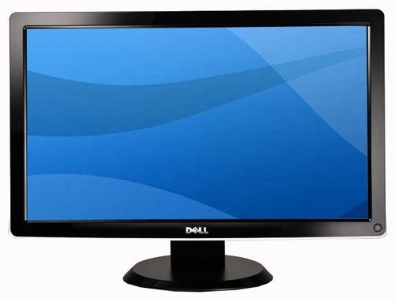
Coordinate Systems
Screen
Window
World

Slide 8
Coordinate Systems
Screen
Window
Viewport - 3
Viewport - 1
Viewport - 2
Aspect Ratio = W/H = 1

Slide 9
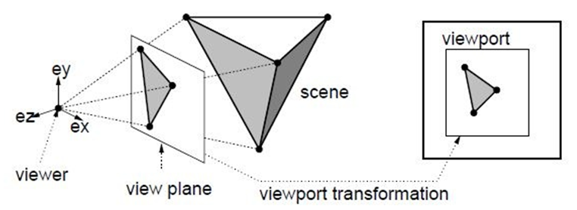
OpenGL viewing process
Projection Plane
Projector rays/
Projectors
Projection : 3D → 2D

Slide 10
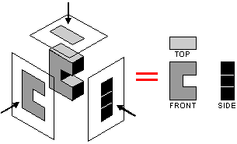

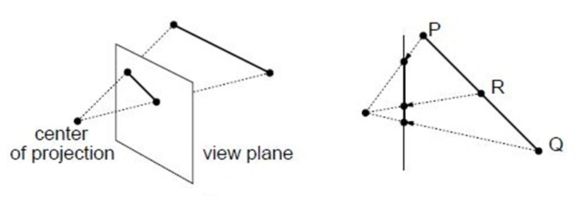
Projection : Orthographic & Perspective
Projection Plane
projectors
projectors
(at infinite)
(at finite)

Slide 11
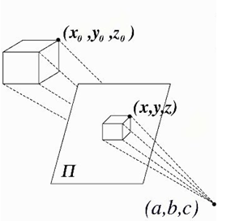
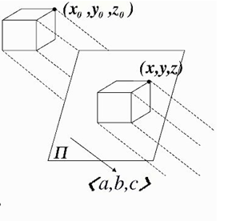
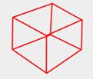
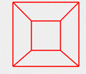

Projection : Orthographic & Perspective
eye
Perspective
Orthographic

Slide 12
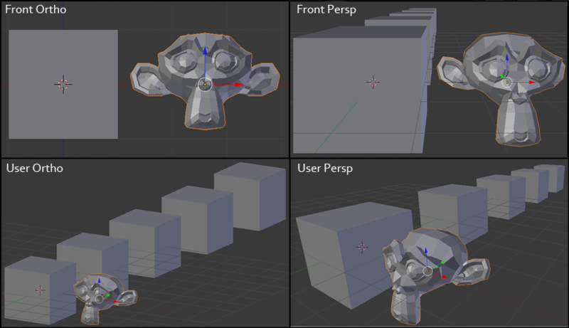
Projection can change the Feeling !

Slide 13
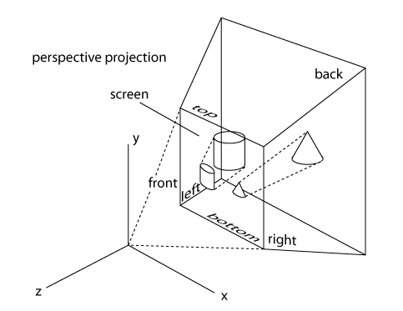
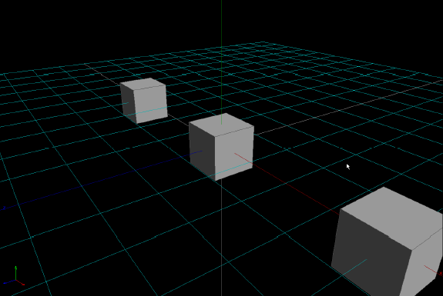
Perspective projection provides you a depth feeling
Which one is better ? Orthographic ? Or Perspective?

Slide 14
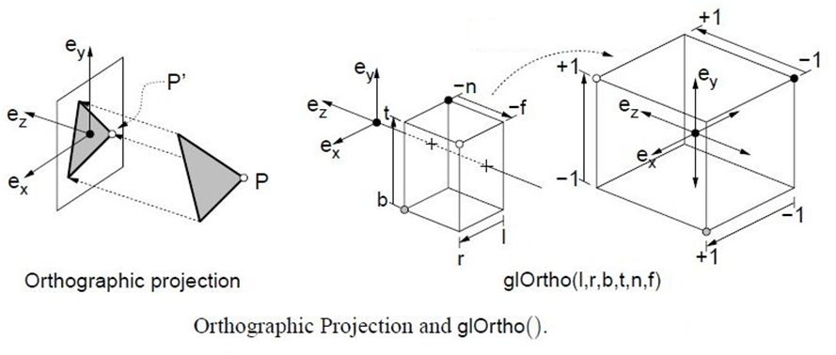
Projection in OpenGL : orthographic

Slide 15
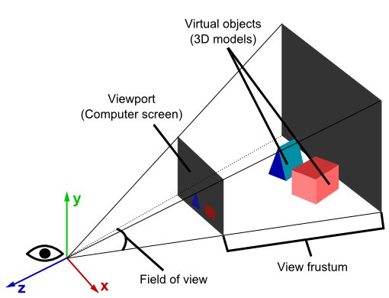
Projection in OpenGL : perspective
We assume an eye/ camera at COP
- ve
+ ve

Slide 16
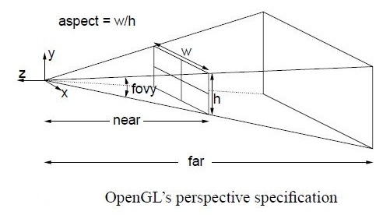
Projection in OpenGL : perspective
Just distance

Slide 17
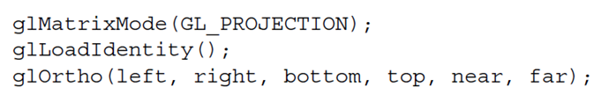
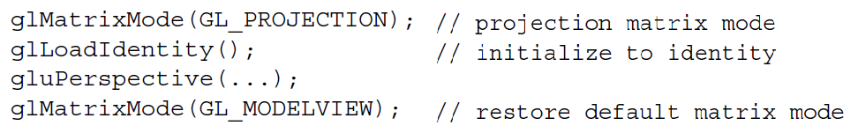
Before going to code…….
Setting up a projection
(like setting a Frustum)
To show it in viewport
Returning to a simple matrix mode to do transformation
(like a simple graph paper)

Slide 18
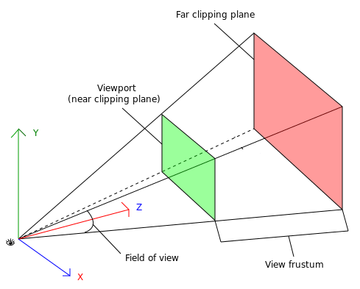
Getting Confused?
We need to render the object within the Frustum area to make it visible.
Always –ve z-axis ?

Slide 19
Getting Confused?
What if, we try to rotate it along y-axis
What if, modeling something in +ve z- axis ?

Slide 20
Getting Confused?
What if, we try to rotate it along y-axis
What if, modeling something in +ve z- axis ?

Slide 21
Do you’ve a solution?
It actually never passes through the Frustum !
So, shall we never see it? ☹

Slide 22
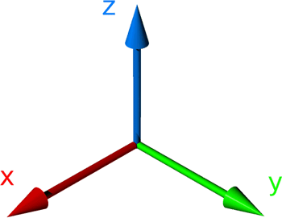
Series of transformation
We need Transformations

Slide 23
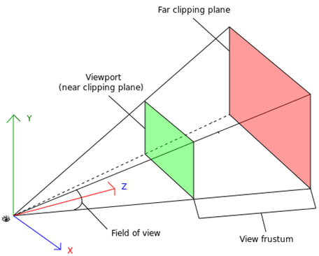
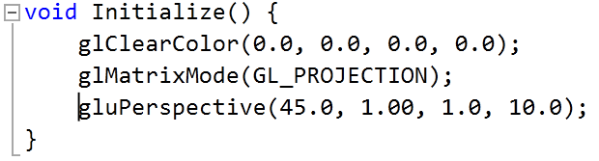
Lets code!
(W/H = 1)
(10.0)
(1.0)
(45.0)

Slide 24
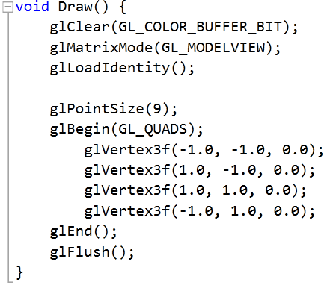
Lets code!
(W/H = 1)
(10.0)
(1.0)
(45.0)

Slide 25
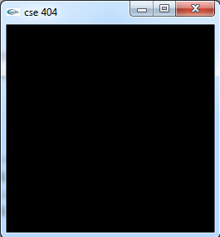
Lets code!
output
(W/H = 1)
(10.0)
(1.0)
(45.0)
BUT, WHY ?????

Slide 26
Lets code!

Slide 27
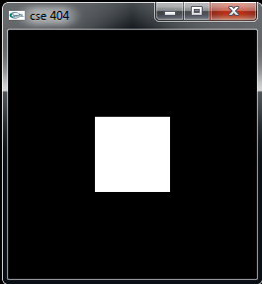
Lets code!
- 8.0

Slide 28
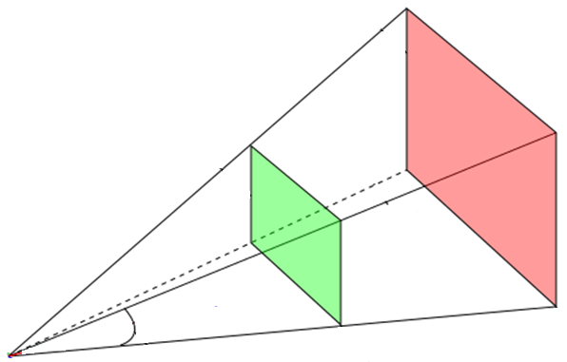
Want to drive a car ?

Slide 29

Want to drive a car ?

Slide 30
Want to drive a car ?

Slide 31
Want to drive a car ?

Slide 32
Want to drive a car ?

Slide 33


Want to drive a car ?

Slide 34
Lights in openGL

Slide 35
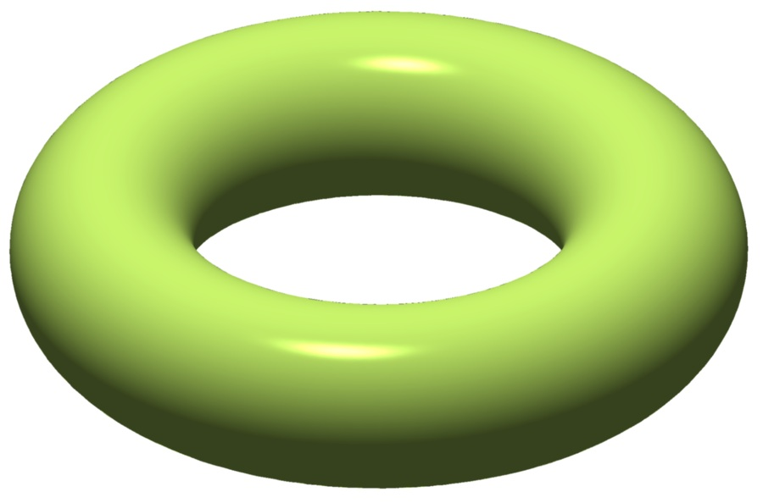
Why Light
Changes in Light
Light provides the feeling of materials
Light provides the presence of depth of a 3D object

Slide 36
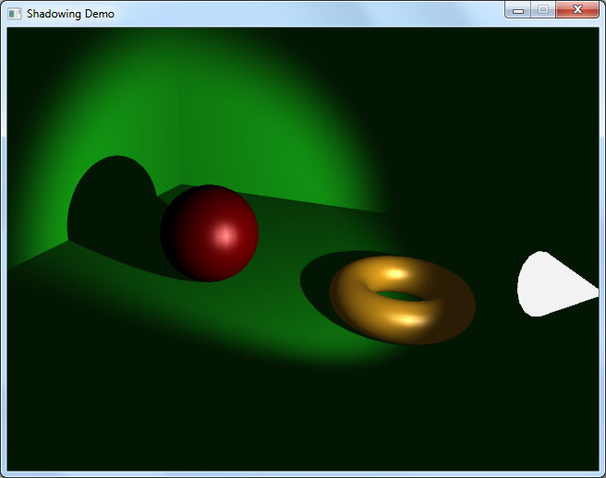
Why Light

Slide 37
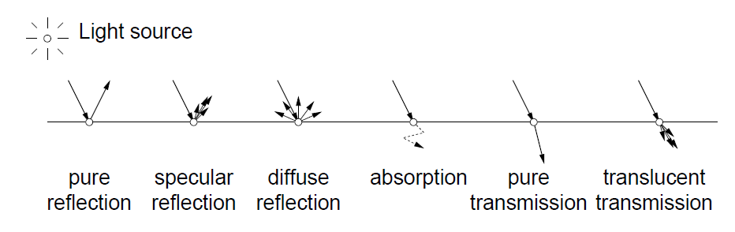
Light properties
Ambient emission:
does not come from any one location. Like heat, it is scattered uniformly in all locations and directions. A point is illuminated by ambient emission even if it is not visible from the light source.
In OpenGL, there’re features to
enable lighting
adding light sources
set up their positions and properties!

Slide 38
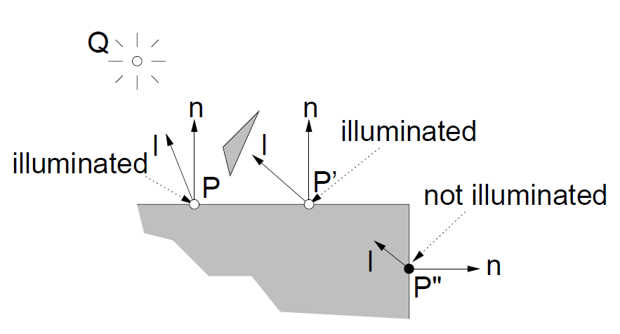
Light rays fall, but where ?
Depends on the Normal on a plane
We’ve to define Normal for a plane or surface
source
Plane - 1
Plane - 2

Slide 39
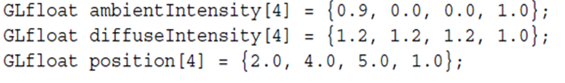

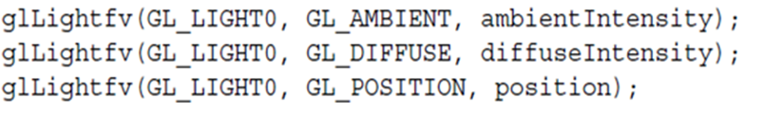
Before going to code…….
glLightfv (where, what, value)

Slide 40
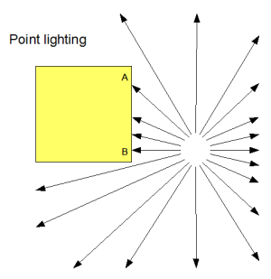
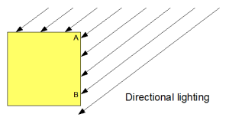
Light Position (positional & directional)

Slide 41
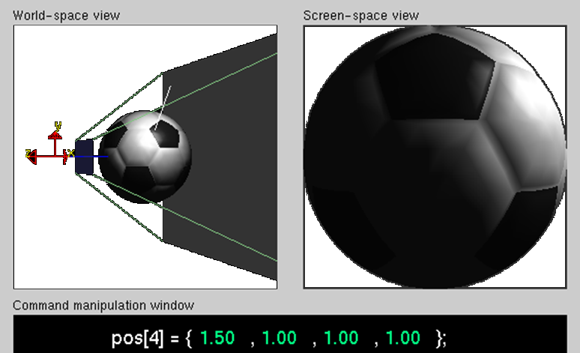
Light Position (positional)

Slide 42
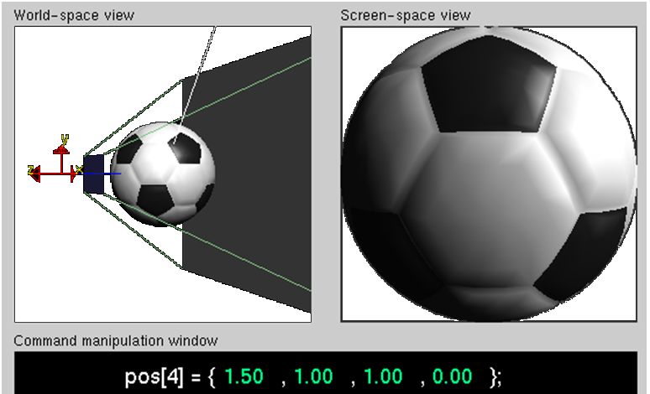
Light Position (directional)

Slide 43
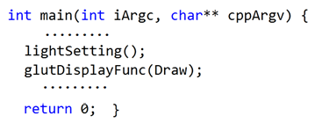
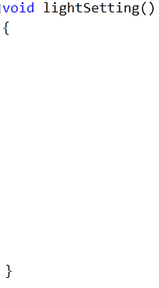




Example code

Slide 44

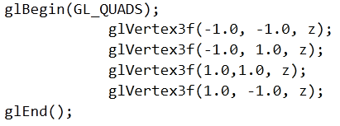
Example code

Slide 45
Example code

Slide 46

Example code

Slide 47
Some 3D objects and shapes in openGL

Slide 48
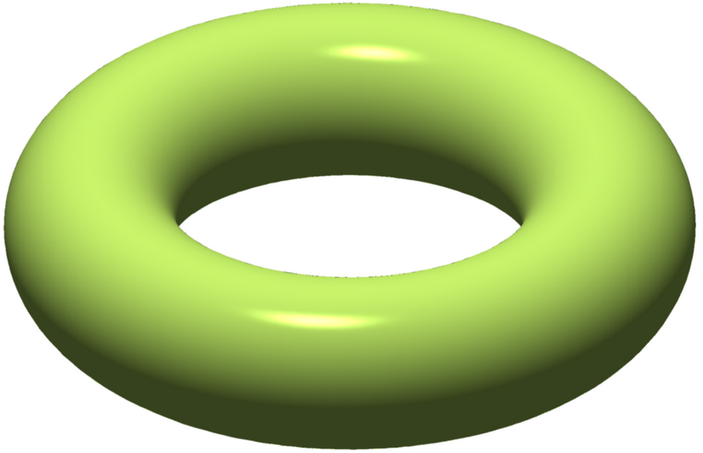
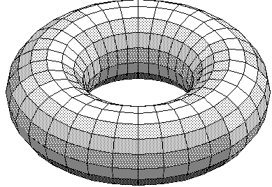
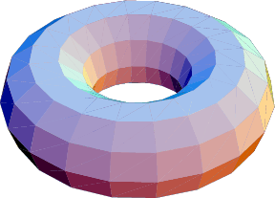
The Torus

Slide 49
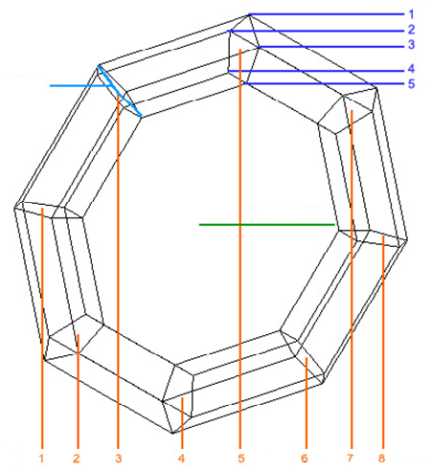
The Torus
Sides
Inner radius
glutSolidTorus(I, O, S, R);
Outer radius
Rings

Slide 50

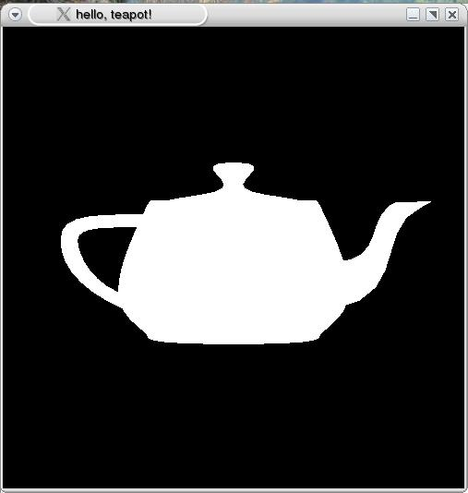
The Tea Pot
glutSolidTeapot (radaius);

Slide 51
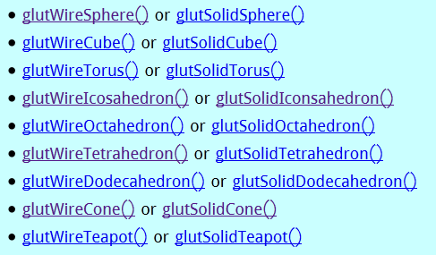
Go for More . . . . !!!

Slide 52
THANK YOU

