Slide 1
SYSTEM TO ENHANCE EDUCATION QUALITY IN RURAL AREAS
CSE7101- Capstone Project
FINAL VIVA
Batch Number: CSE_94
Under the Supervision of,
Dr. Prema Arokia Mary G
Associate Professor
School of Computer Science and Engineering
Presidency University
Roll Number | Student Name
20221CSE0484 | K SAI SRI
20221CSE0446 | MEGHANA K
20221CSE0061 | SHAIK MOHAMMED IMRAN
Name of the Program: B.Tech, Computer Science and Engineering
Name of the HoD: Dr. Blessed Prince
Name of the Program Project Coordinator: DR. MUTHURAJU V
Name of the School Project Coordinators: Dr. Sampath A K , Dr. Geetha A

Slide 2
Content
Problem Statement
Objectives
Background and Related work for title Selection
Architecture Diagram
Modules
Algorithms
Hardware and Software Requirements
Innovation or Novel Contributions
Git-hub Link
Timeline of the Project
Result
References

Slide 3
Problem Statement
Problem Statement Number: PSCS_32
Organization: Government of Kerala
Category: Software
Problem Description: Ideate and implement a system to enhance the quality of education in rural areas.
The aim of the system should not only focus on increasing the literacy rate but also
should assist to elevate the communication skills and knowledge of the targeted
society.

Slide 4
Objectives
Provide study materials in local languages for rural students to make learning inclusive and accessible across linguistic backgrounds.
Track each student’s learning progress and skills to enable personalized academic support and monitoring.
Share information about scholarships, grants, and job opportunities to guide learners toward educational and career advancement.
Offer a multilingual chatbot capable of understanding and responding to study-related queries in the user’s preferred language using rule-based NLP and custom language detection logic, thereby providing automated mentorship and real-time assistance.

Slide 5
Background and Related work
In India, several government and non-government initiatives have tried to improve rural education. The Diksha platform offers free digital content for students and teachers, and SWAYAM provides online courses from top institutions. While these platforms are valuable, they depend on good internet connectivity and are often limited to a few languages, making them less effective in remote rural areas.
A national review by ITU indicates that even though digital tools and local content help, manyrural areas still struggle with connectivity, language barriers, and teacher training.
NGOs such as Pratham have worked to improve literacy rates through community-based programs, and Room to Read India has focused on enhancing reading skills and building school libraries. These efforts have made progress in increasing enrolment and basic literacy, but many rural students still struggle to access personalized learning, continuous mentorship, and career-related resources.
Government schemes like Samagra Shiksha Abhiyan and PM e-Vidya aim to strengthen school infrastructure and promote digital education, yet gaps remain in implementation, especially in areas with low internet speed, poor teacher training, and lack of local-language learning materials.
Our project builds on these efforts by combining multiple features like digital learning resources in local languages, mentorship, progress tracking, and access to scholarships and job opportunities into a single platform designed specifically for rural learners in India.

Slide 6
Background and Related work(contd...)
AUTHOR | YEAR | TITLE | METHODOLOGY | INFERENCE
Ojat Darojat, Ajat Sudrajat, Darsiharjo, Lisa Dwi Ningtyas, Cecep Kustandi | 2025 | Learning Media Use in Rural | Mixed-method, GWT ANOVA | Flipped classroom w/ downloads best for low connectivity.
Ayesha Zulfiqar, Muhammad Bilal, Muhammad Nadeem Iqbal | 2024 | Factors Affecting Rural Schools | Quantitative survey | Facilities, teaching quality, poverty strongly impact outcomes.
Chaoyang Wang | 2024 | Rural Edu. Reform | Policy & case analysis | Focus: student autonomy, teacher training, infrastructure.
Radhika Kapur | 2024 | Education in Rural India | Qualitative descriptive | Fix infra, recruit teachers, improve methods/resources.
K.S. Suryanarayana, V.S. Prasad Kandi, G. Pavani, Akuthota Sankar Rao, Sandeep Rout, T. Siva Rama Krishna | 2024 | AI-Enhanced Learning Mgmt | AI system design | Personalized learning, analytics aid sustainability; privacy concerns.

Slide 7
Background and Related work(contd...)
AUTHOR | YEAR | TITLE | METHODOLOGY | INFERENCE
Yang Yu, Desmond Appiah, Bernard Zulu, and Kofi Asamoah AduPoku | 2024 | Integrating Rural Dev., Edu. & Mgmt | Literature review | Community participation + tech → sustainable rural development.
Xining Wang,Gareth W. Young,Muhammad Zahid Iqbal,Conor Mc Guckin | 2024 | XR in Rural Education | Workshop + focus groups | XR seen as transformative for vocational & contextual learning.
Dr. Prem Das Maheshwari | 2024 | Digital Intervention NEP 2020 | Policy/feature analysis | Digital infra + local content → bridge rural divide; but poor connectivity persists.
Muhammad Tahir Khan Farooqi ,Ishaq Amanat ,Muhammad Awan | 2024 | AI Ethics in Education | Systematic review | AI → privacy risks, teacher resistance; need training & safeguards.
Ying Lin, Northern Arizona | 2024 | Computer Networks in Distance Edu. | Conceptual analysis | Strong network infra vital for high-quality distance learning.

Slide 8
Background and Related work(contd...)
AUTHOR | YEAR | TITLE | METHODOLOGY | INFERENCE
Yuling Sun, Xiuqi Zhu, Xiaomu Zhou, Bingsheng Yao, Kai Zhang, Dakuo Wang, Jiaju Chen, Liang He | 2025 | ICT in Rural China | Qualitative interviews & obs. | Remote classes work if local teachers contextualize content.
Salam Michael Singh, Shubhmoy Kumar Garg, Amitesh Misra, Aaditeshwar Seth, Tanmoy Chakraborty | 2024 | SUKHSANDESH AI Sexual Edu. | Platform proposal | AI avatars break stigma; need safety & language localization.
Te-Hsin Hsieh & Xueye Lai | 2024 | ML for Rural Talent Dev. | RF & XGBoost analysis | ML predicts adaptability; supports scalable training.
Multiple authors | 2024 | Gen-AI in Rural Teaching | Analytical review | Gen-AI personalized learning but infra gaps hinder adoption.
Arihant Bardia & Aayush Agrawal | 2024 | MindCraft AI Learning | System design | AI personalization + mentorship + low bandwidth support helps rural learners.

Slide 9
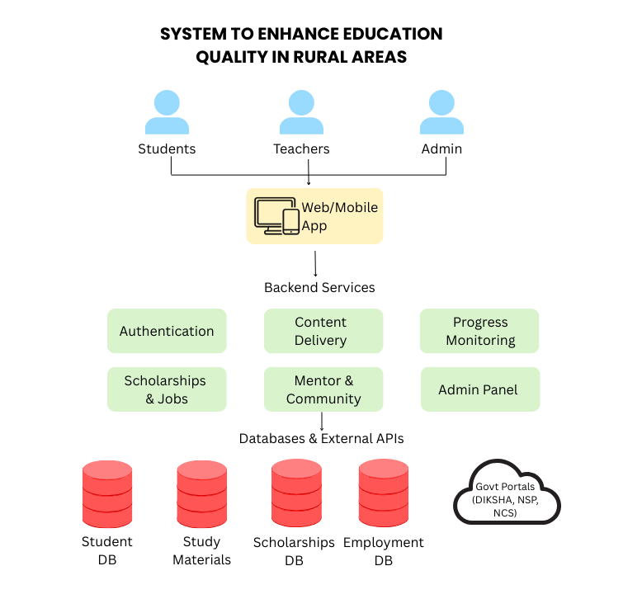
Architecture Diagram

Slide 10
Modules
1. User Module
Handles registration and login for students, mentors, and parents.
Supports profile management in multiple Indian languages with data secured through bcrypt authentication and role-based access control (RBAC).
2. Study Material Module
Provides access to digital learning resources such as PDFs, notes, and quizzes.
Includes multilingual support using rule-based NLP and allows content download for offline accessibility in low-connectivity regions.
3. Skill Progress and Monitoring Module
Tracks student learning progress and communication skills over time.
Displays performance analytics through an interactive dashboard showing metrics like completion rates and engagement levels.
4. Scholarship and Grants Module
Lists available scholarships, grants, and educational aid programs.
Displays eligibility criteria, deadlines, and direct links to official application portals.
5. Employment and Opportunities Module
Provides updates on jobs, internships, and vocational training programs relevant to students’ fields of study.
Promotes career awareness by sharing verified listings and guidance materials.
6. Chatbot and Automated Mentorship Module
Implements a multilingual, rule-based NLP chatbot that answers academic queries in the user’s preferred language.
Acts as an automated mentor, offering predefined educational and motivational responses from multilingual templates, enabling continuous guidance without requiring live mentors.
7. Community and Support Module
Facilitates peer-to-peer learning and interaction, allowing students to share study tips, challenges, and experiences.
Provides a structured communication channel between students and mentors for feedback and academic discussions.

Slide 11
Algorithms
1. Authentication (bcrypt)
Purpose: Securely verify user credentials using password hashing.
Use: Protects all user accounts (students, mentors, and admins) by encrypting passwords with bcrypt, ensuring privacy and security during login and registration.
2. Role-Based Access Control (RBAC)
Purpose: Enforce data access boundaries based on user type.
Use: Defines permissions for students, mentors, and administrators—ensuring each role can only access authorized modules such as progress tracking, mentorship dashboards, or content management.
3. Data Management (CRUD Operations)
Purpose: Manage learning content and user information efficiently.
Use: Enables creation, retrieval, updating, and deletion of entries such as study materials, progress records, and scholarship listings through secure RESTful API endpoints.
4. Session and Token Management
Purpose: Maintain seamless user sessions with secure authorization.
Use: Uses JWT (JSON Web Tokens) and Express middleware to keep users authenticated during active sessions, providing smooth navigation without frequent re-login.
5. Search and Filtering
Purpose: Simplify content discovery and data handling.
Use: Allows users to quickly locate study materials, mentors, or opportunities using keyword-based search and filtering logic for faster retrieval and user convenience.
6. Multilingual Query Handling (Rule-Based NLP)
Purpose: Enable understanding and response generation in multiple languages.
Use: Detects language using franc and custom script-based detection, then applies rule-based logic to generate responses from predefined multilingual templates—supporting inclusivity for rural learners.

Slide 12
Hardware and Software Requirements
Hardware Requirements
Processor: Intel i5 / AMD Ryzen 5 or higher
RAM: 8 GB or more
Storage: 256 GB SSD
OS: Windows 10 / Linux / macOS
Software Requirements
Frontend (User Interface):HTML5, CSS3, JavaScript, Tailwind CSS, React.js
Backend (Server & API): Node.js + Express.js
Database: MongoDB (NoSQL)
External APIs & Services: Google Meet API, Google Translate API
Hosting & Deployment: GitHub, Netlify, Render

Slide 13
Innovation or Novel Contributions
Our system is unique because it:
Unified Learning Platform – Combines study materials, automated mentorship, progress tracking, and career resources in a single accessible web application.
Multilingual Support – Enables learning in multiple Indian languages through rule-based NLP and custom language detection, ensuring inclusivity for students from diverse linguistic backgrounds.
Automated Mentorship – Uses predefined multilingual templates and rule-based logic to offer motivational and educational guidance without the need for live mentors.
Smart Content Suggestions – Recommends study materials and learning paths based on student progress and engagement data.
Career and Scholarship Integration – Displays verified opportunities for scholarships, grants, and jobs to guide students beyond academics.
Optimized for Low Bandwidth – Built as a lightweight system using Node.js and Tailwind CSS, supporting smooth operation even in regions with limited internet connectivity.

Slide 14
Git-hub Link
https://github.com/imrxnsk/SmartEduRural.git

Slide 15
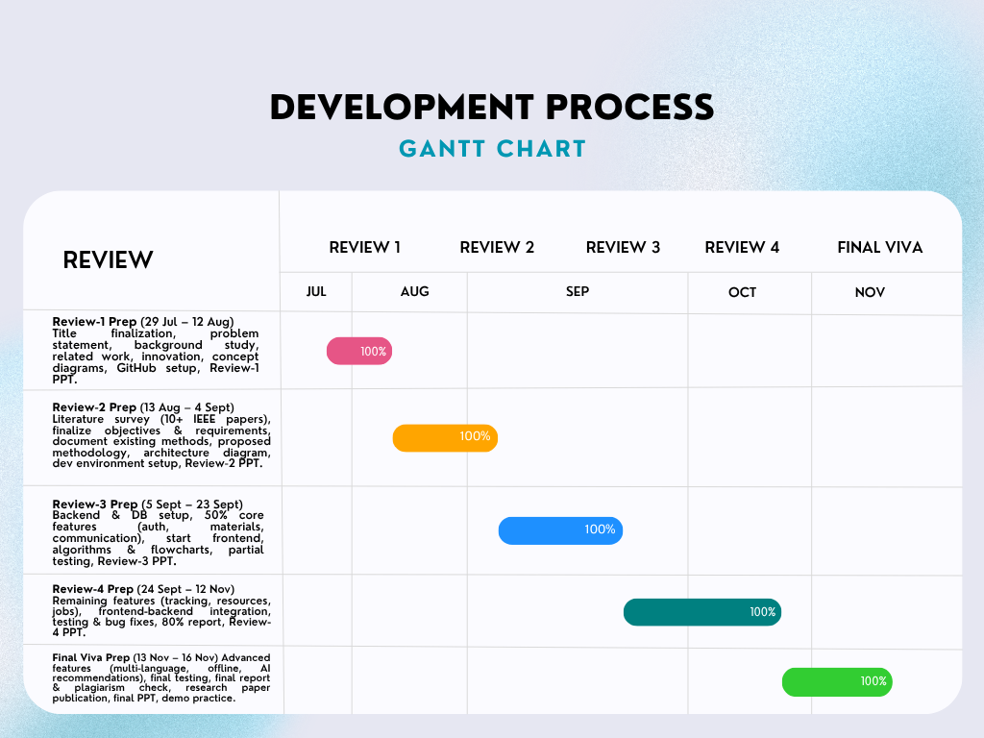
Timeline of the Project (Gantt Chart)

Slide 16
Result
Successfully developed a Smart Education System designed to enhance the quality of rural education through multilingual support, mentorship, and accessibility.
Built a lightweight and responsive frontend using HTML5, JavaScript (ES6), and Tailwind CSS, ensuring compatibility with mobile and low-end devices.
Implemented a modular Node.js backend using Express.js, with RESTful APIs managing data exchange, chatbot logic, and progress tracking.
Integrated Key Modules:
User Authentication – Login and registration for students, mentors, and parents.
Study Materials Module – Allows students to access and download learning content in local/regional languages.
Scholarship and Job Listings Module – Displays up-to-date information on available scholarships, grants, and employment opportunities.
Student Progress Tracking Module – Enables students to monitor their learning performance and skill growth over time.
Multilingual Chatbot Module – Supports real-time study-related queries in any language using rule-based NLP, franc language detection, and custom Indian script detection.
Automated Mentorship Module – Provides motivational and educational guidance through predefined multilingual templates, simulating personalized mentoring for students.

Slide 17
References (IEEE Paper format)
1] A. Bardia and A. Agrawal, “MindCraft: Revolutionizing Education through AI-Powered Personalized Learning and Mentorship for Rural India,” arXiv preprint arXiv:2502.05826, Feb. 2025.
[2] Aashish Jain and Rohit Khokher, “Technologies for Quality and Sustainable Online Education in Rural India: A Comprehensive Review,” in Kaleidoscope: ITU Academic Conference, 2024.
[3] R. Vaidehi, A. Bheemeshwar Reddy, and S. Banerjee, “Explaining Caste-based Digital Divide in India,” arXiv preprint arXiv:2106.15917, Jun. 2021.
[4] S. Hussain, Z. Wang, and S. Rahim, “E-learning Services for Rural Communities,” arXiv preprint arXiv:1308.4820, Aug. 2013.
[5] N. Singh, S. Singh, B. Goswami, S. Kumar, and B. Kumar, “Bridging the Digital Divide: A Comprehensive Analysis of ICT Infrastructure in Rural Schools of Jharkhand, India,” Educational Administration: Theory and Practice, vol. 30, no. 6, pp. 4456–4460, Jun. 2024.
[6] Y. Yu, D. Appiah, B. Zulu, and K. A. AduPoku, “Integrating Rural Development, Education, and Management: Challenges and Strategies,” 2024.
[7] X. Wang, G. W. Young, M. Z. Iqbal, and C. Mc Guckin, “The potential of extended reality in rural education’s future – perspectives from rural educators,” 2024.
[8] P. D. Maheshwari, “Digital intervention in elementary education: Analysing the implementation of NEP 2020 in rural India,” 2024.
[9] M. T. K. Farooqi, I. Amanat, and M. Awan, “Ethical considerations and challenges in the integration of artificial intelligence in education: A systematic review,” Sep. 15, 2024.
[10] Y. Lin, “Application and challenges of computer networks in distance education,” 2024.

Slide 18
References (IEEE Paper format)(contd...)
[11] O. Darojat, A. Sudrajat, Darsiharjo, L. D. Ningtyas, and C. Kustandi, “Implementation of learning media usedbystudents in rural areas: A mixed-method study,” 2025.
[12] A. Zulfiqar, M. Bilal, and M. N. Iqbal, “Identification of factors affecting the quality of education in ruralareas’elementary schools,” 2024.
[13] C. Wang, “Rural education development and reform: Implementation of quality education and innovation intheeducation system,” 2024.
[14] R. Kapur, “Understanding education system in rural communities,” 2022.
[15] K. S. Suryanarayana, V. S. P. Kandi, G. Pavani, A. S. Rao, S. Rout, and T. S. R. Krishna, “Artificial intelligenceenhanceddigital learning for the sustainability of education management system,” 2024.
[16] Y. Sun et al., “Who changed the destiny of rural students, and how?: Unpacking ICT-mediated remoteeducation inrural China,” 2024.
[17] S. M. Singh, S. K. Garg, A. Misra, A. Seth, and T. Chakraborty, “SUKHSANDESH: An avatar therapeuticquestionanswering platform for sexual education in rural India,” 2024.
[18] T.-H. Hsieh and X. Lai, “Analyzing rural online education talent development with data and machinelearning,” 2024.
[19] Multiple authors, “Research on the status quo of rural teaching based on generative artificialintelligence,”2024/2025.
[20] A. Bardia and A. Agrawal, “MindCraft: Revolutionizing education through AI-powered personalized learningandmentorship for rural India,” 2025.

Slide 19


