Slide 1


Welcome to the Future: Your iMS Systems
Adoption Pack

Slide 2
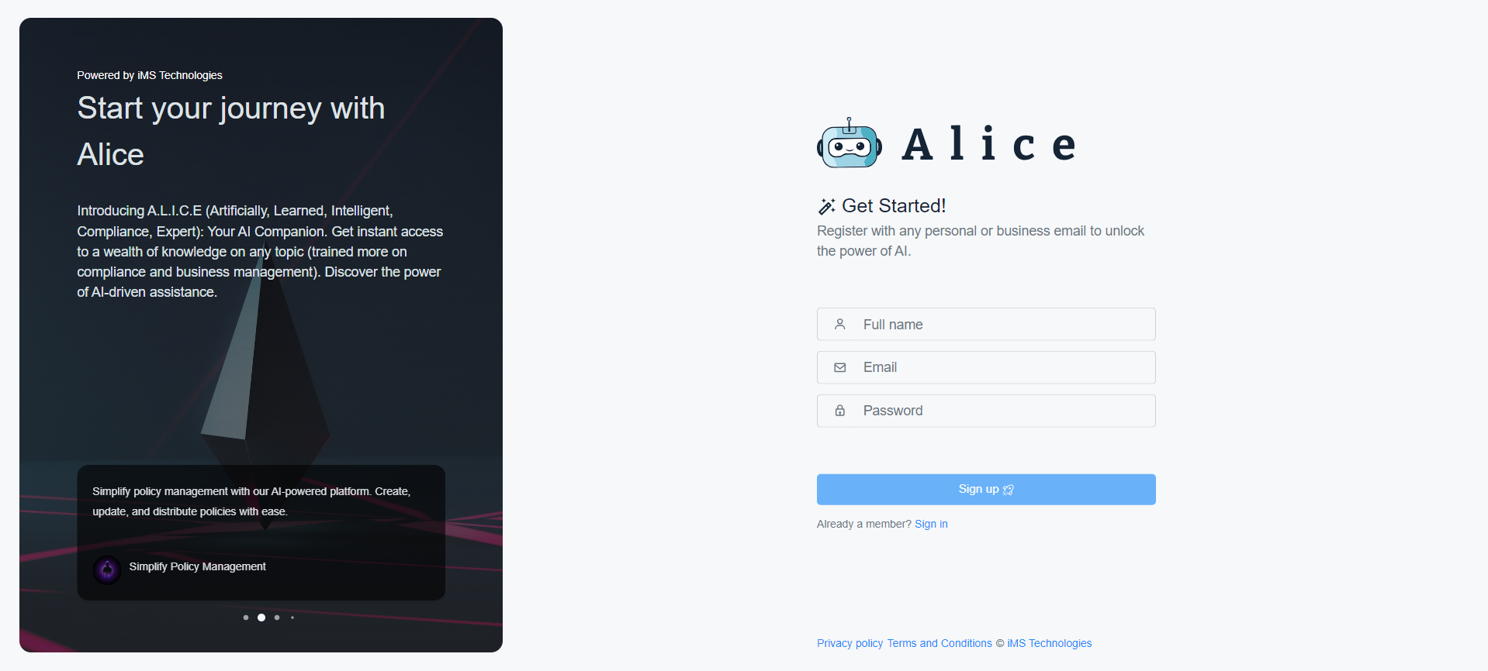
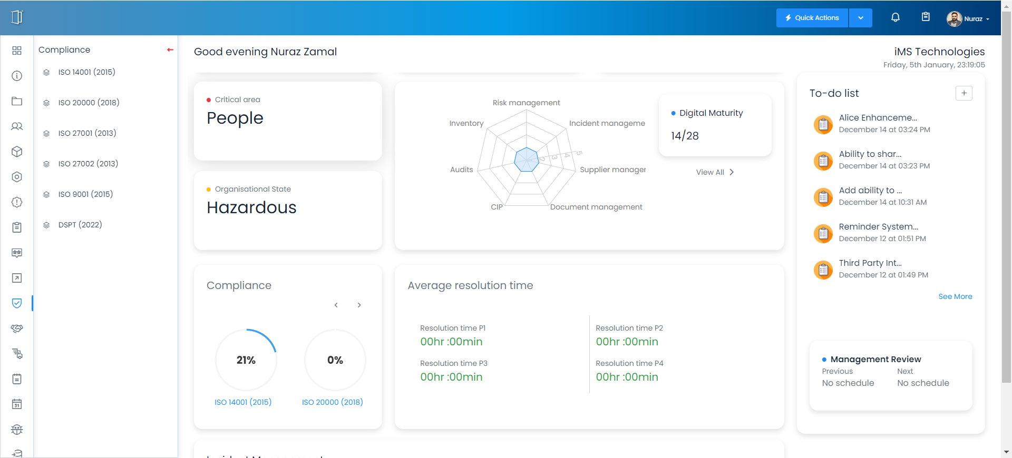
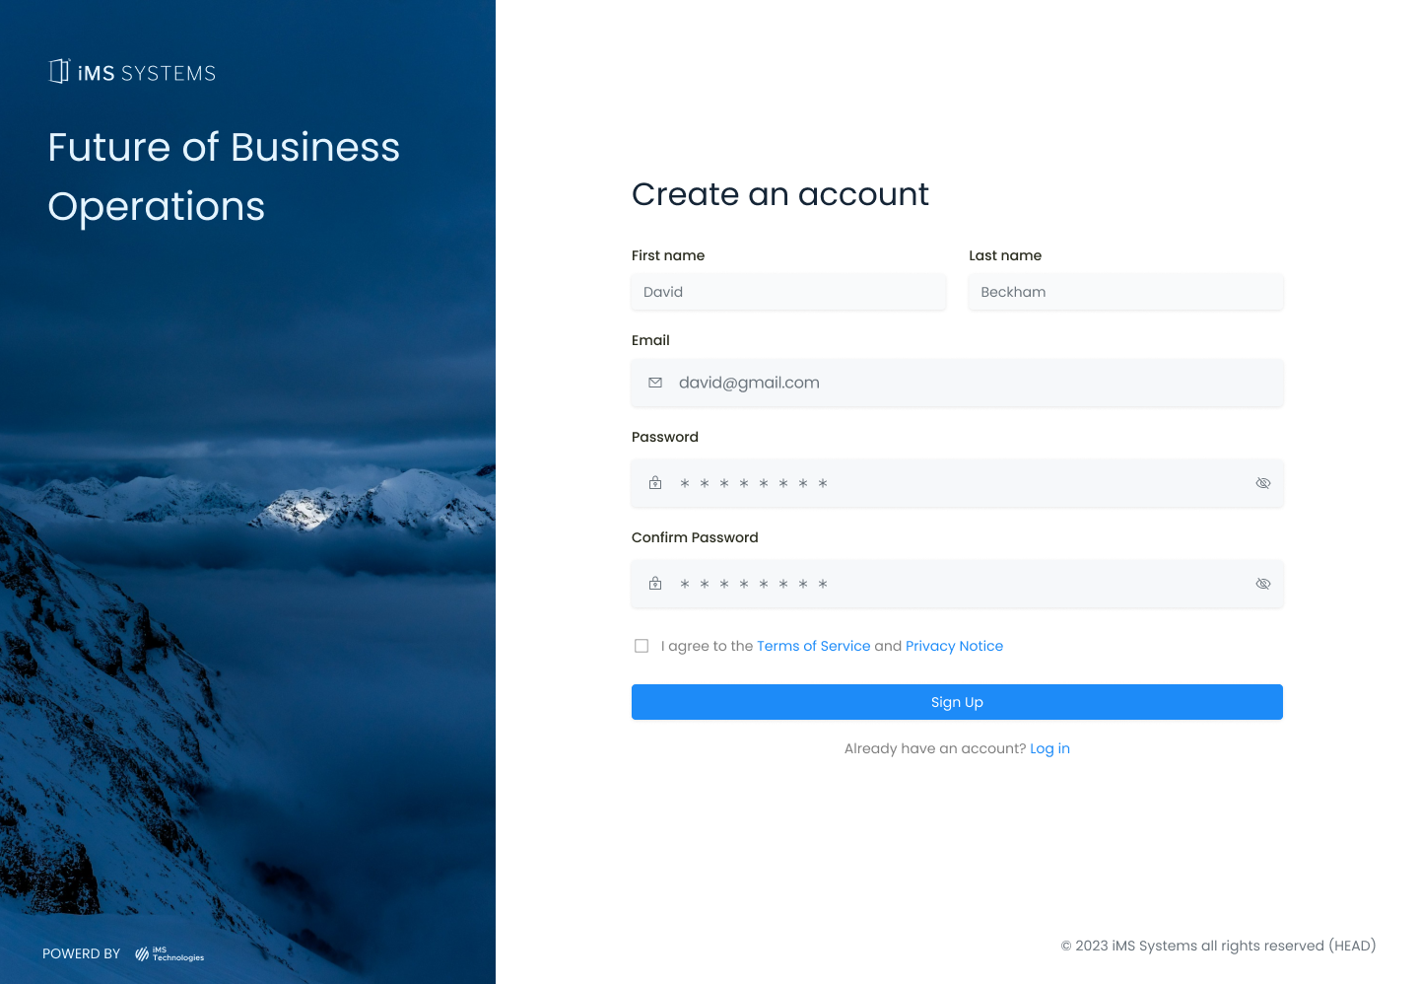


Streamline Compliance Management
With iMS Systems, you can say goodbye to the complexities of managing multiple compliance frameworks and regulations. Our solution consolidates all compliance requirements into one centralised system, providing you with real-time visibility on risks and conformance against standards and policies. You can expect a streamlined compliance management process, allowing you to track progress, identify gaps, and take proactive measures to address any non-compliance issues.
Harness the Power of AI with Alice
As part of your iMS Systems adoption, you will have access to Alice, our intelligent assistant powered by Artificial Intelligence (AI). Alice will become your compliance expert, analysing data, providing insights, and reviewing risks. You can expect Alice to generate risk treatment plans, conduct impact analysis, and assist in producing policies aligned with compliance standards. With Alice by your side, you can save time, reduce administrative tasks, and make informed decisions based on data-driven insights.

Slide 3
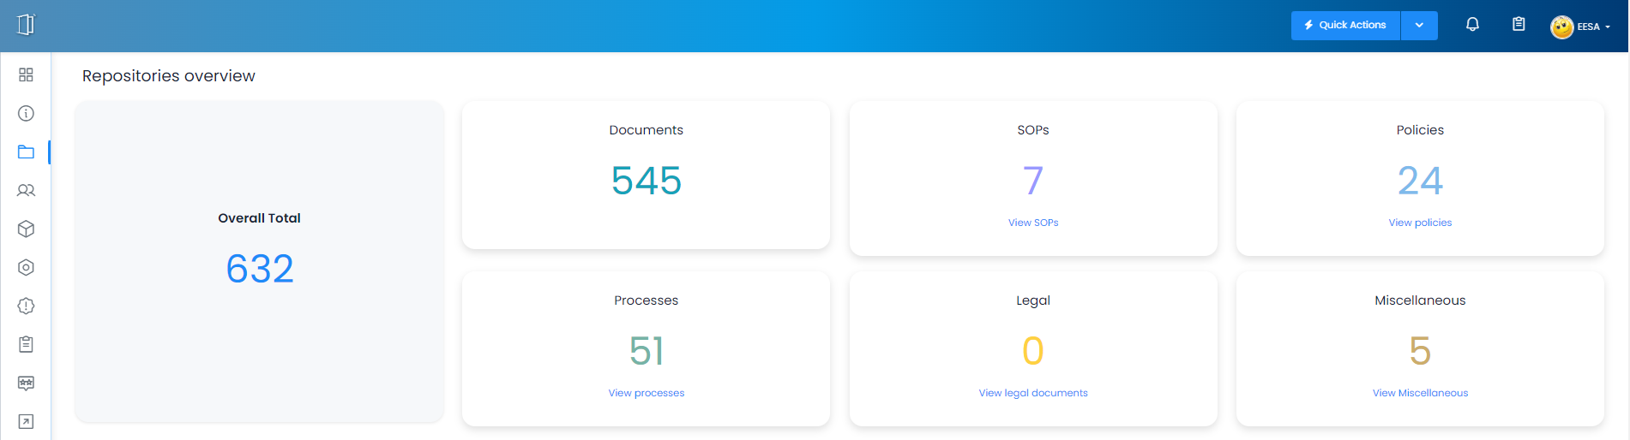
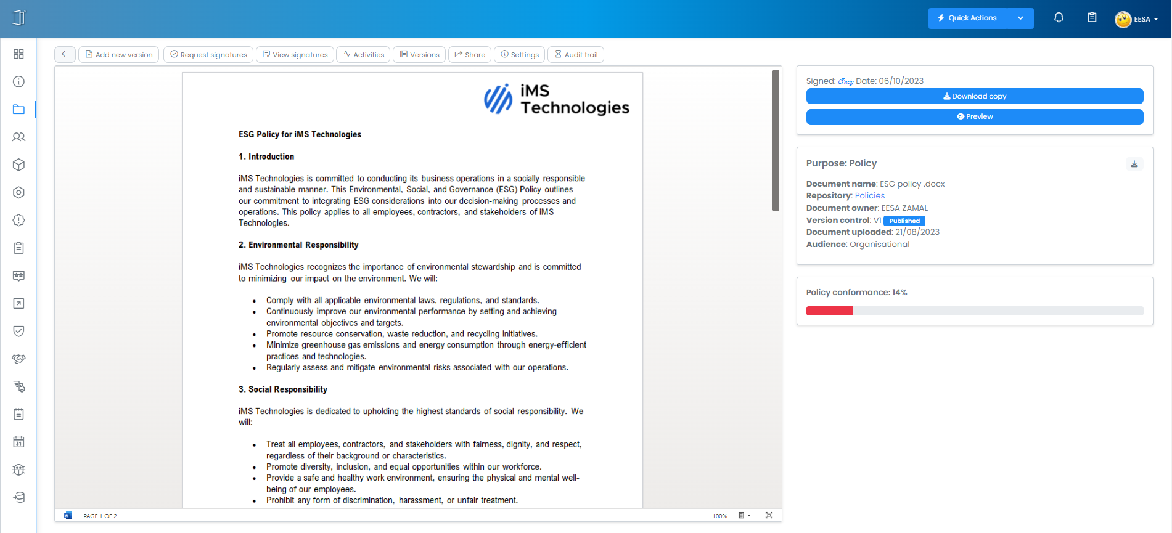
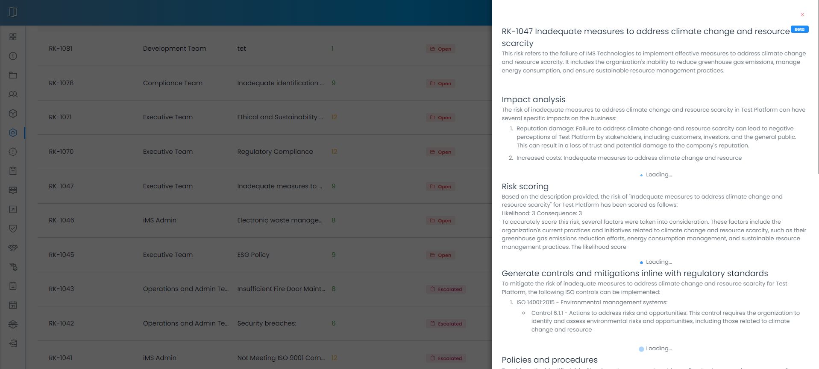
Document Management: Consolidate, Centralise, and Share with Confidence
You will streamline your document management processes by consolidating and centralising all your documents.
This solution enables easy access, efficient collaboration,
and robust security measures.
You can securely share documents internally and externally, track activities with an audit trail, and ensure compliance with ISO 27001. Additionally, iMS Systems allows you to track policies and processes, manage documents inline with CIA principles,
and benefit from an intuitive interface and automated
workflows for efficient document management.
Transforming Risk Management for the Digital Age
iMS Systems offers an AI-powered assistant, Alice, for comprehensive risk management. Alice analyses data, identifies risks, and provides real-time monitoring. It generates treatment plans, integrates with compliance frameworks, and enables informed decision-making. Adopting iMS Systems and Alice AI equips your organisation with tools to enhance efficiency, protect assets, and drive growth

Slide 4
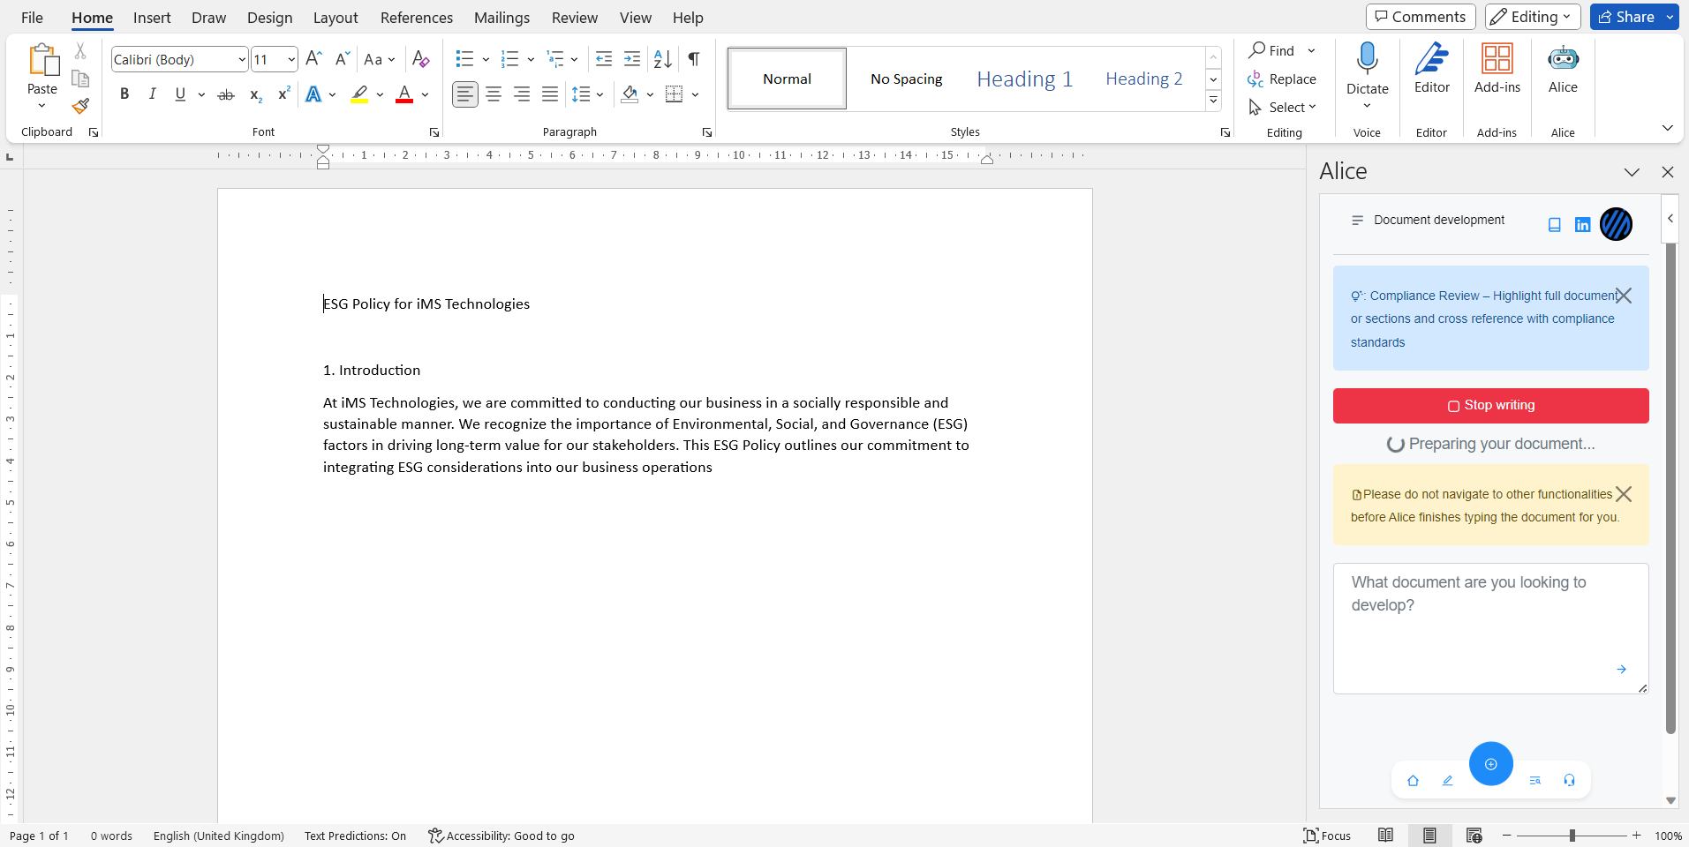
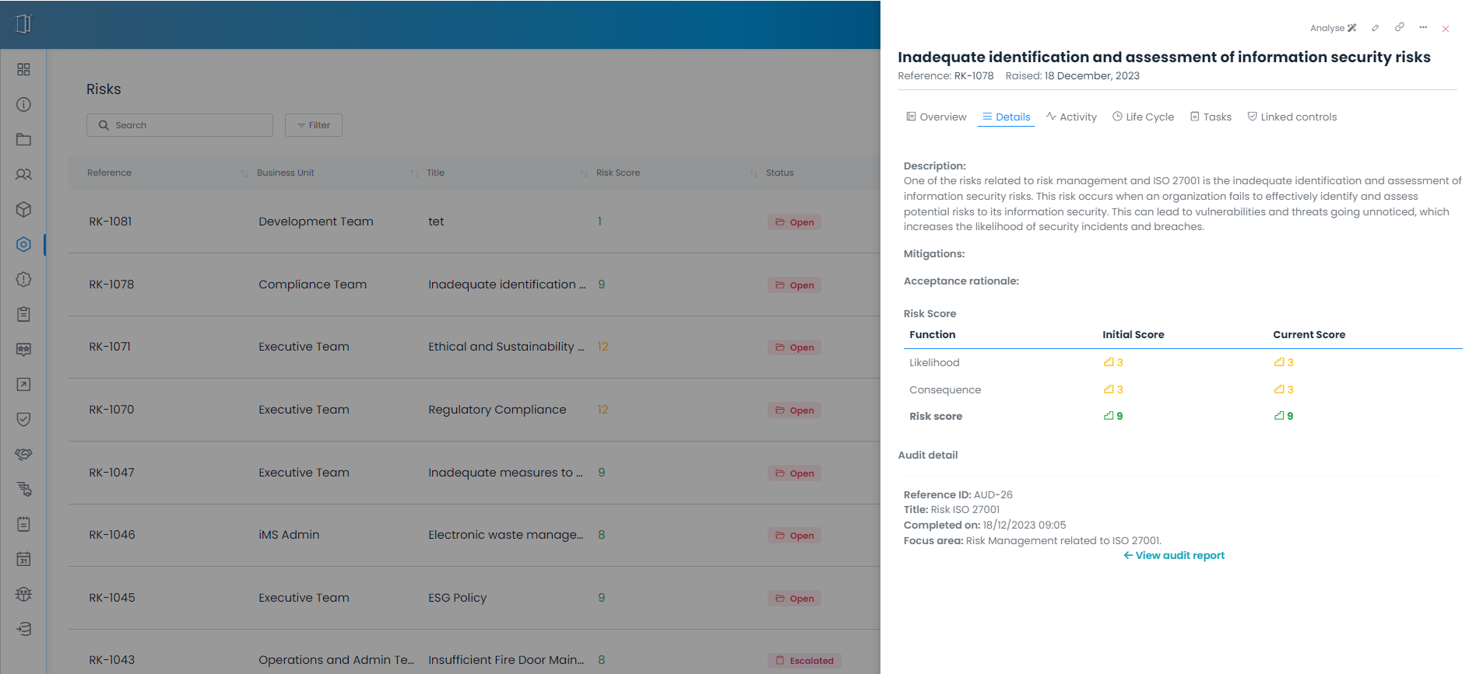
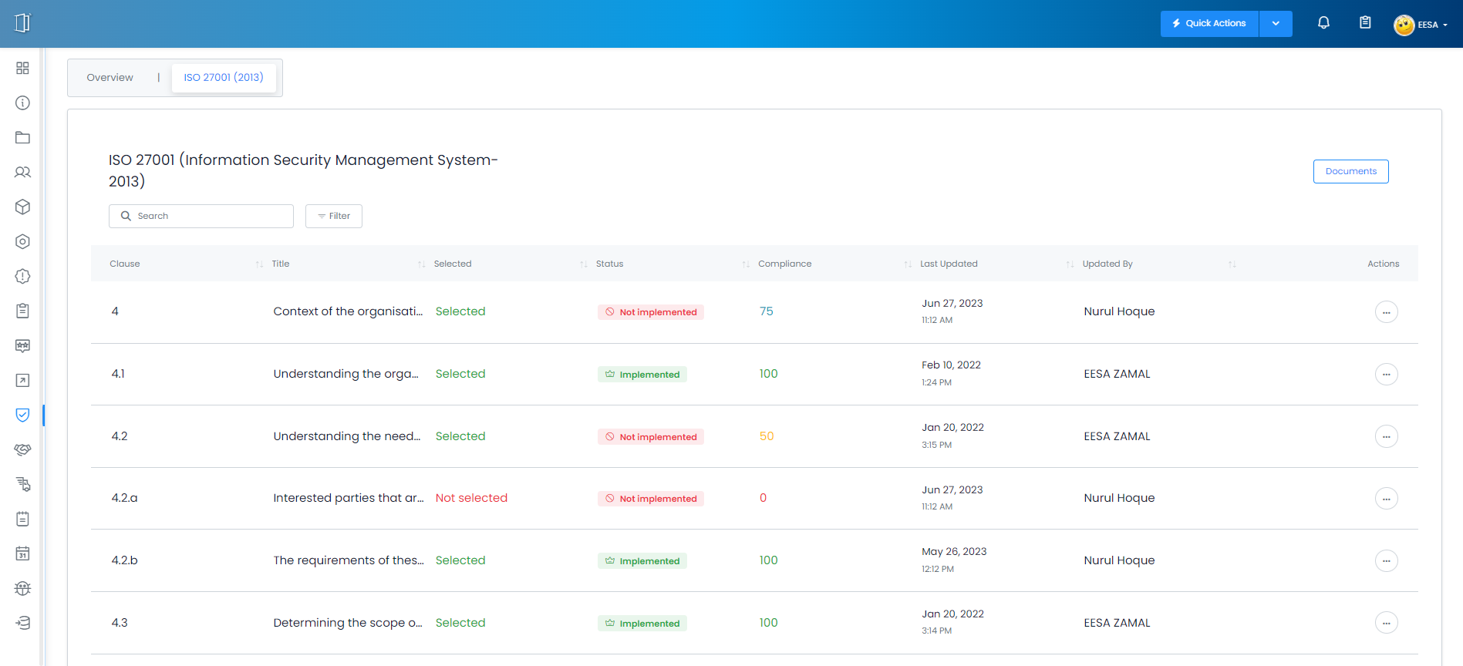
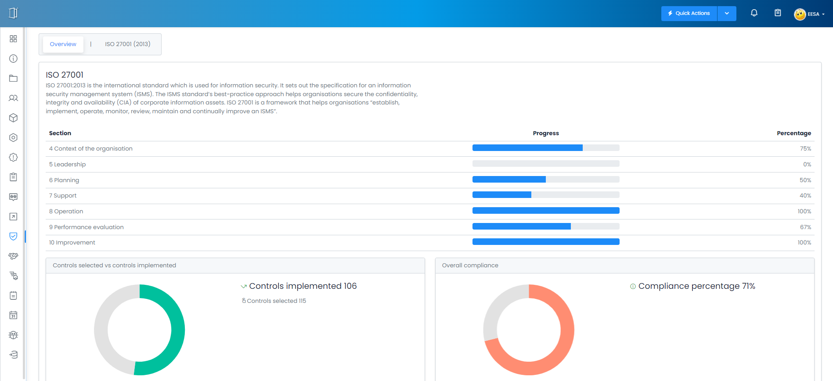
Comprehensive Solution for Future-Proofing
iMS Systems offers a comprehensive solution that goes beyond current compliance requirements. By adopting our system, you are preparing your organisation for future regulatory changes and industry trends. You can expect a holistic approach to compliance management, risk analysis, and policy generation. iMS Systems will help you future-proof your operations, ensuring that you stay ahead of the curve and maintain a competitive edge
Assure Interested Parties
Adopting iMS Systems will provide assurance to your interested parties, including customers, partners, and investors. By demonstrating your commitment to maintaining high standards and meeting regulatory requirements, you will build trust and confidence in your organisation's operations. Expect iMS Systems to enhance your reputation and attract potential business opportunities, as interested parties recognise your dedication to compliance excellence.

Slide 5
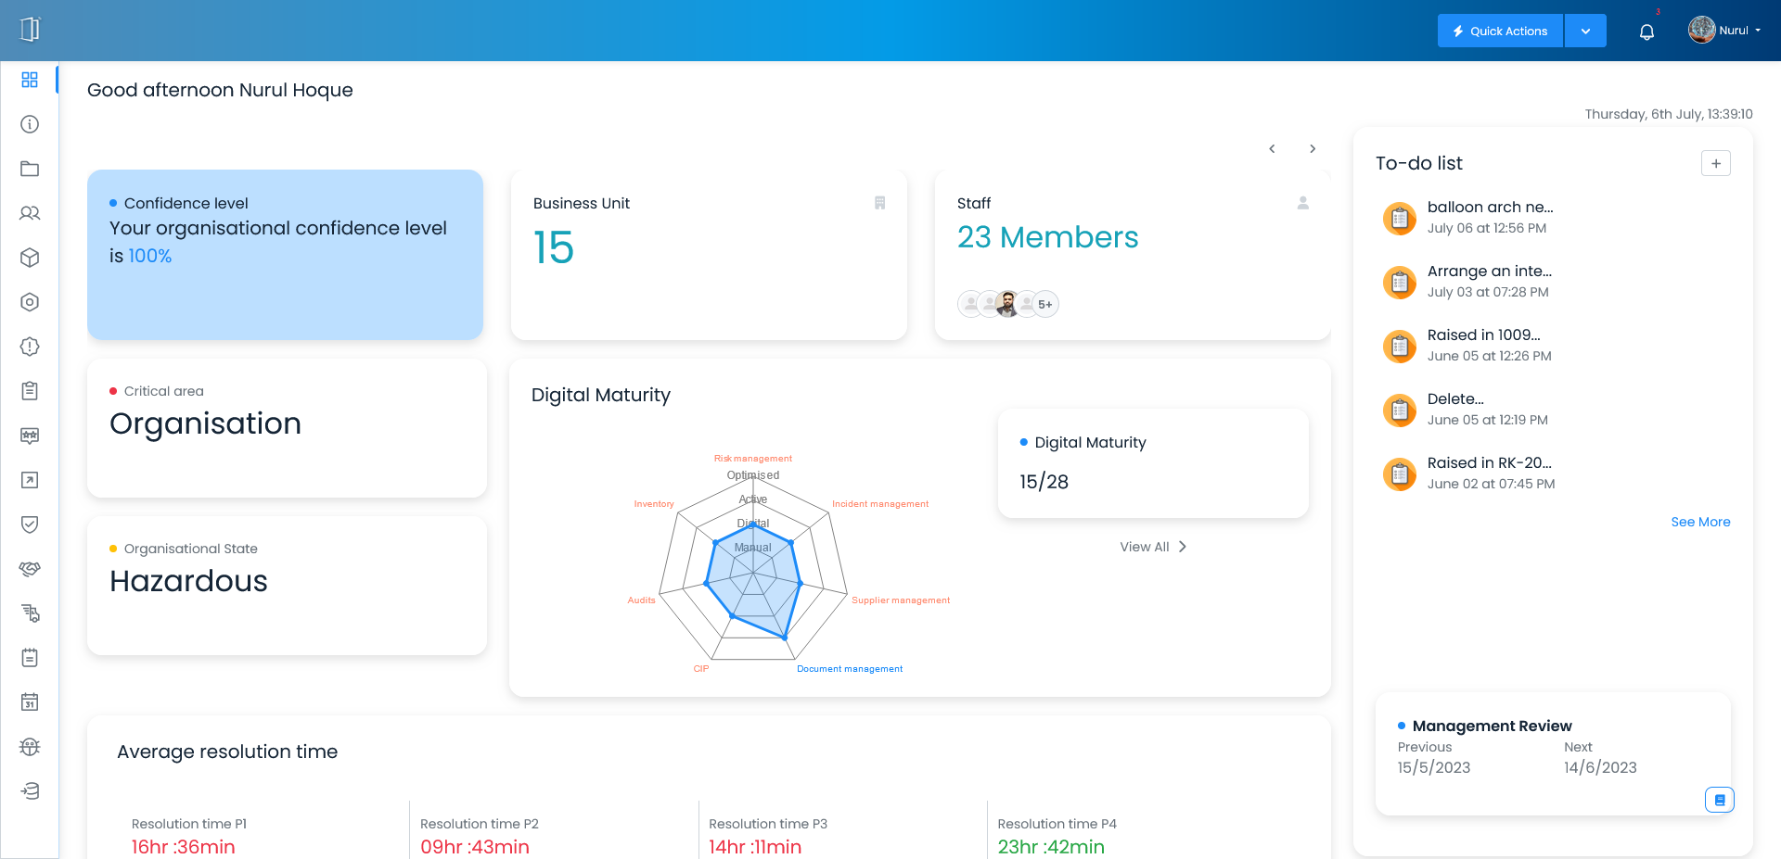
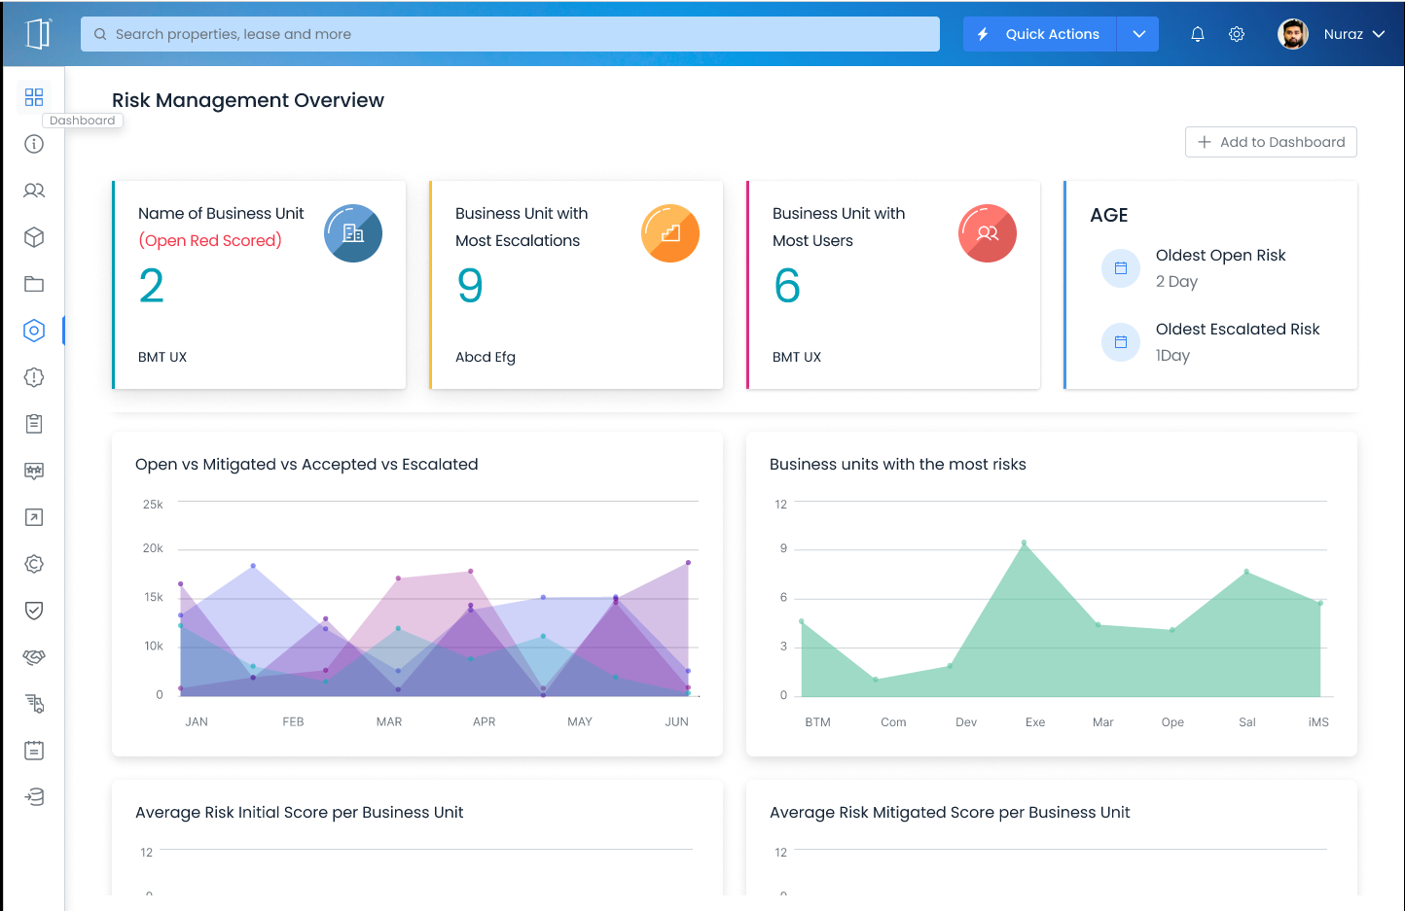
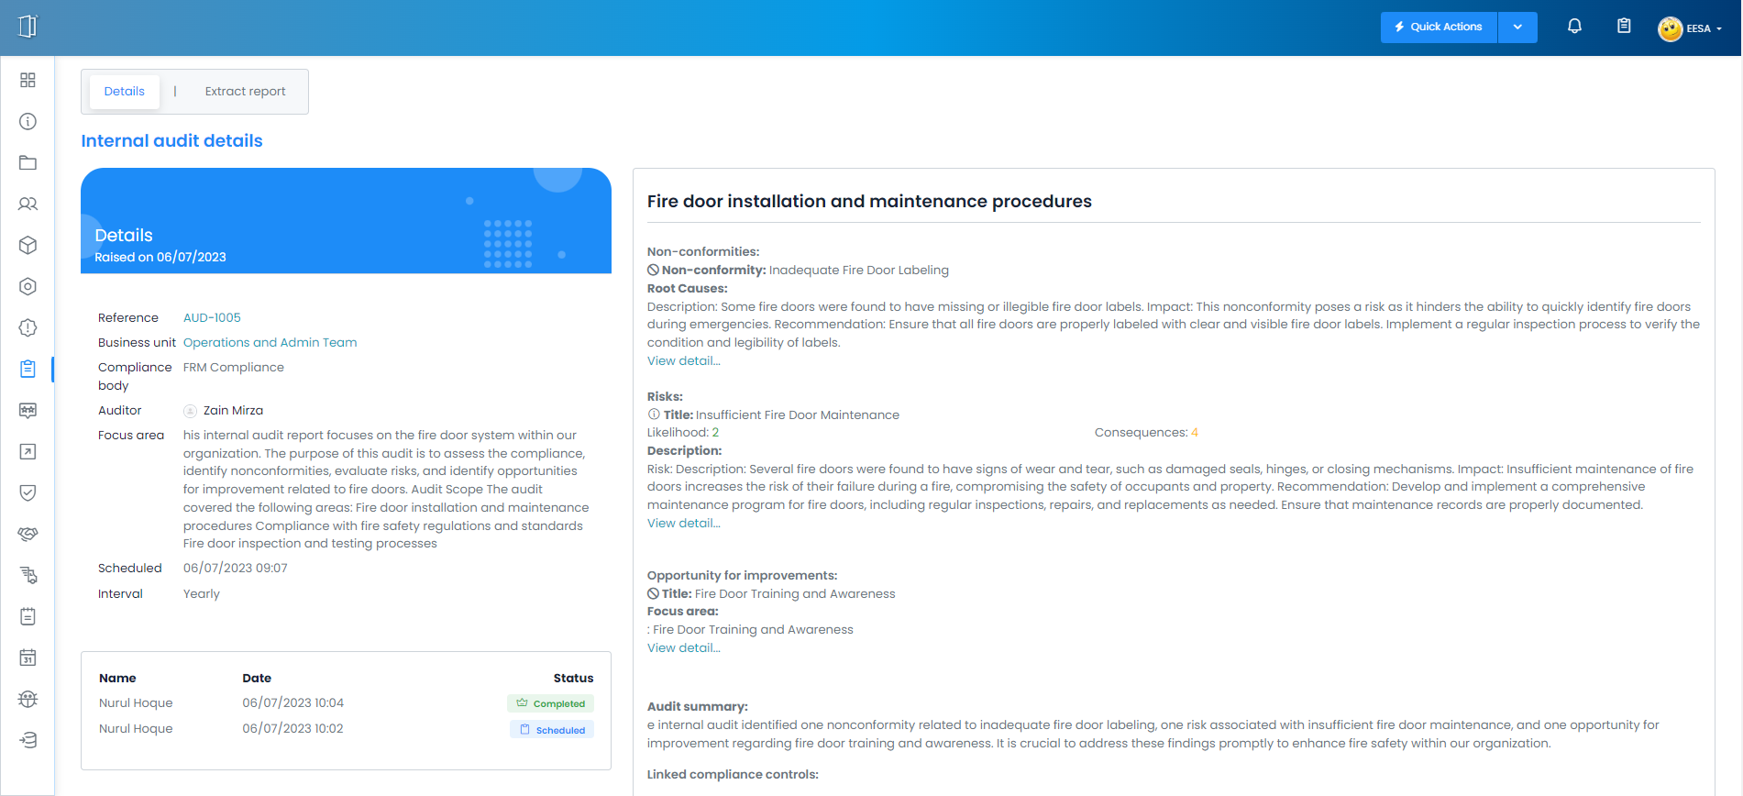
Prepare for External Audits with Ease
As part of your iMS Systems adoption, you can expect a seamless process when it comes to external or remote audits by certification bodies. Our solution provides the necessary tools and features to prepare for audits, including the ability to generate reports, track compliance progress, and demonstrate adherence to regulatory requirements. You can expect a streamlined audit process, saving time and resources for your organisation.
Embrace the Future Today
By adopting iMS Systems, you are embracing the future and positioning your organisation for success. This welcome pack provides just a glimpse of what you can expect from your iMS Systems adoption. As you embark on this journey, our team will be there to support you every step of the way, ensuring a smooth transition and helping you unlock the full potential of iMS Systems.
The unique value proposition of iMS Systems lies in its combination of compliance management, risk analysis, and policy generation in one platform. This holistic approach simplifies compliance, enhances efficiency, and reduces the risk of non-compliance.

Slide 6


Welcome to the future of business operations!!
Get ready to experience improved efficiency, enhanced assurance, and a competitive advantage with iMS Systems. Let's embark on this exciting journey together!

