Slide 1

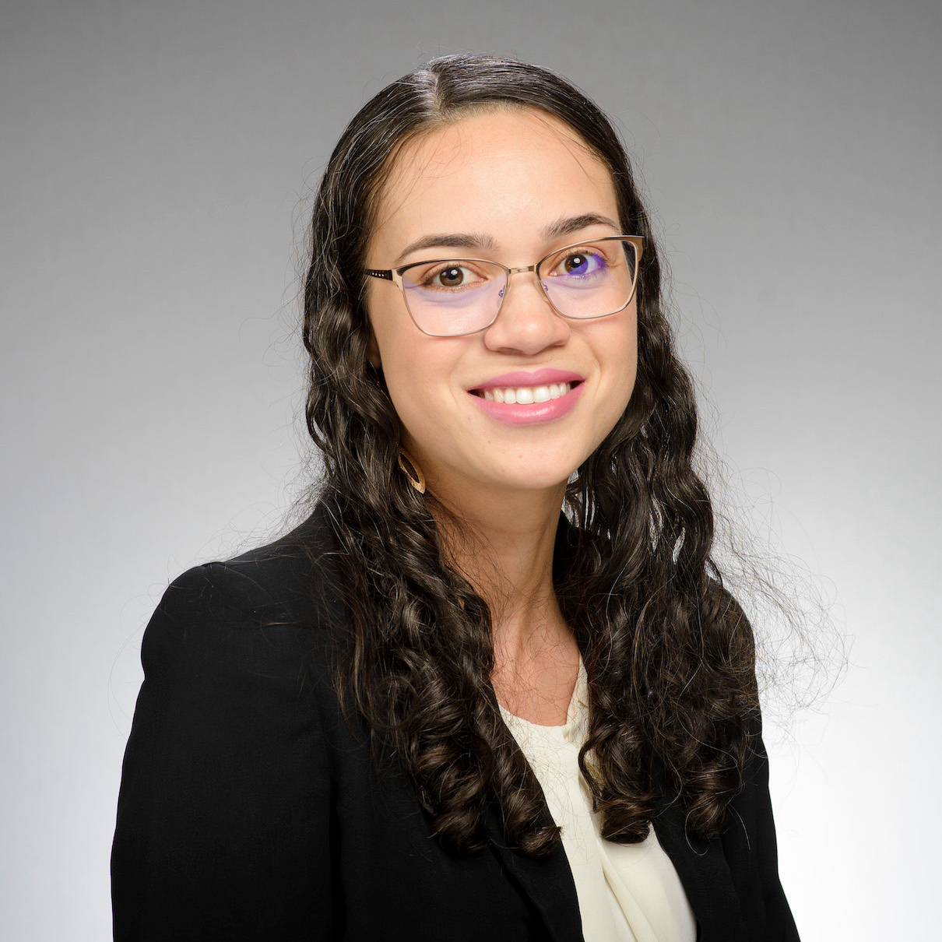

BERT-Based GitHub Issue Report Classification
Mohammed Latif Siddiq
msiddiq3@nd.edu
Joanna C. S. Santos
joannacss@nd.edu
Security & Software Engineering Research Lab

Slide 2
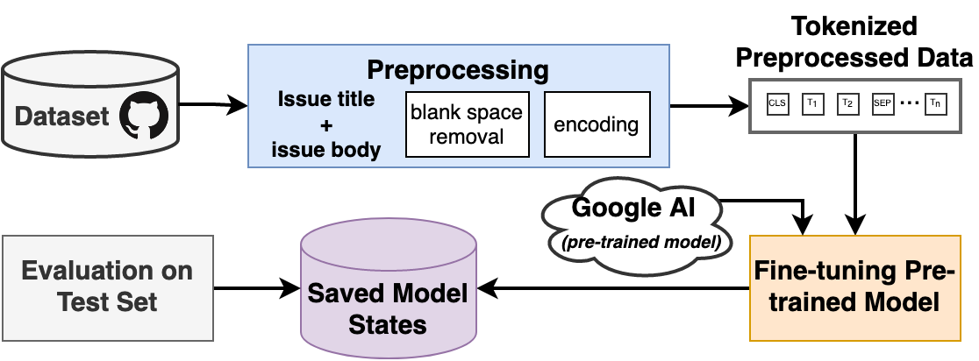
Approach Overview
Set | Bug | Enhancement | Question | Total
Training | 306,937 (50%) | 254,468 (41.4%) | 53,059 (8.6%) | 614,464 (76.4%)
Validation | 54,166 (50%) | 44,906(41.4%) | 9,363 (8.6%) | 108,435 (13.5%)
Testing | 40,152 (49.9%) | 33,290(41.3%) | 7,076 (8.8%) | 80,518 (10.0%)

Slide 3




Using BERT: Motivation
Not Require any Substantial Architecture Modifications
State of the Art of 11 NLP Tasks
A New Standard
of Pre-training
Language Model
Availability of Open-source Source Codes and Tutorials

Slide 4
Feature Engineering & Preprocessing
Text Cleaning & Feature Extraction
Encoding
Hyperparameters
Issue Title
Tokenizer:
BertTokenizer
Pretrained Model:
‘bert-base-uncase’
Parameters:
add_special_token: True
return_attention_mask: True
padding: Longest
truncation: True
return_tensors: pt
Pretrained Model for Training and Evaluation:
‘bert-base-uncase’
Optimizer:
AdamW(Learning Rate: 1e⁻⁵, eps: 1e⁻⁸)
Learning Rate Schedule:
linear schedule with warmup
Issue Body
Issue Data
Gensim
Feature

Slide 5
Model Result
Model | Bug | Enhancement | Question | Global
FastText | 0.8515 | 0.8307 | 0.4557 | 0.8162
Epoch 1 | 0.8833 | 0.8704 | 0.5714 | 0.8554
Epoch 2 | 0.8859 | 0.8733 | 0.6058 | 0.8586
Epoch 3 | 0.8866 | 0.8721 | 0.5776 | 0.8584
Epoch 4 | 0.8844 | 0.8701 | 0.6023 | 0.8561

Slide 6


Examples of Predicted Cases
Sample Title | Class
Add database backup to dropbox nan | Enhancement
Cannot add hp to wall nan | Bug
How to prevent dead loop? | Question
Sample Title | Prediction | Class
ModuleNotFoundError: No module named Hello | Enhancement | Bug
software development direction | Bug | Question

Slide 7

Improvement Ideas
Using New SOTA Pre-trained Models
Preprocessing Data by Removing Duplicates and
Useless Elements (i.e. Images, Codes)
Creating a Balanced Dataset
Exploring Different Hyperparameters

Slide 8


Challenges in Training and Evaluation
Shared GPU
Unfit for Larger Batch Size
Training Time: 18 Hours/Epoch
Testing Time: 6 Hours

Slide 9
BERT-Based GitHub Issue Report Classification
Thank You
Mohammed Latif Siddiq
msiddiq3@nd.edu
Joanna C. S. Santos
joannacss@nd.edu
Any Questions?
Security & Software Engineering Research Lab

