Slide 1

DATA STRUCTURE AND ALGORITHAM
DSA project (EVENT COST ESTIMATOR)
presented by :
MAAZ HASAN (04)
MOHD SAQIB (07)
SAIFUR REHMAN (13)
MOBASHSHAR FAHIM (29)
SUBMITTED TO – MR PASHA QADRI SIR
Department of cs&it
manuu.

Slide 2
Content: INTRODUCTION PROBLEM & SOLUTION CODE EXECUTION FLOW CHART END.

Slide 3
Problem before event cost estimator:
Uncertainty in Budgeting: They often struggled to predict costs accurately, leading to underestimations or overspending.
Hidden or Unexpected Costs: Things like insurance, equipment rentals, and taxes would be overlooked, resulting in surprise expenses.
Time-Consuming Research: Organizers had to manually gather cost data for venues, catering, and materials, which wasted time and resources.

Slide 4
Cost Estimator Solves These Problems:
Providing Accurate Budget Forecasts: It calculates total costs by factoring in all necessary expenses—like venue, staff, and materials—based on inputs like event size and location.
Identifying All Expenses: By offering a detailed breakdown of common costs, it helps organizers avoid surprises and ensure nothing is missed.
Saving Time: Instead of researching each component individually, the estimator aggregates costs or provides standardized pricing ranges, making the process efficient.

Slide 5
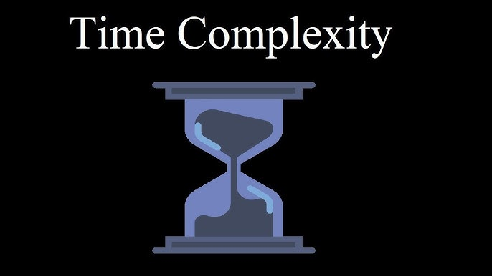
The time complexity of the program is O(1), as each function (input validation, cost calculation, and display) runs in constant time. The program involves simple input handling and calculations, making its overall time complexity constant, provided valid inputs are given without excessive retries.

Slide 6

CONCLUSION:
The program helps users estimate and manage event costs, allowing them to make informed decisions based on their budget and event requirements.

Slide 7


