Slide 1
Introduction
to
Microprocessors
Course Teacher: Md. Fahmidur Rahman Sakib
Lecturer, Department of Computer Science & Engineering Metropolitan University
Course ID: CSE 237
Course Title: Microprocessor and Interfacing

Slide 2
Topics to be Covered in this Course !!
Concept of microprocessor
Evolution and Internal architecture of microprocessors
Intel 8086 Microprocessor: internal architecture, register structure, programming model, addressing modes, instruction set
Coprocessors, Multiprocessor system
An overview of Intel 80186, 80286, 80386 & Pentiums
Stepper Motor, Transducers, printers, motors and peripherals.
Assembly language programming

Slide 3
Recommended Texts
Microprocessors and Interfacing: Programming and Hardware, Author: Douglas V. Hall
Microprocessors and Interfacing , Author: D. A. Godse, A.P. Godse
Computer Peripheral & Interfacing, Author: Gourav Gupta, Eagle Prakashan, Jalandhar

Slide 4
Does Earlier Knowledge Require ??
You should have the knowledge about –
Number Systems.
Basics of “Digital Logic Design” course.
Basics of “Computer Organization and Architecture” course.
“Basic Programming”.

Slide 5
Concept of Computer
Data Processing
Computer
Data Storage

Slide 6
Major Components of Computer
MEMORY
I/O
SYSTEM BUS
Computer
CPU

Slide 7
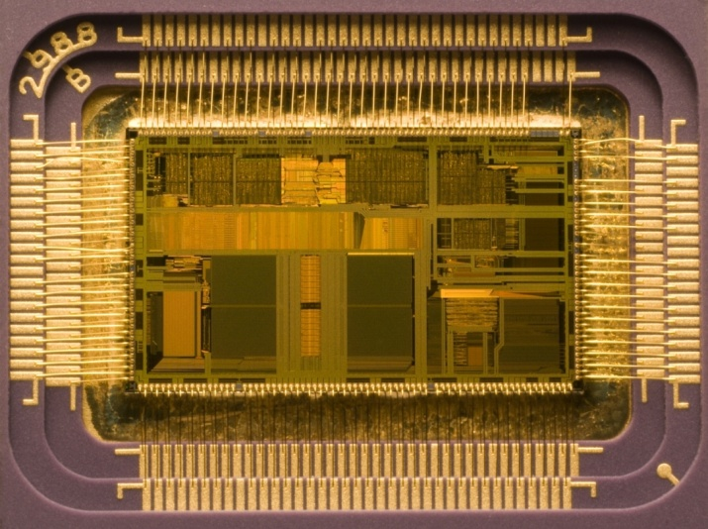
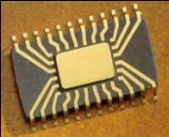
Concept about Microprocessor
A microprocessor incorporates most or all of the functions of a central processing unit (CPU) on a single integrated circuit (IC).
Die of an Intel 80486DX2 microprocessor (actual size: 12×6.75 mm) in its packaging
CPU

Slide 8
Central Processing Unit
A central processing unit (CPU), or sometimes just called Microprocessor (μP), is a description of a class of logic machines that can execute computer programs.
This broad definition can easily be applied to many early computers that existed long before the term "CPU" ever came into widespread usage. However, the term itself and its initialism have been in use in the computer industry at least since the early 1960s.
The form, design and implementation of CPUs have changed dramatically since the earliest examples, but their fundamental operation has remained much the same.

Slide 9
Central Processing Unit/Microprocessor (μP)
To synchronize and control the
overall operation of the μP system
Control Unit & Instruction Decoder
To decode instruction and
pass the necessary control signals to CU
To perform the arithmetic and logical
operations within the CPU
Arithmetic/Logic Unit
A set of internal storage
locations within the CPU
To perform shift and rotate
operations that may either be
arithmetic or logical in nature
Registers
Control and Status Registers
User-Variable Registers

Slide 10
So .. What is Microprocessor?
A microprocessor (abbreviated as µP or uP) is a Silicon Chip that contains an electronic central processing unit (CPU). In the world uP or CPU used interchangeably, which is made from miniaturized transistors and other circuit elements on a single semiconductor integrated circuit (IC).
The integration of the whole CPU onto a single VLSI Chip therefore greatly reduced the cost of processing capacity.
Architectures of Microprocessors:
8-bit designs
16-bit designs
32-bit designs
64-bit designs
Multi-core designs
RISC (Reduced Instruction Set Computer)
CISC (Complex Instruction Set Computer)
Special-purpose designs: Microcontrollers, Digital Signal Processors (DSP) and Graphics Processing Units (GPU).

Slide 11
List of Microprocessors
1971 - Intel 4004, 1st single chip CPU, 4-bit processor, 45 instructions
1972 - Intel 4040, enhanced 4004, 60 instructions
1972 - Intel 8008, 8-bit μP
1972 - Texas Instrument TMS 1000, 1st single μC, 4-bit
1974 - Intel 8080, successor to the 8008, used in Altair 8800
1975 - Motorola 6800, used MOS technology
1976 - Intel 8085, updated 8080, +5V power supply
1976 - Zilog Z80, improved 8080
1976 - TI TMS 9900, 1st 16-bit μP
1978 - Zilog Z8000, Motorola 68000, 16-bit μP
1978 - Intel 8086, 16-bit, IBM’s choice...

Slide 12

Similar but Different !! Microcontroller (μC)
Microcontroller is an IC dedicated to perform one task.
Integrates the memory and other features of a microprocessor.
A microcontroller is the integration of
Microprocessor
Memory
ROM types – commonly flash PROM
RAM – Static ram
MEMORY
I/O
SYSTEM BUS
CPU

Slide 13
List of Microcontrollers
1972 - Texas Instrument TMS 1000, 1st single μC, 4-bit
1976 - Intel 8048, 8-bit μC, 1k ROM, 64b RAM, 27 I/O
1980 - Intel 8051, 4k ROM, 128b RAM, 32 I/O, 2 16-bits timers
1980s
(MCS-51 family)
- Intel 8031, 8052, 8751, …
- Atmel AT89C51, AT 89C1052/2051,…
- Dallas Semiconductor DS5000 series…
Philips, National Semiconductor, …
(Other μCs) Microchip PIC16 series, Motorola 68HC11, Zilog’s Z86

Slide 14
Microprocessor System Vs Microcontroller System
Microprocessor | Microcontroller
Used where intensive processing is required | Used where task is fixed and predefined
Only CPU is in the chip. Memory, I/O port are connected externally | CPU, Memory, I/O port – all are connected on the same single chip
Higher Clock speed and external RAM used is also higher | Lower Clock speed and RAM used is also lower
The program for the microprocessor can be changed for different applications. | The program for the microcontroller is fixed once it is designed
Cost is comparatively higher | Cost is comparatively lower
Power consumption is higher | Power consumption is lower
Overall size of the system is large | Overall size of the system is smaller
Applications include personal computers | Applications include washing machines, camera etc.

Slide 15
Food for thought
We know that your computer uses a microprocessor. But what about your keyboard?

Slide 16
Microprocessor System Vs Microcontroller System
Data Bus
CPU
General
purpose
Micro
processor
CPU
RAM
ROM
Serial
COM
Port
RAM
ROM
I / O
Port
Timer
I / O
Port
Serial
COM
Port
Timer
Address Bus
General-Purpose Microprocessor System
Microcontroller

Slide 17
Assembly Language
Assembly language:
Assembly language is used for most programming because it is difficult to program a microprocessor in its native machine language.
Assembler:
An assembler is a program that converts assembly language into machine language.
Assemblers are similar to compilers in that they produce executable code. However, assemblers are more simplistic.

Slide 18
High level language vs Machine language
int a, b, c; a = 83; b = -2; // high level language c = a + b;
--------------------------------------------------------------------------------------------------------------------------------------------------------------------------
0010 0001 0000 0100
0001 0001 0000 0101
0011 0001 0000 0110 //machine language
0111 0000 0000 0001
0000 0000 0101 0011
1111 1111 1111 1110

Slide 19
Example of 8085 Assembly Language
Address Instruction
202A MVI A, 21H ; Copies 21 into accumulator
202C MVI B, 2AH ; Copies 2A into B register
202E ADD B ; Adds B reg. content with Acc and stores the result in Acc.
202F STA [41 FF] ; Stores the Acc (the sum) into the memory location 41 FF.
2032 HLT ; Stops the program

Slide 20
Memory storage of the Assembly language
Address Instruction/Data
202A MVI A,
202B 21
202C MVI B,
202D 2A
202E ADD B
202F STA
2030 FF
41
2032 HLT

Slide 21
Another Example of 8085 Assembly Language
Address Instruction
2020 MVI B, 24 ; Copies 24 into B register
2022 INR B ; Increment B reg content by 1
2023 MOV A, B ; Copies B register into Acc.
2024 SUB B ; Subtracts B reg content from Acc and stores the result in Acc.
2025 STA [5F FF] ; Stores the Acc content into the memory location 5F FF.
2028 HLT ; Stops the program

Slide 22
Example of 8086 Assembly Language
Add 2 with 3
mov cl, 3 : copy the value 3 in the internal register cl // so currently cl is holding the value 3
add cl, 2 : add the value 2 with the current value of cl // after adding 2, cl is now and store sum in cl holding the value 5
Subtract 2 from 3
mov cl, 3 : copy the value 3 in the internal register cl //so currently cl is holding the value 3
sub cl, 2 : sub the value 2 from the current value of cl //after subtracting 2, cl is now holding the value 1
mov, add, sub --- opcodes or instructions
cl, 3, 2 ---- operands

Slide 23
Food for thought
Using cl register show assembly code for the following expression :
5 + 6 – 10

Slide 24
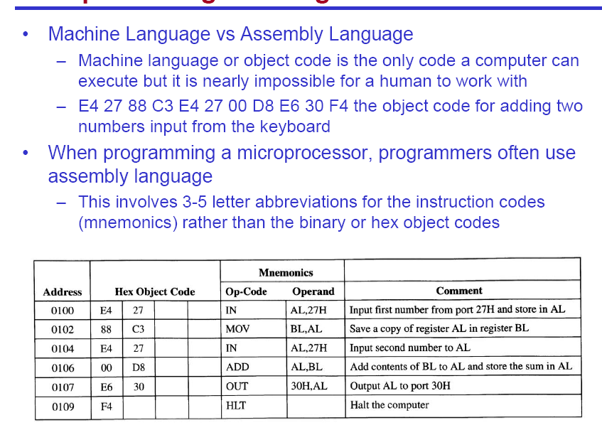
Assembly Language vs. Machine Language

Slide 25
Self Learning
Assembly Language VS Machine Language
Assembler VS Compiler

Slide 26
Thank You!!

