Slide 1
Overview of Microcomputer
Structure and Operation
Course Teacher: Md. Fahmidur Rahman Sakib
Lecturer, Department of Computer Science & Engineering Metropolitan University
Course ID: CSE 237
Course Title: Microprocessor and Interfacing

Slide 2
Lecture References:
Book:
Microprocessors and Interfacing: Programming and Hardware, Author: Douglas V. Hall

Slide 3
Block Diagram of a Simple Microcomputer
Components of Microcomputer:
CPU (Microprocessor)
Memory (RAM, ROM etc)
I/O
System Buses:
Address bus
Data bus
Control bus
Address bus
CPU
ROM
RAM
I/O
interface
I/O
devices
Data bus
Control bus

Slide 4
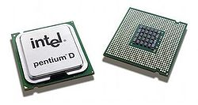
CPU - Central Processing Unit
FETCH : Take in binary-coded instructions from memory
DECODE : Analyze or make sense of the instructions
EXECUTE : Carry out the instructions
Controls overall operation of the computer
Important components: Registers , ALU , Control Unit
Pentium D dual core processors

Slide 5
Memory
This is where all the binary coded instructions and data are stored. Example: ROM, RAM etc.
RAM (Random Access Memory) :
Can be read and written to anytime by the CPU.
It is volatile memory. That means contents of RAM are erased when the power to the computer is turned off.
ROM (Read Only Memory) :
Can only be read by the CPU.
It is pre-loaded with data and software that never changes like computer's initial start-up instructions.
It is non volatile memory. That means contents of ROM are NOT erased when the power to the computer is turned off.

Slide 6
I/O Unit
Input/output (I/O) units serve as a medium of communication between the user and the computer.
Inputs are the signals or data received by the system, and outputs are the signals or data sent from it.
Devices that provide input or output to the computer are called peripherals.
For example:
keyboard, mouse (input)
display, printer (output)
hard disk (both input & output)

Slide 7
System Bus
System bus is made up of three types of bus :
Address Bus
Data Bus
Control Bus
WRITE operation : When data is written onto memory location or an I/O port by the processor
READ operation : When data is read from a selected memory location or an I/O port by the processor

Slide 8
Address Bus
Carries memory address of the instructions which are to be executed
Information transfer takes place from the MP to the memory or I/O elements. That is why address bus is Unidirectional.
On these lines the CPU sends out the address of the memory location or I/O port that is to be written to or read from
The number of locations that the CPU can address is determined by the number of address lines
For example : microprocessor with 32 bit address bus can
address 2³² memory locations

Slide 9
Data Bus
It is a bidirectional bus
Data can flow in both directions, that is, to or from the microprocessor.
The size of the data bus varies from one microprocessor to another.
Usually matches the word length of the microprocessor
Usually a multiple of 8
We talk of 4-bit, 8-bit, 16-bit , 32-bit and 64-bit processors which refers to the normal word length of the microprocessor

Slide 10
Control Bus
It carries timing and control signals generated by the CPU that are used to synchronize operation of the individual microcomputer elements.
It can carry many different signals. For e.g.
I/O Read
I/O Write
Interrupt
Memory read
Memory write

Slide 11
Fetching & Execution Cycles
The Fetch & Execute Cycle of the CPU is composed of three basic operations :
Fetch
Decode
Execute
Fetch :
The instruction required from memory is stored or copied in the instruction register.
Increments the program counter so that it points to the next instruction.

Slide 12
Fetching & Execution Cycles
Execute cycle
The actual actions which occur during the execute cycle of an instruction.
Depend on both the instruction itself and the addressing mode specified to be used to access the data that may be required.

Slide 13
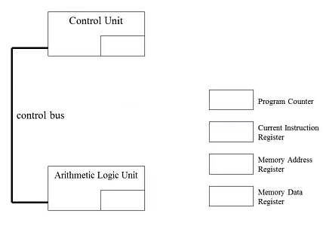
The CPU’s Special Purpose Registers
Program Counter : Holds address of next instruction
Instruction Register : Holds the instruction currently being executed or decoded
Memory Address Register : Holds memory address from where data will be fetched
Memory Data Register : Holds the data being transferred to the memory or from the memory by the CPU

Slide 14
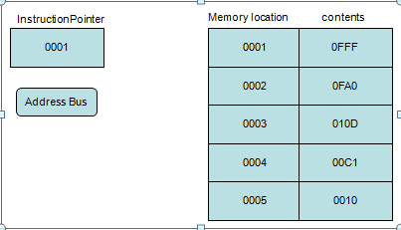
Fetching an Instruction
Step 1
Instruction Pointer (IP) or a program counter is register, that holds the address of the next instruction to be fetched.

Slide 15
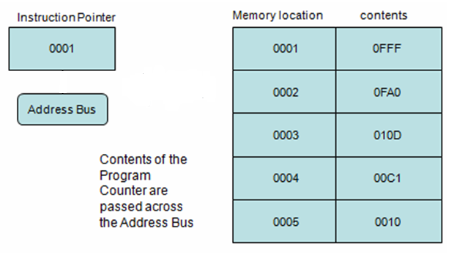
Fetching an Instruction
Step 2

Slide 16
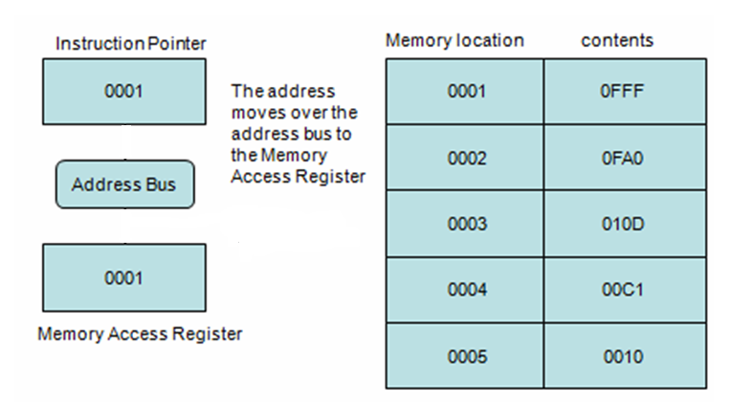
Fetching an Instruction
Step 3
The address moves over the address bus to the Memory Address Register
Memory Address Register

Slide 17
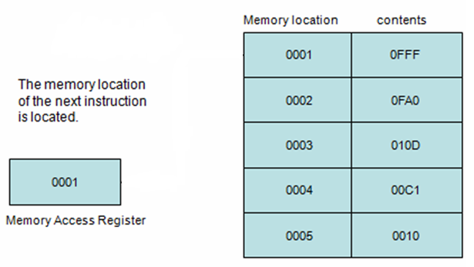
Fetching an Instruction
Step 4
Memory Address Register

Slide 18
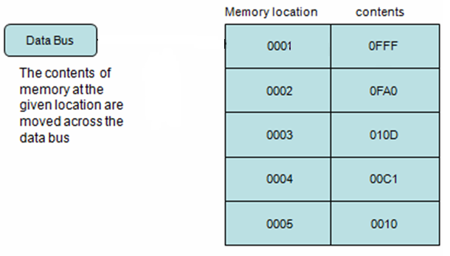
Fetching an Instruction
Step 5

Slide 19
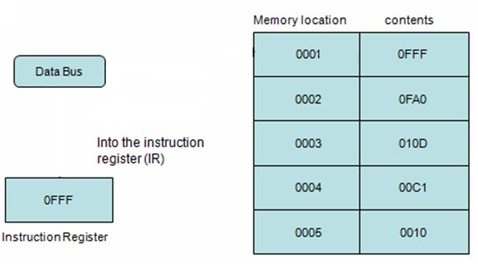
Fetching an Instruction
Step 6
Memory Data Register

Slide 20
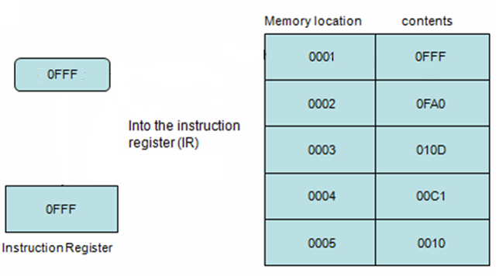
Fetching an Instruction
Step 7
Memory Data Register

Slide 21
Food for thought
What do you understand by a 32 bit Data Bus ?
BIOS is a special program that orchestrates loading the computer's operating system. Should it be stored in ROM or RAM ?

Slide 22
Thank You!!

