Slide 1
Intel 8086 Microprocessor
Memory Partition and Registers
Course Teacher: Md. Fahmidur Rahman Sakib
Lecturer, Department of Computer Science & Engineering Metropolitan University
Course ID: CSE 237
Course Title: Microprocessor and Interfacing

Slide 2
Lecture References:
Book:
Microprocessors and Interfacing: Programming and Hardware, Chapter # 2, Author: Douglas V. Hall
The 8086/8088 Family: Design, Programming, And Interfacing, Chapter # 2, Author: John Uffenbeck.
CSE 237 : Microprocessor & Interfacing
Metropolitan University

Slide 3
Microprocessor
Intel 8086
The microprocessor 8086 can be considered to be the basic processor for the Intel X86 family from 1978.
It has a 20-bit address bus along with 16-bit data bus.
With the knowledge of 8086 16-bit processor, one can study the further versions of this processor 80186, 80286, 80406 and Pentium.
CSE 237 : Microprocessor & Interfacing
Metropolitan University

Slide 4
Memory Partitioning for 8086 Processor
The 8086 processor assign a 20-bit physical address to its memory locations.
2²⁰ → 1 MByte -> 1,048,576 bytes
20 bits → 5 hex digits
First addresses: 00000, 00001,…,0000A,…FFFFF.
But Registers are 16-bits (4 Hex digits) and can address only 2¹⁶ = 64 KBytes. 0000,0001,0002,……FFFF
Suppose 20 bits → 5 hex digits: 38A41H
Here, 0011 1000 1010 0100 0001 = 20 bits = 5 Hex digits
Partition the memory into segments
Total of (16), 64 Kbytes segments might be positioned within the 1 Mbyte address space of an 8086 processor.
3 | 8 | A | 4 | 1
0011 | 1000 | 1010 | 0100 | 0001
CSE 237 : Microprocessor & Interfacing
Metropolitan University

Slide 5
Memory Segment: Address Space
FFFFF
F0000
FFFF0 To FFFFF
is reserved for
ROM (16 bytes)
E0000
D0000
C0000
B0000
A0000
90000
8000:FFFF
80000
One Segment
8000:0000
70000
60000
50000
segment
offset
40000
00000 to 3FFFF
is reserved in
RAM to load
system function
30000
20000
10000
00000
CSE 237 : Microprocessor & Interfacing
Metropolitan University

Slide 6
Memory Segmentation
Segmentation is the process in which the main memory of the computer is logically divided into different segments and each segment has its own base address.
It is basically used to enhance the speed of execution of the computer system, so that the processor is able to fetch and execute the data from the memory easily and fast.
A segment is a logical unit of memory that may be up to 64 kilobytes long. Each segment is made up of contiguous memory locations.
CSE 237 : Microprocessor & Interfacing
Metropolitan University

Slide 7
Memory Segment: Address Space
Memory segment is a block of 2¹⁶ (64) KBytes consecutive memory bytes.
Each segment is identified by a 16-bit number called segment number, starting with 0000 up to FFFFh. Segment registers hold segment number.
Within a segment, a memory location is specified by giving an offset (16-bit) = It is the number of bytes from the beginning of the segment (0→ FFFFh).
The basic difference between Logical and physical address is that Logical address is generated by CPU in perspective of a program whereas the physical address is a location that exists in the memory unit.
CSE 237 : Microprocessor & Interfacing
Metropolitan University

Slide 8
Memory Segment: Address Space
A memory location may be specified by a segment number and offset ( logical address ).
Example :
A4FB : 4872
h
Offset: is the distance from the beginning to a particular location in the segment.
Segment Number: defines the starting of the segment within the memory space.
Segment
Offset
CSE 237 : Microprocessor & Interfacing
Metropolitan University

Slide 9
Segmented Memory Address
Highest Address: A4FB:FFFF = A4FB0 FFFF
B4FAF
A9822 (20 bits)
Offset 4872 (16 bits)
Base address: A4FB (16 bits)
A4FB0 (20 bits)
Lowest Address: A4FB:0000 = A4FB0
4Hex digits = 4 x 4 = 16 digits
so lowest value can be 0000 and highest value can be FFFF
CSE 237 : Microprocessor & Interfacing
Metropolitan University

Slide 10
Segmented Memory Address
Start location of the segment must be 20 bits => the absolute address is obtained by appending a hexadecimal zero (0H = 0000) to the segment number, i.e. , multiplying by 16(10_{h}).
Adds 4 Nibble bits at the lower portion of each 16-bit address.
Starting location Address = Segment number X 10_{h} = A4FB0
So, the Physical Memory Address is equal to:
Physical Address = Segment number X 10_{h} + Offset
Physical Address for A4FB : 4872
A4FB0 h
+ 4872 h
A9822 h (20 Bits)
Here, A4FB0 =1010 0100 1111 1011 0000 (16+4=20bits)
4872 = 0100 1000 0111 0010 (16 bits)
A9822 =1010 1001 1000 0010 0010 (20 bits)
CSE 237 : Microprocessor & Interfacing
Metropolitan University

Slide 11
Memory Segmentation
Types Of Segmentation:
Overlapping Segment – A segment starts at a particular address and its maximum size can go up to 64kilobytes. But if another segment starts along with this 64kilobytes location of the first segment, then the two are said to be Overlapping Segment.
Non-Overlapped Segment – A segment starts at a particular address and its maximum size can go up to 64kilobytes. But if another segment starts before or after this 64kilobytes location of the first segment, then the two segments are said to be Non-Overlapped Segment.
CSE 237 : Microprocessor & Interfacing
Metropolitan University

Slide 12
Physical Location of Segments
Segment Physical Address (hex)
…
10021
10020
End of Segment 2 1001F
1001E
…
10010
End of Segment 1 1000F
1000E
…
10000
End of Segment 0 0FFFF
0FFFE
…
00021
Start of Segment 2 00020
0001F
…
00011
Start of Segment 1 00010
0000F
…
00003
00002
00001
Start of Segment 0 00000
0001F physical address has
Different logical address
For Segment 0,
Base address = 0000 offset = 001F
For Segment 1,
Base address = 0001
Offset = 000F
64Kbyte
CSE 237 : Microprocessor & Interfacing
Metropolitan University

Slide 13
Registers:
Registers:
Information is stored in registers
Registers are classified according to the functions they perform
All Processors have internal registers some are visible and some are not visible to the programmers.
Internal Registers are used as temporary storage for operands, and if the operand is already in memory, it takes less time for execution of the associated instruction.
CSE 237 : Microprocessor & Interfacing
Metropolitan University

Slide 14
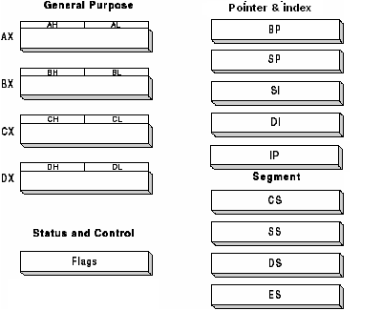
8086 Register Categories
Data registers (4): General data registers hold data for an operation (AX, BX, CX, DX).
Address registers (9): (Segment, Pointer and Index registers) hold the address of an instruction or data.
Status register (1): FLAG register keeps the current states of the processor.
CSE 237 : Microprocessor & Interfacing
Metropolitan University

Slide 15
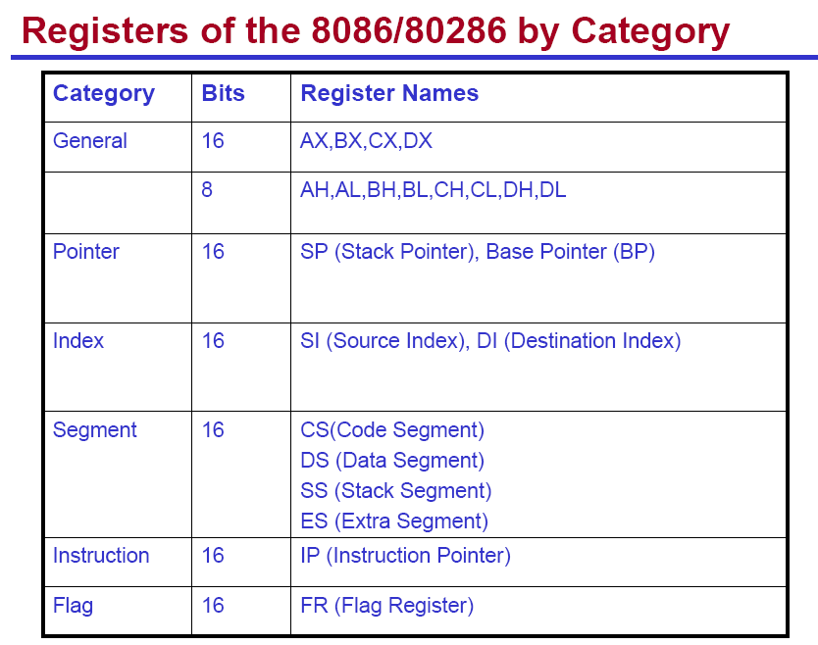
8086 Registers and Memory
Number of Registers: 14, each of that16-bit registers
Memory Size: 1M Bytes
CSE 237 : Microprocessor & Interfacing
Metropolitan University

Slide 16
Memory Segment and Segment Registers
Note that, 8086 does not work with the whole 1MB memory at a given time, it works only with four 64KB segments within the whole memory, namely
Code segment CS: holds segment number of the code segment.
Data Segment DS: holds segment number of the data segment.
Extra Segment ES: holds alternate segment number of the data segment.
Stack Segment SS: holds segment number of the stack segment and used when sub-program executes.
Codes , data , and stack are loaded into different memory segments (registers).
CSE 237 : Microprocessor & Interfacing
Metropolitan University

Slide 17
General Data Registers
These are 16-bit registers and can also be used as two 8 bit registers: low and high bytes can be accessed separately
AX (Accumulator)
Can be partitioned into AH, AL
Most efficient register for arithmetic, logic operations and data transfer: the use of AX generates the shortest machine code.
In multiplication and division operations, one of the numbers involved must be in AL or AX
BX (Base)
The base address register (offset)
CX (Counter)
Counter for looping operations: loop counter, in REP instruction, and in the shift and rotate bits
DX (Data)
Used in multiply and divide, also used in I/O operations
CSE 237 : Microprocessor & Interfacing
Metropolitan University

Slide 18
Pointer and Index Registers
Used for offset of data, often used as pointers. Unlike segment registers, they can be used in arithmetic and other operations.
SP (Stack Pointer):
Used with SS for accessing the stack segment.
Holds Offset address relative to SS
Always points to word (byte at even address)
An empty stack will had SP = FFFEh
BP (Base Pointer):
Used with SS to access data on the stack. However, unlike SP, BP can be used to access data in other segments.
Primarily used to access parameters passed via the stack
Holds Offset address relative to SS
CSE 237 : Microprocessor & Interfacing
Metropolitan University

Slide 19
Pointer and Index Registers
SI (Source Index):
Source of string operations. Used with DS (or ES).
Can be used for pointer addressing of data with effective address (EA)
Used as source in some string processing instructions
Offset address relative to DS
DI (Destination Index):
Destination of string operation. Used with ES (or DS).
Can be used for pointer addressing of data
Used as destination in some string processing instructions
Offset address relative to ES
IP (Instruction pointer):
Points to the next instruction.
Offset address relative to CS
CSE 237 : Microprocessor & Interfacing
Metropolitan University

Slide 20
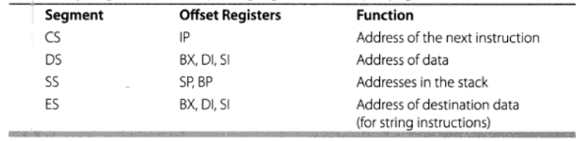
Memory Segmentation
Rules of the Segmentation: Segmentation process follows some rules:
The starting address of a segment should be such that it can be evenly divided by 16.
Minimum size of a segment can be 16 bytes and the maximum can be 64 kB.
CSE 237 : Microprocessor & Interfacing
Metropolitan University

Slide 21
Memory Segmentation
Advantages of the Segmentation The main advantages of segmentation are as follows:
It provides a powerful memory management mechanism.
Data related or stack related operations can be performed in different segments.
Code related operation can be done in separate code segments.
It allows to processes to easily share data.
It allows to extend the address ability of the processor, i.e. segmentation allows the use of 16 bit registers to give an addressing capability of 1 Megabytes. Without segmentation, it would require 20 bit registers.
It is possible to enhance the memory size of code, data or stack segments beyond 64 KB by allotting more than one segment for each area.
CSE 237 : Microprocessor & Interfacing
Metropolitan University

Slide 22
Task
Q1. Suppose, segment no = 1111 H, offset = 1332 H, calculate the physical address?
Q2. Suppose, physical address = 33330, offset = 0020, calculate the segment no?
CSE 237 : Microprocessor & Interfacing
Metropolitan University

Slide 23
Thank You!!
CSE 237 : Microprocessor & Interfacing
Metropolitan University

