Slide 1
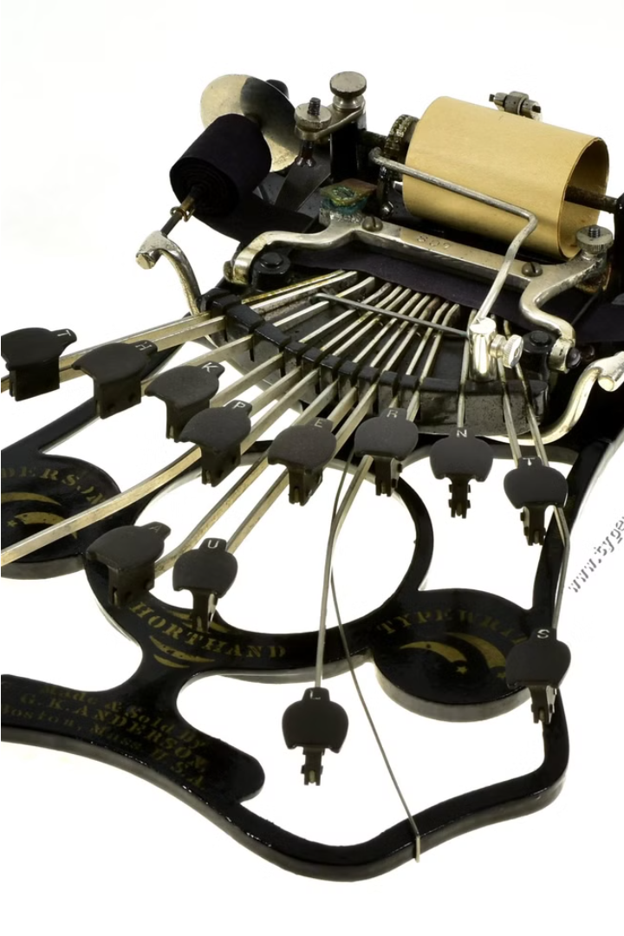


Introduction to Stenography
Stenography is the art of writing shorthand, a rapid and efficient way of transcribing speech or other information. It has evolved from ancient practices to modern digital technologies, enabling accurate and instantaneous recording.
by Sajib Chandra Paul

Slide 2
History of Stenography
Modern Digital Era
Ancient Origins
Today, stenography has embraced digital technologies, with computer-aided transcription and voice recognition software making the process more efficient and accessible.
Stenography can be traced back to ancient civilizations like Greece and Rome, where scribes developed symbol-based systems to record speeches and legal proceedings.
1
2
3
Technological Advancements
The 19th century saw the invention of stenography machines and the widespread adoption of shorthand systems like Pitman and Gregg, revolutionizing the field.

Slide 3
Stenography Techniques
1
Phonetic Shorthand
2
Machine Stenography
3
Computer-Aided Transcription
Stenographers use abbreviated symbols and abbreviations to represent the sounds of words, allowing for rapid transcription.
Specialized stenography machines, called stenotypes, enable stenographers to input shorthand directly into a computer for real-time transcription.
Software translates the stenographic input into full text, providing instant transcripts and facilitating post-editing.

Slide 4
Stenography Equipment and Technology
Stenography Machines
Computer Software
Voice Recognition
Stenography machines, or stenotypes, have a unique keyboard layout that allows stenographers to input shorthand strokes with both hands simultaneously.
Computer-aided transcription (CAT) software translates the stenographic input into full text, providing instant transcripts and facilitating post-editing.
Advanced voice recognition technology can now integrate with stenography, allowing for a hybrid approach to transcription.

Slide 5




Applications of Stenography
Legal Proceedings
Broadcast Media
Medical Transcription
Corporate Settings
Stenographers are essential in courtrooms, depositions, and other legal settings, providing real-time transcripts of proceedings.
Stenographers caption live television broadcasts, ensuring accessibility for viewers who are deaf or hard of hearing.
Stenographers provide real-time transcription services for business meetings, conferences, and other professional events.
Stenographers transcribe medical reports, doctor-patient conversations, and other healthcare-related audio, ensuring accurate documentation.

Slide 6
Advantages of Stenography
Speed and Accuracy
Efficiency
Stenographers can transcribe speech at speeds of up to 300 words per minute with high accuracy.
Stenographic transcription is more efficient than manual typing, reducing the time and resources required.
Real-Time Capabilities
Accessibility
Stenographers can provide instant, verbatim transcripts of live events, enabling timely access to information.
Stenographic transcription enhances accessibility for individuals who are deaf or hard of hearing.

Slide 7




Challenges in Stenography
Skill Acquisition
Technological Adaptation
Specialized Knowledge
Mastering stenography requires extensive training and practice, which can be a significant barrier to entry.
Stenographers must stay up-to-date with constantly evolving technologies, software, and equipment.
Stenographers must have a deep understanding of medical, legal, and other industry-specific terminology.

Slide 8

Conclusion and Future Outlook
Expanding Opportunities
Ongoing Relevance
As the world becomes more connected, stenographers will have opportunities to work remotely and support global clients and events.
Stenography remains a vital skill, as the demand for accurate, real-time transcription continues to grow across various industries.
1
2
3
Technological Integration
Stenography is poised to integrate further with emerging technologies, such as artificial intelligence and voice recognition, enhancing its capabilities.

