Slide 1
Formal Language & Automata
Kim, Han Woo

Slide 2
1. Discovering the Turing Machine - Formalization of Algoritm
2. Theory of Sequential Machine
3. Kleen’s Regular Set ( Relation between Finite Automata & Regular set)
4. Mathematical Model of Formal Language – by Noam Chosky

Slide 3
Chap. 1 Introduction
* Basic concept of lanuage
What is the origin of language?
Tower of Babel?
No fossile remains.(cf Smithonian Musium
* Mathematical background

Slide 4
1.1 What is the language?
* Definition of Language
* Mathematical Modeling of Language

Slide 5
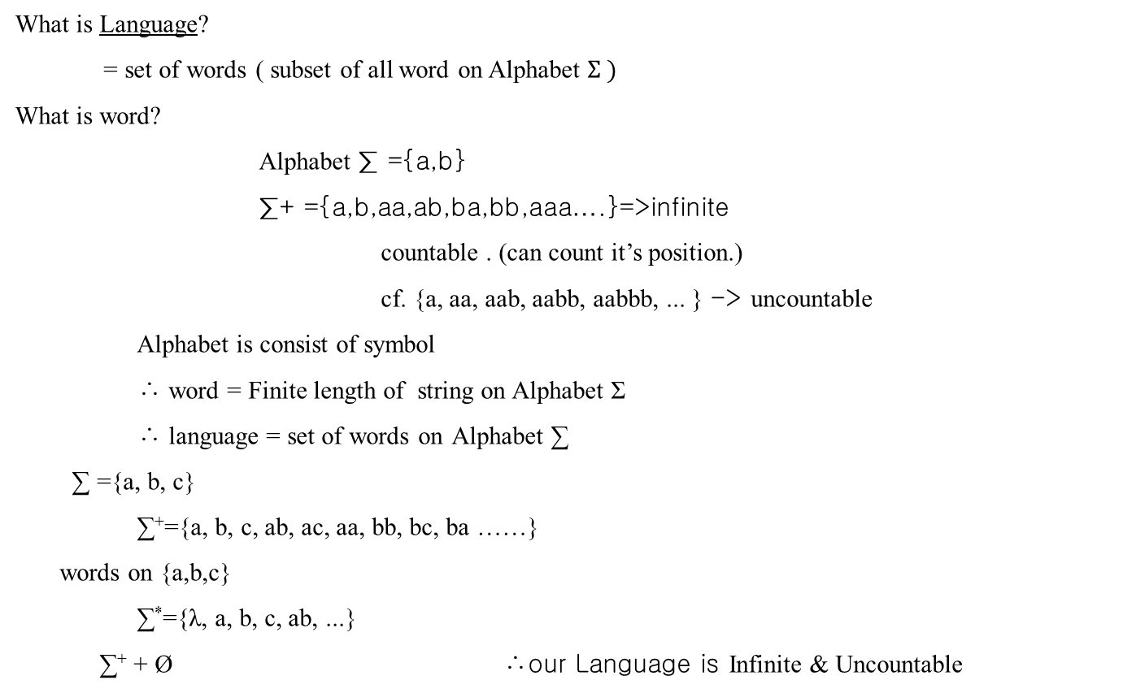

Slide 6
1.2 Description of Language
1. Fully enumerate
2. L = {a^{i} ,b^{i} ; i ≥ 1}
3. Mechanical Procedure whether a word on Alphabet ∑ belong to the language or not (=Algolithm)
reject
∑⁺ = {a, b, aa, ab, ba, bb, aaa, aab, aac, ...}
L = {a, aa, aab, aabb, abbbba, ...}
When Algolithm exists, we will say Algolithm accept word
reject word

Slide 7
Chap.2 Finite Automata & Regular Language
What is Automata?
Concepts
2.1 Finite Automata
Definitin
It’s relation to Regular Language
.

Slide 8
Recursive set(Recursive Language)
the Lanuage that has algorithm accepting it.
Sequential Machine
X(t) z(t)
q(t) q(t+1) Next state Present state Input
g(t+1) = δ( g(t) , x(t) )
q(t) q(t+1) z(t) = δ( g(t) , x(t) )
output Present state Input
delay
J
K Q(t+1)
(=output)

Slide 9
next state g(t+1)
x / y output
-> state transition table
1/1
-> state transition diagram.
1 / 0 0 / 1
Σ = {0, 1}
x/y 1 accept 01001:accept
0 reject 11001:reject
1 / 1
input current state | 0 | 1
A | C / 1 | A / 1
B | C / 0 | A / 0
C | B / 0 | C / 1
A
B
0/0
C
0/0
Input
Output

Slide 10
Definition 2.1> A Deterministic(↔Non-Deterministic) Finite Acceptor (Automata)
= A Deterministic Finite Automata
M = (Q, ∑, , q0, F)
Q : Set of States
∑ : input
: state transition Function(cf: meaning of function)
q0 : initial state
F : final state
What is SM? (Sequential Machine)
SM = (Q, ∑, , ∆, w)
1/1
A
1/0
0/1
0/0
1/1
B
C
0/0

Slide 11
Q : {A, B, C}
∑ : {0, 1}
:
∆ : output {0, 1}
w : output function
 | 0 | 1
A | C | A
B | C | A
C | B | C
 | 0 | 1
A | 1 | 1
B | 0 | 0
C | 0 | 1

Slide 12
0
Z = 1 (△ = 1)
A
Stick to output
1
1
0
Z = 0 (△ = 0)
B
C
1
Z = 1 (△ = 1)
0
F: (a set of final state )
If we arrive in A,B by input, only output 1 is obtained, denoted as
If we arrive in C by input, only output 0 is obtained
Q : { A , B ,C }
q 0 : { A}
∑ : { 0 , 1 }
F : { A , B }
δ :Q Χ ∑ Q’
∴ This is a Automata.
Current
state
input
Final
state

Slide 13
□ automata that accept 11010
1
1
0
1
0
A
B
C
D
E
F
1
0
0
0
1
G
Fig 2.1
0
0
0
1
q₀
q₁
q₂
1
1
M = ( { q₀, q₁, q₂ } , { 0, 1 } , δ , { q₀ } , { q₁ } )
Q
∑
δ
q0
F
δ ( q₀ , 0) = q₀
δ ( q₀ , 1) = q₁
δ ( q₂ , 1) = { q₁, q₂ }
δ ( q₁ , 0) = q₀
δ ( q₁ , 1) = q₂
Non – Deterministic Finite Automata
δ ( q₂ , 0) = q₂
δ ( q₂ , 1) = q₁

Slide 14
(10)* => 10 pattern appears several times ex) λ, 10, 1010, 101010,…
0*(10)* => ex) 010, 0, 10, 0010, 001010 ,…
(10)*1(11)* => ex) 1, 101, 111, 10111, 1010111, 10101111,…
δ(q₀, ab) = δ(δ(q₀, a),b) = δ(q_{k,} b) = q_{i} => δ*(q₀, ab) = q_{j} ex) δ*(q₀, 1011) = q₂
DFA(Deterministic Finite Automata) & Language
L(M) = { ω ∈ ∑⁺ | δ*(q₀, ω) = F }
(Final state)
L = { a^{n}b : n ≥ 0} => b, ab, aab, aaab, …
L(M₁) = { a^{n}b : n ≥ 0}
For input a,b ,state goes to q2 and rejected
a
a
b
a, b
After reaching q₂. Automata remains state q₂ unchanged for any input
= Trap state.
q₀
q₁
q₂
M₁

Slide 15
L(M2) = { abω : ω ∈ ∑* }
( ab should appear in front of.= prefix)
a, b
a
b
q₀
q₀
q₁
M₂
b
a
q₀
Trap state
a, b

