Slide 1
Th. 2.2 Let L be a language accepted by NFA, Then there exist a DFA that accept same L
Proof. DFA : A’ NFA : A
a∈∑, |a| = 1 NFA : δ({q₁, q₂, …, q_{l}}, a) = {p₁, p₂, …, p_{k}} DFA : δ({q₁, q₂, …, q_{l}}, a) = {p₁, p₂, …, p_{k}}

Slide 2
ii) X ∊ Σ * | X | = arbitrary
NFA : δ ( q₀, X) = { q₁, q₂, …, q_{i}} 이면
DFA : δ′ ( q₀, X) = [ q₁, q₂, …, q_{i}] 이 됨을 보이면 된다.
| X | = 0 일 때,
NFA : δ ( q₀, λ ) = { q₀ }
DFA : δ′ ( q₀, ) = [ q₀ ] 이 됨을 보이면 된다.
아무 입력도 안 들어간 상태
2) | X | = 1 일 때,
NFA : δ ( { q₀, q₁, …, q_{i} }, a ) = { P₁, P₂, …, P_{k} }
DFA : δ′ ( [ q₀, q₁, …, q_{i} ] , a ) = [ P₁, P₂, …, P_{k} ]
3 ) | X | = n 일 때, 성립한다고 가정하면
4 ) | X | = n + 1 일 때도 성립함을 보이면 증명 완료.
NFA : δ ( q₀, Xa ) = δ ( δ ( q₀, X ), a ) = δ ( { q₁, q₂, …, q_{i} }, a ) = { P₁, P₂, …, P_{k} }
DFA : δ′ ( q₀, Xa ) = δ′ ( δ′ ( q₀, X ), a ) = δ ( [ q₁, q₂, …, q_{i} ], a ) = [ P₁, P₂, …, P_{k} ]

Slide 3
Def. 3. 2
1. Φ
2. λ
3. a ∊ Σ , a is regular expression
if r₁, r₂ is regular expression then
4. L( r₁ + r₂ ) = L( r₁ ) ∪ L( r₂ )
5. L( r₁ · r₂ ) = L( r₁ ) · L( r₂ )
6. L( ( r₁ ) ) = L( r₁ )
7. L( r₁* ) = ( L ( r₁ ) )*
Context free language
∞
C F L
r . e
∞
CFL의 class가
r.e class보다 크다.
Context
Sensitive
language
C S L
P S L

Slide 4
Ex)3. 2
L( a* · ( a + b) ) = L( a*) · L( a + b )
= ( L( a ) )* · ( L( a ) ∪ L( b ) )
= { λ , a , aa , aaa , …} { a , b )
= { a , aa , aaa , aaaa , …b, ab, aab, aaab…}

Slide 5
Theorem 3.1
If L is regular expression ,
there exist NFA that accept L.
L ( 0 )
L ( 1 )
0
1
L ( 01 ) = L( 0 ) · L( 1 )
·
0
λ
1
A ( 0 )
A ( 1 )
· (conternation) λ can be used.
L ( 01 )
L ( 10 )
0
1
1
0

Slide 6
L(10 + 01)
L ( 10 )
병렬로 붙였다는 표시를
하기 위해 쓴 것으로
붙이지 않아도 상관없다.
(책에는 모듈의 init state와
Final state의 성질을 제시하고
새로운 init state와 Final state를
연결하도록 되어있다.)
λ
1
0
λ
L ( 01 )
λ
0
1
λ
L(0 + 1)
λ
0
+ (Union)은 λ를 사용해 병렬로 붙이면 된다.
λ
1

Slide 7
A(01)*
λ,10,1010,101010,···
λ
q₀
λ
1
0
* is made by loop with λ
A(01+10)*
λ
λ
λ
λ
λ
λ
q₀
0
1
λ
λ
A(01)
q₀
q_{F}
λ
1
0
λ
A(10)

Slide 8
L(01(01+10)*(11)*)
NFA
q₀
0
1
λ
λ
λ
λ
λ
λ
0
1
λ
λ
1
1
λ
1
0
λ
같다
0
1
1
1
0
1
λ
<-프로그래밍할때 적합한 방법
q₀
q1
q2
NFA
1
0

Slide 9
Chap 4. Formal Grammar
Definition of Grammar
Example of Grammar

Slide 10
4. 1 Grammar
Linguistic’s view
How to make a Grammar

Slide 11
Context free Grammar
Context sensitive Grammar
Phrase structure Grammar

Slide 12
4.2 Context Free Language
Formal Grammar?
- System that build the language < language : Formal Grammar + Syntactic sugar >
G = ( V , T , S , P )
V : Variable ( Non Terminal Symbol ) – capital letter
T : Terminal ( Terminal Symbol ) –small letter
P : Product Rules ( Rewriting Rules )
S : Start Symbol
Ex 1.11) G = ( { S } , { a , b } , S , P )
P : S → a S b
S → λ
Generation
S ⇒ a S b ⇒ aa S bb ⇒ aaa S bbb ⇒ a^{n} S b^{n} ⇒ a^{n}b^{n}
Parsing

Slide 13
The little boy runs fast
variable variable variable
P : < Sentence > → < Noun Phrase > < Verb Phrase >
< NP > < VP >
< NP > → < Adjective > < Noun Phrase >
< NP > → < Adjective > < Noun >
< Adj > < N >
< VP > → < Verb > < Adverb >
< V > < Adv >

Slide 14
<Sentence>
<NP>
<VP>
<Adj>
<NP>
<V>
<Adv>
<Adj>
<N>
Generation
Parsing
The
little
boy
runs
fast
terminal
※ Parser : parsing하는 녀석

Slide 15
<Sentence>
<NP>
<VP>
<Adj>
<NP>
<V>
<Adv>
<Adj>
<NP>
<Adj>
<N>
The
little
the
boy
runs
fast
→ 문법은 맞지만
뜻은 통하지 않는다.
Push-down Automata : Grammar에 적합한지를 check해주는 Automata.

Slide 16
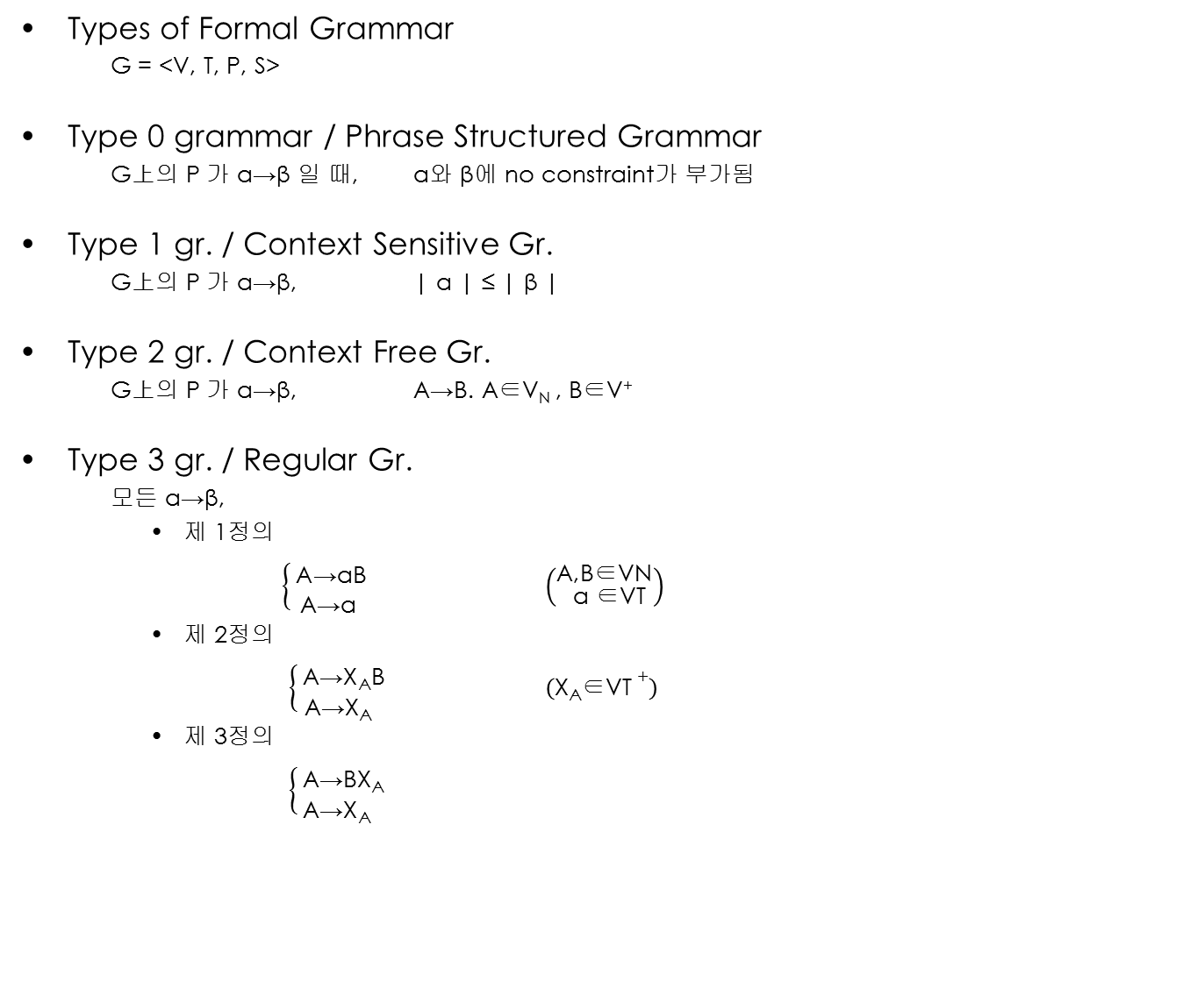
A→β. A∈V, β∈(V∪T)⁺
A,B∈V
a∈T
X_{A}∈T⁺

Slide 17
Recursive set 이 아닌 영역
RL
CFL
CSL
PSL
Recursive set

Slide 18
5 장. Properties of Context Free Language
The more constraints impose on the grammar, the less power of expression goes.
Negotiations between RG and PSG
Contemporary PL(Java, C#...) uses CFG

Slide 19
Def 5.1
G = < V, T, S, P > is Context free.
P is of the form A -＞β
A ∈ V
β ∈ ( V ∪ T )*
L(G) : Context free language.
Ex 5.1 )
S -＞ aSa
S -＞ bSb G = ( {S}, {a, b}, S, P )
S -＞ λ
S =＞ aSa =＞ abSba =＞ abbSbba =＞ abbbba
L(G) = { w | ww^{R} : w ∈ Σ* }
G =＞ applying once one of the productions in G, left hand side turns into right hand side.
g* =＞ applying production many times in G, Left hand side turns into right hand side.

Slide 20
Ex 5.3 )
L = { a^{n}b^{m} : n ≠ m }
n > m n < m
S -＞AS₁ S -＞S₁B
S₁ -＞ aS₁b | λ S1 -＞ aS₁b | λ
A -＞ aA | a B -＞ bB | b
=>
S -＞AS₁ | S₁B
S₁ -＞ aS₁b | λ
A -＞ aA | a
B -＞ bB | b

Slide 21
5. Finite Automata and Regular Language
Theorem ;
If L is a regular language on Σ, then there exists right(left) linear grammar G such that L=L(G)

Slide 22
5.1 Regular Grammar.
L(G): Regular Language. (G: regular grammar)
Def> 3.3
G is regular G
All productions of the from
A -> xB
A -> x right-linear
or
A -> Bx
A -> x left-linear
A,B ∈ V
x ∈ T＊
Ex 3.12)
S -> abS | a
S => abS => ababS => abababS(<-a)
=> (ab)＊a
S -> S₁ab
S₁ -> S₁ab|S₂
S₂ -> a
S=> S₁ab => S₁abab => S₁ababab => S₂(<-a)ababab
=> aab(ab)＊

Slide 23
Ex 3.13)
S -> A
A -> aB | λ right-linear and left-linear rules are mixed
B -> Ab It’s not a regular grammar but context grammar.
(regular G context free G)
S=> A => aB => aAb

Slide 24
Th 3.3 S → 0A S → 1A right linear regular G
A → 01B B → 11B
B → 0
S ⇒ 0A S ⇒ 1A
S ⇒ ( 0 + 1 ) A ⇒ ( 0 + 1 ) 01B
⇒ ( 0 + 1 ) 010 ⇒ ( 0 + 1 ) 01 ( 11 ) B
⇒ ( 0 + 1 ) 01 ( 11 )* B
⇒ ( 0 + 1 ) 01 ( 11 )* 0
S → B0 B → B11 left linear regular G
B → A01 A → 0 A → 1
S ⇒ B0 ⇒ B ( 11 )* 0 ⇒ A01 ( 11 )* 0 ⇒ ( 0 + 1 ) 01 ( 11 )* 0
Unix yacc → push-down automata를 programming 하는 것.
Grammar를 만들어서 yacc에 집어넣으면 push-down automata를
자동으로 생성해 준다. (상업적으로 이용하면 안되지만.)

Slide 25
Sentential Form vs Sentence
L(G)={ω|ω∈T* ,S ^{=>} ω }
S abaabb
sentence
S => ω₁= > ω₂=>……..=> ω_{n}=> ω
Sentential form:contains variables and terminals
G=(V,T,S,P)
V={S,B,C}
T={a,b,c}
P= S →aSBC
S → aBC
CB→BC context sensitive. (not context free)
aB→ab
bB→bb →TV → TT
bC→bc
cC→cc

Slide 26
S=> aSBC
=> aaSBCBC
(a…a)^{n-1} S(BC)^{n-1}
^{n n}
=>a…aBCBC...BC
=>a…aBBCCBCBC…BC
=>a…aBBCBCCBC…BC
=>a…aBBBCCCBC…BC
=>a…aB…BC…C ← Time Complexity of e^{w}
=>a…abB…BC…C
=>a…ab…bcC…C
=>a…ab…bcc…C
=>a…ab…bc…c
=>a^{n}b^{n}c^{n}
Context free grammar could not generate it !!!

Slide 27
p. For context free G ,When parsing w, (w ∈ L(G)) , Time complexity is |w|³ . Java has the same time complexity .
Context sensitive L that has greater class than context free L has Time complexity of e ^{w}
w₁ , w₂ ∈ (V ∪ T)*
w₁ ⇒ w₂ : one step derivation
G w₂ is derivated from w₁
Leftmost & Rightmost derivation
S → AB
A → aaA
A → λ
B → Bb
B → λ
S ⇒AB ⇒aaAB ⇒aaB ⇒aaBb ⇒aab : leftmost derivation
S ⇒AB ⇒ABb ⇒Ab ⇒aaAb ⇒aab : rightmost derivation

Slide 28
5.2 Derivation tree
p.139 Def 5.3) G is context free grammar, ordered derivation tree has following properties
The root : S
Leaf : T ∪ {λ}
Interior vertex : V
A ∈ V A has children a₁a₂a₃…a_{n}
A
G속에 A → a₁a₂a₃…a_{n}를 가지고 있어야 한다
a_{n}
a₁
a₂
….
5. Leaf : λ이면 그 아래에 아무것도 만들지 말라

Slide 29
ex 5.6)
S → aAB
A → bBb
B → A|λ
S
S
a
A
B
a
A
B
b
B
b
A
→ derivation tree
abbbb
→ partial derivation tree
λ
b
B
b
b
B
b
λ

Slide 30
yacc : derivation tree를 만들어 줌
G = < V, T, S, P>
V = {S, A , B}
T = {a, b}
P ⇒ S → aSA S → a
A → SbB A →bb
B → BA B → b
Left-most derivation
S ⇒ aSA ⇒ aaA ⇒ aaSbB ⇒ aaabB ⇒ aaabBA ⇒ aaabbA ⇒ aaabbbb

Slide 31
Right-most derivation
S ⇒ aSA ⇒ aSSbB ⇒ aSSbBA ⇒ aSSbBbb ⇒ aSSbbbb ⇒ aSabbbb ⇒ aaabbbb
S
a
S
A
a
S
b
B
a
B
A
b
b
b
*
Theorem 5.1> 임의의 cfg (Context free grammar)에 대해 가 성립하면
G에서는 반드시 left-most derivation이 존재한다.
S ⇒ X ( X ∈ T )
G

Slide 32
Left another version
S=>aSA=>aaSAA=>aaaAA=>aaabbA=>aaabbbb
G is ambiguous !
Def. 5.5> G is said to be ambiguous
W∈LCG ) 적어도 두 개의 derivation tree가 생기면.
아무리 고쳐도 ambiguous한 G를 inherently ambiguous 하다라고 한다.
S
a
S
A
a
S
A
b
b
a
b
b

Slide 33













Slide 34








E
E
E
+
E
E
*
E
I
E
*
E
E
+
E
I
a
I
I
I
I
c
b
c
a
b

Slide 35







E
E
+
T
T
T
*
F
F
F
I
I
I
c
a
b

Slide 36
Chap 6. Simplification of CFG (Context Free Grammar)
Theorem 6.1) G = <V, T, S, P>
P : A → x₁Bx₂
B → y₁ | y₂ | ‧ ‧ ‧ | y_{n} y_{i}∈ T
Ḡ = <V, T, S, P>
P : A→ x₁ y₁x₂ | x₁ y₂x₂ | ‧ ‧ ‧ | x₁ y_{n}x₂
B is replaced directly.
L(G) = L(Ḡ)
Ex 6.1 ) A → a | aaA | abBc A → a | aaA | ababbAc | abbc
B → abbA | b B → abbA | b
A => aaA => aaabBc => aaabbc A => aaA => aaabbc
^{G} ^{Ḡ}
steps are decresed!

Slide 37
6.1 Removing Useless Production
G is context free grammar.
* *
G G
① ②
A is useful. Otherwise A is useless.
Ex6.1) P of G :
↘terminals can not be obtained!
∴ A is useless symbol. Refering to ②.
Ex6.2)
↓
from S, B can not be reached! ∴
∴ B is useless. Refering to①.

Slide 38
Ex6.3)
①pick up what makes the terminal.
↘
becomes terminal.

Slide 39
② From start symbol, check the useless variable Dependency Graph 사용 C xDy
C
D
S
A
B
C
Terminal 생성 불가능이므로
생각하지 않아도 됨
Unless!
결국 ,
S -> aS | A
A -> a
만 남는다.

Slide 40
Def. 6. 2 Removing λ Production
A λ : λ production
A λ A is nullable.
Ex 6. 4 ) S aS₁b
S aS₁b | λ
S aS₁b | ab S₁ 대신에 λ를 미리 집어 넣음
S₁ aS₁b | ab
Remove λ. Good performance를 위해서 이렇게 함
*

Slide 41
ex 6.5 ) S → ABaC
A → BC
B → b | λ
C → D | λ
D → d
Theorem 6.3 ) L(G) : G contains λ production.
L(G’) : G’ contains no λ production.
S → ABaC | BaC | AaC | Aba | aC | Aa | Ba | a
A → B | C | BC
B → b
C → D
D → d
λ를 사용해야 설계가 편하다.
λ가 없을 때 performance가 더 좋기 때문에 이런 과정을 거친다.
Removing unit production.

Slide 42
Theorem. 임의의 cfg에 대해 S W 이면 (W∈T )
반드시 leftmost derivation이 있다
Proof A W : K step
One step derivation에서는 trivial
K-step 에서 성립한다고 가정
K+1 step
A α W
α = B₁ B₂ …B_{n} (B_{i} ∈ V)
W= U₁U₂ … U_{n} (U_{i} ∈ T*)
B_{i} U_{i}
*
*
=
=
=
>
G
*
=
=
=
>
G
*
*
=
=
=
>
=
=
=
>
G
G
*
=
=
=
>
G

Slide 43
A로부터 1-step l,m,d derivation
A→U₁ B₂ B₃ B₄ … B_{M}
A로부터 2nd step derivation
A→U₁ U₂ B₃ B₄ … B_{M}
3rd step derivation
A→U₁ U₂ U₃ B₄ … B_{M}
A→U₁ U₂ U₃ U₄ … U_{M}

Slide 44
Remove Unit Production
A → B (비효율적 설계)
Ex 6.6) S → Aa|B
B → A|bb
A → a|bc|B
S → Aa
B → bb Unit Production을 제외하고 모두 골라냄.
A → a|bc
＋
S → bb|a|bc
A → bb Unit Production을 고쳐줌.
B → a|bc
∥
S → Aa|bb|a|bc
A → a|bc|bb Unit Production 제거 완료!
B → a|bc|bb

Slide 45
6.2 Reduced Grammar
1. G는 word를 도출하지 않는 V를 갖지 않는다.
2. G는 start symbol에서 도출되는 어떤 중간어에도 포함되지 않는 V를 갖지 않는다.
3. G는 A → B 를 갖지 않는다.
4. G는 A → λ 를 갖지 않는다.

