Slide 1
Def 12.3
· regular language
language L is called regular L=L(M)
if there exist some M accept above L
ex)2.6
L={aωa : ω ∈ {a,b}*}
b a
q₀ a q₁ a q₂
b
b
q₃
Trap state a, b

Slide 2
Performance of dfa
∑ = {1} ∑* = {ƛ ,1,11,111,1111,…}
Autonomous.
q₃ System behavior
1 1 1 for the only 1 input
q₀ q₁ q₂ encountered
M1 1
1
q₄
Lq₁ = {1} : a set of words that have final state as q
Lq₂ = {11,11111,11111111,…}
Lq₄ = {1111,1111111,1111111111,…}
L(M1) = Lq₁ ⋃ Lq₂ ⋃ Lq₄
L that Autonomous dfa accept is such that L should be
Ultimately Periodic Set.
Transient state below n and Periodic part with n Ex) L = {7, 10, 13, 16, 19, 22, …} cf){1, 4, 9, 16, 25, 36, …}

Slide 3
Input
0
L_{B} = (0 : odd, 1 : even )
= {0, 000, 00000, ……
011, 01111, 0111111, …….}
L_{A} = 0 : even, 1 : even
L_{C} = 0 : even, 1 : odd
L_{D} = 0 : odd, 1 : odd
L(M₂) = L_{C} U L_{B}
A family of, a ancesstor of , a sister of, even no, odd no
M₂
A
B
0
1
1
1
1
0
C
D
0
xRy : δ (q₀₁, x) = δ (q₀₁,y) ex) ₀₁₁R₀₀₀ relation
xRx : Relation R is reflexive
xRy yRx : Relation R is Symmetric.
cf) xRy x is a father of y
xRy y is a father of x (wrong) not Symmetric.
xRy, xRy xRy : Relation R은 transitive하다.
relation R that satisfies these 3 properties is equivalent class.
M₂ has A, B, C, D 4 equivalent class
m
f
2001
2000
2 equivalent class
4 equivalent class

Slide 4
Neccesary and sufficient condition that L is accept by dfa
L must have equivalent classes with finite index and right invariant.
Right invariant
x, y ∈ ∑*, When Relation R defined to be δ (q₀, x) = δ (q₀, y) ,
z ∈ ∑*, for z, if xRy then xzRyz.
In case of hakbun , xzRyz is not defined.
0·1R0·1 xzRyz *union of equivalent class and right invariant should be satisfied
operator concatenation

Slide 5
ex) Design the automata that accepts a Number of 1’s to be 4n+1, 4n+3
q₀ <= L₀ = { x is 4n }
q₁ <= L₁ = { x is 4n+1 }
q₂ <= L₂ = { x is 4n +2}
q₃ <= L₃ = { x | x ∈ ∑* and x = 4n +3 }
L = L₁∪ L₃
Word x ... ( 4n+i ) x ∈ q_{i}
x₀ … ( 4n+i ) x₀ ∈ q_{i}
x₁ … ( 4n+i+1 ) x₁ ∈ q_{i+1}
number of 1’s
δ(q_{i}, 0) = q_{i}
δ(q_{i}, 1) = q_{i+1}
δ(q₃, 0) = q₃
δ(q₃, 1) = q₁
0
0
0
0
q₀
1
q₁
1
q₂
1
q₃
1

Slide 6
2.2 Non Deterministic Finite Automata
M = (Q, Σ, δ, q₀, F)
DFA δ : Q × Σ → Q’
NFA δ : Q × (Σ ∪ {λ}) → 2^{Q}
ex) Q × a → { q₁, q₂ , q₃ }
One of the element of Power set . When q₁, q₂, q₃ are in Q
Φ, {q₁}, {q₂}, {q₃}, {q₁, q₂}, {q₁, q₃}, {q₂, q₃}, {q₁, q₂, q₃}
Correspond to it.
a
a
One of them accepted,
Consider it as accepted.
q₁
q₂
q₃
a
q₀
a
a
q₄
q₅
a
δ(q₀, a) = {q₁, q₄}
δ({q_{1,} q₄}, a) = δ(q₁, a) ∪ δ(q₄, a) = { q₂ } ∪ { q₅ } = { q₂, q₅ }
NFA is more convenient than DFA. (especially in desige phase )

Slide 7
0, 1
q₀
1
q₁
1
q₂
In case two or more 1’s read, Accepted
NFA
M₁
δ(q₀, 0) = {q₀}
δ(q₀, 1) = {q₀ , q_{1,}} δ({q₀ , q_{1,}})
δ(q₀, 0) = {q₀} = δ(q₀, 1) ∪ δ(q₀, 1)
δ(q₁, 0) = φ = δ(q₀, q₁) ∪ {q₂} = {q₀ , q₁ , q_{2,}}
M1 is equivalent to M2. = As far as input is concerned, M1 and M2 has same result(accept or reject).
0
1
1
q₀
q₁
1
q₂
Ending with 2 or more 1’s → Accept
0
DFA
0

Slide 8
0
q₀
q₁
0,1
q₂
λ, 01, 0101, ‥ ‥ accept
1
λ
δ(q0, λ) = {q0 , q2} λ means no input
δ(q1, 0) = {q0 , q2}
λ
a
λ
q₀
q₁
q₂
| λ| = 0
| a | = 1
| λa | = 1
| λλa | = 1
δ*(q₁, a) = {q₀, q₁, q₂}
δ (q₁, λλa) = q₁
δ (q₁, λλaλ) = q₂
δ (q₁, λλaλλ) = q₀
δ*(q₂, λ) = {q₀, q₂}
no length, going to state itself.

Slide 9
↙NFA
핵심 종료조건
Def 2.6 > L(M) = {ω | δ* (q₀, ω) ∩ F ≠ ø}
L(M’) = {ω | δ* (q₀, ω) = F}
If NFA exist that accept L, then there exist DFA equivalen to NFA.
For the set Q, there exist 2^{|Q|} subsets,
If we make states labeled by subset name, DFA can be constructed equivalent to NFA .
ex) p.65
NFA:
DFA:
0
1
q₀
q₁
q₂
0,1
0,1
{q₀}
0
1
{q₀, q₁}
{q₁}
0
1
0,1
{q₀, q₁, q₂}
{q₂, q₁}
0,1
{q₂}
0
ø
1
0
1
0,1

Slide 10
Chap. 3 Regular Expression
How to express the language
2. I will show that the language accepted by automata is
regular language
.

Slide 11
┌computer language
regular language – context free language┐
└context sensitive language-phrase structure language
Natural language┘ → bigger class.
Σ = {0,1}
L = {1} 1 bold face
└ language with only one word 1
L = {010} 010
L = {010, 011} 010 + 011
01(0 + 1)
L = {110, 0110, 11, 011} 110 + 0110 + 11 + 011
= 1(10 + 1) + 01(10 + 1)
commutative law fails for concaternation!

Slide 12
L={00, 01} L={01, 11}
00 + 01 + 01 + 11
= 00 + 01 + 11
λL = L = Lλ
∑ = {0, 1}
{0, 1}* = {λ, 0, 1, 00, 01, 10, … }
= λ + 0 + 1 + 00 + 01 + 10 + …
= (0+1)*
{00, 11}* = (00 + 11)* = λ + 00 + 11 + 0000 + 1100 + 0011 + …
0* = λ + 0 + 00 + 000 + …

Slide 13
{1, 10, 100, 1000, 10000, … }
= 10* set closure operator
11(0+1)* any symbols will do after 11
(0+1)*11 any symbols will do before 11
1(0+1)*1 any symbols will do if first and last symfol should be 1
. + *
What is regular language ?
from 0, 1, λ, Making concaternation, union, set closure operation
finite times, we can get regular language.
NK (Graphics + Desgin) = NK and (Graphics or Design)
(01 + 10)*(10 + 1) <- regular language
((01 + 10)*(10 + 1)*)* <- regular language

Slide 14
Def 3.1 >
1. φ, λ and a ∈ ∑ are all regular expression ← primitive R.E
2. If r₁ , r₂ is regular language, then so are r₁ + r₂ , r_{1•}＊r₂ , r¡ * , (r1)
3. A string is R.E iff it can be derived from primitive R.E by a finite # of applications of the rule in 2.
δ(q₀ , λ) = {q₀ , q₁ , q₂} λ : null string
δ({q₀ , q₁ , q₂} , 0) = {q₀ , q₁ , q₂}
δ({q₀ , q₁ , q₂} , 1) = {q₁ , q₂}
δ({q₀ , q₁ , q₂} , 2) = {q₂}
o
1
2
q₀
q₁
q₂
λ
λ

Slide 15
δ({q₁ , q₂} , 0) = φ
δ({q₁ , q₂} , 1) = {q₁ , q₂}
δ({q₁ , q₂} , 2) = {q₂}
δ({q₂} , 0) = φ
δ({q₂} , 1) = φ Non Deterministic
δ({q₂} , 2) = {q₂}
δ(q0 , λ) makes it accepted,
Deterministic
[q₀ , q₁ , q₂] label
δ`([q₀ , q₁ , q₂] , 0) = [q₀ , q₁ , q₂]
δ`([q₀ , q₁ , q₂] , 1) = [q₁ , q₂]
δ`([q₀ , q₁ , q₂] , 2) = [q₂]
↑
↓

Slide 16
0
1
δ’([q₁,q₂],0) = [Ø]
δ’([q₁,q₂],1) = [q₁,q₂]
δ’([q₁,q₂],2) = [q₂]
δ’([q₂],0) = [Ø]
δ’([q₂],1) = [Ø]
δ’([q₂],2) = [q₂]
q₀’
1
q₁’
[q₀.q₁,q₂]
[q₁,q₂]
2
2
0
q₂’
0,1
q₃’
[q₂]
Ø
2
0,1,2

Slide 17
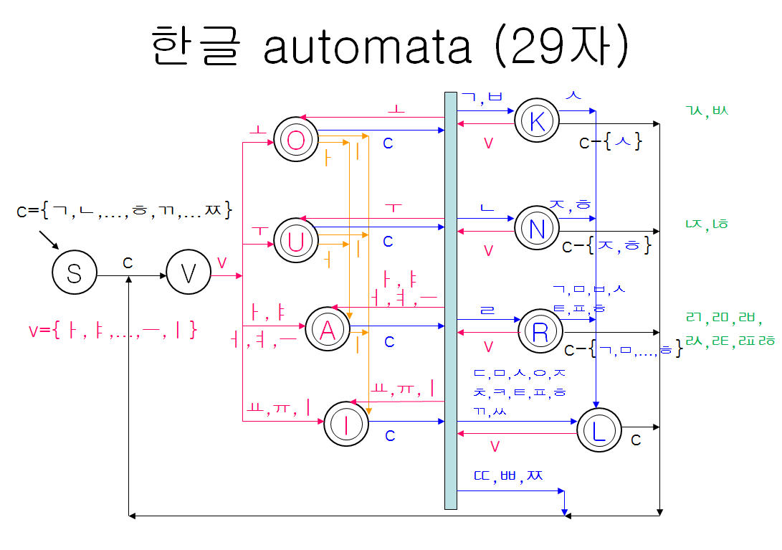

Slide 18
